Slide 1

Detecting Fake News using Advanced Language Models: BERT and RoBERTa
SARDAR VALLABHBHAI NATIONAL INSTITUTE OF TECHNOLOGY, SURAT
Guided by: Dr. Alok Kumar(Assistant Professor)
Presentation by: Rutuja G. Gangane (P24CS004)

Slide 2
Contents
Introduction
Related work
Proposed work
Methodology
Future scope
Conclusion

Slide 3
Introduction
The widespread use of social media has accelerated the dissemination of fake news, which can manipulate public opinion and threaten societal integrity. Fake news includes intentionally false content and is often disseminated for political or financial gain. Identifying it is complex due to varied content types and formats. This paper aims to tackle this challenge using transformer-based language models like BERT and RoBERTa.

Slide 4
Related work
Earlier methods for fake news detection employed:
Traditional ML: Algorithms like SVM, Naive Bayes, and Logistic Regression using textual features like TF-IDF.
Deep Learning: CNNs, RNNs, and hybrid models that improved accuracy by capturing deeper text representations.
Advanced Language Models: BERT-based architectures (including enhanced and hybrid models) have recently shown better contextual understanding and improved detection accuracy.

Slide 5
Proposed work
The authors propose a fake news detection model using:
BERT and RoBERTa language models.
A focus on effective tokenization.
Evaluation on the LIAR dataset, which includes manually fact-checked political statements.

Slide 6
BERT Architecture – Overview & Working
BERT (Bidirectional Encoder Representations from Transformers) is a deep learning model developed by Google for natural language processing tasks. It’s based on the Transformer encoder architecture, and it reads text bidirectionally, meaning it understands the context of a word from both the left and right sides.
Architecture Components:
Input Embeddings = Token Embedding + Segment Embedding + Positional Embedding
Uses a [CLS] token for classification tasks
Uses Self-Attention Mechanism to model relationships between all words
Trained with two objectives:
Masked Language Modeling (MLM): 15% of words are masked; model predicts them.
Next Sentence Prediction (NSP): Model learns the relationship between sentence pairs.

Slide 7
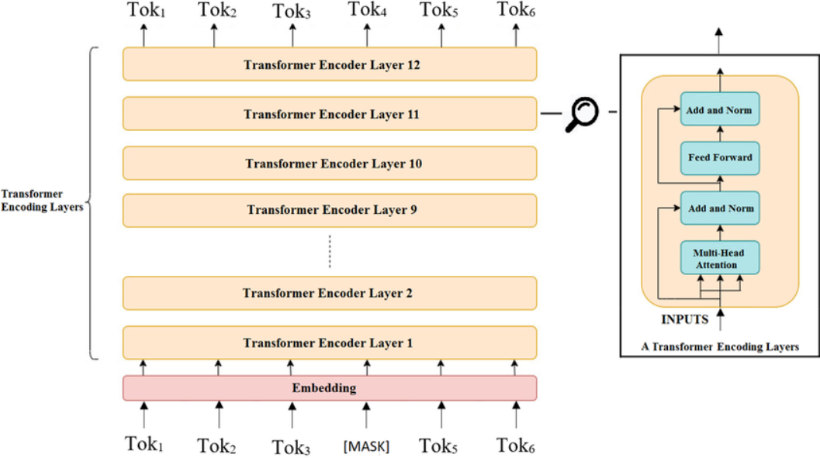
Bert-base model

Slide 8
BERT MODEL WORKING
How it works:
Text is tokenized using WordPiece tokenizer.
Tokens are converted to embeddings and input to Transformer layers.
Self-attention layers compute contextual relationships across all tokens.
The final [CLS] token embedding is used for classification (e.g., fake or true news).

Slide 9
roBERTa Architecture – Overview & Working
RoBERTa (Robustly Optimized BERT Approach) is an improved version of BERT by Facebook AI. It retains BERT’s base architecture but modifies training strategies for better performance.
Key Improvements Over BERT:
Removes NSP task
Trained on more data and for a longer time
Uses larger batch sizes and longer input sequences
Dynamic masking instead of static masking

Slide 10
roBERTa Model working
How it works:
Follows BERT's tokenization and embedding strategy.
Applies only Masked Language Modeling (no NSP).
Uses a more diverse and dynamic training strategy, improving generalization.
Outputs classification results from the final [CLS] embedding.

Slide 11
BERT vs. RoBERTa – Key Differences
Feature | BERT | RoBERTa
Pretraining Tasks | MLM + NSP | MLM only (no NSP)
Training Data | 16GB | 160GB+ (10x more data)
Masking Strategy | Static | Dynamic
Sequence Length | 512 tokens | 1024 tokens
Training Duration | Shorter | Longer
Performance (per paper) | 64% Accuracy(from paper) 63% Accuracy(in implementation) | 66% Accuracy(from paper) 64% Accuracy(in implementation)

Slide 12
Implementation details
Dataset: LIAR Dataset
Source: Collected by PolitiFact.com, a fact-checking organization.
Content: 12.8K short political statements from 2007–2016.
Features include: statement, speaker, speaker’s job, party affiliation, etc.
Original labels (6 classes):
Pants-on-Fire, False, Barely-True, Half-True, Mostly-True, True
Labeling Strategy
Converted to binary classification:
Fake: Pants-on-Fire, False, Barely-True
Real (True): Half-True, Mostly-True, True
Data Split
80% Training
10% Validation
10% Testing

Slide 13
Model Configurations
1. BERT with Native Tokenizer
Uses BERT tokenizer (WordPiece).
Handles rare words via subword splitting.
Trained for 2 epochs to avoid overfitting.
Achieved 63% accuracy.
2. BERT with GPT-2 Tokenizer
Tokenized using GPT-2 Byte-Pair Encoding (BPE).
Slight mismatch with BERT’s pretraining tokenizer.
Accuracy dropped to 60%.

Slide 14
Model Configurations
3. RoBERTa with Native Tokenizer
Uses RoBERTa tokenizer (an optimized WordPiece variant).
Trained longer and on more data.
Best performance with 64% accuracy.
4. RoBERTa with GPT-2 Tokenizer
GPT-2 tokenizer used instead of native.
Slight performance decline, achieving 63% accuracy.

Slide 15
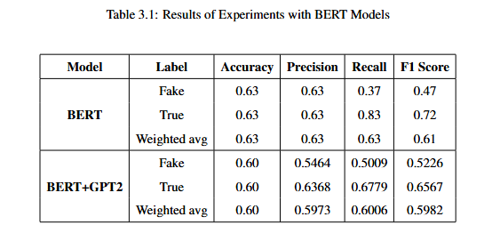
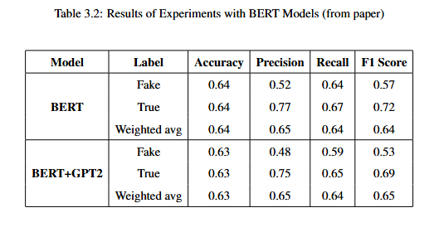
Result analysis (BERT model)

Slide 16
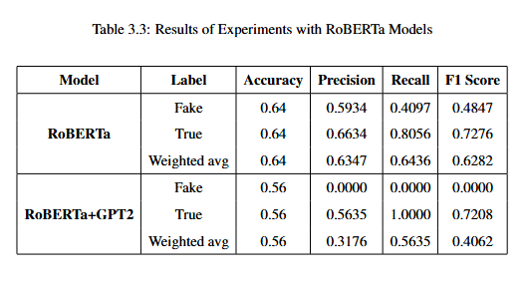
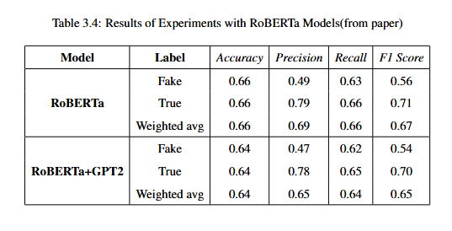
Result analysis

Slide 17
Future scope
Future Scope
Expand the model to larger and more diverse datasets to enhance generalizability.
Experiment with more advanced models or hybrid architectures combining multiple transformers.

Slide 18
conclusion
The study confirms that BERT and RoBERTa outperform other traditional and deep learning approaches, with RoBERTa achieving the highest accuracy (64%). Proper preprocessing and use of native tokenizers significantly enhance performance. The results validate transformer models as effective tools for fake news detection.

Slide 19
references
https://github.com/Tariq60/LIAR-PLUS/tree/master/dataset/tsv
Angizeh, L. B., & Keyvanpour, M. R. (2024). Detecting fake news using advanced language models: BERT and RoBERTa. *Proceedings of the 2024 International Conference on Web Research (ICWR)*, 46–52. https://doi.org/10.1109/ICWR61162.2024.10533352
https://www.researchgate.net/publication/372906672/figure/fig2/AS:11431281179224913@1691164535766/BERT-model-architecture.ppm

Slide 20
Thank you!

