Slide 1


Diabetes Prediction
Aditya Awati 240843025003
Disha Dalvi 240843025013
Prachi Sohani 240843025027
Rutuja Jadhav 240843025055

Slide 2

Problem Statement
Develop an advanced predictive model to assess the likelihood of individuals developing chronic disease, such as diabetes based on a comprehensive analysis of lifestyle factors (e.g., BMI, HighChol, HighBP, physical activity) etc. The model will leverage machine learning techniques to analyze large dataset, enabling personalized health risk assessments.

Slide 3
Objective :
To develop an optimized machine learning model for diabetes prediction
To compare different ML models and identify the best-performing one
To analyze model performance using accuracy, precision, recall, and F1-score
To build a user-friendly web application using Streamlit

Slide 4
Scope of Study:
Utilizing ML algorithms
(Random Forest, XGBoost, CatBoost, KNN)
Implementing feature selection, model tuning, and performance evaluation.
Developing a web application for real-time prediction

Slide 5
Proposed Methodology :
- Data Collection:
CDC BRFSS 2015 dataset (253,680 records, 21 features)
- Data Preprocessing:
Converted to Binary Classification (0 = No Diabetes, 1 = Diabetes)
Feature Selection & Cleaning
- Model Selection & Training:
Random Forest, XGBoost, CatBoost, KNN
- Deployment:
Developed Streamlit Web App

Slide 6
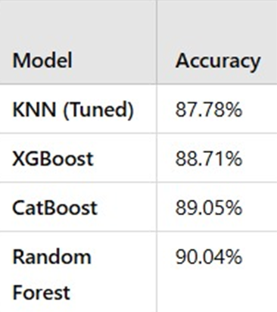
Results:

Slide 7
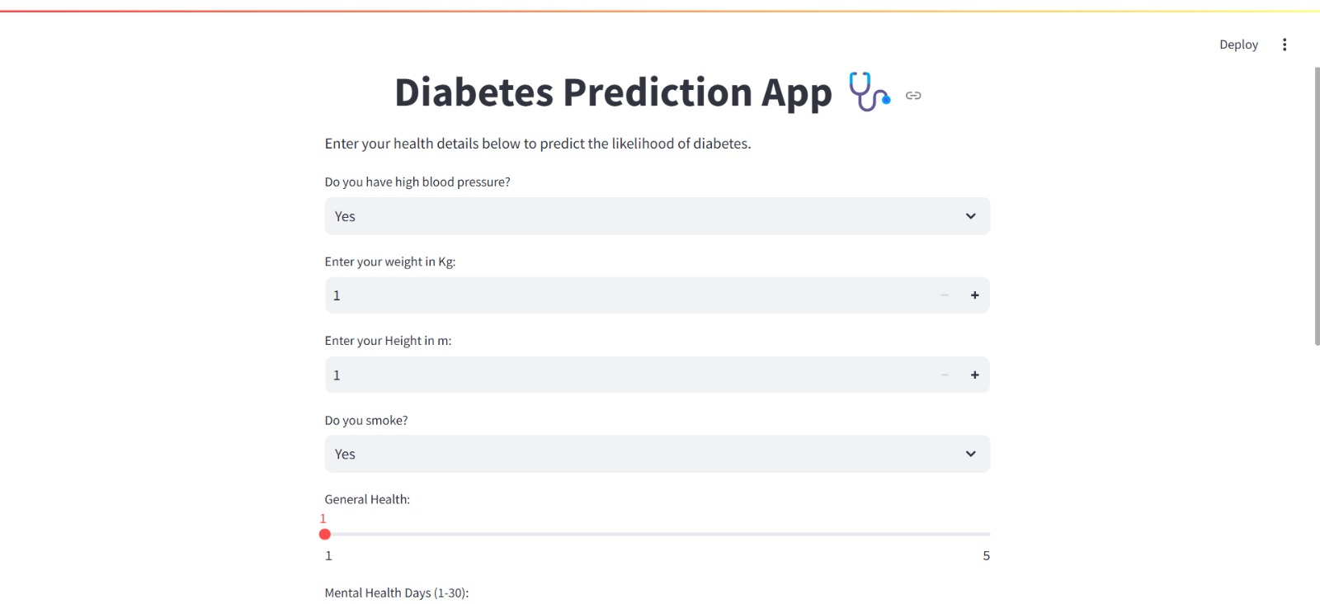
User Interface :

Slide 8
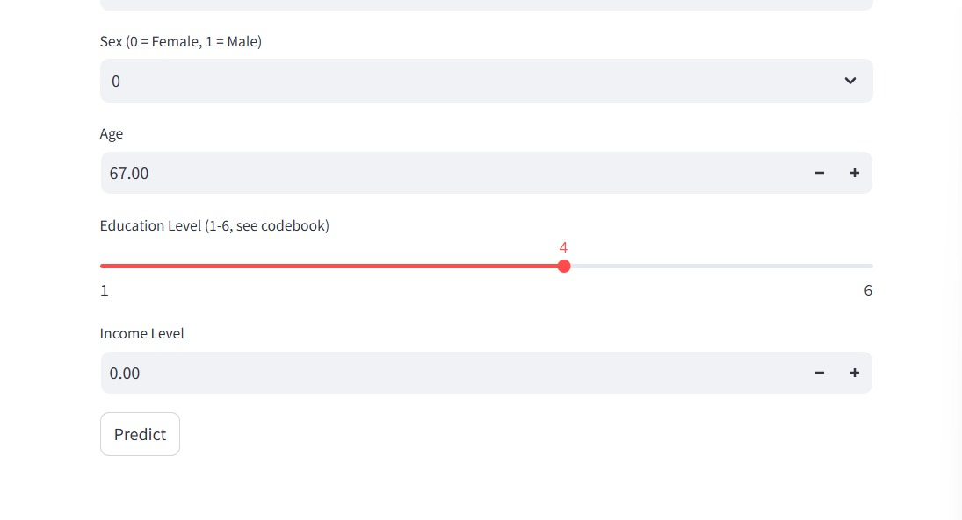
User Interface :

Slide 9
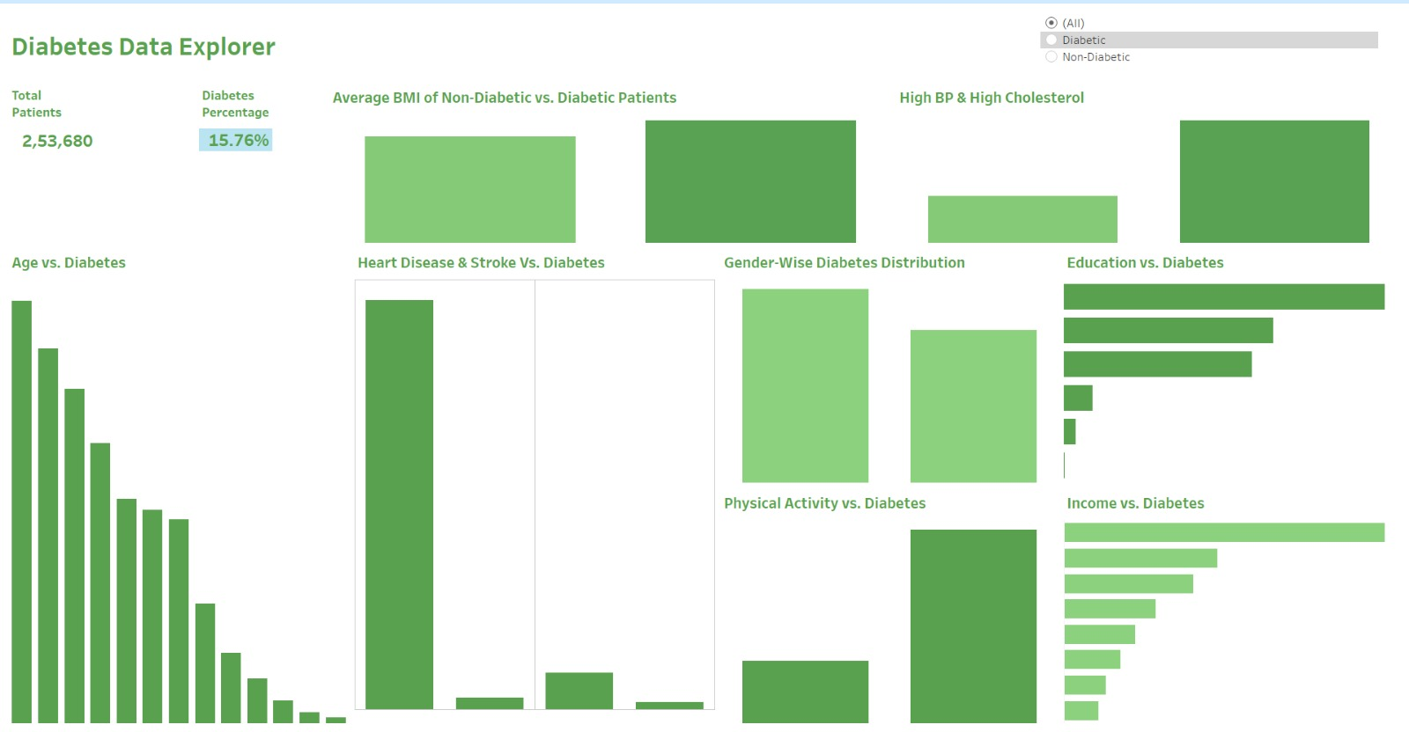
Data Visualization Using Tableau :

Slide 10
Conclusion:
the developed diabetes prediction system serves as a valuable decision-support tool for healthcare professionals and individuals, aiding in early detection and proactive diabetes management.

Slide 11
Future Scope:
Enhancing the model with deep learning techniques for improved accuracy.Integrating real-time patient data from wearable devices for continuous monitoring.Expanding the system to provide personalized health recommendations based on dietary and lifestyle factors.Deploying the system as a mobile-friendly application to increase accessibility.

Slide 12


