Slide 1
Satyak An application to monitor dementia patients

Slide 2
Agenda :
Introduction
Domain
Motivation
Literature Survey
Objectives
Proposed System
Modules
Tools and Technologies
Features
Functional Requirements
Non-Functional Requirements
Use Cases
System Architecture Diagram
14. Work Flow of Application
Data Flow Diagrams
State Diagram
16. Entity Relationship Diagrams
UML Diagrams
Class Organization
18. Algorithms
19. Pseudo Codes
Screen Shots
Testing
Conclusion and Future Scope
References

Slide 3
Introduction
What is Dementia??
Dementia is a prevalent term to represent a group of symptoms that occurs owing to the damage and death of brain cells.
The familiar symptoms observed are impaired memory, judgment, thinking, decision making, orientation, language, etc. This impairment in cognitive function is commonly accompanied and occasionally preceded by deterioration in emotional control, social behaviour, or motivation.
Dementia mainly affects older people but it isn't a normal part of aging.
Proper documentation is always important in a continuous care operation like Dementia.

Slide 4
It is critical to document each patient’s condition and history of care.
There is a high demand to deliver secure, cost effective, user-friendly, quality service, good aesthetic and user friendly GUI all under one app. healthcare solutions. The boom in electronic health records apps for smartphones enable medical practitioners to provide the same.
It will be very convenient and helpful if all the required information is available at a single glance just a touch away. To fulfil these requirements, mobile applications are increasing immensely on the strategic front.

Slide 5
Domain
Android
Firebase
Cloud Technologies
Flutter & Dart

Slide 6
Motivation
The use of manual mode of managing medical records in the healthcare institutions has been a dominant challenge that dismally affects easy management of records and timeous access during healthcare service delivery.
In some instances the existing systems appears to be less functional in terms of file tracking and provision of the required information for business continuity.
Availing the facility at home for the ones who cant afford to enroll for care centers.
It is observed that many health care organizations still maintain paper records of patients’ files.
At Satyak: Assisted living centre for dementia, since all the records were managed manually, it affected the accuracy, relevance, timeliness, confidentiality of the data.
The specific problem that led to this project was the lack of an integrated records management system.

Slide 7
Literature Survey Research Paper

Slide 8
Research Paper | Key words | Supported Platforms | Limitations of Health Information System | Advantages over Current Health Information System
ECM System implementation readiness to improve medical record management in Limpopo Province, South Africa | ECM, ERM, Healthcare Service | Windows, MAC iOS | Don’t have a collaborative system to integrate the records management responsibility. Incapable of capturing medical history of the patients, tracking paper-based records movement or creation but capture only personal details and billing data. | One record accessed by many people at the same time Provision of timely, accurate, trustworthy, complete and effective records security throughout the life span. Compliance with legislative framework. Creation of reliable knowledge at all stages of the life span.
Utilizing Open ERP for creating medical record management system in Smart Hospital | ERP, EHR , Healthcare Service | Desktop Application | Financial issues. Temporary loss of productivity associated with EHR adoption, privacy and security concerns and several unintended consequences. | Quality of care. Reduction in medical errors, and other improvements in patient-level measures that describe the appropriateness of care.
Design and development of a web-based hospital information System [1998] | Computer-based Patient Record (CPR) | Web based client-server architecture Desktop Application | Reduction in access. Reduction in the rate. of hospital admissions. Increasing employees' workload and dissatisfaction. | Improved Medical Processes. Digital medical records. Increase in staff interaction and facility management. Market strategy.
Hospital Management based on Data Mining [2008] | Cyberspace in Hospital, Course Spatiotemporal Data Mining | Desktop Application | Ethical, Legal, Social, Administrative, Privacy Issues. Data Ownership Lawsuits. Privacy and Security of Human Data. | Healthcare insurers being able to detect fraud and abuse. Physicians identify effective treatments and best practices.

Slide 9
Literature Survey Comparative analysis of similar apps

Slide 10
Name Of Application | Year of Launch | Supported Platforms | Audience | User Support | Subscription | Categories
Dr Chrono | 2009 | SaaS, iOS | Medical practices of all types and sizes | Business Hours, Online | NA | Chiropractic, Claim Processing, Dermatology, E-Prescription, EMR, Billing, Medical Spa, Occupational & Physical Therapy, Optometry, Patient Portal, Plastic Surgery, Podiatry, Telemedicine
iCare | 2012 | SaaS, iOS, Android | Health Systems, Hospitals, Clinics, Practices | Online, 24/7 Live Support | Free | E-Prescription, EMR, Long Term Care, Billing, Appointment Scheduling, Nursing Home, Patient Portal, Pharmacy, Population Health Management, Telemedicine
Simple Practise | 2012 | SaaS, iOS, Android | Solo and group private practitioners in the health and wellness industry. | Business Hours, Online | Paid, Free Version available with limited features | EMR, Billing, Appointment Scheduling, Case Management, Patient Portal, Physical & Speech Therapy
Thera Nest | 2012 | SaaS, iOS, Android | Designed for individual practitioners, family counseling centers, mental health agencies, social service organizations, faith-based groups, psychology practices, schools, universities & large therapy practices. | Business Hours, Online | Paid Only | EMR, HIPAA Compliance, Human Services, Billing, Appointment Scheduling, Case Management, Patient Portal, Telemedicine

Slide 11
Dr. Pad Application | Medical Records Application ( Med clin ) | Medical Records Application (Yerokhin Vldimir )
Create and keep track of patient's appointments, visit history, and medical records. | Manages appointments, Tracks Medical history reports and information history, etc | Record-keeping of all visits to doctors, appointments, recommendations, referrals to lab tests.
Easy to use the mobile app, elegantly designed for phone and tablet. | Supports multiple screens, phones, small and large size tablets. Works on Chromebook system | User-friendly and intuitive interface supports all mobile devices.
Attach Medical documents(audio, video, and image) in PDF format only. ( Number depends on free, paid, cloud plan ) | Attach medical documents of any type (pdf, word, etc) or capture them using the camera or video recording. It also exports medical data to Excel sheets, pdf and graphs. | Enclosing of separate medical documents (files of all formats) in the form of attachment to a medical visit/analysis.
Autocomplete medication once saved initially. | Most of the data are stored using the auto-complete technique. | Data isn’t stored using the auto-complete technique.
No Search technique is used in this app. | Multiple Search Technique by name, phone no, visit date, appointment date, etc. | No Search technique is used in this app.
Records are maintained through texts. | Records video or image capture for medical activities, with or instead of writing text. | Records are maintained through texts.

Slide 12
Dr. Pad Application | Medical Records Application ( Medclin) | Medical Records Application (Yerokhin Vldimir )
No Such feature is a part of this application. | The availability to launch Google Maps navigation to drive to the (patient & doctor & hospital) stored address starting from your current location. | No Such feature is a part of this application.
Store clinical data in unlimited secured cloud storage. No separate cloud account or setting is required. Cross-user and cross-device syncing available. | According to needs, choose to store your medical data either in your device memory or on secure cloud storage where data sync is enabled. | Synchronization of data, safe data storage on the Google servers
A feature of switching to the visiting clinic and accessing the clinical data is added if the doctor is visiting many clinics, and access to the clinical data is provided with an invitation. | Could be used for private practice management as a clinical information system, clinic management system, Doctor Patient Medical Record, Healthcare management mobile application, Patient Medical Records to track Patient history, Electronic Medical Records (EMR), Electronic Health Records (EHR) | No such feature is a part of this application.
No such feature is a part of this application. | The capability of adding patient information via the device contact list; if the patient info is on the device contacts list | No such feature is a part of this application.
No such feature is a part of this application. | Username and password authentication. | No such feature is a part of this application.

Slide 13
Objectives
To transform the clumsy process of manually filling an extremely long form into a digitalized form which is less prone to errors.
To effectively communicate the specific remarks and needs medication updates, amongst various doctors onboard, in a synchronized fashion.
To represent and analyse the medical data, progress report and all the daily assessments via Infographics.
To Auto Summarize the data on a regular interval.
To serve as a platform for different institutions to collaborate.
To avail the resources and services at home for the ones who cant afford to enroll for care centers.

Slide 14
Proposed System
Treating and caring for patients with Dementia has always been an arduous task, for both the hospital staff as well as the patients' caretakers. The proposed system provides a convenient and quick view to help facilitate the patient onboarding, maintaining patient health history, monitor the medication as well as the health of the patients and maintain the inhouse activities and records.

Slide 15
Modules
Actors in Picture:
Admin : Medical Officer & Psychiatrist.
Nursing Care and Specialists.
Patient’s Registered Legal Guardian.
Social Workers
Modules :
Registration Module.
History Module.
Nursing Assessment Module.
Doctor’s Assessment Module

Slide 16
Registration Module: This module consists of the homepage, as well as the login management system for the resident, legal guardian and the nursing staff. Specialists and the Admin have direct login rights. The errors are minimised as compared to the regular manual entry process also providing a user friendly UI.
History Module: This module will be used to obtain various kinds of history which will decide the line of medication for patients respectively.
Nursing Assessment Module: This module enables the nursing staff as well as the Specialists to create analyse the data that includes Nursing chart, Medicine chart, Dietary Chart, Activities of Daily Life, Sensory Assessments. The data in this module can be accessed by specialists too. The reports can be generated will be summarised with varying degrees of granularity i.e. weekly, monthly, annually.
Doctor Assessment Module: This module consists of 4 assessments namely Physical Assessment, Cognitive Assessment, Psychological Assessment, Physiotherapy Assessment, Social Workers and Investigations. The reports can be generated will be summarised with varying degrees of granularity i.e. monthly, annually.

Slide 17
Features
Integrated Management System: The proposed system will update the resources regarding the topic for the caretakers who cant afford or has a reach to these centers, manage all records and assessments as well as analyze the data using data visualization.
Realtime Patient Activity Tracking using Dashboard
Auto summarisation of data
Digitalising the complete medical data.

Slide 18
Tools and Technologies
Requirements :
Android via SDK
Firebase
Flutter
Dart
Local Host (Later on deploy on cloud)
Database :
Firebase
Hardware requirements :
OS : Windows 7 SP1 or later ( 64 bit )
Android handset with android V4.4 KitKat or more
Software requirements :
Android Studio
Android emulator with version 6.0 or more
Flutter SDK
VS Code Editor
Firebase
Git (Optional and can be used for version control)

Slide 19
Functional Requirements
Registration
Add Patient
Add Nursing Staff
Assign Patient Health Number
Homepage
Medical Record Management
Nursing Assessment
Doctor’s Assessment
Analyze Medical Record
Check in & Checkout
Delete Patient Health Number
Database
Patient Mandatory Information
Update Patient Information
Search for Patient
Nursing Staff Mandatory Information
Update Nursing Staff Information
Search for Nursing Staff
Doctor Mandatory Information
Update Doctor Information
Search for Doctor

Slide 20
Non Functional Requirements
Performance
Password Management
Regular Database Archiving
Virus Protection
Response time
Capacity
User Interface
Conformity
Availability
Backup
Errors
Safety Requirements
Patient Identification
Guardian
Identification
Login Id
Modification
Nurse Rights
Doctor Rights
Data Security
Software Quality Attributes
Accuracy and Reliability
Security
Fast Speed
Compatibility

Slide 21
Use Cases
Admin : Medical Officer & Psychiatrist.
Nursing Care
Specialists: Psychologist, Physiotherapist, etc
Social Workers
Patient
Legal Guardian

Slide 22
Software Model : Kanban

Slide 23
Agile Approach
A lean software development methodology.
Aim is to control and manage the flow of features (represented by Kanban cards) to match the number of features entering the process and those being completed.
WIP limits : Measure of capacity : focus on only a small amount of work at one time.
Kanban Board tool : provides a clear representation of all project activities, their number, responsible persons, and progress.

Slide 24
Key distinguishing feature : absence of pronounced iterations
Activities or processes that result in the expenditure of effort and/or resources towards goals that are not producing value for the customer are eliminated.
With no iterations a Kanban project has no defined start or end points for individual work items.
Communication with the customer is ongoing, they can check the work results whenever they like, and the meetings with the project team can happen even daily.

Slide 25
Comparison – Why Kanban?
Kanban does not impose any role definition , Scrum does!
Along with the absence of formal iterations, role flexibility makes Kanban attractive.
Kanban is an agile methodology that is not necessarily iterative.
Processes like Scrum have short iterations which mimic a project lifecycle on a small scale, having a distinct beginning and end for each iteration. Kanban allows the software be developed in one large development cycle.

Slide 26
System Architecture Diagram
Firebase: Database
Admin
Android Device with
Internet Connection
Login/
Register
Nursing
Assessment
Nursing Care
Firebase Cloud Technology
Doctor’s
Assessment
Photo
Gallery
User Interface
Record
Management
System
Interface
Flutter using Dart
Specialists
Resources
More
Guardian
Android via SDK

Slide 27
Data flow Diagram
Nursing Care &
Specialists
Satyak
Legal Guardian/
Patient
Patient
details
Admin

Slide 28
Data flow Diagram
Registration
Complete
Diagnosis
Patient
Doctor
Medical
Report
Analysis of
assessments
Analysis of
Assessments
Admin&
Specialist
Medical Report &
Prescription
Summarization of
data
Guardian
Guardian
Specialists

Slide 29

State Diagram
Register
Follow up
Results are okay
Medical data
Results are not okay
Prescription
Discharge
Diagnosis of
Assessments
Treatment
Plan

Slide 30
Entity Relationship Diagram
Name
Patient ID
History
Admission date
Name
Contact details
Identity Proof
Education
Details
Name
Qualification
Contact details
Admin
Patient
Satyak
Nursing care
Guardian
Investigation
Specialist
Parameters
Date
Highlights
Name
Contact
Address
Relation with patient
Name
Qualification
Contact details
Treatment
Plan
Follow up Date
Medicines
Prescription

Slide 31
UML Diagram
Admin
Specialist
Check for all
Patients
Check Patient
Nursing, Doctor’s Assessment
Update
Guardian
Monthly
Report
Photo Gallery
Specialist Login
Specialist
Release
All patients
diagnosed
Check
Patient
Nursing,
Specific domain
Assessment
Admin
Login
Admin Release

Slide 32
UML Diagram
Nursing Care
Patient
Check for all
Patients
Nurse
Login
Check Patient
Nursing Assessment,
Conduct Activities
Patient
Release
Completely
treated
Patient
Registration
Nursing & Doctor
Assessment
Daily, weekly
& monthly
conduction
Nurse
Release

Slide 33
Class Organisation Diagram
Person
Name: String
ID: Int
DOB: Date
Address: String
Ph no: Int(10)
Staff
Name: String
Joining Date: Date
Qualification: String Documents: String
Hospital
Name: String
Address: String
Ph no: Int(10)
Admin
Name: String
Ph no: Int(10)
Patient
Name: String
Date of admission: Date
Medical records
Prescription
Specialist
Name: String
Ph no: Int(10)
Nurse
Name: String
Ph no: Int(10)

Slide 34
Work Flow of Application
Start
Nurse
Admin
Specialist
Legal
Guardian
Login
Redirect
To
Nurse
Account
Redirect
To
Admin
Account
Redirect
To
Specialist
Account
Redirect to
Legal Guardian
Account
Valid
Login
Identify User
Logout
End

Slide 35
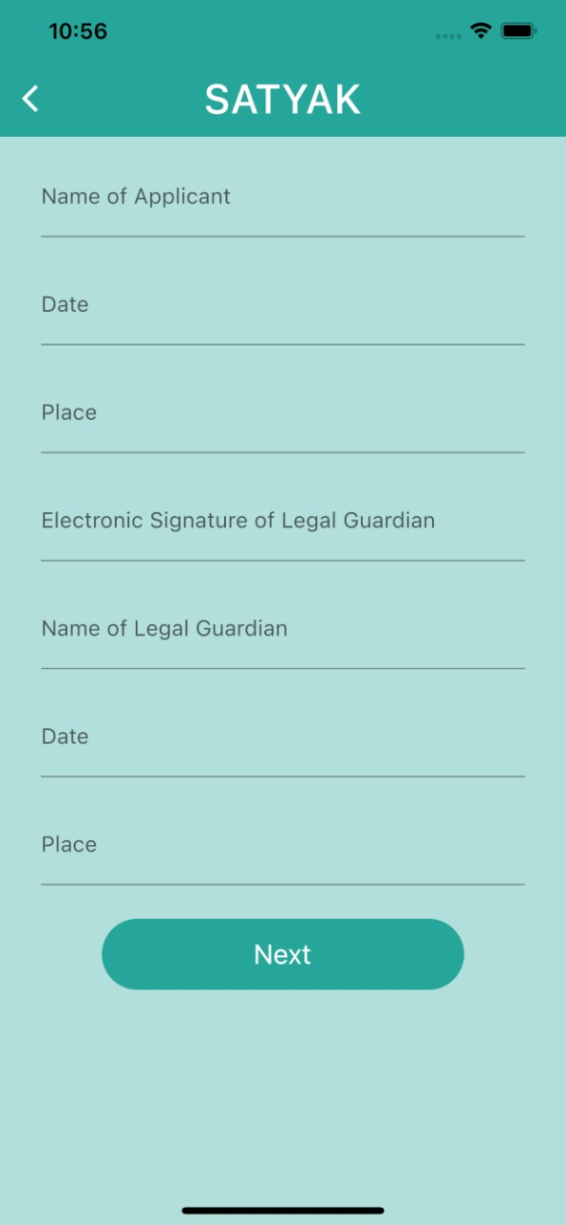
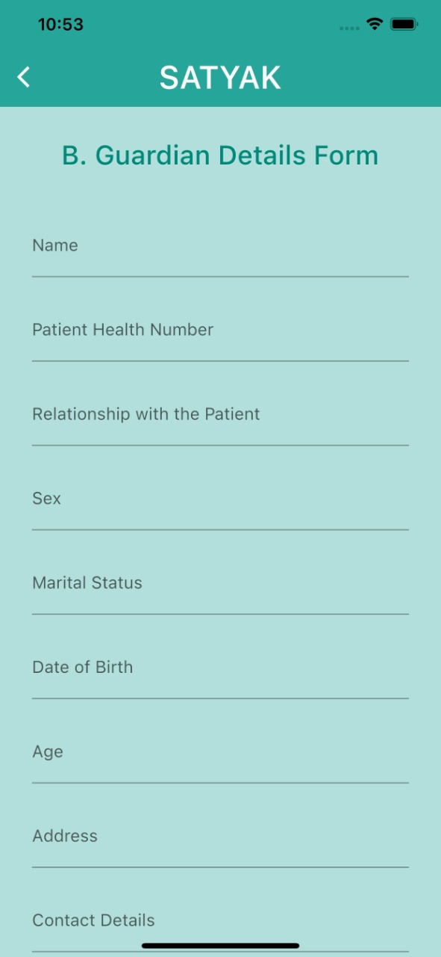
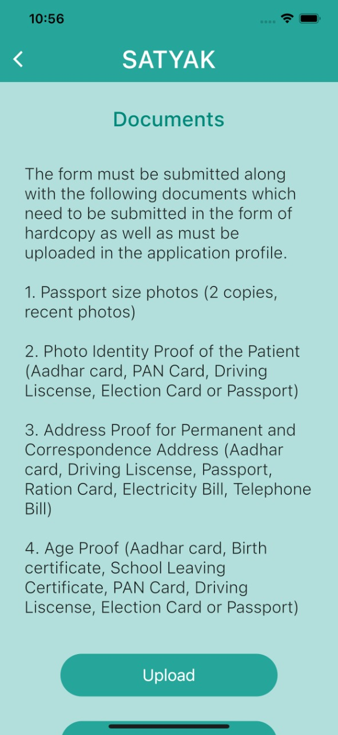
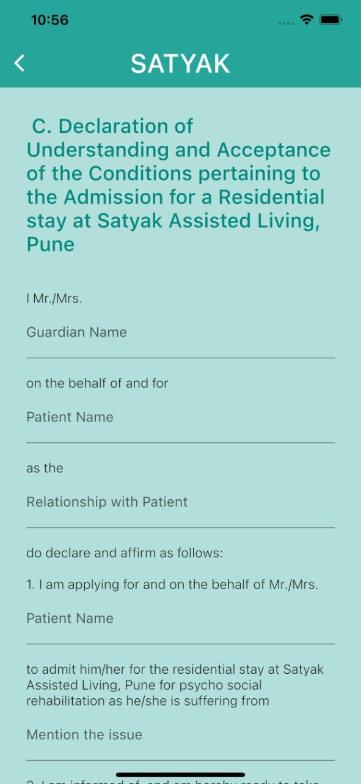
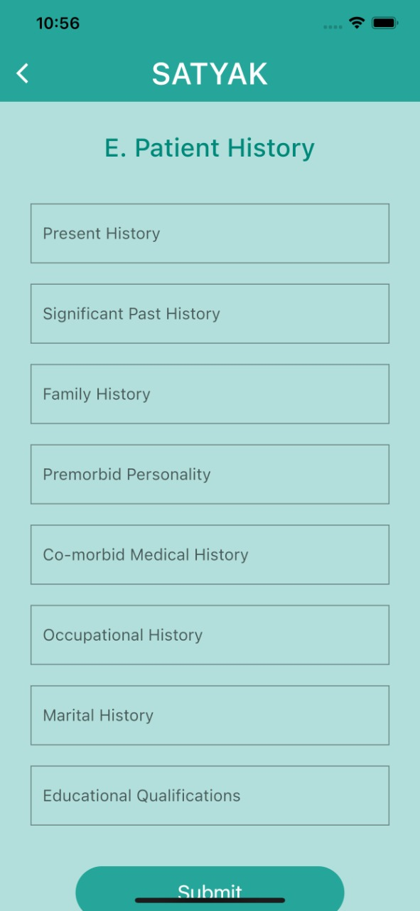
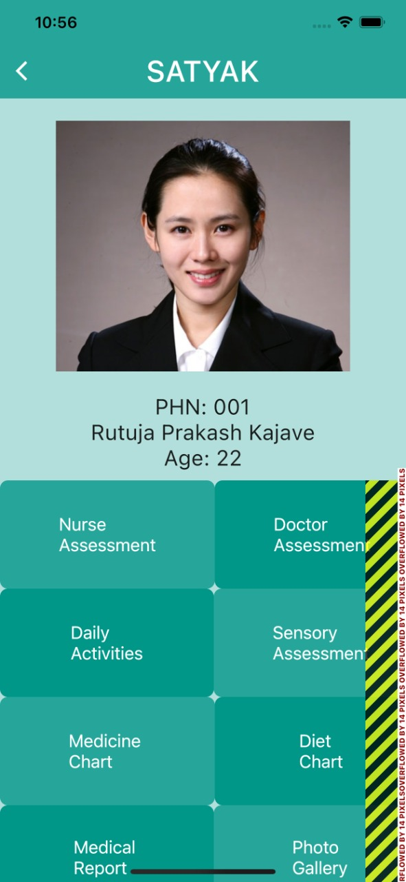
Screen Shots of UI

Slide 36
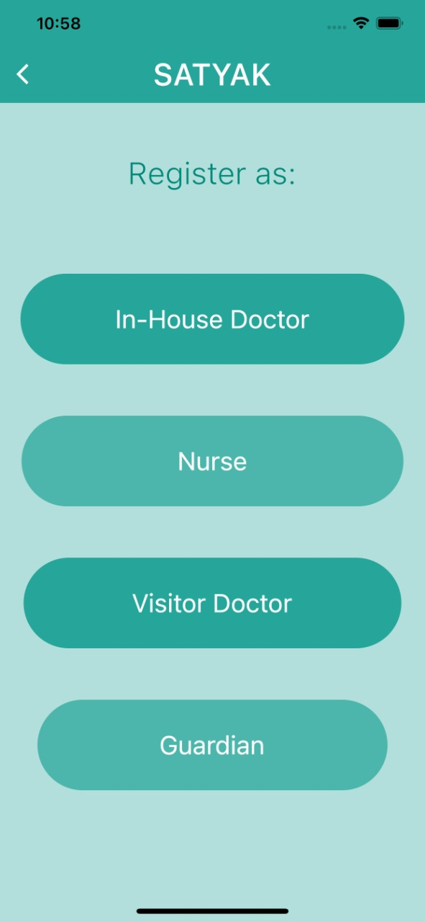
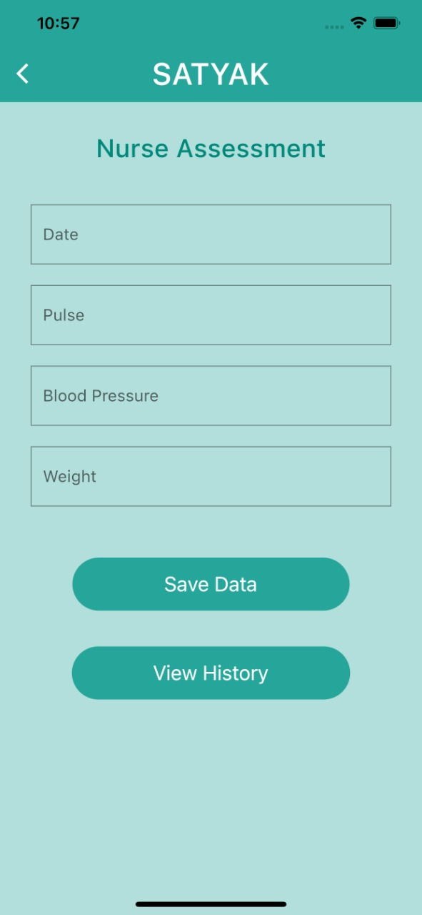
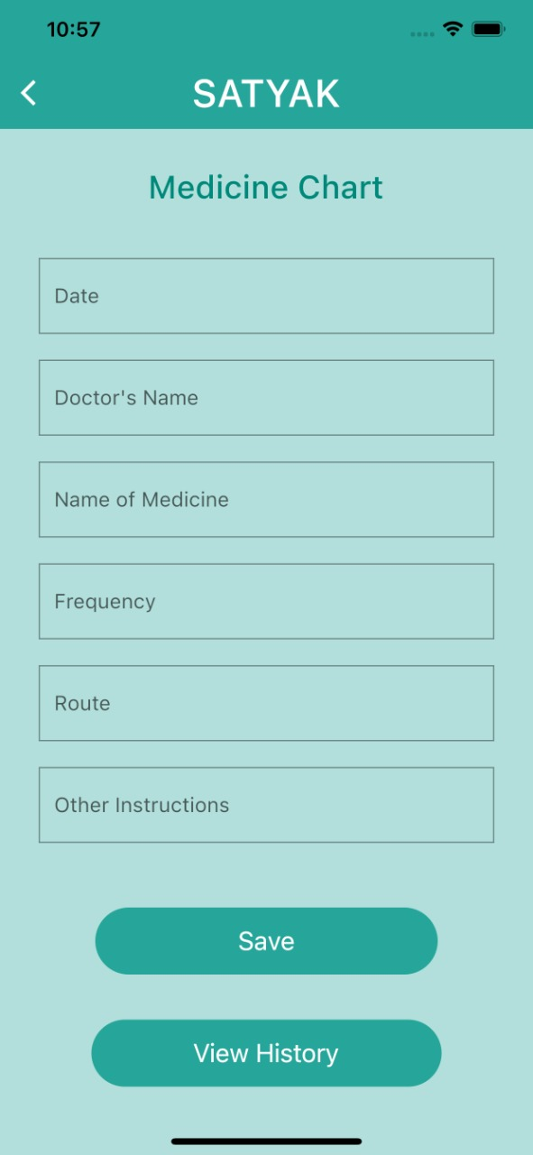
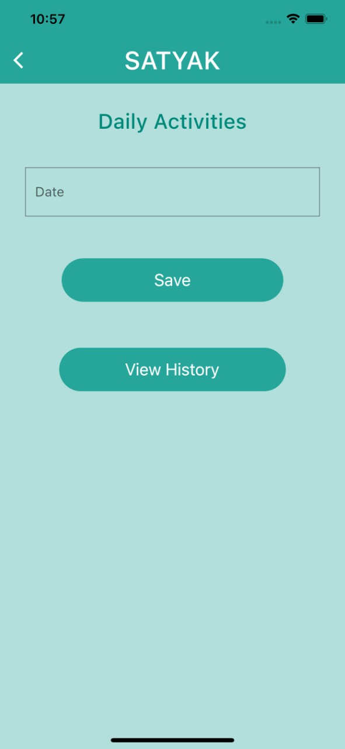
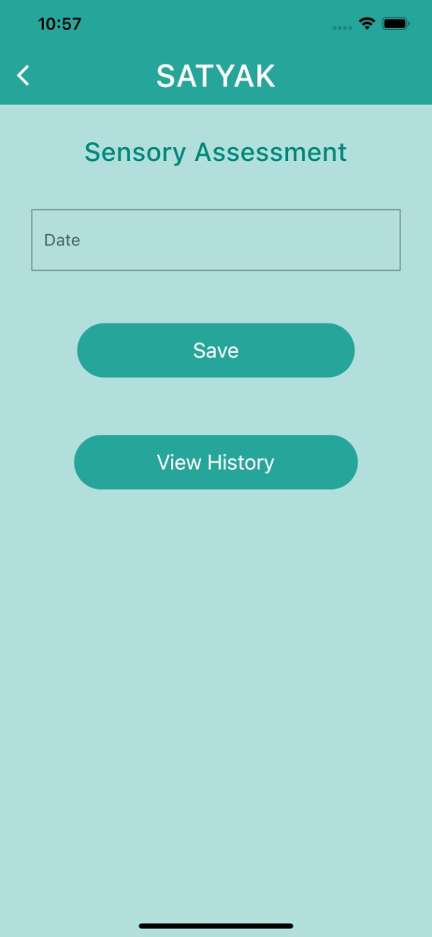
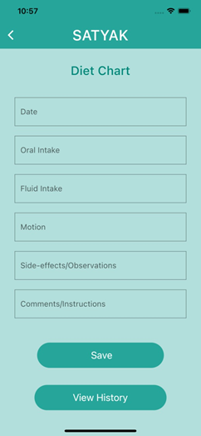

Slide 37
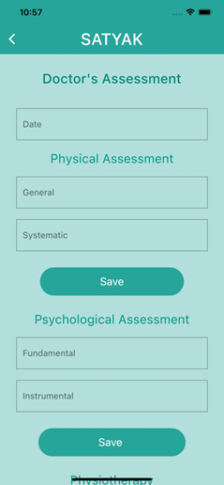
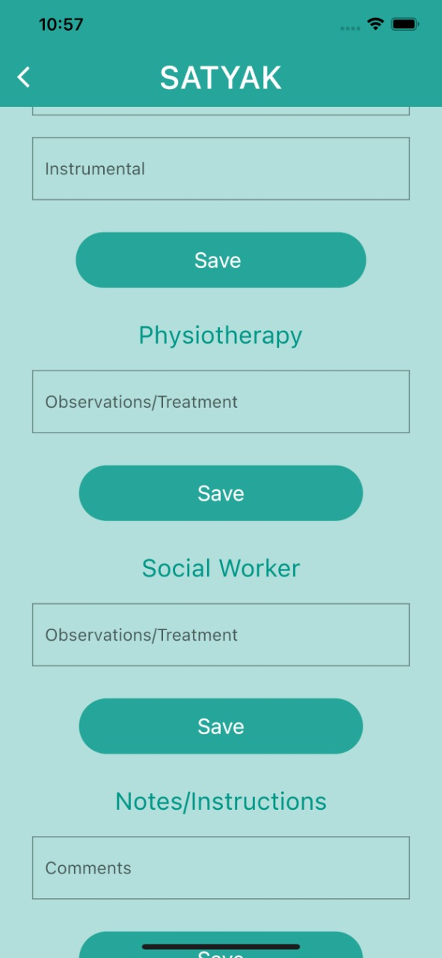
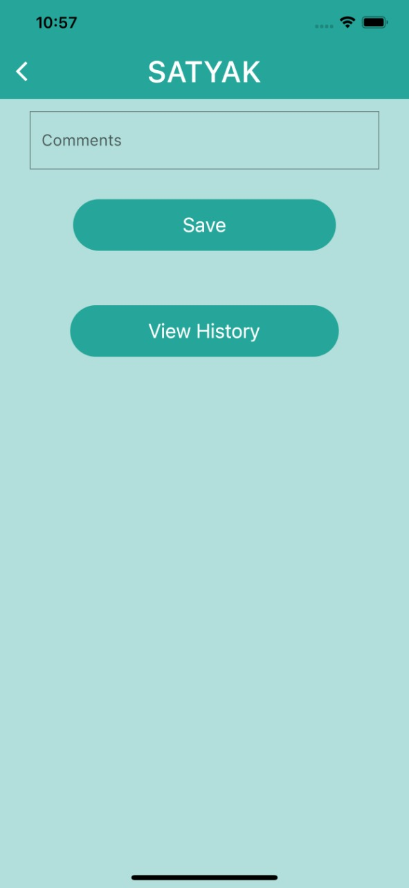
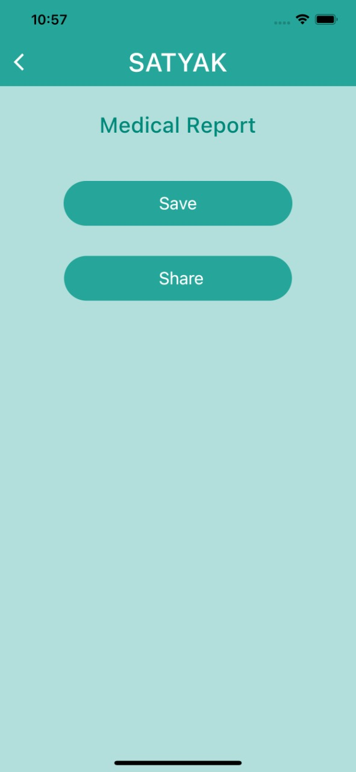
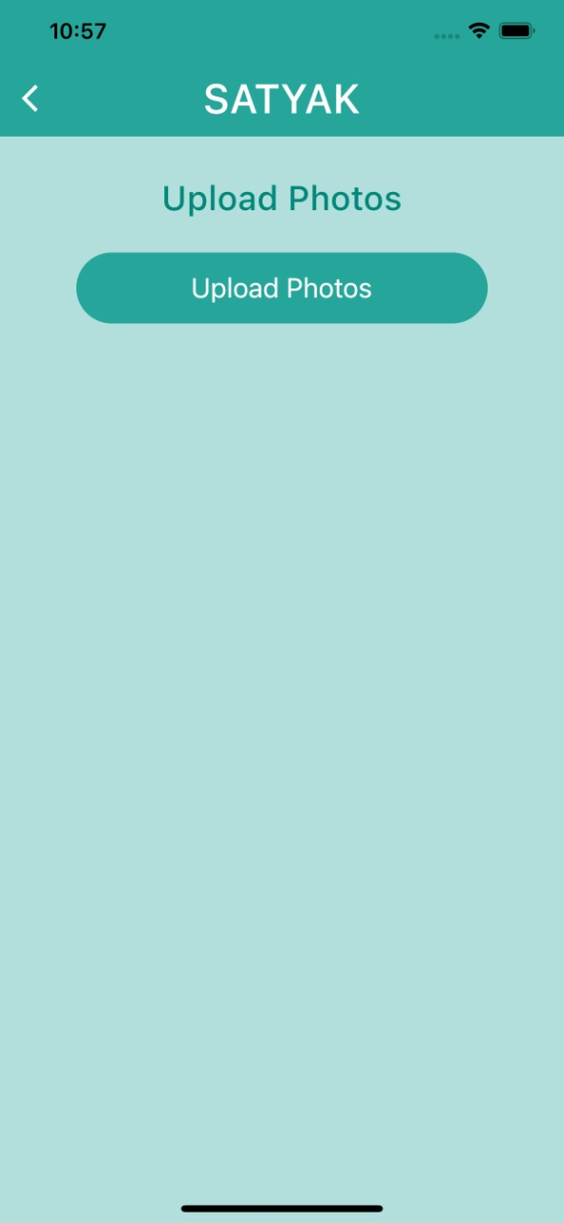
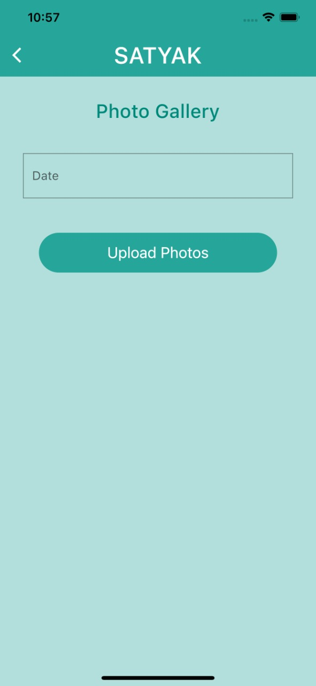

Slide 38
Testing
Unit Testing
Functional Testing
Testing Strategy and Approach
Test Objectives
Features to be Tested

Slide 39
Test Cases

Slide 40
Login Page
Login Page
Functional Test Case | Type of test
Verify if a user will be able to login with a valid username and valid password. | Positive
Verify if a user cannot login with a valid username and an invalid password. | Negative
Verify the login page for both, when the field is blank and Submit button is clicked. | Negative
Verify the ‘Forgot Password’ functionality. | Positive
Verify the messages for invalid login. | Positive
Verify if the data in password field is either visible as asterisk or bullet signs. | Positive
Verify if a user is able to login with a new password only after he/she has changed the password. | Positive
Verify if the ‘Enter’ key of the keyboard is working correctly on the login page. | Positive
Verify the time taken to log in with a valid username and password. | Performance & Positive Testing
Verify if the font, text color, and color coding of the Login page is as per the standard. | UI Testing & Positive Testing
Verify if there is a ‘Cancel’ button available to erase the entered text. | Usability Testing

Slide 41
Registration Page
Test Cases | Feature | Description | Steps To Execute | Test Data / Input | Expected Results
TC-001 | User Interface | Check all the text boxes, radio buttons, buttons, etc | 1. Click on Radio buttons, buttons and dropdowns | N/a | UI should be perfect
TC-002 | Required fields | Check the required fields by not filling any data | 1. Do not enter any value in the field. | N/a | It should show a mandatory symbol (*) on mandatory fields.
 |  |  | 2. Click on the Register button.
TC-003 | Required fields | Check user should Register by filling all the required fields | 1. Enter valid values in the required fields. | N/a | 1. Users should be registered successfully.
 |  |  | 2. Click the Register button. |  | 2. A successful registration message should show.
 |  |  |  |  | 3. Mail should send to the user
TC-004 | Optional Fields | Check all the optional fields when do not fill data | 1. Do not enter any detail in optional fields | N/a | 1. It should not ask to fill the optional fields
 |  |  | 2. Enter valid data in required fields |  | 2. User should be registered successfully
 |  |  | 3. Click on the Signup button |  | 3. A successful registration message should show
 |  |  |  |  | 4. Mail should send to the user

Slide 42
TC-005 | Optional Fields | Check all the optional fields when filling data | 1. Enter valid data in optional fields | N/a | 1. User should be registered successfully
 |  |  | 2. Enter valid data in required fields |  | 2. A successful registration message should show
 |  |  | 3. Click on the Register button |  | 3. Mail should send to the user
TC-006 | Email validation | • Check the Email text field that has an Email address without @ symbol. • Check the Email text field that has a random string instead of a real email. • Check the Email text field that has @ symbol written in words. • Check the Email text field that has a missing dot in the email address. | 1. Enter Invalid Emails | 1.testAtgmail.com | It should show the validation message for valid email
 |  |  | 2. Click on the Register Button. | 2.test@gmailcom
 |  |  |  | 3.test@gmail
 |  |  |  | 4.@gmail
TC-007 | Email validation | Check all the valid emails | 1. Enter valid Emails | 1.test.22@gmail.com | It should not show any validation message
 |  |  | 2. Click on the Register Button. | 2.test@gmail.com

Slide 43
TC-008 | Phone Number validation | Check the phone number when passing alphanumeric data | 1. Enter alphanumeric data in phone field | 1. dada5$7567#7 | It should show the validation message 8 for Phone Number
 |  |  | 2. Click on Register button
TC-009 | Phone Number validation | Check the phone number when not pass country code | 1. Enter valid phone number without country code | 1. 9012078654 | It should show the validation message for country code is required
 |  |  | 2.Click on Register button
TC-010 | Phone Number validation | Check the phone number when passing country code | 1. Enter valid phone number with country code | 1. +9190112244 | It should not show any validation message
 |  |  | 2.Click on Register button
TC-011 | Password Validation | Check the password limit when enter value less than min | 1. Enter value which is alphanumeric but less than 8. | 1. Password | It should show validation message
 |  |  | 2.Click on Register button

Slide 44
TC-012 | Password Validation | Check the password limit when enter value greater than max | 1. Enter alphanumeric value but more than 32. | Any Random string with numbers | It should show validation message
 |  |  | 2.Click on Register button
TC-013 | Password Validation | Check the password when passing only numbers | 1. Enter a value in numbers which is in between 8-32 | 1. 12345678 | It should show validation message
 |  |  | 2.Click on Register button
TC-014 | Password Validation | Check the password when passing valid data | 1. Enter value in alphanumeric which is in between 8-32 | 1. Pass123456 | It should not show any validation message
 |  |  | 2.Click on Register button
TC-015 | Required Fields | Verify if blank spaces are passed in required fields. | 1. Go to the Site. | N/a | Those Blank spaces should trim and Validation error message for required fields should visible.
 |  |  | 2. Passed blank spaces in required fields.
 |  |  | 3. Click on the Register button

Slide 45
TC-016 | Required Fields | Verify user can verify its Email ID | 1. Go to the Email. | test22@gmail.com | User should get a verification link and able to verify his/her Email ID.
 |  |  | 2. Click on the verification link.
TC-017 | Phone Number Validation | Verify if the length of the phone number is incorrect i.e. less than 10. | 1. Enter phone number less than 10 digits. | 91901122 | It should show the validation error message for phone number length.
 |  |  | 2.Enter all required fields.
 |  |  | 3.Click on Register Button
TC-018 | Phone Number Validation | Verify if the length of the phone number is incorrect i.e. more than 10 | 1. Enter phone number less than 10 digits. | 9.19011E+13 | It should show the validation error message for phone number length.
 |  |  | 2.Enter all required fields.
 |  |  | 3.Click on Register Button
TC-019 | Password Validation | Verify if the password required rules are not satisfied in the password | 1. Enter the password which not satisfies the required rule. | passw | It should display error with required rules for password value (like it
 |  |  | 2.Click on Register button

Slide 46
Conclusion and Future Scope
Since we work in collaboration with a dementia care centre, we plan to test our system with the data of the real patients wherein the actors mentioned could access , accept and display the data.
Records are electronically kept safeguarding from loss and unauthorized access.
The administrator could assess the tables within the database directly, create new users and generally manage the application. The menu screen enables to browse through the application by clicking on each of the menu buttons.
The application is also designed in such a way that it could be accessed directly using the internet. Simple html files are created which are linked to java Servlets at the backend. The Servlets are connected to a database if a record is required or an update is made.

Slide 47
Conclusion and Future Scope
As a part of future scope is to explore other scenarios and apply them in practice to enhance the current healthcare data management :
Add voice interface that can be used as a medium of communication with the patient.
Establish sensor system to monitor the activities of the patient.
Collaborate with other organizations and services as required.
Add Payment gateways.
We would like to extend the structure of a patient record and its metadata, using the semantics of healthcare data, including the possibility of sharing radiology images, which is much more challenging

Slide 48
References
https://www.academia.edu/5202538/HOSPITAL_MANAGEMENT_SYSTEM_A_Project_work_submitted_to_the_DEPARTMENT_OF_COMPUTER_APPLICATIONS_Guided_by
https://www.lovelycoding.org/hospital-management-system-project-for-final-year/
https://www.researchgate.net/profile/Patrick_Ngulube/publication/324871047_ENTERPRISE_CONTENT_MANAGEMENT_SYSTEM_IMPLEMENTATION_READINESS_TO_IMPROVE_MEDICAL_RECORDS_MANAGEMENT_IN_LIMPOPO_PROVINCE_SOUTH_AFRICA/links/5af93eb00f7e9b026bf6dd12/ENTERPRISE-CONTENT-MANAGEMENT-SYSTEM-IMPLEMENTATION-READINESS-TO-IMPROVE-MEDICAL-RECORDS-MANAGEMENT-IN-LIMPOPO-PROVINCE-SOUTH-AFRICA.pdf
http://article.sapub.org/10.5923.j.se.20170601.01.html
https://sourceforge.net/software/electronic-medical-records/android/

Slide 49
Thank you !!
Team Members
Rutuja Kajave | 4437
Shravni Sangamnerkar | 4463

