Slide 1
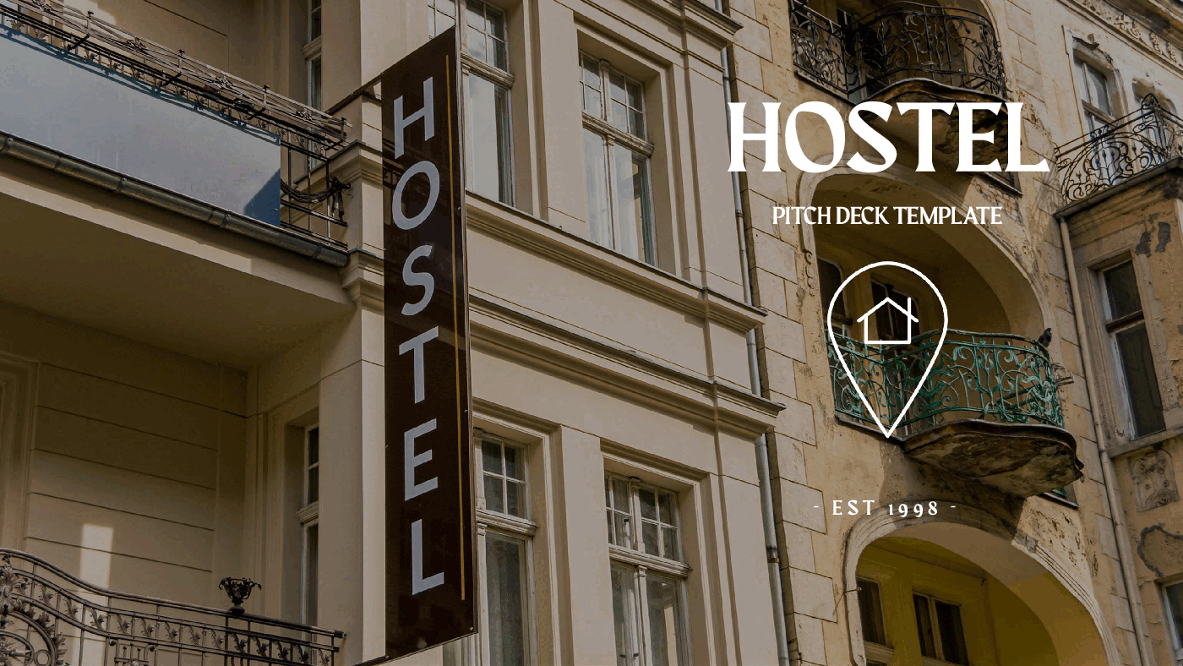
HOSTEL ANALYSIS
Presented By
Rutuja Pathare

Slide 2
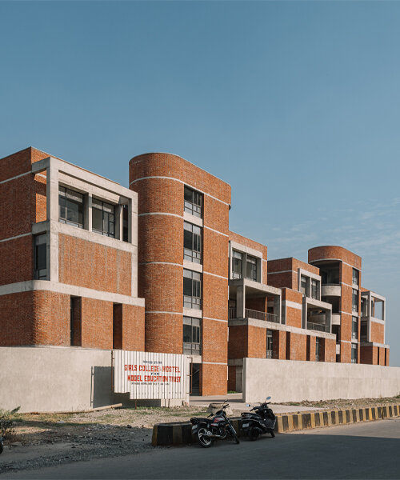
Introduction
Hostel chains face challenges in optimizing their revenue and occupancy rates due to limited insights into customer behavior, room preferences, and profitability of individual hostels. Without detailed analysis, managers struggle to make data-driven decisions on pricing, promotions, and resource allocation. Additionally, understanding which hostels and managers drive the most revenue remains unclear, hindering strategic growth.

Slide 3
Objectives
To empower hostel management with detailed analytics on customer booking behavior and revenue generation.
To identify the most profitable hostels and the managers driving their success.
To reveal which room types are most preferred and how pricing strategies impact revenue.
To support strategic decision-making by uncovering opportunities for increasing occupancy and optimizing room pricing.
Ultimately, to enhance business performance and competitiveness in the hospitality market through data-driven insights.

Slide 4
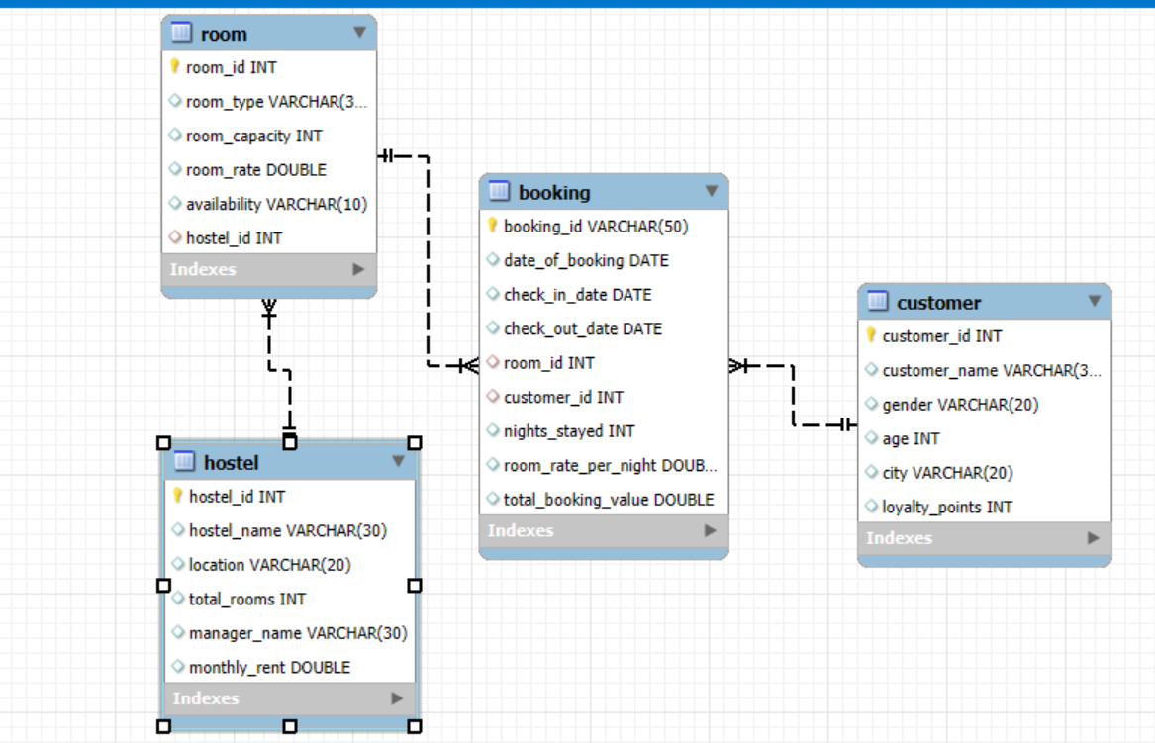
Tables of Dataset

Slide 5
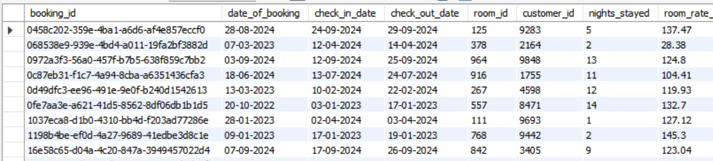
Overview of Tables

Slide 6
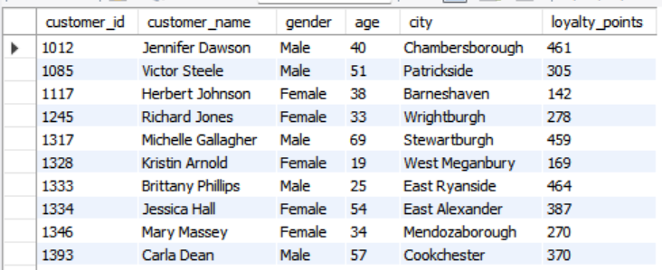
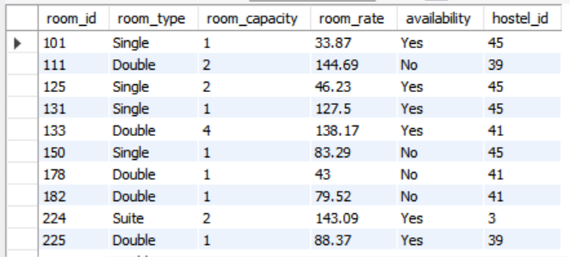
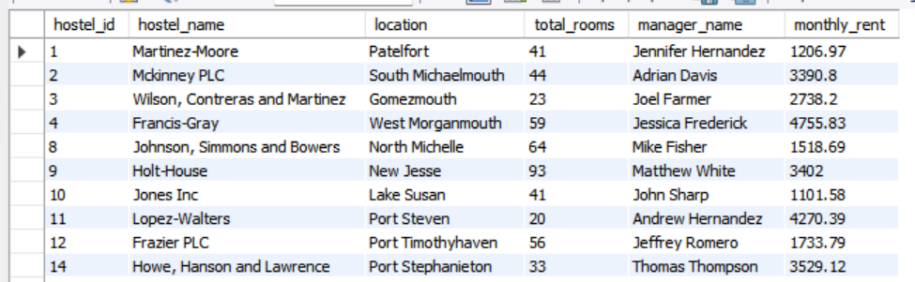

Slide 7
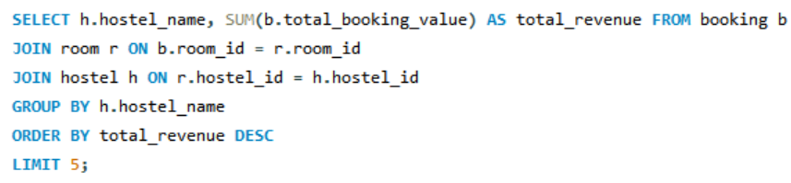
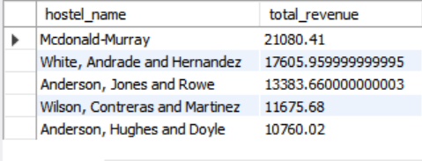
TOP 5 HOSTEL BY REVENUE 1)What are the top 5 hostels by total booking revenue.
Observation : Mcdonald-Murray hostel has most revenue generated hostel.

Slide 8
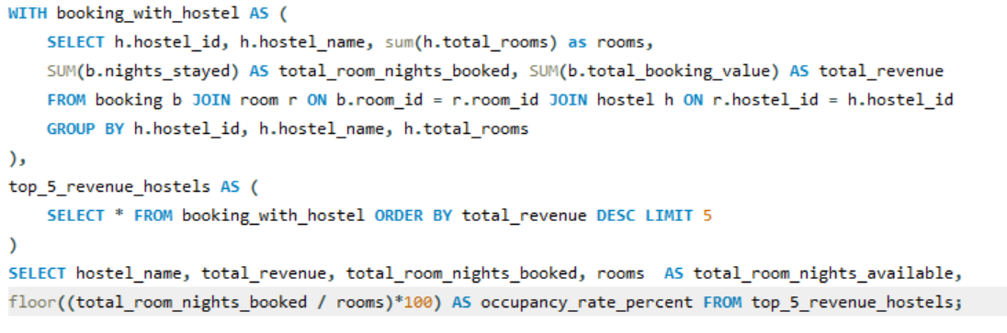
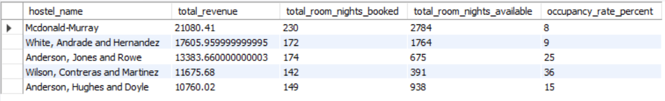
OCCUPANCY RATE OF TOP 5 HOSTELS 2) What are the top 5 hostels generating the highest total revenue, and what is their room occupancy rate as a percentage?
Observation: Mcdonald-Murray hostel has less occupancy rate and Wilson, Contreras and Martinez hostel has more occupancy rate in percentage.

Slide 9
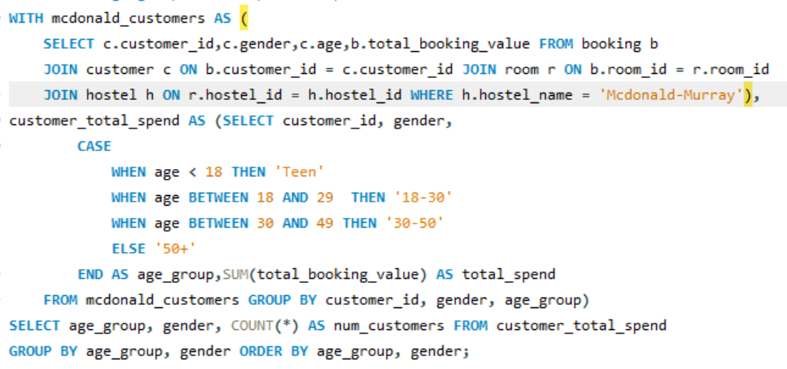
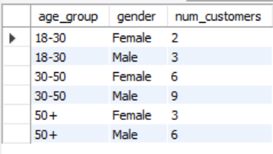
MOST PREFER AGE-GROUP AT MCDONALD-MURRAY 3) What is the distribution of customers by age group and gender at the Mcdonald-Murray hostel?
Observation: 30-50 Age Group is most prefer Mcdonald-Murray Hostel.

Slide 10
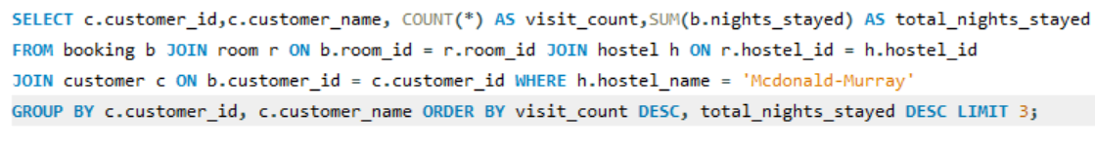
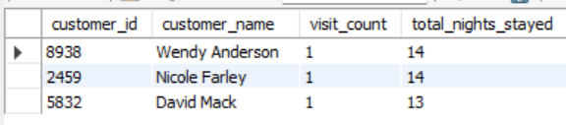
TOP 3 CUSTOMER BY LONG STAYED 4) Who are the top 3 most frequent customers at the Mcdonald-Murray hostel, based on visit count and total nights stayed?
Observation: Wendy Anderson and Nicole Farley customer has stayed more nights at Mcdonald-Murray Hostel.

Slide 11
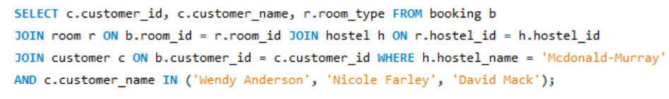
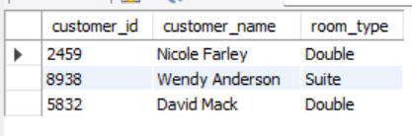
ROOM TYPE IS REFER BY TOP 3 CUSTOMER 5)Which room type is refer by top 3 customer at Mcdonald-Murray Hostels?
Observation: Top Customer refer mostly Double room type.

Slide 12
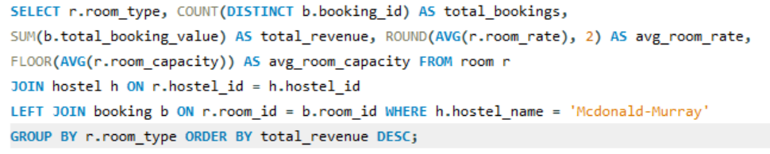
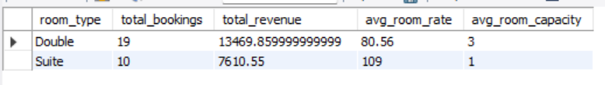
AVERAGE ROOM RATES AND ROOM CAPACITY 6) What is the total revenue, average room rate, and average room capacity by room type at the Mcdonald-Murray hostel?
Observation: Average room rate is less and room capacity is more therfore double room type is most refer at Mcdonald-Murray Hostel.

Slide 13
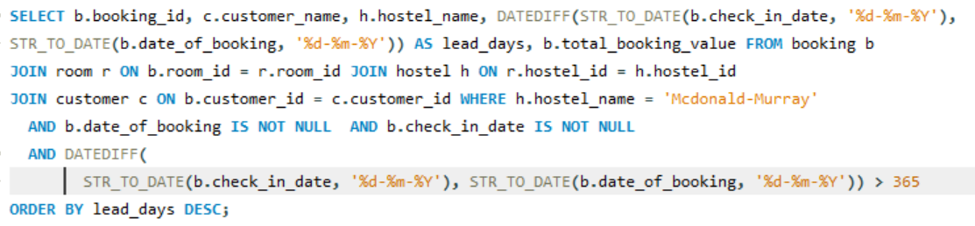
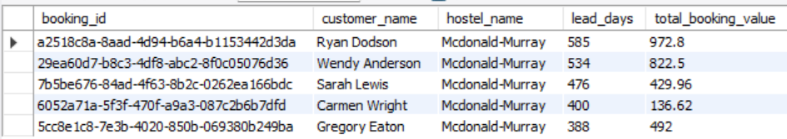
DIFFERENCE BETWEEN BOOKING AND CHECK IN DATE 7) What is the number of days between booking and check in dates ,how does that affect total booking value at Mcdonald-Murray?
Observation : Riyan Dodson customer check in 585 days after booking date.

Slide 14
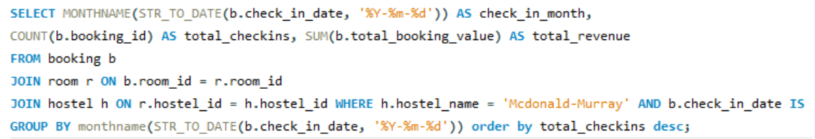
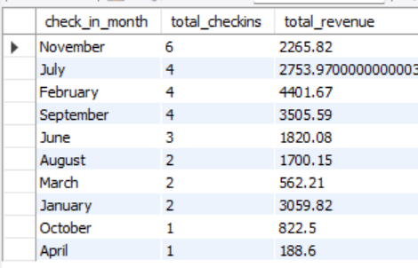
HIGHEST CHECK IN MONTH 8) In which month did the Mcdonald-Murray hostel receive the highest number of check-ins, and what was the total revenue for each month?
Observation : In November Month has maximum checkins but in febuary month maximum revenue.

Slide 15
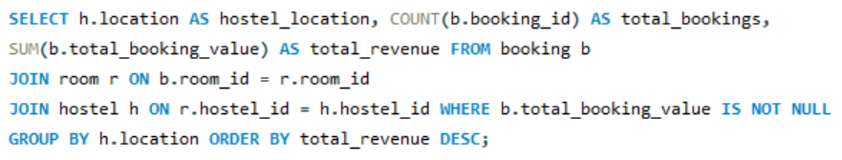
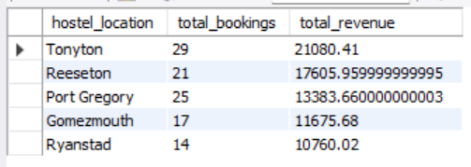
TOP 5 LOCATION BY REVENUE 9) Which location is more help to generate more revenue?
Observation : Tonyton city help to generate more revenue.

Slide 16
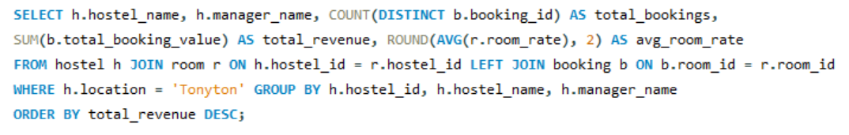
POPULAR HOSTEL IN TONYTON CITY 10) Which hostel in tonyton location help to generate revenue and its average room rate?
Observation : Mcdonald-Murray hostel is help to generate more revenue in tonyton location.

Slide 17
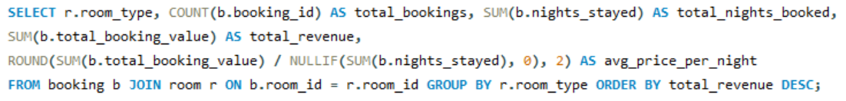
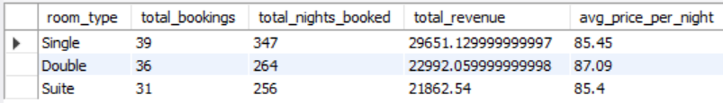
TOTAL NIGHTS BOOKED BY ROOM TYPE 11) What is total booking, total nights booked by room type ?
Observation : Single room type is most prefer for booking.

Slide 18
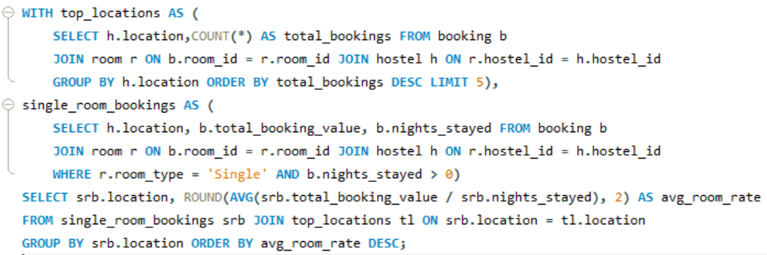
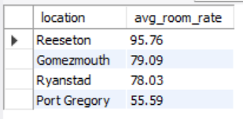
AVERAGE ROOM RATE OF SINGLE ROOM TYPE 12) What is the average room rate of single room type in top 5 locations?
Observation : In Reeseton location is highest average room rate.

Slide 19
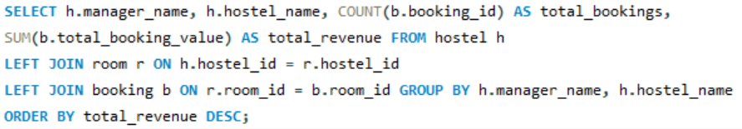
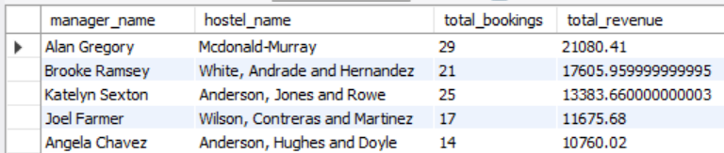
HOSTEL MANAGER BY MOST PROFITABLE HOSTEL 13) Which hostel managers oversee the most profitable hostels?
Observation : Alan Gregory Manager oversee the most profitable hostels.

Slide 20
Conclusion
The analysis highlights that Mcdonald-Murray hostel generates the highest revenue but has a lower occupancy rate, suggesting scope for optimization. Double rooms are most preferred by frequent customers, and the 30–50 age group is the key customer segment. Tonyton is the top-performing location, and Alan Gregory manages the most profitable hostels. These insights can support better pricing, marketing, and operational decisions to improve overall hostel performance.

Slide 21


