Slide 1

GroshopAid- Indoor obstacle avoidance and RFID based shopping aid for visually impaired people
(GROUP-3)
Vishwakarma Institute of Technology, Pune
HONORS PROJECT – TY B 2023
Authors:
Shweta Munjewar, Rutuja Nagdekar, Mitali Nimase
Supervisor: Dr. Jyoti Madake
Department of E&TC Engineering

Slide 2
Introduction
Literature Survey
Methodology
Novelty
Future Scope
Conclusion
References
Contents

Slide 3
INTRODUCTION:
A Supermarket is a place where customers come to purchase daily using products. After that custom has to wait in line for the billing process
Autonomous shopping is a concept that involves the use of technologies such as RFID readers and cameras to enable a seamless and convenient shopping experience for customers.
RFID readers are used to track products and detect their location, while cameras are used for object recognition and to identify products.
Customer adds products to their cart, the RFID reader and camera technology automatically records the items and their prices.

Slide 4
LITERATURE SURVEY

Slide 5
[1]
Smart Mobile Autonomous Robotic Trolley
ATmega 16 microcontroller is interfaced with the EM18 RFID reader module, buzzer and LED indicator.
Wireless data transfer is achieved through ZigBee .
Web-based management component for configuring the system and generating and binding barcode tags
[2]
Blind shopping: enabling accessible shopping for visually impaired people through mobile technologies.
Paper analyzed the centralized and automated billing system that uses RFID and ZigBee communication technology.
Assigning RFID tags to each product and designing shopping carts with a Product Identification Device (PID)
[3]
Customer behavior analytics using an autonomous robotics-based system
The software consists of an Intel NUC with a Core-i7 processor that performs all onboard calculations.
Using Convolutional Neural Networks, robots can perform autonomous navigation and localization and recognise the shelve’s contents..

Slide 6
[4]
An RFID warehouse robot
robot can identify root & it will pick up the item and navigate to the specified destination using a line follower module.
The PIC microcontroller and RFID reader communicate in half duplex mode
The PIC microcontroller reads RFID reader data and displays it on the LCD.
[5]
Supermarket Shopping System using RFID as the IoT Application
The system includes RFID tags, readers, a backend server, and a mobile app.
The RFID-enabled shopping cart updates the virtual shopping cart on the mobile app in real-time as customers shop, and the backend server tracks inventory levels and alerts staff when necessary.
[6]
Innovative Shopping Cart For Smart Cities
The cart includes a self-propelled electric motor for easy movement, a touchscreen display for product information and promotions, and an RFID reader for automated billing. also includes a built-in refrigeration system to keep perishable items fresh, reducing food waste.
The cart includes a waste sorting system for recyclable and non-recyclable materials.

Slide 7
METHODOLOGY

Slide 8
Dataset :
Dataset consists of RGB images.
300 - Person
300 - Rack
300 - Trolley
300 - Other

Slide 9
Feature Extraction:
Scale Invariant Feature Transform(SIFT)
Extracts feature vector of 512 x 512 dimension.
Rotation and Scale Invariant
Robust to occlusion and clutter
Shape of feature vector from SIFT: 1638768 x 128
Histogram of Oriented Gradients (HOG)
Extracts feature vector of 128 x 64 dimension.
Shape of feature vector from SIFT: 226440 x 128

Slide 10
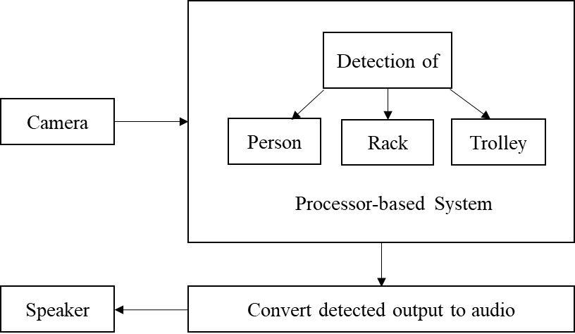
Methodology
The camera captures the environment and sends it to the processor-based system. Person, Rack, and Trolley are classified and detected by the processor-based system.
Block -Diagram(Obstacle detection)

Slide 11
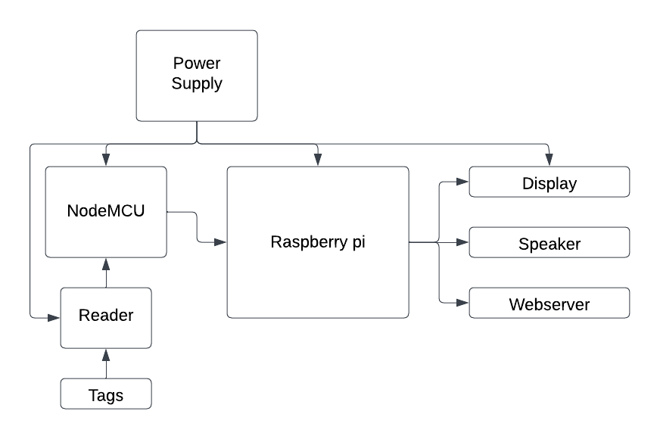
Methodology
Raspberry pi and Node MCU are integrated where input to the system are tags. The output from the system is display showing the total amount, speaker and webserver
Block -Diagram(Setup)

Slide 12
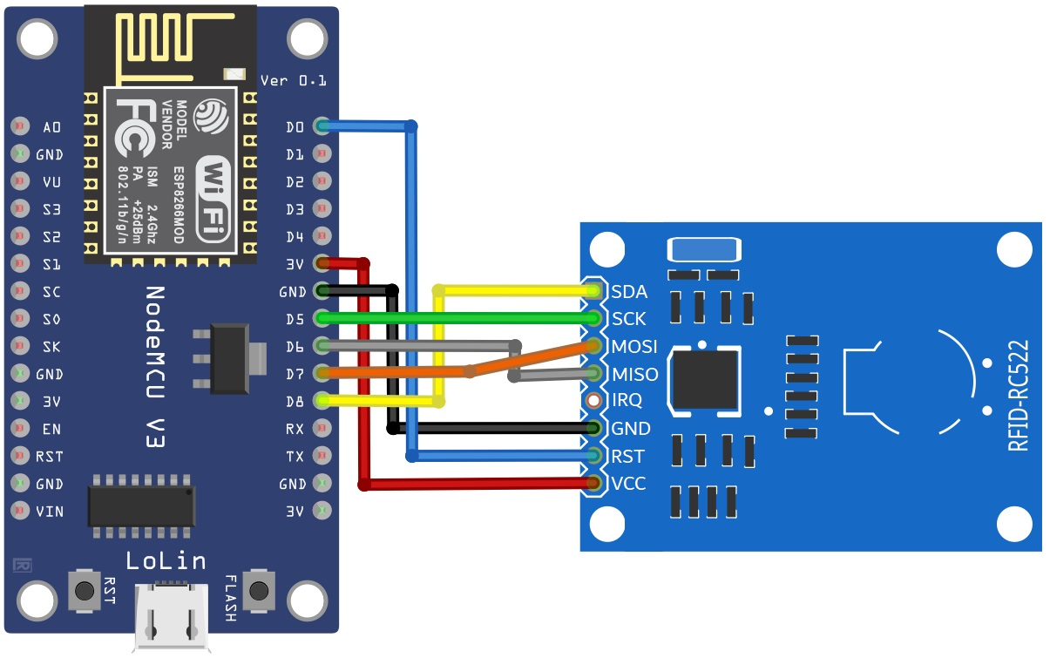
Interfacing of NodeMcu with RFID reader
The RFID module (RC522) communicates with the NodeMCU over the SPI protocol, and the data transfer is bidirectional. The NodeMCU sends commands to the RFID module to read or write data, and the RFID module responds with the requested data.

Slide 13
Range of detection can be increased
Real-time object detection
Novelty
Less time required
Cost Effic
Portable and lightweight systems
Portable and Lightweight System
Good Accuracy

Slide 14
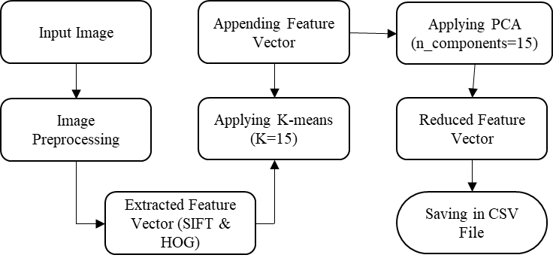
Dimensionality Reduction Process:
Using :
K Means
PCA

Slide 15
Classifiers | Accuracy
Random Forest Classifier | 81%
Logistic Regression | 80%
Decision Tree Classifier | 75%
Performance Metrics
Multiclass
Classification

Slide 16
FUTURE SCOPE
Autonomous shopping is promising, with the potential for expanded use of robots in retail stores to perform various tasks such as restocking shelves and assisting customers
Additionally, the integration of mobile apps and virtual assistants can enable customers to navigate and shop more efficiently
Detection and classification of the objects can be improved in the future using large datasets.
Overall, the future of autonomous shopping is likely to involve a more streamlined and efficient shopping experience that prioritizes convenience and customer satisfaction.

Slide 17
GroshopAid- Indoor obstacle avoidance and RFID based shopping aid for visually impaired people using a camera is a promising technology.
Activity classification of Person, Rack and Trolley is done using the Random Forest , Logistic Regression and Decision Tree classifiers.
The proposed system gives the best accuracy for the Random Forest classifier with the SIFT and HOG descriptor.
The Testing accuracy for Random Forest is 81%, which is good accuracy.
Conclusion

Slide 18
References:
Sanap, Mayur, Priya Chimurkar, and Narendra Bhagat. "SMART-smart mobile autonomous robotic trolley." In 2020 4th International Conference on Intelligent Computing and Control Systems (ICICCS), pp. 430-437. IEEE, 2020.
López-de-Ipiña, Diego, Tania Lorido, and Unai López. "Blind shopping: enabling accessible shopping for visually impaired people through mobile technologies." In Toward Useful Services for Elderly and People with Disabilities: 9th International Conference on Smart Homes and Health Telematics, ICOST 2011, Montreal, Canada, June 20-22, 2011. Proceedings 9, pp. 266-270. Springer Berlin Heidelberg, 2011.
Hanooja, T., C. G. Raji, M. Sreelekha, Jemsheer Koniyath, VK Muhammed Ameen, and M. Mohammed Noufal. "Human friendly smart trolley with automatic billing system." In 2020 4th International Conference on Electronics, Communication and Aerospace Technology (ICECA), pp. 1614-1619. IEEE, 2020.
Suryaprasad, J., BO Praveen Kumar, D. Roopa, and A. K. Arjun. "A novel low-cost intelligent shopping cart." In 2011 IEEE 2nd International Conference on Networked Embedded Systems for Enterprise Applications, pp. 1-4. IEEE, 2011.
Mekruksavanich, Sakorn. "Supermarket shopping system using rfid as the iot application." In 2020 Joint International Conference on Digital Arts, Media and Technology with ECTI Northern Section Conference on Electrical, Electronics, Computer and Telecommunications Engineering (ECTI DAMT & NCON), pp. 83-86. IEEE, 2020.
Khairnar, Prasiddhi K., and Dhanashri H. Gawali. "Innovative shopping cart for smart cities." In 2017 2nd IEEE international conference on recent trends in electronics, information & communication technology (RTEICT), pp. 1067-1071. IEEE, 2017.

Slide 19
CONTRIBUTION
Shweta - Dataset Collection , Obstacle detection model, Report and PPT
Rutuja - Dataset Collection , Auto-Shopping model , Website Development, Report Making
Mitali - Dataset Collection , Obstacle detection model, Report and PPT

Slide 20
THANK YOU!

