Slide 1
Pima Indians Diabetes Prediction
Name: Rutuja S. Sankhe

Slide 2
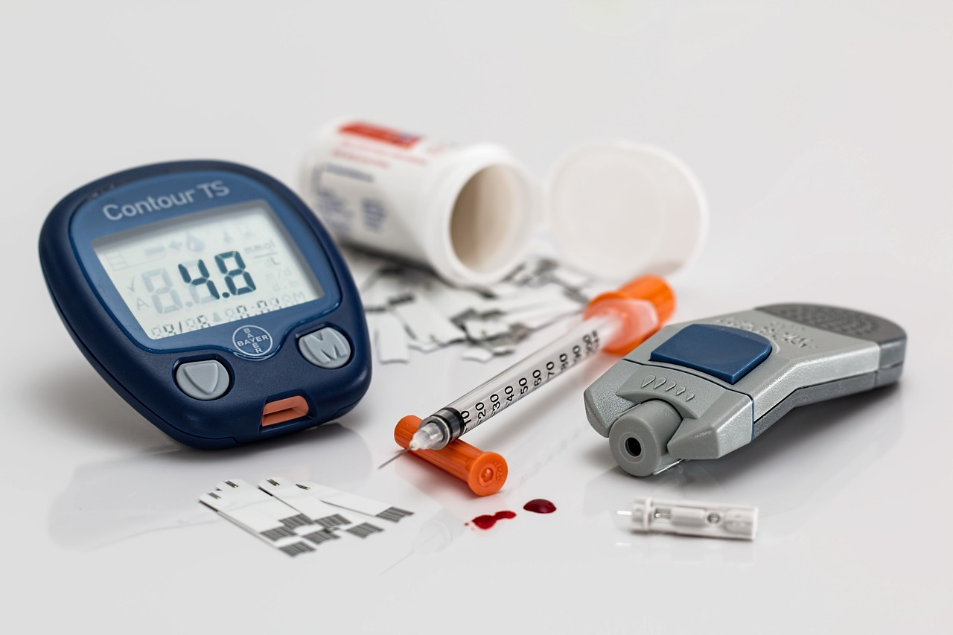
Problem Statement
Pima Indians Diabetes Database this dataset is originally from the National Institute of Diabetes and Digestive and Kidney Diseases.
The objective of the dataset is to diagnostically predict whether or not a patient has diabetes, based on certain diagnostic measurements included in the dataset.
In particular, all patients here are females at least 21 years old of Pima Indian heritage.
.

Slide 3
Problem Statement
The datasets consists of several medical predictor variables and one target variable, Outcome.
Predictor variables includes the number of pregnancies the patient has had, their BMI, insulin level, age, and so on.

Slide 4






Software Used
Tools Used:
1. Google Colab – Notebook
Libraries Used:
1. Data Analysis: Numpy, Pandas, Sci-kit Learn
2. Data Visualization: Matplotlib, Seaborn

Slide 5
Data Description
Pregnancies: Number of times pregnant
Glucose: Glucose level
BloodPressure: Blood pressure
SkinThickness: Triceps Skin fold thickness
Insulin: Insulin level
BMI: Body Mass Index
DiabetesPedigreeFunction: A function that calculates the likelihood of having diabetes based on the family members.
Age: Age (in years)
Outcome: Information about whether the individual has diabetes or not. Affected by the disease (1) or Not (0)

Slide 6
Data Preprocessing
Handling missing values
Checking data type
Data cleaning

Slide 7
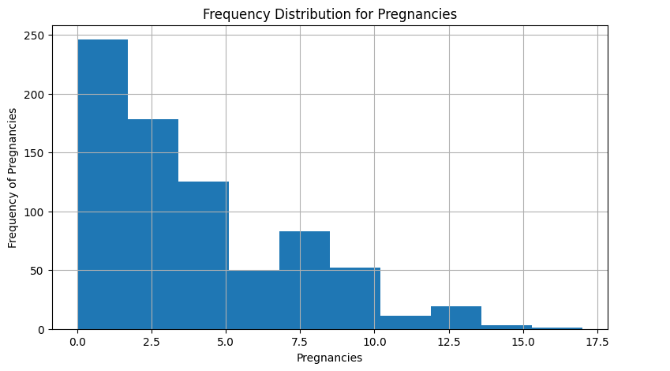
Data Visualization
Pregnancies:

Slide 8
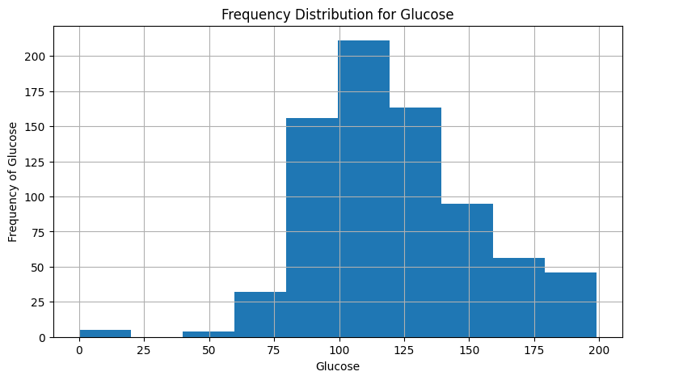
Data Visualization (Continued)
Glucose:

Slide 9
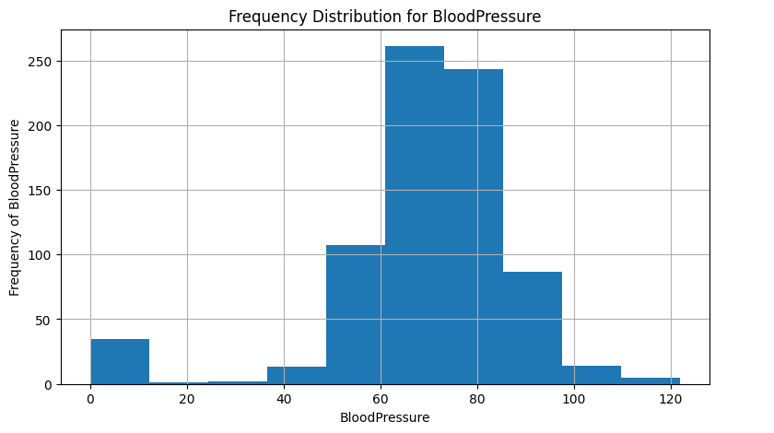
Data Visualization (Continued)
BloodPressure:

Slide 10
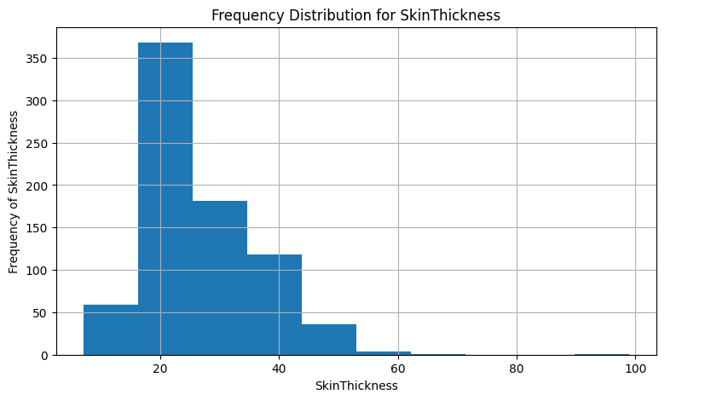
Data Visualization (Continued)
SkinThickness:

Slide 11
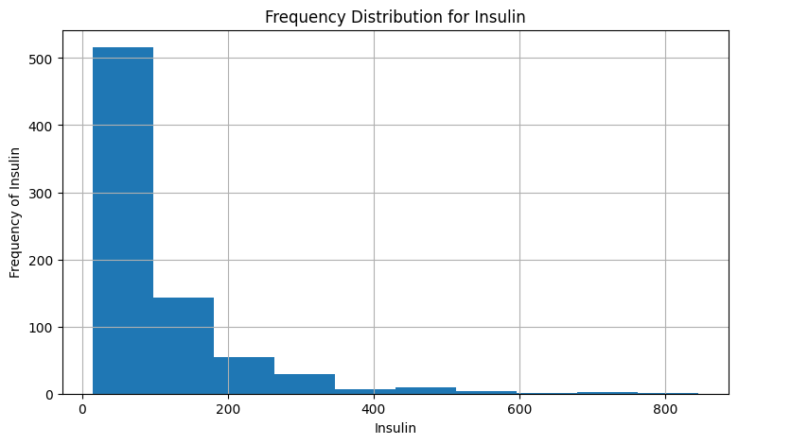
Data Visualization (Continued)
Insulin:

Slide 12
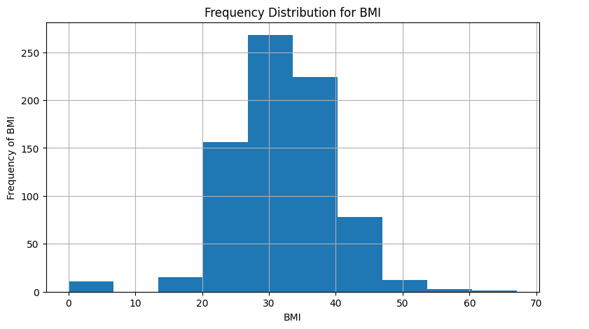
Data Visualization (Continued)
BMI:

Slide 13
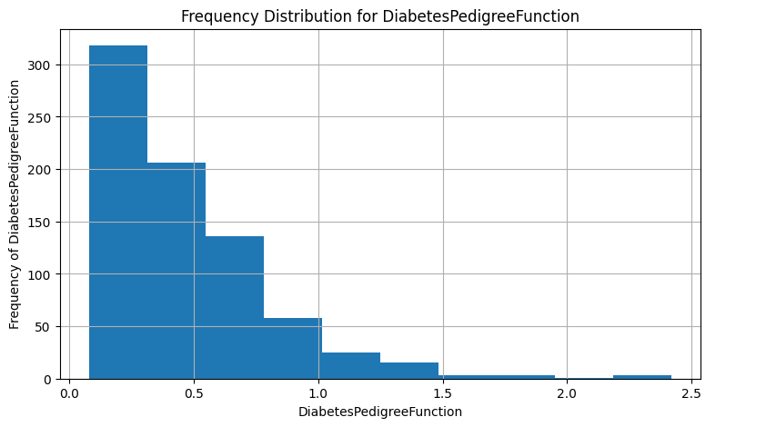
Data Visualization (Continued)
DiabetesPedigreeFunction:

Slide 14
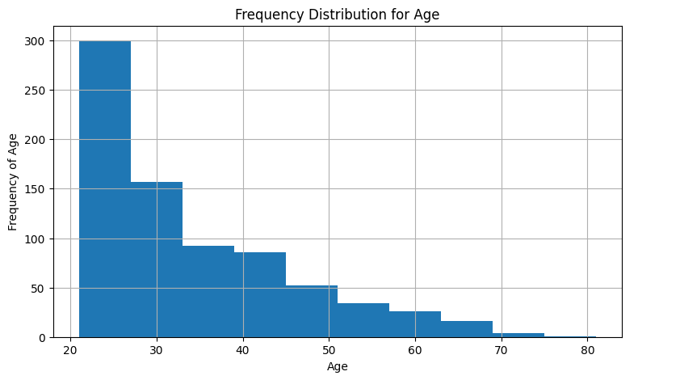
Data Visualization (Continued)
Age:

Slide 15
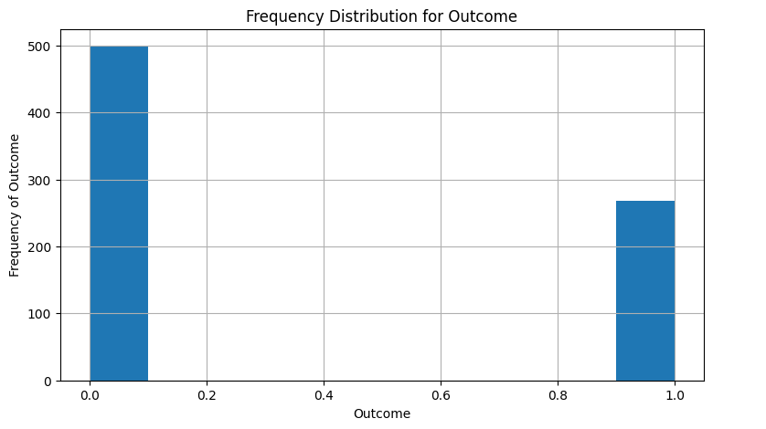
Data Visualization
Outcome:

Slide 16
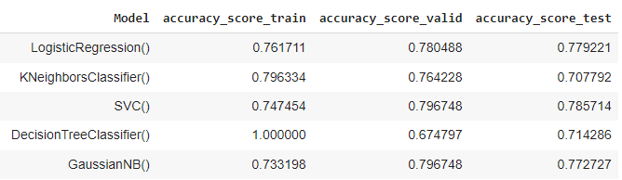
Results

Slide 17
Identify the Best Model
Training with the different basic model for prediction and checking the accuracy
Predicting with the unseen data and checking the accuracy
Select the model on the basis of the accuracy score of train and test Or
Choose the model which is best fit to predict

Slide 18
Conclusion
The main aim of this project is to design and implement Diabetes Prediction using different machine learning models and it has been achieved successfully. During this process I used different libraries to do the data visualization. Evaluating model based on various performance metrics provides a comprehensive understanding of their effectiveness.

Slide 19
Thank You!

