Slide 1
Mall Customer Data:K-Means Cluster Analysis
Name: Rutuja S. Sankhe

Slide 2
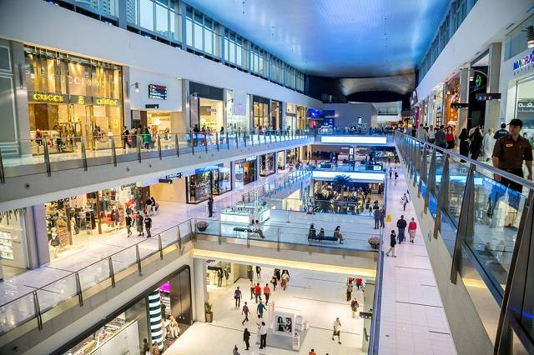
Problem Statement
We have a dataset of Mall Customers, which is the data of customers who visit the mall and spend there.
The data includes the following features:
1. Customer ID
2. Genre
3. Age
4. Annual Income (k$)
5. Spending Score(1-100) (based on customer behaviour and spending nature)

Slide 3
Problem Statement
The given features gives the overview of calculated value of how much a customer has spent in the mall, the more the value, the more he/she has spent.
From this dataset, we need to calculate some patterns for unsupervised learning method.

Slide 4





Software Used
Tools Used:
1. Google Colab: Notebook
Libraries Used:
1. Data Analysis: Numpy, Pandas
2.Data Visualization: Matplotlib, Seaborn

Slide 5
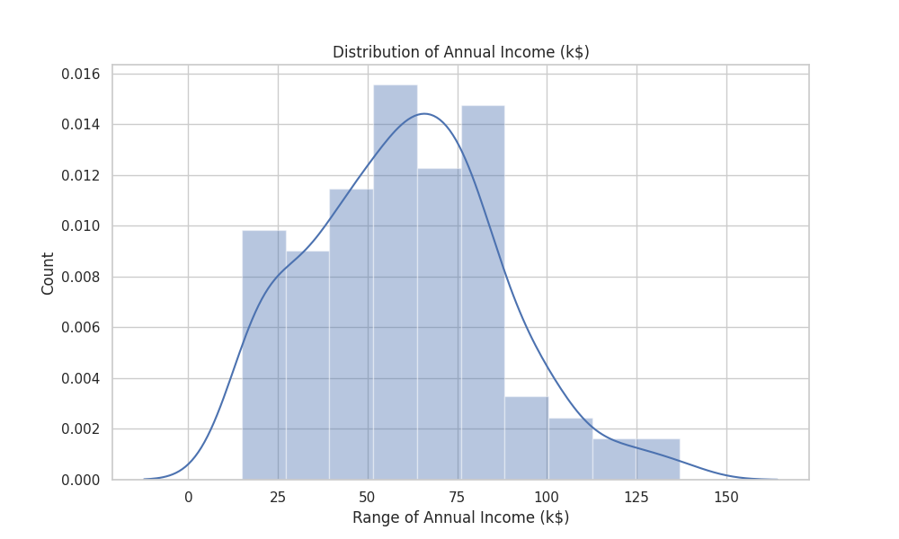
Data Visualization
Annual Income Distribution:

Slide 6
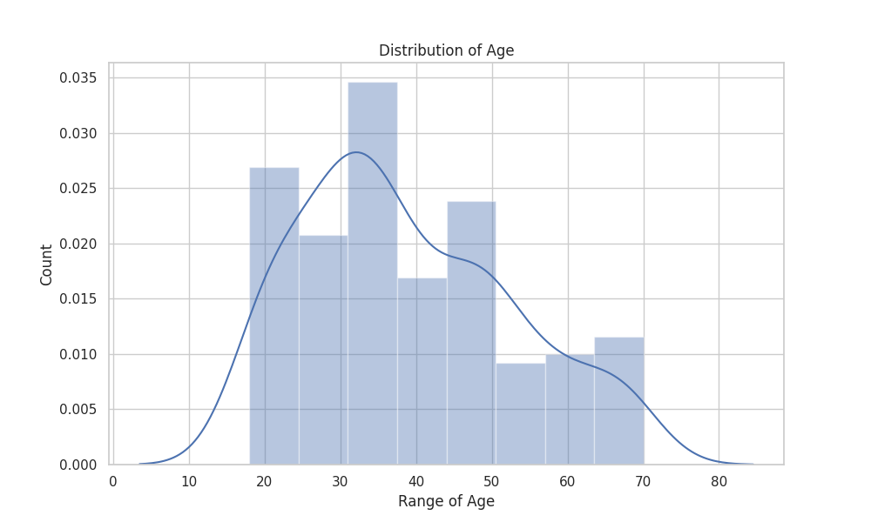
Data Visualization(Continued)
Age Distribution:

Slide 7
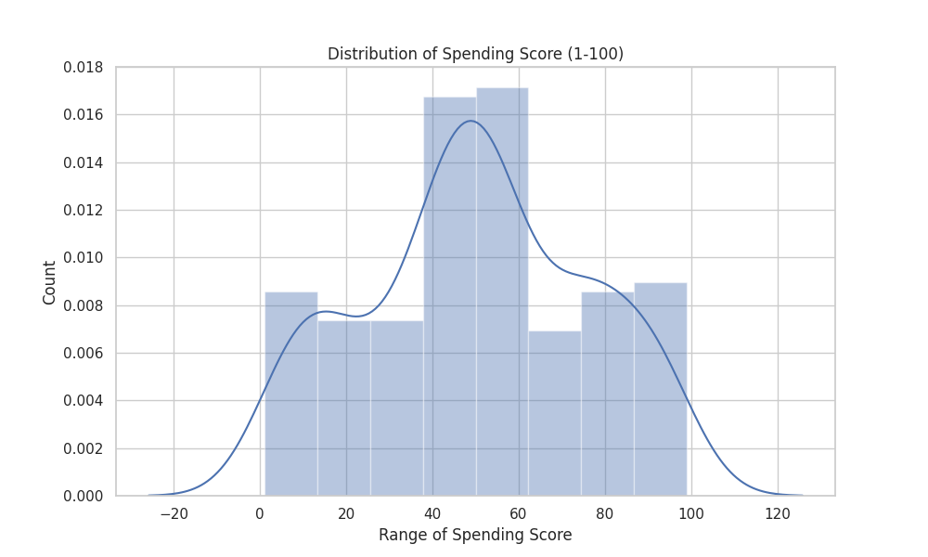
Data Visualization(Continued)
Spending Score Distribution:

Slide 8
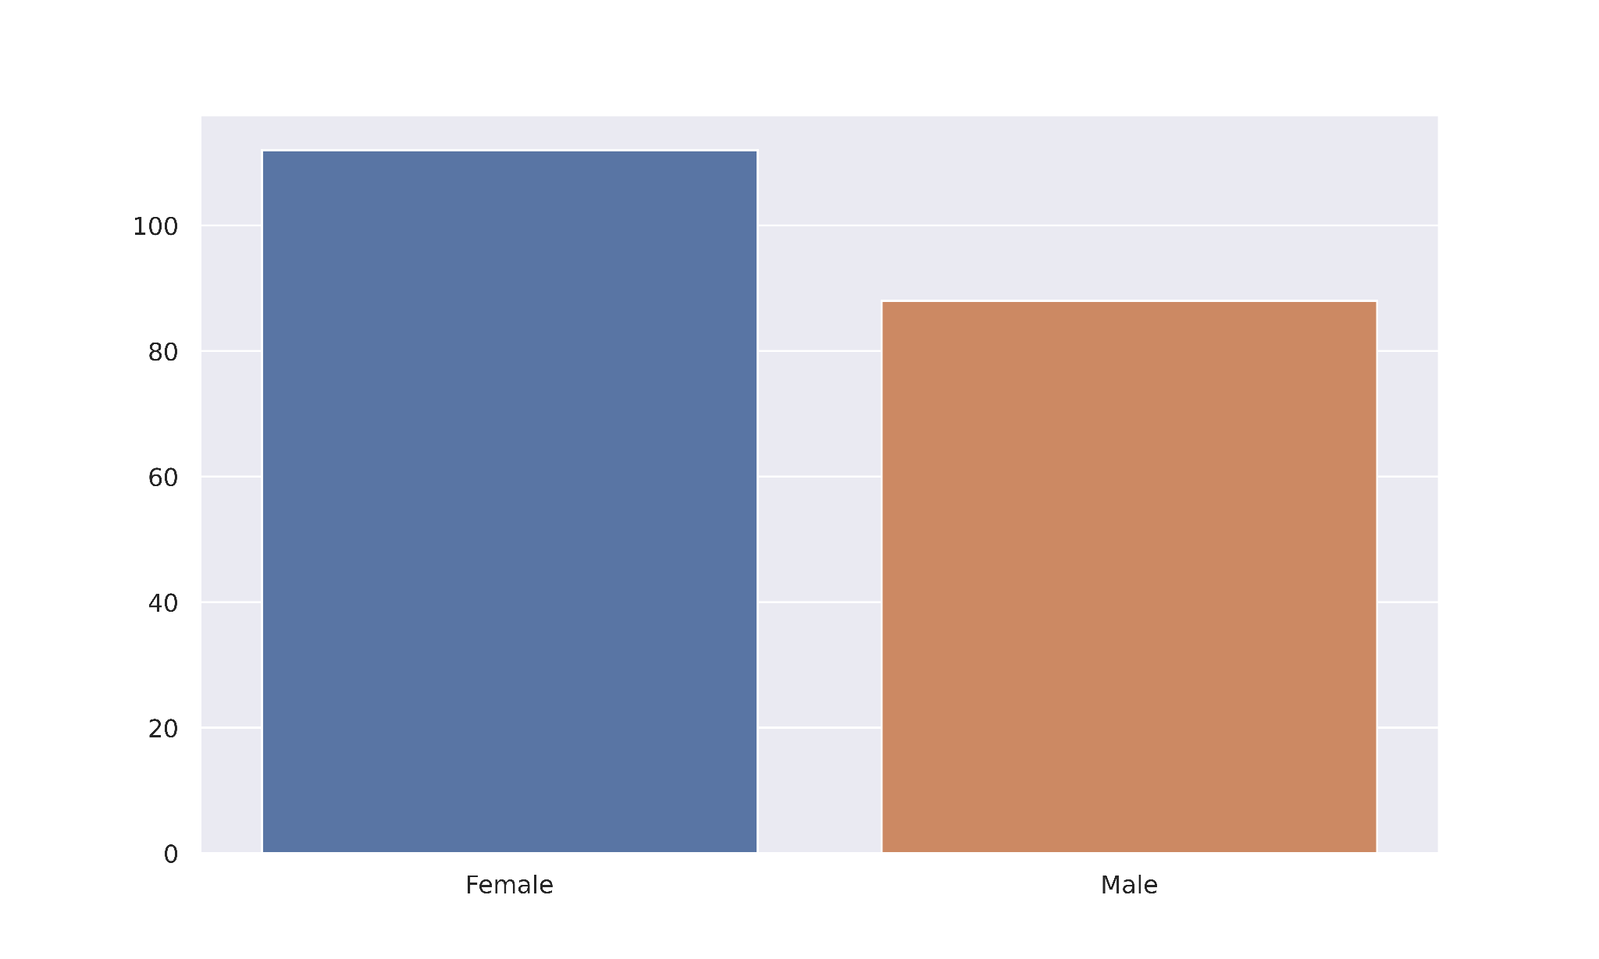
Data Visualization
Gender Analysis:

Slide 9
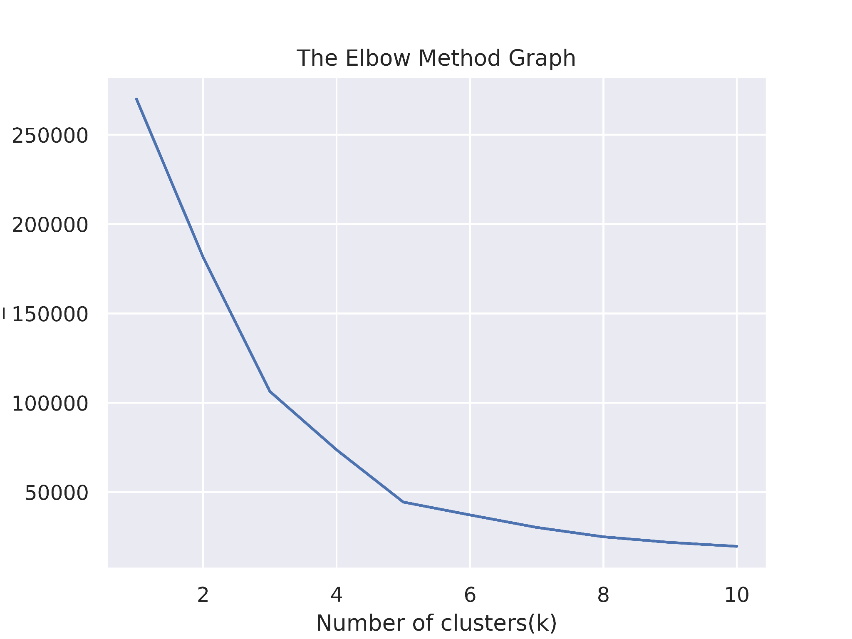
Elbow Method Graph
From the plot, we can see the elbow point is at 5.So the number of clusters will be 5.

Slide 10
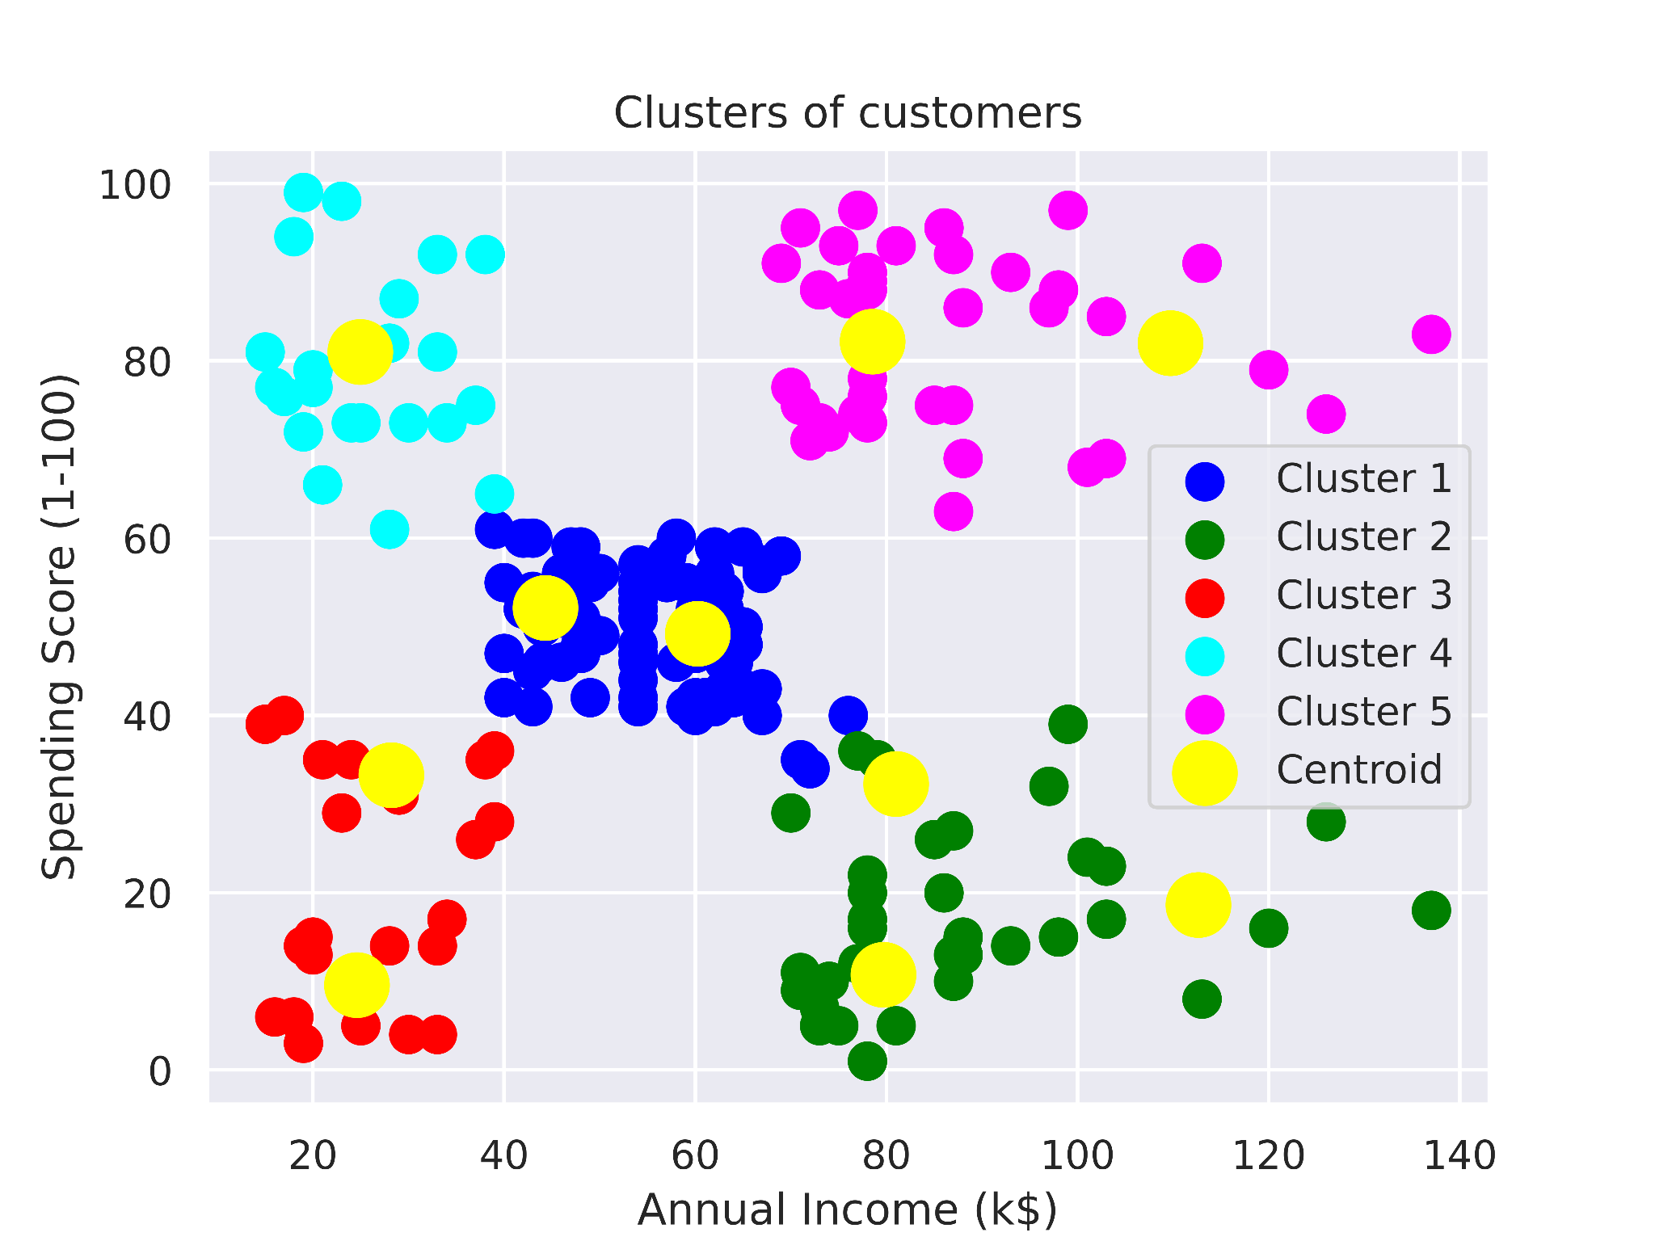
Visualizing the Clusters

Slide 11
Visualizing the Clusters
Observations:
Cluster 1: Customers with average salary and average spending.
Cluster 2: Customer has a high income but low spending, so they can be categorized as careful.
Cluster 3: Customers have low income and low spending so they can be categorized as sensible.
Cluster 4: Customers with low income with very high spending so they can be categorized as careless.
Cluster 5: Customers with high income and high spending so they can be categorized as target, and these customers can be the most profitable customers for the mall owner.

Slide 12
Conclusion
The main objective of this project is to design and analyze Mall Customer data with the help of K-Means Unsupervised Learning algorithm. It is one of the most popular clustering algorithms and usually the first thing practitioners apply when solving clustering tasks to get an idea of the structure of the dataset. K-Means is used to determines the best value for K center points or centroids by an iterative process.

Slide 13
Thank You!

