Slide 1
JUnit Testing
By
Anand Kulkarni
Anand.pune38@gmail.com

Slide 2
Introduction
JUnit is an open source testing framework for Java
It is a simple framework for creating automated unit tests
JUnit test cases are Java classes that contain one or more unit test methods
These tests are grouped into test suites
JUnit tests are pass/fail tests explicitly designed to run without human intervention
JUnit can be integrated with several IDEs, including Eclipse
The JUnit distribution can be downloaded as a single jar file from http://www.junit.org
It has to be kept in the classpath of the application to be tested
Notes:
Unit Testing
A unit test is a piece of code written by a developer that executes a specific functionality in the code under test. Unit tests ensure that code is working as intended and validate that this is still the case after code changes.
Unit Testing with JUnit
JUnit 4.x is a test framework which uses annotations to identify methods that are tests. JUnit assumes that all test methods can be executed in an arbitrary order. Therefore tests should not depend on other tests.
Installation of JUnit
If you use Eclipse you can use the integrated JUnit in Eclipse for your testing.
If you want to control the used JUnit library explicitly, download JUnit4.x.jar from the JUnit website at http://www.junit.org/ . The download contains the "junit-4.*.jar“ which is the JUnit library. Add this library to your Java project and add it to the classpath.
2

Slide 3
JUnit with Eclipse
Create a new Project JUnitProj
Add JUnit.jar to the Classpath
Right click the Project and create a new Source folder called ‘test’
Create a new Java class called Calculator in a package junit.first
Add 2 methods add and sub to the Calculator class which does addition and subtraction of 2 numbers respectively
package junit.first;
public class Calculator {
public int add(int x,int y)
{ return x+y; }
public int sub(int x,int y)
{ return x-y; } }
Notes:
3

Slide 4
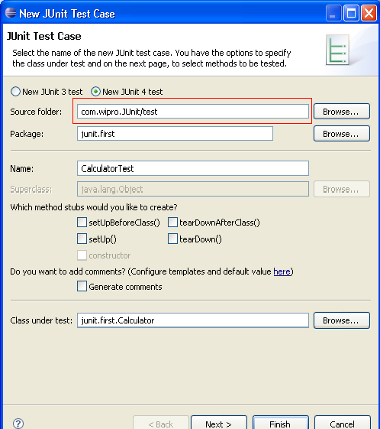
JUnit with Eclipse (Contd.).
Right click on the Calculator class in the Package Explorer and
select New->JUnitTestCase
select "New JUnit4 test“
set the source folder to "test“ – the test class gets created here
Notes:
4

Slide 5
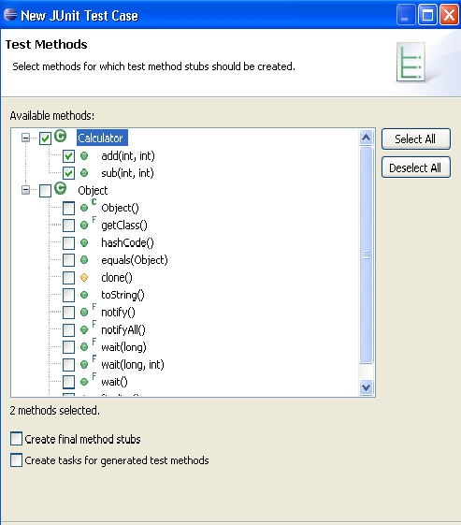
JUnit with Eclipse (Contd.).
Press "Next" and select the methods you want to test
Select the required methods
Notes:
5

Slide 6
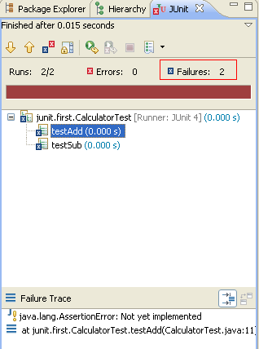
JUnit with Eclipse (Contd.).
Right click on CalculatorTest class and select
Run-As → JUnit Test
The results of the test will be displayed in JUnit view
This is because the testAdd and testSub are not implemented correctly
Brown color indicates failure
Notes:
6

Slide 7
How to write a JUnit test method
All the test methods should be marked with the Junit annotation - @org.junit.Test
All the JUnit test methods should be "public" methods
The return type of the JUnit test method must be “void"
The test method need not start with the test keyword
Here is a simple JUnit test method:
@Test
public void testAdd() {
Calculator c=new Calculator();
assertEquals("Result",5,c.add(2,3));
}
Notes:
7

Slide 8
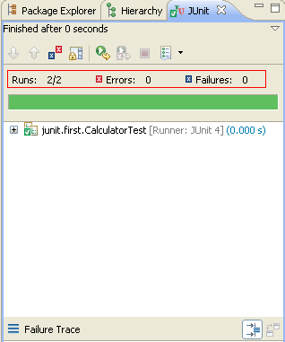
JUnit with Eclipse
Now let’s provide implementation to the code and run the test again
public class CalculatorTest {
@Test
public void testAdd() {
Calculator c=new Calculator();
assertEquals(5,c.add(2,3));
}
@Test
public void testSub() {
Calculator c=new Calculator();
assertEquals(20,c.sub(100,80));
} }
Green color indicates pass
Notes:
Unit tests are implemented as classes with test methods. Each test method usually tests a single method of the target class. Sometimes, a test method can test more than one method in the target class, and sometimes, if the method to test is big, you split the test into multiple test methods.
The unit test class is an ordinary class, with two methods, tesAdd() and testSub. Notice how this method is annotated with the JUnit annotation @Test. This is done to signal to the unit test runner, that this is method represents a unit test, that should be executed. Methods that are not annotated with @Test are not executed by the test runner.
Inside the testAdd() method an instance of Calculator is created. Then it's add() method is called with two integer values.
Finally, the assertEquals() method is called. It is this method that does the actual testing. In this method we compare the output of the called method (add()) with the expected output.
If the two values are equal, nothing happens. The assertEquals() method returns normally. If the two values are not equal, an exception is thrown, and the test method stops executing here.
The assertEquals() method is a statically imported method, which normally resides in the org.junit.Assert class. Notice the static import of this class at the top of MyUnitTest. Using the static import of the method is shorter than writing Assert.assertEquals().
8

Slide 9
Assert methods with JUnit
assertArrayEquals()
Used to test if two arrays are equal to each other
int[] expectedArray = {100,200,300};
int[] resultArray = myClass.getTheIntArray();
assertArrayEquals(expectedArray, resultArray);
assertEquals()
It compares two objects for their equality
String result = myClass.concat("Hello", "World");
assertEquals("HelloWorld", result);
assertEquals(“Reason for failure”,”HelloWorld”,result);
Will get printed if the test will fail
Notes:
assertArrayEquals()
Used to test if two arrays are equal to each other. If the arrays are equal, the assertArrayEquals() will proceed without errors. If the arrays are not equal, an exception will be thrown, and the test aborted. Any test code after the assertArrayEquals() will not be executed.
assertEquals
The assertEquals() method can compare any two objects to each other. If the two objects compared are not same, then an AssertionError will be thrown.
9

Slide 10
Assert methods with JUnit (Contd.).
assertTrue() , assertFalse()
Used to test whether a method returns true or false
assertTrue (testClass.isSafe());
assertFalse(testClass.isSafe());
assertNull(),assertNotNull()
Used to test a variable to see if it is null or not null
assertNull(testClass.getObject());
assertNotNull(testClass.getObject());
assertSame() and assertNotSame()
Used to test if two object references point to the same object or not
String s1="Hello";
String s2="Hello";
assertSame(s1,s2); ->true
Notes:
assertTrue() , assertFalse()
If the isSafe() method returns true, the assertTrue() method will return normally. Else an exception will be thrown, and the test will stop there.
If the isSafe() method returns false, the assertFalse() method will return normally. Else an exception will be thrown, and the test will stop there.
assertNull(),assertNotNull()
If the testClass.getObject() returns null, the assertNull() method will return normally, else the assertNull() method will throw an exception, and the test will be stopped.
The assertNotNull() method works oppositely of the assertNull() method. It throws an exception if a null value is passed to it, and returns normally if a non-null value is passed to it.
assertSame(),assertNotSame()
Used to check if two object references point to the same object or not.
10

Slide 11
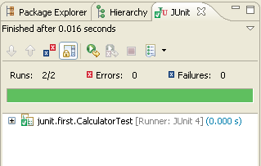
Annotations
Fixtures
The set of common resources or data that you need to run one or more tests
@Before
It is used to call the annotated function before running each of the tests
@After
It is used to call the annotated function after each test method
public class CalculatorTest {
Calculator c=null;
@Before
public void before() {
System.out.println("Before Test");
c=new Calculator();
}
@After
public void after() {
System.out.println("After Test");
}
@Test
public void testAdd() {
System.out.println("Add function");
assertEquals("Result",5,c.add(2,3));
}
@Test
public void testSub() {
System.out.println("Sub function");
assertEquals("Result",20,c.sub(100,80));
} }
O/P :
Before Test
Add function
After Test
Before Test
Sub function
After Test
Notes:
Let's consider the case in which each of the tests that you design needs a common set of objects. One approach can be to create those objects in each of the methods. Alternatively, the JUnit framework provides two special methods, setUp() and tearDown(), to initialize and clean up any common objects. This avoids duplicating the test code necessary to do the common setup and cleanup tasks. These are together referred to as fixtures. The framework calls the setup() before and tearDown() after each test method—thereby ensuring that there are no side effects from one test run to the next.
In Junit 4.x the @Before annotation does the role of the setUp() method and the @After annotation performs the role of the tearDown() method of JUnit 3.x
11

Slide 12
Annotations (Contd.).
@BeforeClass
The annotated method will run before executing any of the test method
The method has to be static
@AfterClass
The annotated method will run after executing all the test methods
The method has to be static
public class CalculatorTest {
static Calculator c=null;
@BeforeClass
public static void before() {
System.out.println("Before Test");
c=new Calculator();
}
@AfterClass
public static void after() {
System.out.println("After Test");
}
@Test
public void testAdd() {
System.out.println("Add function");
assertEquals("Result",5,c.add(2,3));
}
@Test
public void testSub() {
System.out.println("Sub function");
assertEquals("Result",20,c.sub(100,80));
}
}
O/P :
Before Test
Add function
Sub function
After Test
Notes:
@BeforeClass and @AfterClass Use @BeforeClass and @AfterClass annotations for class wide “setup” and “tearDown” respectively. Think them as one time setup and tearDown. They run for one time before and after all test cases.
12

Slide 13
Annotations (Contd.).
@Ignore
Used for test cases you wanted to ignore
A String parameter can be added to define the reason for ignoring
@Ignore(“Not Ready to Run”)
@Test
public void testComuteTax() { }
@Test
Used to identify that a method is a test method
Notes:
Two optional parameters are supported by Test Annotation.
The first optional parameter ‘expected’ is used to declare that a test method should throw an exception. If it doesn't throw an exception or if it throws a different exception than the one declared, the test fails. For example, the following test succeeds:
@Test(expected=IndexOutOfBoundsException.class)
public void checkOutOfBounds()
{
new ArrayList<String>().get(1);
}
The second optional parameter, ‘timeout’, causes a test to fail if it takes longer than a specified amount of clock time (measured in milliseconds). The following test fails:
@Test(timeout=1000)
public void infinityCheck()
{
while(true);
}
13

Slide 14
Annotations (Contd.).
Timeout
It defines a timeout period in miliseconds with “timeout” parameter
The test fails when the timeout period exceeds.
@Test (timeout = 1000) public void testinfinity() { while (true); }
Notes:
14

Slide 15
Parameterised Tests
New feature added in JUnit 4
Used to test a method with varying number of Parameters
Steps for testing a code with multiple parameters
The testing class should be annotated with @RunWith(Parameterized.class)
The class should have these 3 entities
A single constructor that stores the test data
Is expected to store each data set in the class fields
A static method that generates and returns test data
This should be annotated with @Parameters
It should return a Collection of Arrays
Each array represent the data to be used in a particular test run
Number of elements in an array should correspond to the numberof elements in the constructor
Because each array element will be passed to the constructor for every run
A test method
Notes:
Structure of a parameterized test class
The method that generates test data must be annotated with @Parameters, and it must return a Collection of Arrays. Each array represents the data to be used in a particular testrun. The number of elements in each array must correspond to the number of parametersin the class's constructor, because each array element will be passed to the constructor, one at a time as the class is instantiated over and over.
The constructor is simply expected to store each data set in the class's fields, where they can be accessed by the test methods. Note that only a single constructor may be provided. This means that each array provided by the data-generating method must be the same size, and you might have to pad your data sets with nulls if you don't always need a particular value.
Let's put this together. When the test runner is invoked, the data-generating method will be executed, and it will return a Collection of Arrays, where each array is a set of test data. The test runner will then instantiate the class and pass the first set of test data to the constructor. The constructor will store the data in its fields. Then each test method will be executed, and each test method will have access to that first set of test data. After each test method has executed, the object will be instantiated again, this time using the second element in the Collection of Arrays, and so on.
15

Slide 16
Handling an Exception
Two cases are there:
Case 1 :We expect a normal behavior and then no exceptions
Case 2: We expect an anomalous behavior and then an exception
Case 1:
@Test
public void testDiv()
{
try
{
c.div(10,2);
assertTrue(true); //OK
}catch(ArithmeticException expected)
{
fail("Method should not fail");
}}
Case 2:
@Test
public void testDiv()
{
try
{
c.div(10,0);
fail("Method should fail");
}catch(ArithmeticException expected)
{
assertTrue(true);
} }
public void div(int a,int b) {
int c=0;
c=a/b;
System.out.println(c);
}

Slide 17
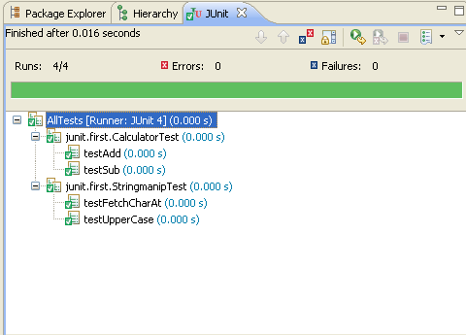
Test Suite
Convenient way to group together tests that are related
Used to bundle a few unit test cases and run it together
Annotations used for this
@RunWith
Used to invoke the class which
is annotated to run the tests
in that class
@Suite
Allows you to manually build a
suite containing tests from many
classes
@RunWith(Suite.class)
@Suite.SuiteClasses({
CalculatorTest.class,
StringmanipTest.class
})
public class AllTests {
}
Notes:
When a class is annotated with @RunWith,JUnit will invoke the class it references to run the tests in that class.
Using Suite as a runner allows you to manually build a suite containing tests from many classes.
Example:-
Calculator.java
--------------------
package junit.first;
public class Calculator {
public int add(int x,int y)
{
return x+y;
}
public int sub(int x,int y)
{
return x-y;
}
}
17

Slide 18
Quiz
1. Which of the following annotations has to be used before each of the test method?
a. @Before
b. @BeforeClass
c. @After
d. None of the above
2. Which of the following are true?
a. All assert methods are static methods
b. The JUnit test methods can be private
c. The JUnit test methods should start with the test keyword
d. All of the above true
None of the above
All assert methods are static methods

