Slide 1

Healthcare Data Analysis Dashboard
Transforming raw patient records into actionable hospital intelligence
PYTHON
SQL
POWER BI
JUPYTER NOTEBOOK

Slide 2
Project Overview
Analyze 55,500 patient records to uncover trends in admissions, billing, conditions, and insurance.
Patient Records
Hospital Billing
Disease Trends
Insurance Usage
Interactive Dashboard

Slide 3



The Problem Hospitals Face
Key Challenges
Tracking admissions manually
Time-consuming billing analysis
Identifying common diseases
Complex insurance reporting
Solution: Data analysis + visualization converts raw data into meaningful insights.

Slide 4
Dataset at a Glance
55,500
13
5
Total Records
Data Columns
Key Categories
Patient Demographics
Clinical & Financial
Name, Age, Gender
Blood Type
Date of Admission
Medical Condition, Medication
Doctor, Hospital
Insurance Provider, Billing Amount
Admission Type, Test Results

Slide 5
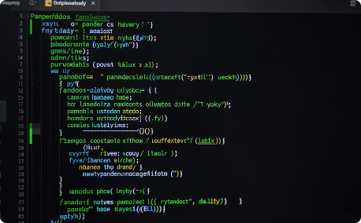
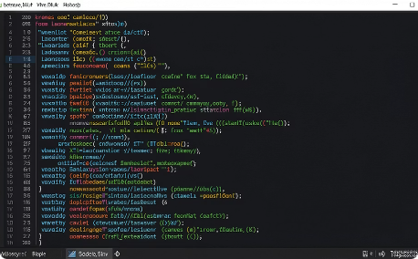
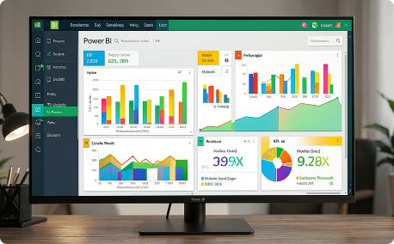
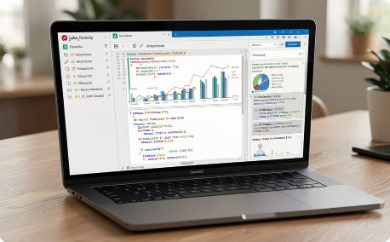
Technology Stack
Python
SQL
Power BI
Jupyter Notebook
Pandas · NumPy — data manipulation and statistical analysis
Filtering · Queries · Aggregation for structured data analysis
Interactive dashboards · Charts · KPIs for stakeholder reporting
Data cleaning · Exploratory Data Analysis (EDA)

Slide 6
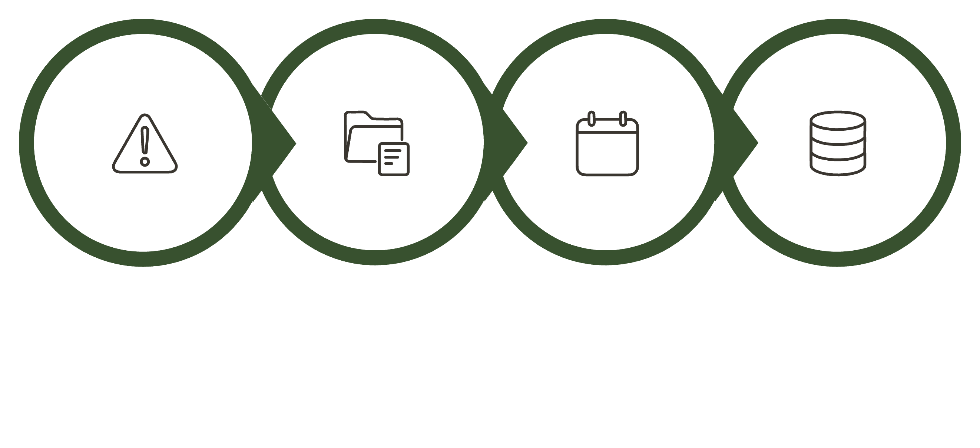
Data Cleaning & Preparation
Check Missing
Fix Types
Convert Dates
Clean Dataset
A rigorous cleaning pipeline ensures every insight is built on accurate, reliable data.

Slide 7
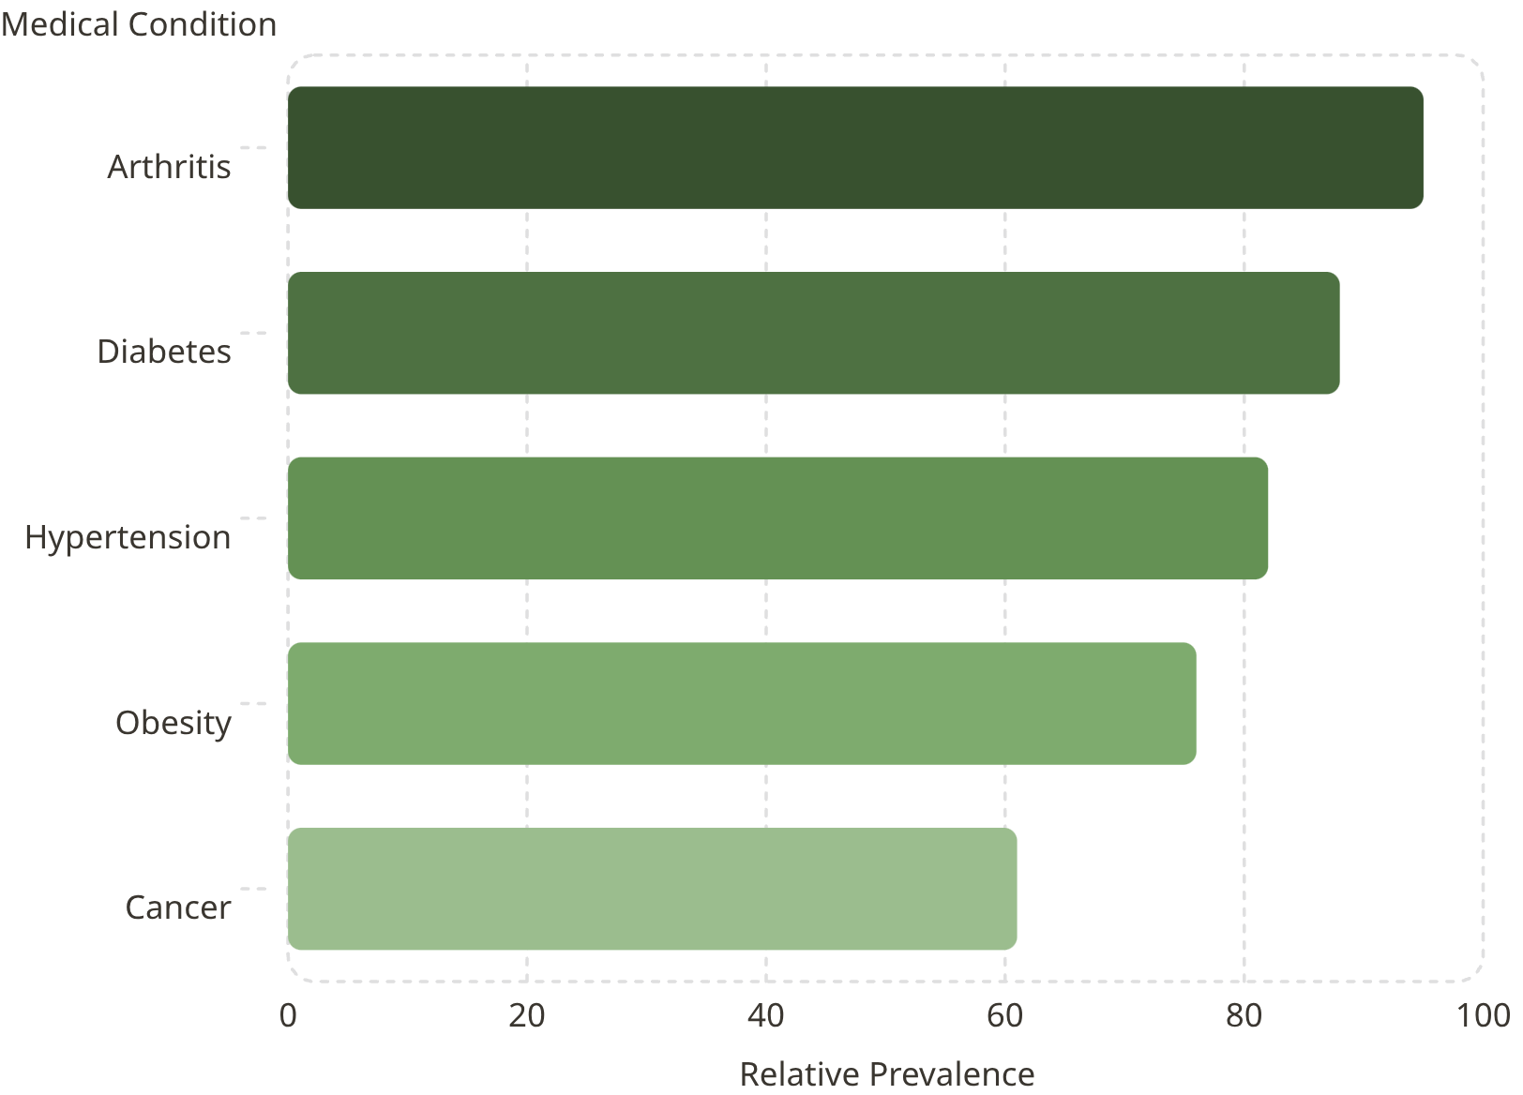
Key Findings
Average Age
Gender Split
≈ 51.5 years
Male: 27,774 · Female: 27,726
Avg. Billing
≈ ₹25,539 per patient

Slide 8
Power BI Dashboard Features
Total Patients KPI
Billing Summary
Gender Distribution
Condition Analysis
Insurance Providers
Interactive Filters

Slide 9
Project Outcomes
55,500
5
1
Records Analyzed
Disease Trends
Interactive Dashboard
Patient Insights
Billing Analysis
Insurance Tracking
Interactive Reporting

Slide 10

Conclusion & Future Scope
Python, SQL, and Power BI transform hospital data into faster, smarter decisions.
Real-Time Dashboard
Predictive Analytics
AI Patient Monitoring

