Slide 1
Business Intelligence
(Bank Marketing Dataset)
Made By :
1) Ruturaj Kotwal (509)
2) Mahesh Kendre (514)

Slide 2
Case Study
Best strategies to improve for the next marketing campaign.
How can the financial institution have a greater effectiveness for future marketing campaigns?
In order to answer this, we have to analyze the last marketing campaign the bank performed.
Our goal is identifying the patterns that will help us find conclusions in order to develop future strategies.

Slide 3
Bank Marketing Data-Set
The data is related with direct marketing campaigns of a Portuguese banking institution.
The marketing campaigns were based on phone calls.
Often, more than one contact to the same client was required, in order to assess if the product (bank term deposit) would be ('yes') or not ('no') subscribed.

Slide 4
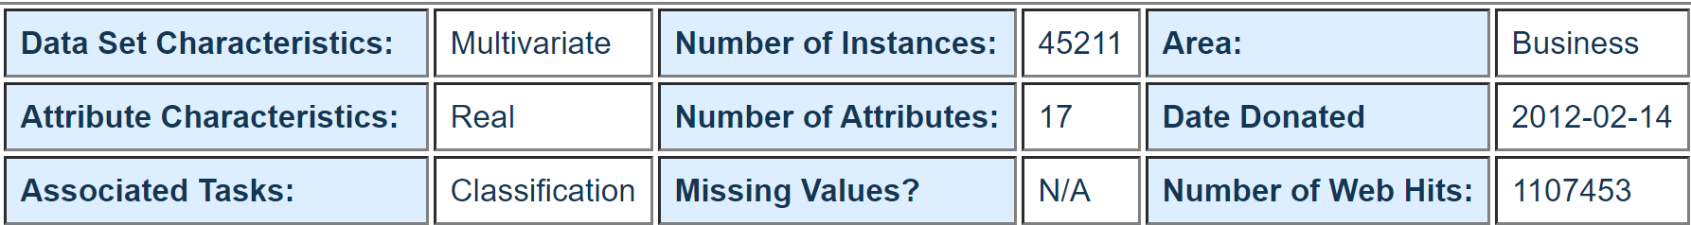
Source :
[Moro et al., 2014] S. Moro, P. Cortez and P. Rita. A Data-Driven Approach to Predict the Success of Bank Telemarketing. Decision Support Systems, Elsevier, 62:22-31, June 2014

Slide 5
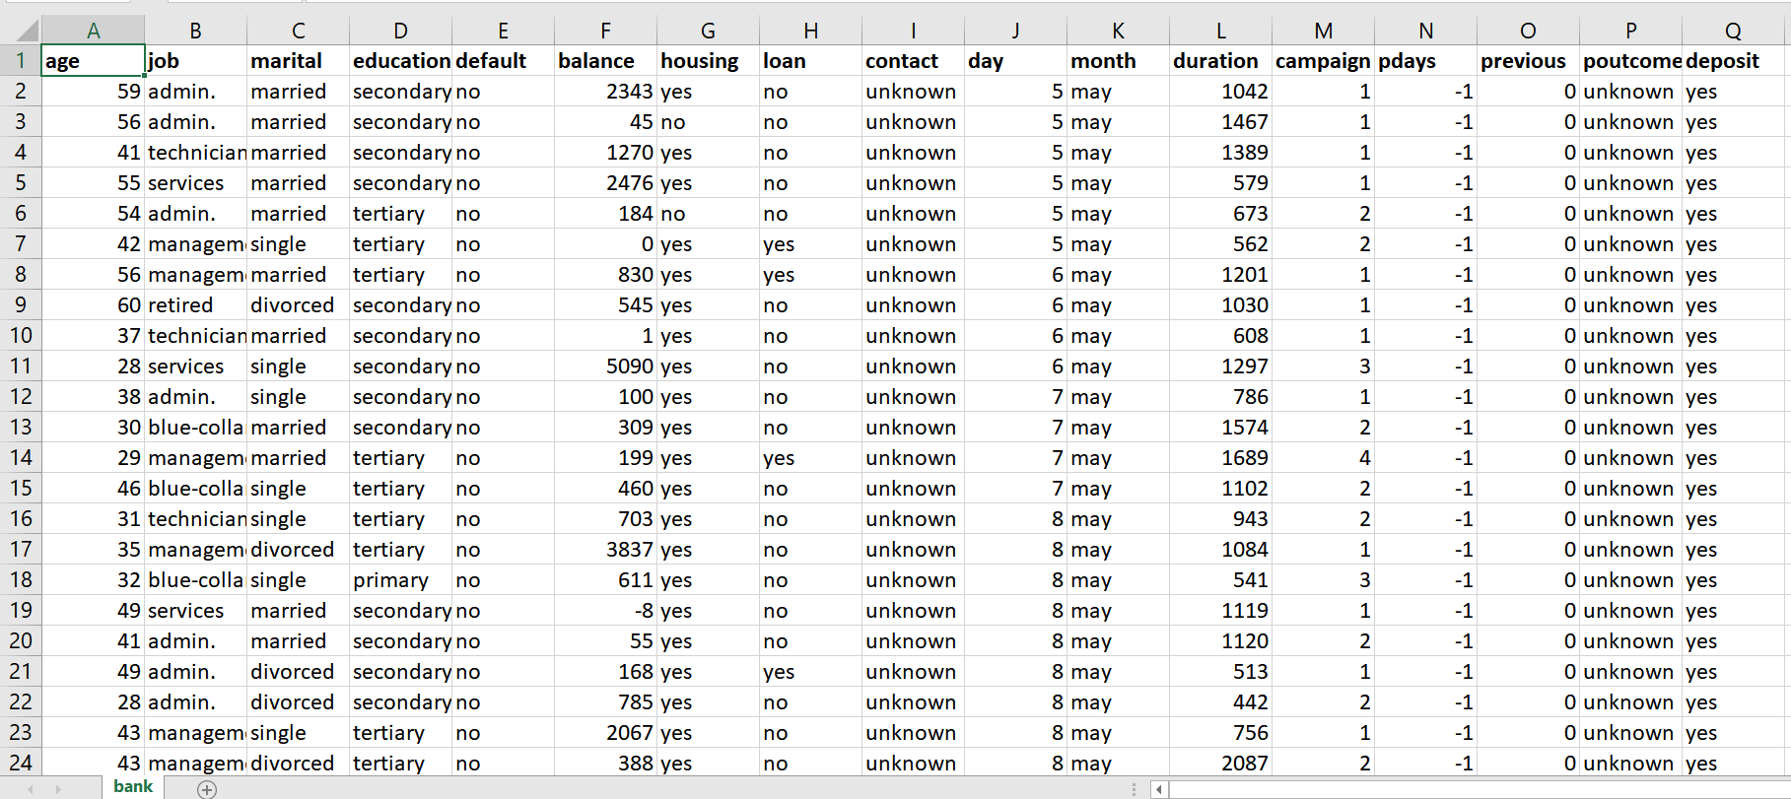

Slide 6
About the Data-Set Attributes
Numeric : Age, Balance, Day, Duration(in seconds), Campaign No, Pdays, Previous
Categorical : Job Profile, Marital Status, Educational Qualification, Mode of Contact, Month, Outcome of Campaign
Binary : Defaulter Status, Housing, Loan, Deposit

Slide 7

R is a language and environment for statistical computing and graphics.
R provides a wide variety of statistical (linear and nonlinear modelling, classical statistical tests, time-series analysis, classification, clustering, …) and graphical techniques, and is highly extensible.
One of R’s strengths is the ease with which well-designed publication-quality plots can be produced, including mathematical symbols and formulae where needed.

Slide 8
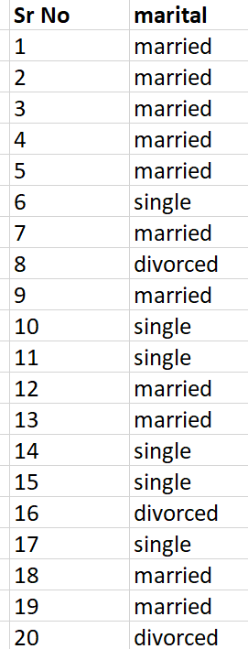
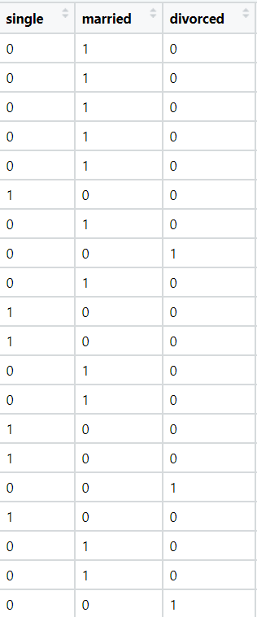
Cleaning the Data

Slide 9
K-means Clustering
Clustering can be defined as the task of identifying subgroups in the data such that data points in the same subgroup (cluster) are very similar while data points in different clusters are very different.
Clustering is used in market segmentation; where we try to find customers that are similar to each other whether in terms of behaviors or attributes.
K-means algorithm is an iterative algorithm that tries to partition the dataset into 'K' pre-defined distinct non-overlapping subgroups (clusters) where each data point belongs to only one group.

Slide 10
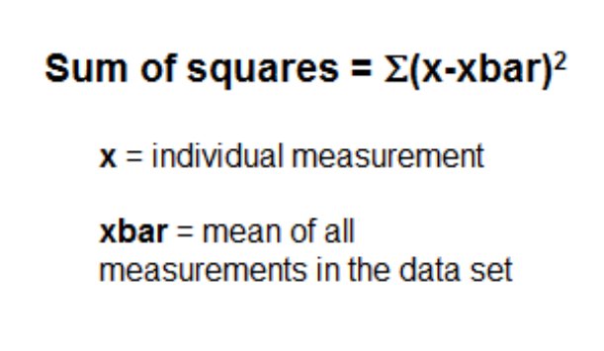
Optimal value of 'K'
Sum of Squares :
In statistics, the sum of squares measures how far individual measurements are from the mean.

Slide 11
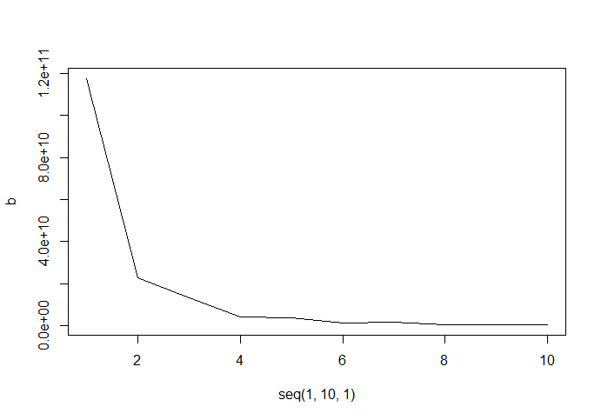
The Elbow Method

Slide 12
Observations
Size of each Cluster :
Cluster 1 = 8834, Cluster 2 = 364, Cluster 3 = 1918, Cluster 4 = 46
Majority Age Group :
30 to 60 years
Majority Job Profiles :
Management, Administrative, Blue-Collar Jobs, Technicians
Majority Marital Status :
Married
Most active time of Year:
February, May through August, November

Slide 13
Conclusions
An Ideal future Customer's traits :
Age should be between 30 to 60 years.
Job profile should be Management / Technician.
Marital status should be Married.
The applicant should have completed Tertiary level of Education.
He should not be defaulter & loans should be minimal.
Preferred mode of communication should be Cellular and must occur largely in mid-year(May to August).

Slide 14
Thank You !!

