Slide 1
Sparse Autoencoder
Online Shopping Behaviour Analysis
A BI-ready data story from hidden behaviour features to customer segments and commercial actions
12,330
15.47%
4
website sessions
sessions purchased
hidden behaviour segments
Prepared from the sparse autoencoder notebook
Sparse Autoencoder - Online Shopping Behaviour Analysis
01

Slide 2
Executive summary
Sparse bottleneck features turn raw web sessions into actionable behaviour segments.
Headline
The sparse autoencoder did not beat the normal model on reconstruction accuracy, but it created useful hidden features that revealed different purchase behaviours.
32.26%
47.17%
Segment 2 purchase rate - strong practical opportunity
Segment 4 purchase rate - rare high-value behaviour
0.0349
1.7627
Segment 2 is the most actionable group: high purchase rate plus useful volume.
Segment 4 is a small, unusual, high-converting group worth deeper investigation.
Segment 3 represents the largest common browsing pattern, but converts below Segment 2.
Segment 1 looks like low-intent behaviour with very weak purchase performance.
Normal AE average test error
Sparse AE average bottleneck activation
Business takeaway: use Segment 2 for campaign prioritisation; investigate Segment 4 as a rare high-value pattern before scaling decisions.
Sparse Autoencoder - Online Shopping Behaviour Analysis
02

Slide 3
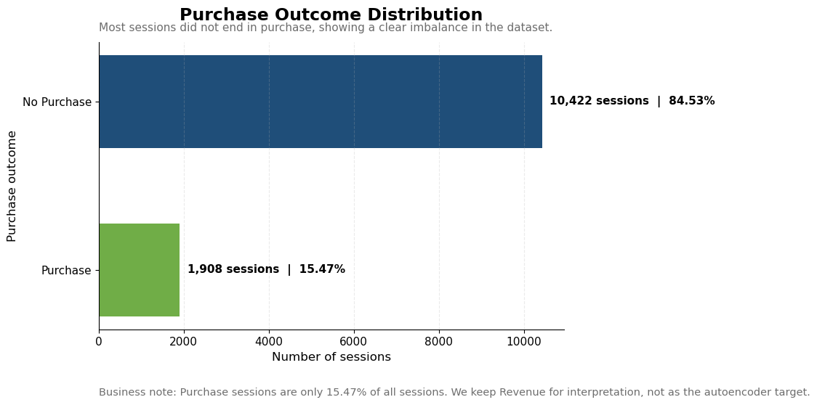
Data landscape: most sessions do not convert
The purchase imbalance is expected in e-commerce and becomes important for interpretation.
84.53%
15.47%
No purchase sessions
Purchase sessions
18
28
original columns
processed model inputs
Revenue was used for interpretation only. The autoencoder learned by reconstructing session behaviour features, not by predicting purchase directly.
Sparse Autoencoder - Online Shopping Behaviour Analysis
03

Slide 4
Method: compress behaviour, then explain segments
The sparse autoencoder acts as a feature-learning layer for marketing analysis.
Workflow
1
2
3
4
5
6
Load sessions
Preprocess
Train models
Extract bottleneck
Cluster
Interpret
12,330 online shopping sessions
Scale numeric features and encode categories
Normal AE vs Sparse AE
12 hidden behaviour values
4 hidden behaviour segments
Purchase rate, volume, error and actions
Sparse autoencoder idea
A normal autoencoder reconstructs data freely. A sparse autoencoder adds a small penalty to keep bottleneck activity lower, creating simpler hidden features.
Notebook question: Can a sparse autoencoder create compact behaviour features that support segmentation, purchase analysis and anomaly-style investigation?
Sparse Autoencoder - Online Shopping Behaviour Analysis
04

Slide 5
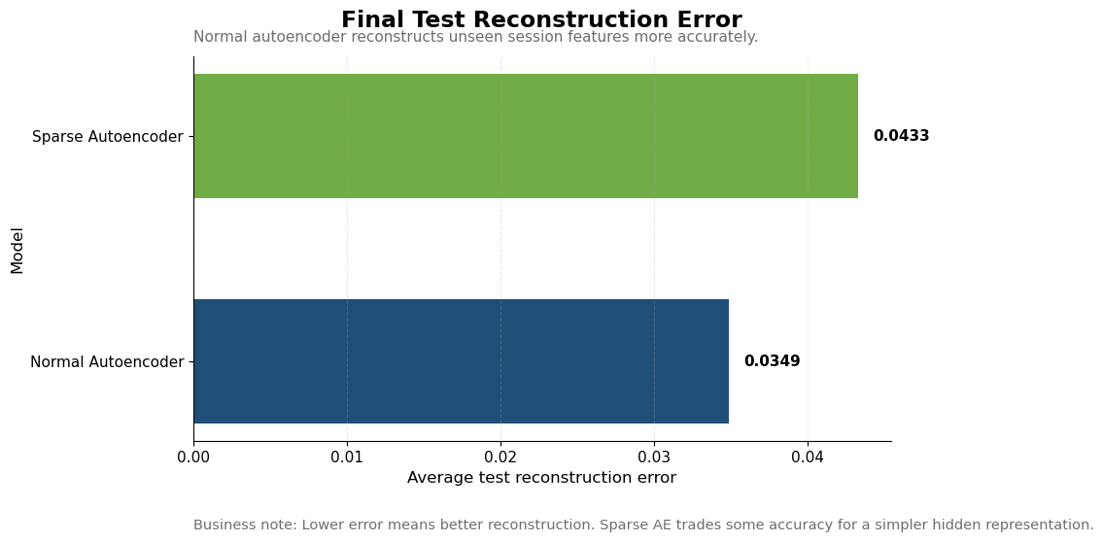
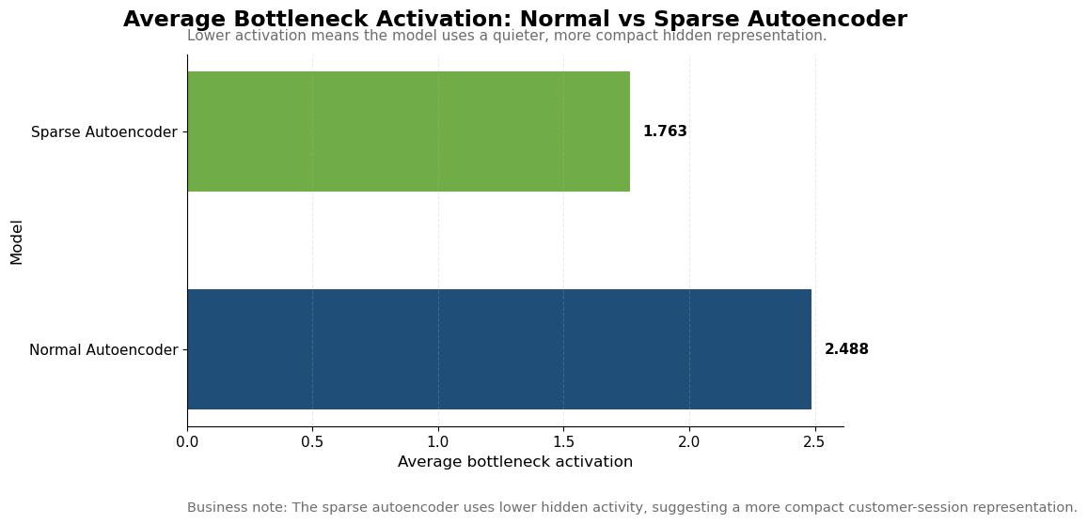
Model trade-off: accuracy vs compactness
Normal AE reconstructs better; Sparse AE creates quieter hidden features.
Result: the sparse model sacrifices some reconstruction accuracy but reduces average bottleneck activation from 2.49 to 1.76.
Sparse Autoencoder - Online Shopping Behaviour Analysis
05

Slide 6
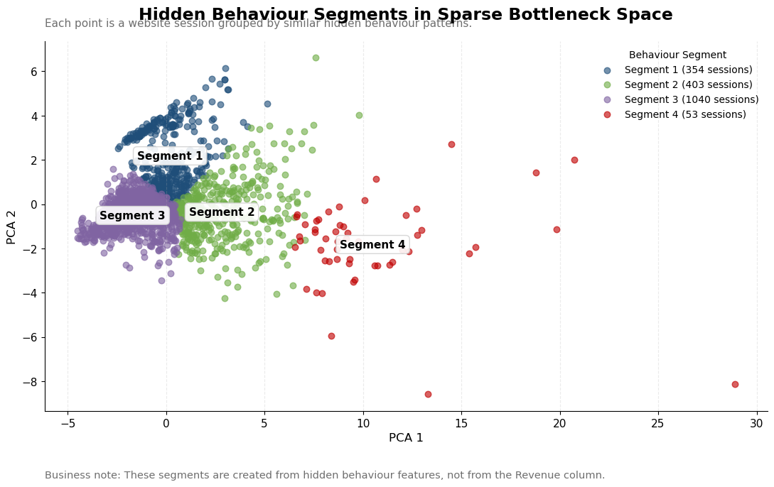
Hidden behaviour space: four segments emerge
KMeans grouped sessions using the sparse bottleneck features, not using Revenue.
Segment
Sessions
Meaning
1
354
low-intent / weak purchase
2
403
high-value opportunity
3
1,040
common browsing
4
53
rare high-value
Segment 3 is the largest common behaviour group; Segment 4 is tiny and visually separated, suggesting unusual behaviour.
Sparse Autoencoder - Online Shopping Behaviour Analysis
06

Slide 7
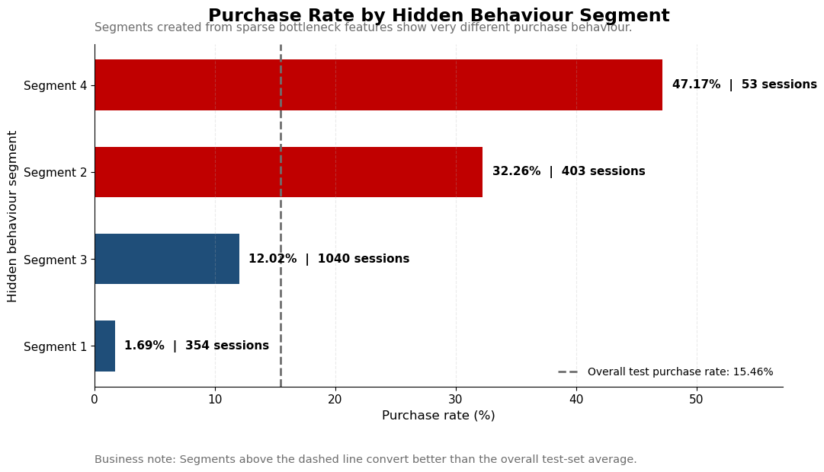
Business impact: purchase rate differs sharply by segment
The hidden segments are commercially meaningful, not just technical clusters.
Segment
Sessions
Purchase rate
Error
1
354
1.70%
0.028
2
403
32.26%
0.057
3
1,040
12.02%
0.039
4
53
47.17%
0.133
Segment 2 is the strongest practical segment: high purchase rate with meaningful session volume. Segment 4 converts highest, but is too small to scale blindly.
Sparse Autoencoder - Online Shopping Behaviour Analysis
07

Slide 8
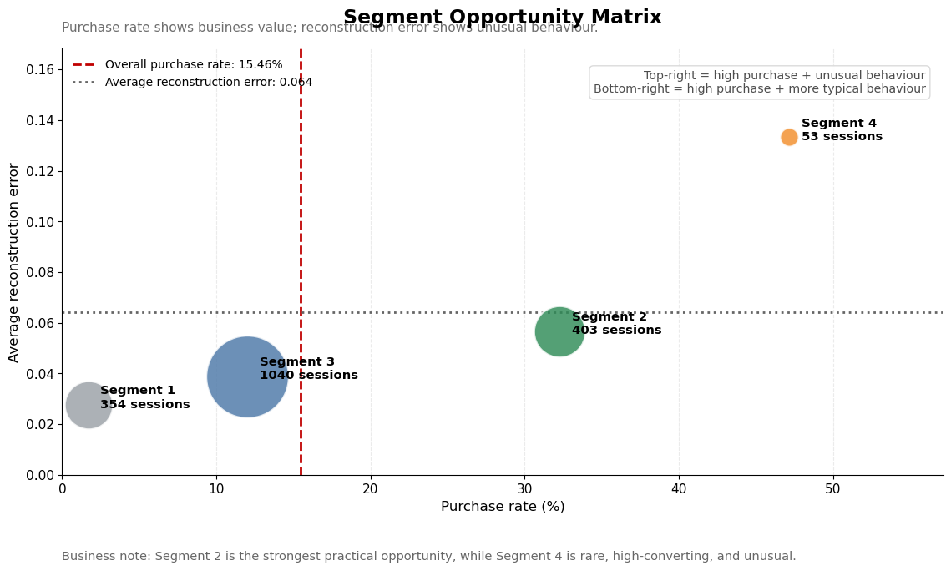
Opportunity matrix: value vs unusual behaviour
Purchase rate shows business value; reconstruction error signals unusual behaviour.
Segment 2: best practical opportunity for campaign focus.
Segment 4: rare, high-converting, unusual behaviour - investigate before scaling.
Segment 3: largest common browsing group - improve journey and conversion nudges.
Segment 1: low conversion - use cautious retargeting or exclude from high-cost campaigns.
Data story: sparse features reveal both commercial opportunity and behavioural rarity.
Sparse Autoencoder - Online Shopping Behaviour Analysis
08

Slide 9
Recommended actions by segment
Turn model outputs into practical marketing decisions.
Segment
Observed signal
Interpretation
Recommended action
Segment 1
Low purchase rate
Low-intent sessions
Limit high-cost targeting; test engagement improvement
Segment 2
High purchase + useful volume
Strongest practical opportunity
Prioritise conversion campaigns and remarketing
Segment 3
Largest group, moderate conversion
Common browsing behaviour
Optimise UX, product discovery and funnel nudges
Segment 4
Highest purchase + unusual
Rare high-value pattern
Investigate behaviour drivers before scaling
Priority: use Segment 2 for near-term campaign action; profile Segment 4 deeply because it is rare, high-converting and harder to reconstruct.
Sparse Autoencoder - Online Shopping Behaviour Analysis
09

Slide 10
Final takeaway and next steps
Sparse autoencoders are useful when the goal is compact behaviour features, not pure reconstruction.
Final takeaway
Next steps
The sparse autoencoder created hidden behaviour features that helped separate low-intent, common browsing, high-opportunity and rare high-value session patterns.
Profile each segment using original session columns.
Test stronger L1 values to increase sparsity.
Use bottleneck features in a purchase-prediction model.
Track segment performance over time in a BI dashboard.
Use reconstruction error for anomaly-style investigation.
What the notebook proved
What it means for business
Normal AE reconstructs better
Use when reconstruction accuracy matters most
Sparse AE creates lower bottleneck activity
Use when compact behaviour features are valuable
Segments differ in purchase rate and error
Use for segmentation, opportunity sizing and anomaly-style analysis
Sparse Autoencoder - Online Shopping Behaviour Analysis
10

