Slide 1
SMART CROP ADVISORY SYSTEM
Machine Learning Based Crop Recommendation, Yield Prediction & Profit Estimation
Domain: Artificial Intelligence in Precision Agriculture & Agribusiness Economics
Notes:
Welcome to the Smart Crop Advisory System presentation. Our system unifies multi-class crop classification, continuous yield forecasting, and real-world Mandi prices with CACP cultivation costs into a complete decision engine.

Slide 2
SMART CROP ADVISORY SYSTEM
Problem Statement & Motivation
Key Agricultural Challenges
• Traditional Decision Making: Over 50% of farmers rely on intuition or generational habit rather than empirical soil data.
• Soil-Crop Mismatch: Planting crops unsuited to nitrogen or potassium levels leads to low productivity and fertilizer wastage.
• Monsoon & Climate Shifts: High inter-annual rainfall and temperature variability increases crop vulnerability.
• High Input Costs: Fertilizer, seed, and machinery expenses have climbed, making uninformed sowing financially perilous.
The Core Research Gap
• Commercial Disconnect: Prior academic tools only output a biological crop label.
• No Profitability Forecast: They fail to answer if the recommended crop will generate a profit.
• Disjointed Information: Mandi prices, cultivation costs, and soil ML models exist in isolated silos.
• Our Solution: A unified engine integrating biological suitability with commercial viability.

Slide 3
SMART CROP ADVISORY SYSTEM
System Objectives & Scope
1. Crop Recommendation
• Train Random Forest & XGBoost classifiers.
• Predict best crop across 22 classes using 7 NPK and weather parameters.
• Achieve >99% test accuracy.
2. Yield Prediction
• Train non-linear regressors across 198k historical records.
• Predict harvest in kg/ha, quintals/ha, and quintals/acre.
• Incorporate seasonal and soil effects.
3. Economics Integration
• Cross-reference 122 APMC Mandi commodity rates.
• Integrate CACP C2 comprehensive cultivation costs across 20 Indian states.
• Break down operational expenses.
4. Farm Advisory Platform
• Compute Gross Revenue, Net Profit, ROI %, and break-even points.
• Build interactive Streamlit web dashboard.
• Support scenario simulation and CSV exports.

Slide 4
SMART CROP ADVISORY SYSTEM
End-to-End System Architecture
Pipeline Decision Flow
• Step 1: Farmer Inputs -> Soil Nutrients (NPK, pH), Weather (Temp, Rain, Humidity), Location & Farm Area.
• Step 2: Crop Recommendation Classifier -> Random Forest predicts primary crop + top-3 alternatives with confidence.
• Step 3: Canonical Mapping & Normalization -> Resolves crop string across Yield, Price, and Cost datasets.
• Step 4: Yield Prediction Regressor -> XGBoost regressor estimates expected harvest (kg/ha and quintals/acre).
• Step 5: Mandi Price Engine -> Official modal market prices and MSP rates retrieved from 122-crop database.
• Step 6: CACP Cost Engine -> Comprehensive C2 state cultivation costs retrieved from 3,880 survey records.
• Step 7: Economic Engine -> Harvest production, gross revenue, cultivation costs, net profit, and ROI % calculated.
• Step 8: Interactive Streamlit UI -> Metric cards, scenario simulations, and diagnostic reports presented.

Slide 5
SMART CROP ADVISORY SYSTEM
Agricultural Datasets (100% Real Data)
Crop Recommendation Data
• File: Crop_recommendation.csv
• Observations: 2,200 rows (100 per class)
• Features: N, P, K, Temperature, Humidity, pH, Rainfall
• Target: 22 major field and horticultural crops
Historical Crop Yield Data
• File: crop_yield_dataset.csv
• Observations: 198,369 records (1966-2017)
• Geographic: 309 districts across 20 Indian states
• Features: 9 environmental/fertilizer + 4 categorical
Mandi Market Prices Data
• File: india-crop-prices.csv
• Commodities: 122 crops from Agmarknet
• Attributes: Modal price, Min, Max, MSP
• Unit: Rs / Quintal (1 Quintal = 100 kg)
Cost of Cultivation Data
• File: cost-of-cultivation.csv
• Records: 3,880 state-level agricultural surveys
• Authority: Commission for Agricultural Costs & Prices (CACP)
• Features: Comprehensive C2 cost, seed, labor, fertilizer

Slide 6
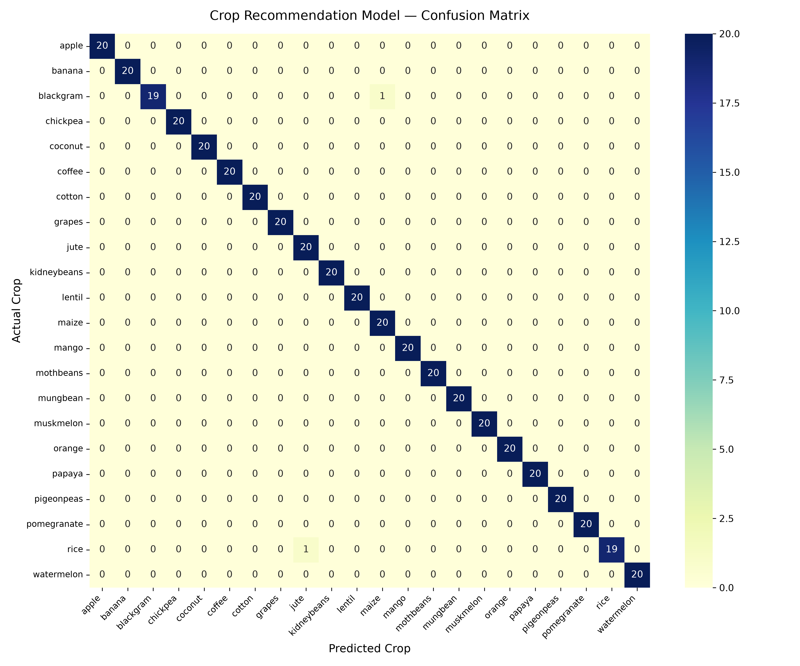
SMART CROP ADVISORY SYSTEM
Crop Recommendation: 99.55% Accuracy
Classifier Comparison
• Task: Multi-class classification (22 crop classes)
• Random Forest: Accuracy = 99.55% | F1 = 0.9955 (WINNER)
• XGBoost Classifier: Accuracy = 99.09% | F1 = 0.9909
• Key Feature Drivers: Humidity (22.8%), Rainfall (21.4%), Phosphorus (16.2%), Potassium (15.8%), Nitrogen (11.7%).
• Stratified Split: 80% train, 20% test partition.
• Artifact: Saved to models/crop_recommendation_model.pkl

Slide 7
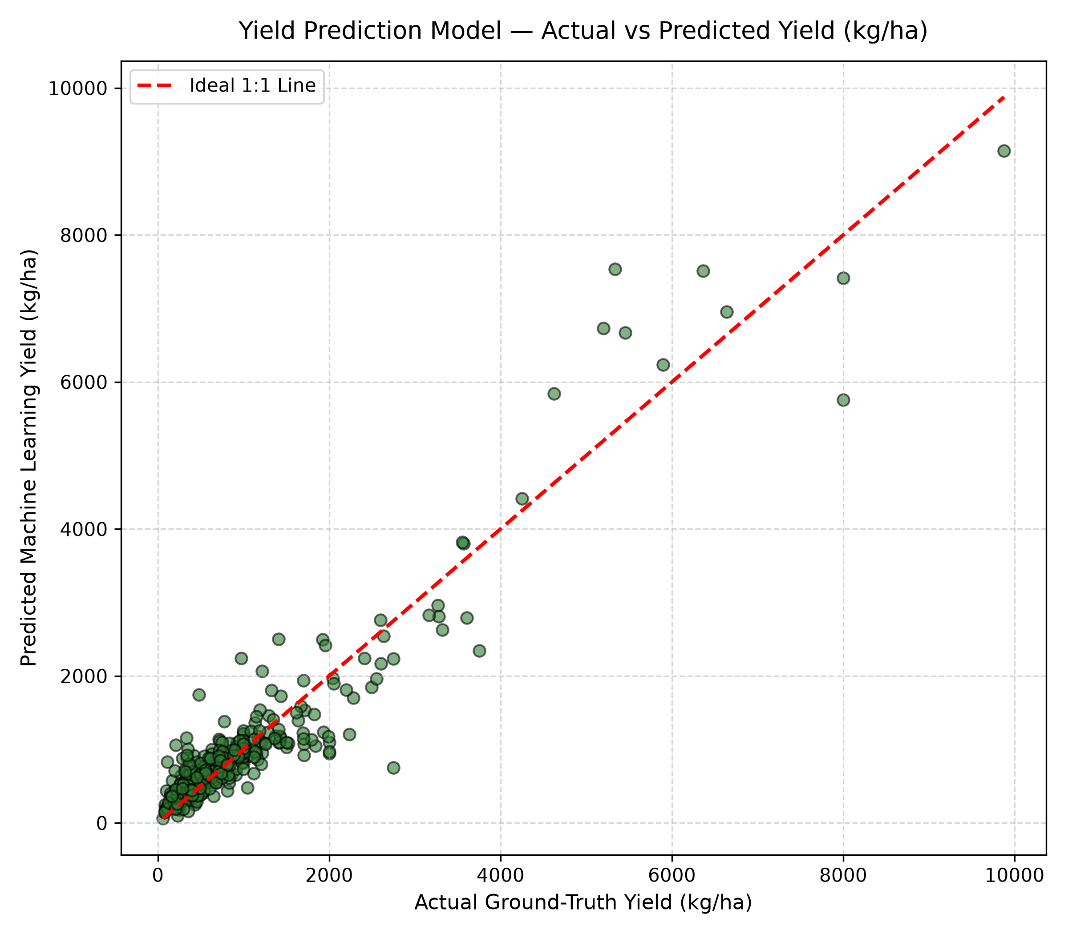
SMART CROP ADVISORY SYSTEM
Crop Yield Prediction: R² = 0.8801
Regression Modeling
• Task: Continuous non-linear yield regression (kg/ha)
• XGBoost Regressor: R² = 0.8801 | RMSE = 516.15 kg/ha (WINNER)
• Random Forest Regressor: R² = 0.8757 | RMSE = 525.41 kg/ha
• Pipeline: ColumnTransformer with OneHotEncoder for State, Crop, Season, Soil Type + StandardScaler for continuous features.
• Predictors: Fertilizer, Rainfall, Crop identity, Soil classification, and Potassium.
• Artifact: Saved to models/yield_prediction_model.pkl

Slide 8
SMART CROP ADVISORY SYSTEM
Agricultural Economics & Calculations
Economic Formulations
• Area Normalization: 1 Hectare = 2.47105 Acres
• Weight Normalization: 1 Quintal = 100 kg
• Total Production = (Yield in kg/ha * Area in ha) / 100
• Gross Revenue = Production (Quintals) * Mandi Price (Rs/Q)
• Cultivation Cost = Area (ha) * C2 Comprehensive Cost (Rs/ha)
• Net Profit = Gross Revenue - Total Cultivation Cost
• ROI (%) = (Net Profit / Total Cost) * 100
• Break-Even Yield = Cost per Hectare / Price per kg
• Break-Even Price = Total Cost / Total Production (Quintals)
Verification Test Case (Sample Run)
• Location: Maharashtra, Vertisols (Black Soil), Kharif Season
• Inputs: N=90, P=42, K=43, Temp=21C, Rain=202mm, Hum=82%, pH=6.5
• Farm Area: 2.5 Acres (1.012 Hectares)
• --------------------------------------------------
• Recommended Crop: Rice (90.16% Confidence)
• Predicted Yield: 2,113.05 kg/ha (8.55 Quintals/Acre)
• Mandi Market Price: Rs 3,680 / Quintal
• C2 Cultivation Cost: Rs 56,357 / ha (Rs 22,806 / Acre)
• Total Production: 21.38 Quintals (2,137.8 kg)
• Gross Revenue: Rs 78,678
• Total Cost: Rs 57,017
• Estimated Net Profit: Rs 21,660 (ROI: 37.99%)

Slide 9
SMART CROP ADVISORY SYSTEM
Streamlit Web Application Features
Interactive UI Highlights
• Agro-Climatic Presets: Gangetic Plains, Deccan Plateau, Semi-Arid Rajasthan, and Coastal Humid for rapid demonstration.
• 6 Primary KPI Metric Cards: Recommended Crop, Predicted Yield, Market Price, Cultivation Cost, Total Revenue, Net Profit.
• Dynamic Scenario Simulation: Sliders allowing farmers to simulate price swings (+/- 40%) and yield shifts to evaluate weather/market risk.
• Theme-Adaptive Design: Dark mode and light mode native containers with zero white artifacts.
• Report Download: Generates and downloads full custom advisory report as CSV.
Software Architecture
• Modular Clean Code in src/:
- src/crop_mapping.py: Canonical normalization
- src/price_lookup.py: Mandi modal prices & MSP
- src/cost_lookup.py: CACP state C2 costs
- src/profit_calculation.py: Unit conversions & INR math
- src/preprocessing.py: Pipeline transformers
- src/crop_recommendation.py: Inference class
- src/yield_prediction.py: Inference class
• Automated Pytest Suite: 15/15 unit & integration tests passed.

Slide 10
CONCLUSION & FUTURE ENHANCEMENTS
• Summary: Developed a complete, production-grade Smart Crop Advisory System integrating Machine Learning with Agribusiness Economics.
• High Performance: 99.55% classification accuracy for Crop Recommendation; R2 = 0.8801 for Continuous Yield Prediction.
• Practical Value: Delivers transparent revenue, cultivation expense, and net profit projections in Indian currency.
• Future Roadmap 1: IoT soil sensor telemetry for automated real-time NPK and moisture feeds.
• Future Roadmap 2: Sentinel-2 satellite NDVI imagery integration for crop growth monitoring.
• Future Roadmap 3: Vernacular regional speech interface for Indian farmers.

