Slide 1
JAVA
DOLAR RUTVIK

Slide 2
Introduction to Java
Java is one of the most popular programming languages because it is used in various tech fields like app development, web development, client-server applications, etc.
Java is an object-oriented programming language developed by Sun Microsystems of the USA in 1991.
It was originally called Oak by James Goslin. He was one of the inventors of Java.
Java = Purely Object-Oriented.

Slide 3
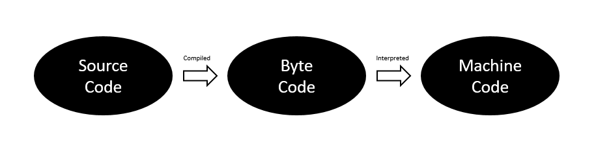
How Java Works?
The source code in Java is first compiled into the bytecode.
Then the Java Virtual Machine(JVM) compiles the bytecode to the machine code.
Java Installation:
JDK stands for Java Development Kit. It contains Java Virtual Machine(JVM) and Java Runtime Environment(JRE).
JDK – Java Development Kit = Collection of tools used for developing and running java programs.
JRE – Java Runtime Environment = Helps in executing programs developed in JAVA.

Slide 4
Basic Structure of a Java Program:
package com.company; // Groups classes
public class Main{ // Entrypoint into the application
public static void main(String[]args){
System.out.println(“Hello World”);
}
}
Keyword
Modifier
Class name
Purameters
Keyword
Functions
Printing Statement
String
MR. DOLAR RUTVIK

Slide 5
Working of the "Hello World" program shown above :
package com.company :
  Packages are used to group the related classes.
  The "Package" keyword is used to create packages in Java.
  Here, com.company is the name of our package.
public class Main :
  In Java, every program must contain a class.
  The filename and name of the class should be the same.
  Here, we've created a class named "Main".
  It is the entry point to the application.
public static void main(String[]args){..} :
  This is the main() method of our Java program.
  Every Java program must contain the main() method.
System.out.println("Hello World"):
  The above code is used to display the output on the screen.
  Anything passed inside the inverted commas is printed on the screen as plain text.

Slide 6
Naming Conventions
For classes, we use Pascal Convention. The first and Subsequent characters from a word are capital letters (uppercase).
Example: Main, MyScanner, MyEmployee, CodeWithHarry
For functions and variables, we use camelCaseConvention. Here the first
character is lowercase, and the subsequent characters are uppercase like
Ex: myScanner, myMarks, CodeWithHarry

Slide 7
Variables
just like we have some rules that we follow to speak English (the grammar),
we have some rules to follow while writing a Java program. This set of these rules
is called syntax. It’s like Vocabulary and Grammar of Java.
Variables
A variable is a container that stores a value.
This value can be changed during the execution of the program.
Example: int number = 8; (Here, int is a data type, the number is the variable name, and 8 is the value it contains/stores).
Rules for declaring a variable name
We can choose a name while declaring a Java variable if the following rules are followed:
Must not begin with a digit. (E.g., 1arry is an invalid variable)
Name is case sensitive. (Harry and harry are different)
Should not be a keyword (like Void).
White space is not allowed. (int Code With Harry is invalid)
Can contain alphabets, $character, _character, and digits if the other conditions are met.

Slide 8
Data Types
Data types in Java fall under the following categories
Primitive Data Types (Intrinsic)
Non-Primitive Data Types (Derived)
Primitive Data Types
Java is statically typed, i.e., variables must be declared before use. Java supports 8 primitive data types:
Data Type | Size | Value Range
1. Byte | 1 byte | -128 to 127
2. short | 1 byte | -32,768 to 32,767
3. int | 2 byte | -2,147,483,648 to 2,147,483,647
4. float | 4 byte | 3.40282347 x 10³⁸ to 1.40239846 x 10⁻⁴⁵
5. long | 8 byte | -9,223,372,036,854,775,808 to 9,223,372,036,854,775,807
6. double | 8 byte | 1.7976931348623157 x 10³⁰⁸, 4.9406564584124654 x 10⁻³²⁴
7. char | 2 byte | 0 to 65,535
8. boolean | Depends on JVM | True or False

Slide 9
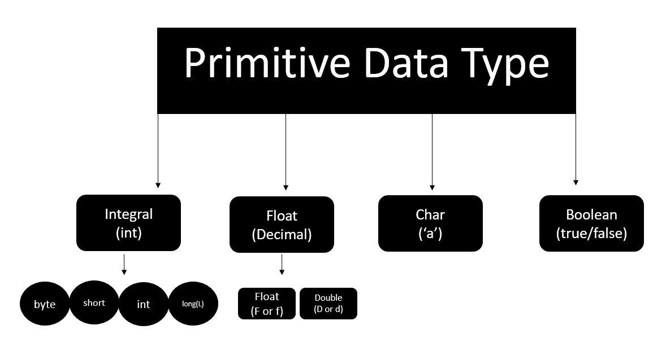
How to choose data types for our variables
In order to choose the data type, we first need to find the type of data we want to store. After
that, we need to analyze the min & max value we might use.

Slide 10
Java Tutorial: Literals in Java
Literals
A constant value that can be assigned to the variable is called a literal.
101 – Integer literal
10.1f – float literal
10.1 – double literal (default type for decimals)
‘A’ – character literal
true – Boolean literal
“Harry” – String literal

Slide 11
// Literals
package com.company;
public class CWH_04_literals {
public static void main(String[] args) {
byte age = 34;
int age2 = 56;
short age3 = 87;
long ageDino = 5666666666666L;
char ch = 'A';
float f1 = 5.6f;
double d1 = 4.66;
boolean a = true;
System.out.print(age);
String str = "Harry";
System.out.println(str);
}
}
Keywords
Words that are reserved and used by the Java compiler. They cannot be used as an Identifier.
{You can visit docs.oracle.com for a comprehensive list}

Slide 12
Getting User Input in Java
Reading data from the Keyboard :
Scanner class of java.util package is used to take input from the user's keyboard.The Scanner class has many methods for taking input from the user depending upon the type of input. To use any of the methods of the Scanner class, first, we need to create an object of the Scanner class as shown in the below example :
import java.util.Scanner; // Importing the Scanner class
Scanner sc = new Scanner(System.in); //Creating an object named "sc" of the Scanner class.
Taking an integer input from the keyboard :
Scanner S = new Scanner(System.in); //(Read from the keyboard)
int a = S.nextInt(); //(Method to read from the keyboard)

Slide 13
Getting User Input in Java
package com.company;
import java.util.Scanner;
public class CWH_05_TakingInpu {
public static void main(String[] args) {
System.out.println("Taking Input From the User");
Scanner sc = new Scanner(System.in);
// System.out.println("Enter number 1");
// int a = sc.nextInt();
// float a = sc.nextFloat();
// System.out.println("Enter number 2");
// int b = sc.nextInt();
// float b = sc.nextFloat();
// int sum = a +b;
// float sum = a +b;
// System.out.println("The sum of these numbers is");
// System.out.println(sum);
// boolean b1 = sc.hasNextInt();
// System.out.println(b1);
// String str = sc.next();
String str = sc.nextLine();
System.out.println(str);
}
}

Slide 14
Chapter 1- Practice Set
Write a program to sum three numbers in Java.
Write a program to calculate CGPA using marks of three subjects (out of 100)
Write a Java program that asks the user to enter his/her name and greets them with “Hello <name>, have a good day” text.
Write a Java program to convert Kilometers to miles.
Write a Java program to detect whether a number entered by the user is an integer or not.

Slide 15
Chapter 1- Practice Set | Java Practice Problems With Solution
package com.company;
import java.util.Scanner;
public class CWH_Ch1_PS {
public static void main(String[] args) {
// Question1
// int a = 4;
// int b = 17;
// int c =6;
// int sum = a + b+c;
// System.out.println(sum);
// Question2
// float subject1 = 45;
// float subject2 = 95;
// float subject3 = 48;
// float cgpa = (subject1 + subject2 +subject3)/30;
// System.out.println(cgpa);
// Question 3
// System.out.println("What is your name");
// Scanner sc = new Scanner(System.in);
// String name = sc.next();
// System.out.println("Hello " + name + " have a good day!");
// Question 5
System.out.println("Enter your number");
Scanner sc = new Scanner(System.in);
System.out.println(sc.hasNextInt());
}
}

Slide 16

Types of Operators
An operator is a symbol that the compiler to perform a specific operation on operands.
Example : a + b = c
In the above example, 'a' and 'b' are operands on which the '+' operator is applied.
Arithmetic Operators :
  Arithmetic operators are used to perform mathematical operations such as addition, division, etc on expressions.
  Arithmetic operators cannot work with Booleans.
  % operator can work on floats and doubles.
  Let x=7 and y=2
Operator | Description | Example
+ (Addition) | Used to add two numbers | x + y = 9
- (Subtraction) | Used to subtract the right-hand side value from the left-hand side value | x - y = 5
* (Multiplication) | Used to multiply two values. | x * y = 14
/ (Division) | Used to divide left-hand Value by right-hand value. | x / y = 3
% (Modulus) | Used to print the remainder after dividing the left-hand side value from the right-hand side value. | x % y = 1
++ (Increment) | Increases the value of operand by 1. | x++ = 8
-- (Decrement) | Decreases the value of operand by 1. | y-- = 1

Slide 17

Comparison Operators :
As the name suggests, these operators are used to compare two operands.
Let x=7 and y=2
Operator | Description | Example
== (Equal to) | Checks if two operands are equal. Returns a boolean value. | x == y --> False
!= (Not equal | Checks if two operands are not equal. Returns a boolean value. | x != y --> True
> (Greater than) | Checks if the left-hand side value is greater than the right-hand side value. Returns a boolean value. | x > y --> True
< (Less than) | Checks if the left-hand side value is smaller than the right-hand side value. Returns a boolean value. | x < y --> False
>=(Greater than or equal to) | Checks if the left-hand side value is greater than or equal to the right-hand side value. Returns a boolean value. | x >= y --> True
<= (Less than or equal to) | Checks if the left-hand side value is less than or equal to the right-hand side value. Returns a boolean value. | x <= y -->False

Slide 18

Logical Operators :
These operators determine the logic in an expression containing two or more values or variables.
Let x = 8 and y =2
&& (logical and) | Returns true if both operands are true. | x<y && x!=y --> True
|| (logical or) | Returns true if any of the operand is true. | x<y && x==y --> True
! (logical not) | Returns true if the result of the expression is false and vice-versa | !(x<y && x==y) --> False

Slide 19

Bitwise Operators :
  These operators perform the operations on every bit of a number.
  Let x =2 and y=3. So 2 in binary is 100, and 3 is 011.
Operator | Description | Example
& (bitwise and) | 1&1 =1, 0&1=0,1&0=0,1&1=1, 0&0 =0 | (A & B) = (100 & 011) = 000
| (bitwise or) | 1&0 =1, 0&1=1,1&1=1, 0&0=0 | (A | B) = (100 | 011 ) = 111
^ (bitwise XOR) | 1&0 =1, 0&1=1,1&1=0, 0&0=0 | (A ^ B) = (100 ^ 011 ) = 111
<< (left shift) | This operator moves the value left by the number of bits specified. | 13<<2 = 52(decimal)
>> (right shift) | This operator moves the value left by the number of bits specified. | 13>>2 = 3(decimal)
Precedence of operators
The operators are applied and evaluated based on precedence. For example, (+, -) has less precedence compared to (*, /). Hence * and / are evaluated first.
In case we like to change this order, we use parenthesis ().

Slide 20
Operators
// OPERATORS PROGRAM
package com.company;
public class CWH_Ch2_Operators {
public static void main(String[] args) {
// 1. Arithmetic Operators
int a = 4;
// int b = 6 % a; // Modulo Operator
// 4.8%1.1 --> Returns Decimal Remainder
// 2. Assignment Operators
int b = 9;
b *= 3;
System.out.println(b);
// 3. Comparison Operators
// System.out.println(64<6);
// 4. Logical Operators
// System.out.println(64>5 && 64>98);
System.out.println(64>5 || 64>98);
// 5. Bitwise Operators
System.out.println(2&3);
// 10
// 11
// ----
// 10
}
}

Slide 21
Java Tutorial: Associativity of Operators in Java
Associativity
Associativity tells the direction of the execution of operators. It can either be left to right or vice versa.
/ * -> L to R
+ - -> L to R
++, = -> R to L
Here is the precedence and associativity table which makes it easy for you to understand these topics better:

Slide 22
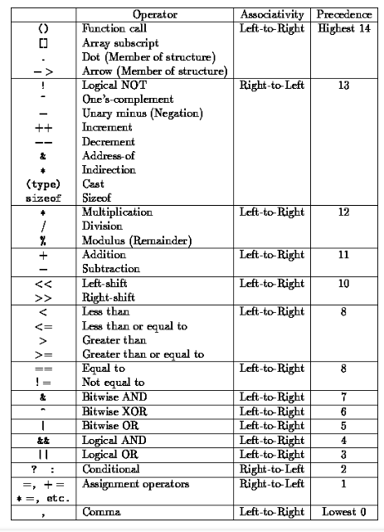
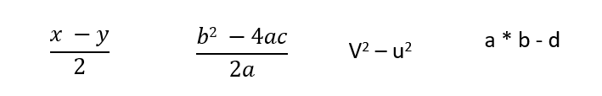
Quick Quiz:

Slide 23
package com.company;
public class cwh_09_ch2_op_pre {
public static void main(String[] args) {
// Precedence & Associativity
//int a = 6*5-34/2;
/*
Highest precedence goes to * and /. They are then evaluated on the basis
of left to right associativity
=30-34/2
=30-17
=13
*/
//int b = 60/5-34*2;
/*
= 12-34*2
=12-68
=-56
*/
//System.out.println(a);
//System.out.println(b);
// Quick Quiz
int x =6;
int y = 1;
// int k = x * y/2;
int b = 0;
int c = 0;
int a = 10;
int k = b*b - (4*a*c)/(2*a);
System.out.println(k);
}
}

Slide 24
Java Tutorial: Data Type of Expressions & Increment/Decrement Operators
Resulting data type after arithmetic operation
Result = byte + short -> integer
Result = short + integer -> integer
Result = long + float -> float
Result = integer + float -> float
Result = character + integer -> integer
Result = character + short -> integer
Result = long + double -> double
Result = float + double -> double
Quick Quiz: What will be the value of the following expression(x).
int y=7;
int x = ++y*8;
value of x?
char a = ‘B’;
a++; (a is not ‘C’)
Increment and Decrement operators
a++, ++a (Increment Operators)
a--, --a (Decrement Operators)
These will operate on all data types except Booleans.
Quick Quiz: Try increment and decrement operators on a Java variable
a++ -> first use the value and then increment
++a -> first increment the value then use it

Slide 25
package com.company;
public class cwh_10_resulting_data_type {
public static void main(String[] args) {
/* byte x = 5;
int y = 6;
short z = 8;
int a = y + z;
float b = 6.54f + x;
System.out.println(b); */
// Increment and Decrement Operators
int i = 56;
// int b = i++; // first b is assigned i (56) then i is incremented
int j = 67;
int c = ++j; // first j is incremented then c is assigned j (68)
System.out.println(i++);
System.out.println(i);
System.out.println(++i);
System.out.println(i);
int y = 7;
System.out.println( ++y *8);
char ch = 'a';
System.out.println(++ch);
}
}

Slide 26
Java Tutorial: Exercise 1 - Solutions + Shoutouts
Write a program to calculate the percentage of a given student in the CBSE board exam. His marks from 5 subjects must be taken as input from the keyboard. (Marks are out of 100)
package com.company;
import java.util.Scanner;
public class cwh_11_ex1_sol {
public static void main(String[] args) {
Scanner scan = new Scanner(System.in);
System.out.println("Enter your Physics marks : ");
int physics = scan.nextInt();
System.out.println("Enter your English marks : ");
int English = scan.nextInt();
System.out.println("Enter your Chemistry marks : ");
int chemistry = scan.nextInt();
System.out.println("Enter your Mathematics marks : ");
int mathematics = scan.nextInt();
System.out.println("Enter your Computer Science marks : ");
int computer = scan.nextInt();
float percentage = ((physics + English + chemistry + mathematics + computer)/500.0f)*100;
System.out.println("percentage : ");
System.out.println(percentage);
}
}

Slide 27
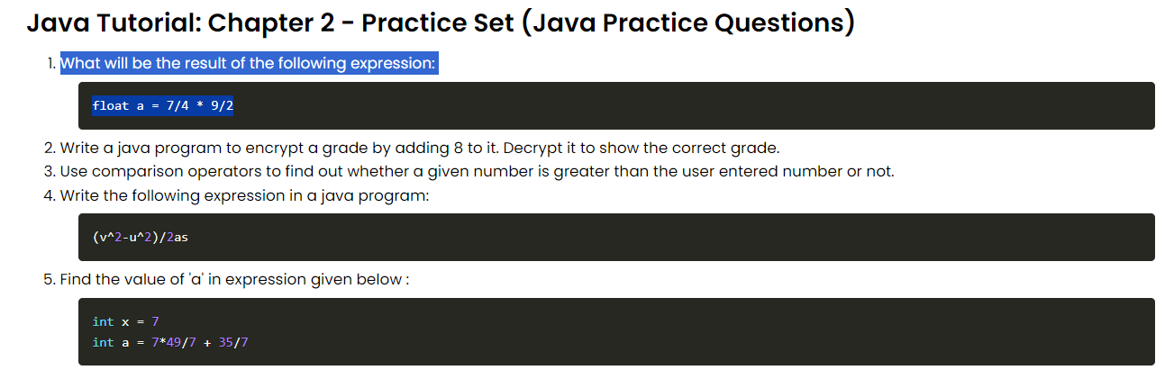
Java Tutorial: Chapter 2 - Practice Set (Java Practice Questions)

Slide 28
package com.company;
public class cwh_12_ps2_pr01 {
public static void main(String[] args) {
float a = 7/4.0f * 9/2.0f;
System.out.println(a);
}
}
package com.company;
public class cwh_12_ps2_pr02 {
public static void main(String[] args) {
char grade = 'B';
grade = (char)(grade + 8);
System.out.println(grade);
// Decrypting the grade
grade = (char)(grade - 8);
System.out.println(grade);
}
}

Slide 29
package com.company;
import java.util.Scanner;
public class cwh_12_ps2_pr_03 {
public static void main(String[] args) {
Scanner sc = new Scanner(System.in);
int a = sc.nextInt();
System.out.println(a>8);
System.out.println(7*49/7+35/7);
}
}
Java Tutorial: Introduction to Strings
A string is a sequence of characters.
Strings are objects that represent a char array. For example
char[] str = {'H','A','R','R','Y'};
String s = new String(str);
is same as :
String s = "Harry";
Strings are immutable and cannot be changed.
java.lang.String class is used to create a String object.
The string is a class but can be used as a data type.

Slide 30
String <String_name> = "<sequence_of_string>";
Example :
String str = "CodeWithHarry";
In the above example, str is a reference, and “CodeWithHarrt” is an object.
Different ways to create a string in Java :
In Java, strings can be created in two ways :
By using string literal
By using the new
Creating String using String literal :
String s1= "String literal"
We use double quotes("") to create string using string literal. Before creating a new string instance, JVM verifies if the same string is already present in the string pool or not. If it is already present, then JVM returns a reference to the pooled instance otherwise, a new string instance is created.

Slide 31
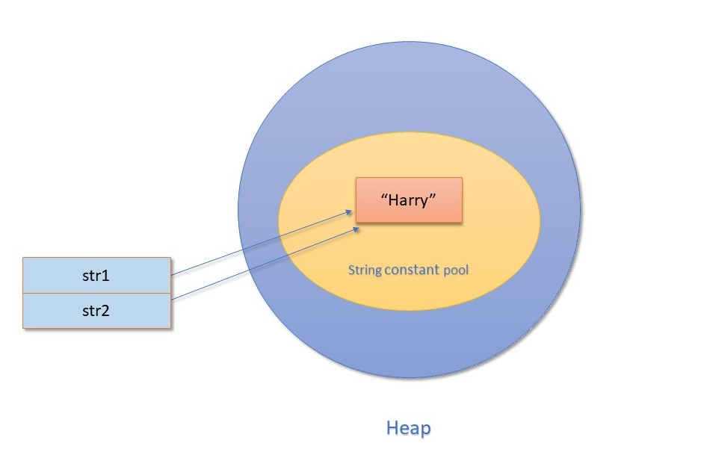
In the above diagram, notice that string "Harry" is already present in the string pool, which is pointed by the str1. When we try to create the same string object using str2, JVM finds that string object with the value "Harry" is already present in the string pool; therefore, instead of creating a new object, a reference to the same object is returned.
String s=new String("Harry");

Slide 32
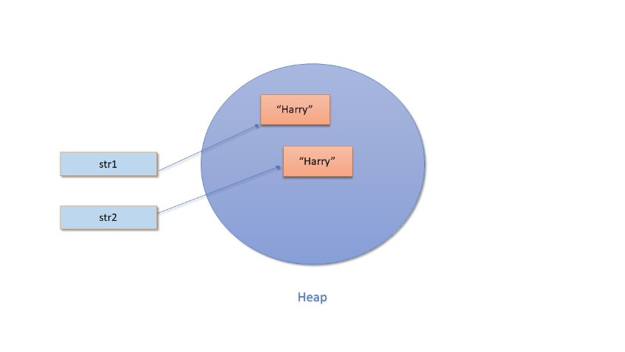
Creating String using new :
String s=new String("Harry");
When we create a string using "new", a new object is always created in the heap memory.

Slide 33
In the above diagram, you can see that although the value of both string objects is the same, i.e., "Harry" still two different objects are created, and they are referred by two different reference variables, i.e., str1 and str2.
See the examples given below to get a better understanding of String literal and String object :
EX : - 1
String str1 = "CodeWithHarry";
String str2 = "CodeWithHarry"
System.out.println(str1 == str2);
EX : - 2
Returns true because str1 and str2 are referencing the same object present in the string constant pool. Now, let's see the case of the String object :
String str1 = new String("Keep coding");
String str2 = new String("Keep coding"");
System.out.println(str1 == str2);
Although the value of both the string object is the same, still false is displayed as output because str1 and str2 are two different string objects created in the heap. That's why it is not considered a good practice two compare two strings using the == operator. Always use the equals() method to compare two strings in Java.

Slide 34
Different ways to print in Java :
We can use the following ways to print in Java:
System.out.print() // No newline at the end
System.out.println() // Prints a new line at the end
System.out.printf()
System.out.format()
System.out.printf("%c",ch)
%d for int
%f for float
%c for char
%s for string

Slide 35
String
package com.company;
import java.util.Scanner;
public class cwh_13_strings {
public static void main(String[] args) {
// String name = new String("Harry");
// String name = "Harry";
// System.out.print("The name is: ");
// System.out.print(name);
int a = 6;
float b = 5.6454f;
System.out.printf("The value of a is %d and value of b is %8.2f", a, b);
//System.out.format("The value of a is %d and value of b is %f", a, b);
Scanner sc = new Scanner(System.in);
// String st = sc.next();
// String st = sc.nextLine();
// System.out.println(st);
}
}

Slide 36
String Methods
String Methods operate on Java Strings. They can be used to find the length of the string, convert to lowercase, etc.
Some of the commonly used String methods are:
String name = “Harry”;
(Indexes of the above string are as follows: 0-H, 1-a, 2-r, 3-r, 4-y)
Escape Sequence Characters :
The sequence of characters after backslash ‘\’ = Escape Sequence Characters
Escape Sequence Characters consist of more than one character but represent one character when used within the strings.
Examples: \n (newline), \t (tab), \’ (single quote), \\ (backslash), etc.

Slide 37
Methods
1. length() | Returns the length of String name. (5 in this case)
2. toLowerCase() | Converts all the characters of the string to the lower case letters.
3. toUpperCase() | Converts all the characters of the string to the upper case letters.
4. trim() | Returns a new String after removing all the leading and trailing spaces from the original string.
5. substring(int start) | Returns a substring from start to the end. Substring(3) returns “ry”. [Note that indexing starts from 0]
6. substring(int start, int end) | Returns a substring from the start index to the end index. The start index is included, and the end is excluded.
7. replace(‘r’, ‘p’) | Returns a new string after replacing r with p. Happy is returned in this case. (This method takes char as argument)
8. startsWith(“Ha”) | Returns true if the name starts with the string “Ha”. (True in this case)
9. endsWith(“ry”) | Returns true if the name ends with the string “ry”. (True in this case)
10. charAt(2) | Returns the character at a given index position. (r in this case)
11. indexOf(“s”) | Returns the index of the first occurrence of the specified character in the given string.
12. lastIndexOf(“r”) | Returns the last index of the specified character from the given string. (3 in this case)
13. equals(“Harry”) | Returns true if the given string is equal to “Harry” false otherwise [Case sensitive]
14.equalsIgnoreCase(“harry”) | Returns true if two strings are equal, ignoring the case of characters.

Slide 38
String Methods Ex :-
package com.company;
public class cwh_14_string_methods {
public static void main(String[] args) {
String name = "Harry";
// System.out.println(name);
int value = name.length();
//System.out.println(value);
//String lstring = name.toLowerCase();
//System.out.println(lstring);
//String ustring = name.toUpperCase();
//System.out.println(ustring);
//String nonTrimmedString = " Harry ";
//System.out.println(nonTrimmedString);
//String trimmedString = nonTrimmedString.trim();
//System.out.println(trimmedString);

Slide 39
//System.out.println(name.substring(1));
//System.out.println(name.substring(1,5));
//System.out.println(name.replace('r', 'p'));
//System.out.println(name.replace("r", "ier"));
//System.out.println(name.startsWith("Har"));
//System.out.println(name.endsWith("dd"));
//System.out.println(name.charAt(4));
//String modifiedName = "Harryrryrry";
//System.out.println(modifiedName.indexOf("rry"));
//System.out.println(modifiedName.indexOf("rry", 4));
//System.out.println(modifiedName.lastIndexOf("rry", 7));
//System.out.println(name.equals("Harry"));
System.out.println(name.equalsIgnoreCase("HarRY"));
System.out.println("I am escape sequence\tdouble quote");
}
}

Slide 40
Conditional Statement
Java Conditionals: If-else Statement in Java
Sometimes we want to drink coffee when we feel sleepy. Sometimes, we order junk food if it is our friend’s birthday.
You might want to buy an umbrella if it’s raining.
All these decisions depend on a certain condition being met.
Similar to real life, we can execute some instructions only when a condition is met in programming also.
If-else block is used to check conditions and execute a particular section of code for a specific condition.

Slide 41
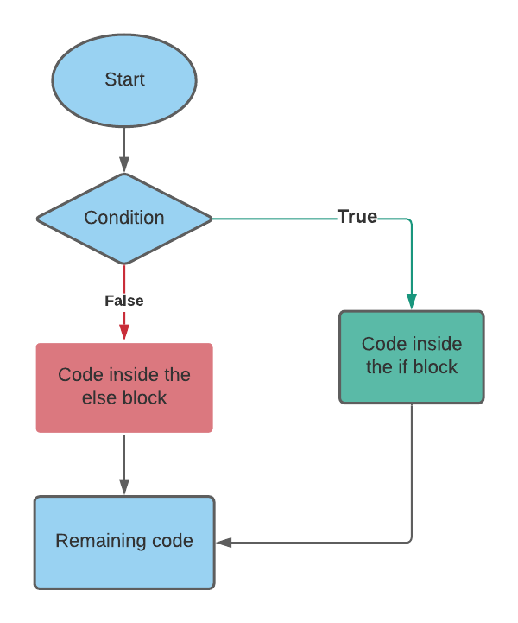
Flow control of if-else in Java

Slide 42
Decision-making instructions in Java
If-Else Statement
Switch Statement
If-Else Statement
Syntax of If-else statement in Java :
/* if (condition-to-be-checked) {
statements-if-condition-true;
}
else {
statements-if-condition-false;
} */
Example:

Slide 43
int a = 29;
if (a>18) {
System.out.println(“You can drive”);
}
else{
System.out.println(“You are underage!");
}
If-else ladder :
Instead of using multiple if statements, we can also use else if along with if thus forming an if-else-if-else ladder.
Using such kind of logic reduces indents.
Last else is executed only if all the conditions fail.
/* if (condition1) {
//Statements;
else if {
// Statements;
}
else {
//Statements
} */

Slide 44
Java Tutorial: Relational and Logical Operators in Java
Relational Operators in Java :
Relational operators are used to evaluate conditions (true or false) inside the if statements. Some examples of relational operators are:
== (equals)
>= (greater than or equals to)
> (greater than)
< (less than)
<= (less than or equals to)
!= (not equals)
Note: ‘=’ is used for an assignment whereas ‘==’ is used for equality check. The condition can be either true or false.
Logical Operators :
Logical operators are used to provide logic to our Java programs.
There are three types of logical operators in Java :
&& - AND
|| - OR
! – NOT
AND Operator :
Evaluates to true if both the conditions are true.
Y && Y = Y
Y && N = N
N && Y = N
N && N = N
Convention: # Y – True and N - False

