Slide 1



Shaping Future India

Slide 2
Project
Work-Life Balance & Mental Health in Students

Slide 3
Understanding The Data
We analyzed a dataset of 27,902 students to explore the key factors influencing their mental health.
Key Columns:
Gender
Sleep Duration
CGPA
Job Satisfaction
Depression
Family Mental Illness
Study Hours
Academic Pressure
Degree
Dietary Habits
Study Satisfaction
Financial Stress
Have you ever had suicidal thoughts?

Slide 4
Different Way used in Data Cleaning
General Ways:
Microsoft Excel
Python with Pandas
SQL
OpenRefine

Slide 5
Pandas
Why Choose Python in Pandas:
Handling Larger Dataset
Advance Data Manipulation
Integration with Other Libraries
Clean & Documented Workflow

Slide 6
Data Cleaning: The Foundation of Quality Insights
Methods Used:
Missing value handling
Data type correction
Data Transformation & Feature Engineering
Data Validation & Cleaning
Data Structuring

Slide 7
Data Cleaning: The Foundation of Quality Insights
Why It Matters??
A clean and well-prepared dataset is crucial for drawing accurate and reliable insights. These steps ensured that our data was consistent, complete, and ready for meaningful analysis.

Slide 8
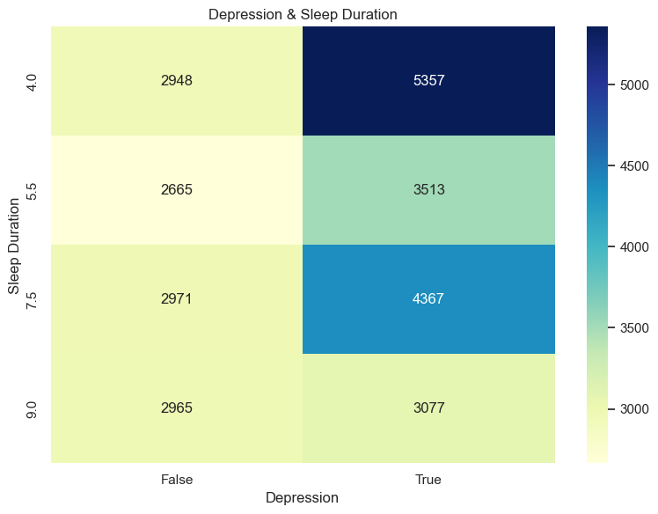
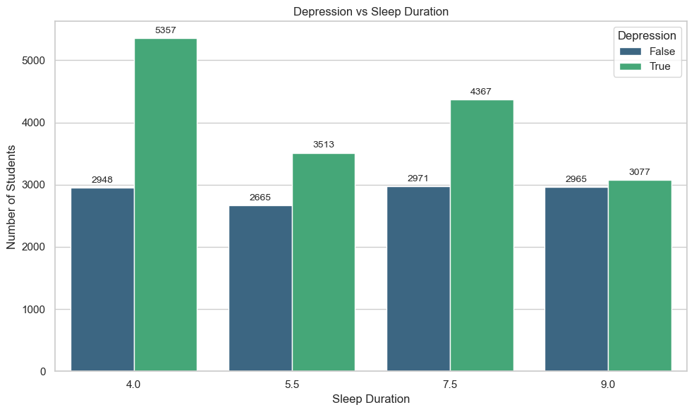
Visualization
✮ Sleep Duration & Depression

Slide 9
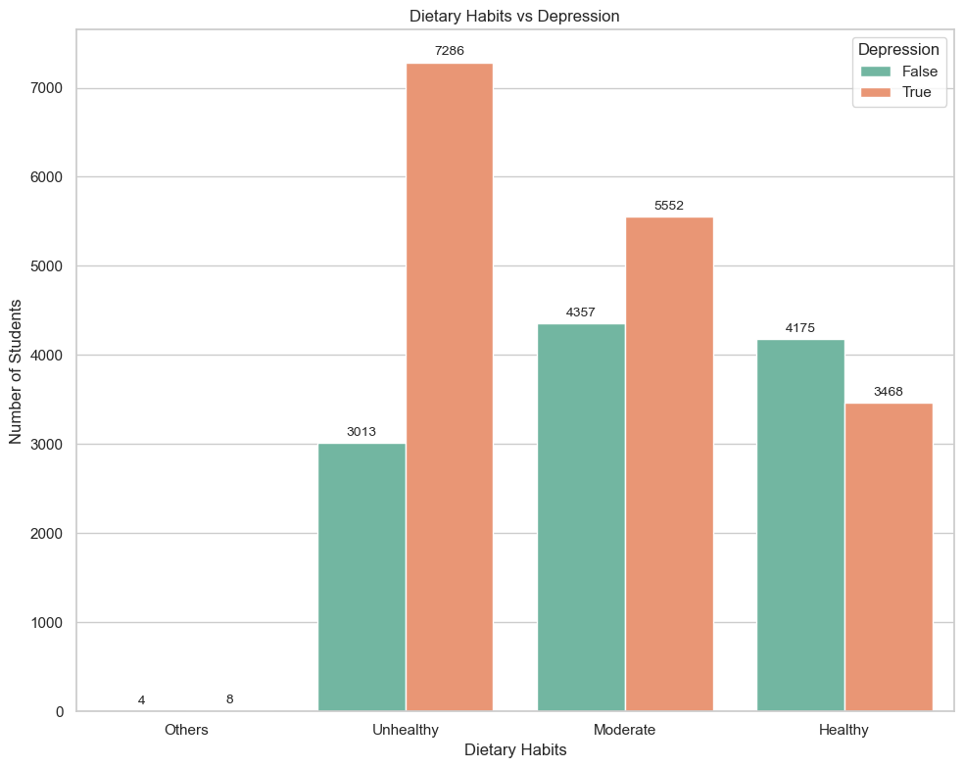
Visualization
✮ Dietary Habit(Healthy) & Depression
Objective:
To Show Dietary Habit affection in Depression
Insight:
A Striking 7286 students are unhealthy due to depression showing depression clear in affect in health & which is highest among all the other depression impact

Slide 10
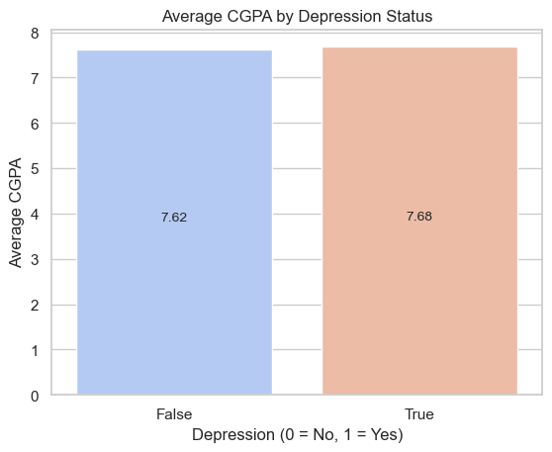
Visualization
✮ CGPA by Depression and Non-Depression Student
Objective:
challenges the common assumption that depression always correlates with lower academic performance.
Insight:
students who report depression have a slightly higher average CGPA than those who do not.
The difference is +0.04, which is small but statistically measurable.

Slide 11
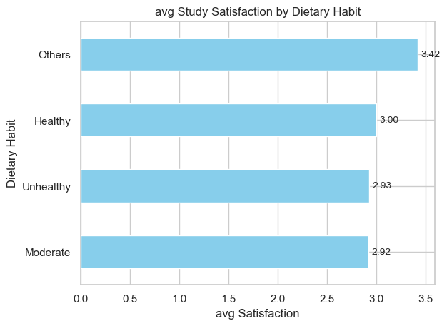
Visualization
✮Study Satisfaction of Dietary Habit
Objective:
To Compare study satisfaction with each dietary habit
Insight:
Other category have more satisfying for some student, this could relect cultural preferences, or flexible eating routines that align better with invidual needs

Slide 12
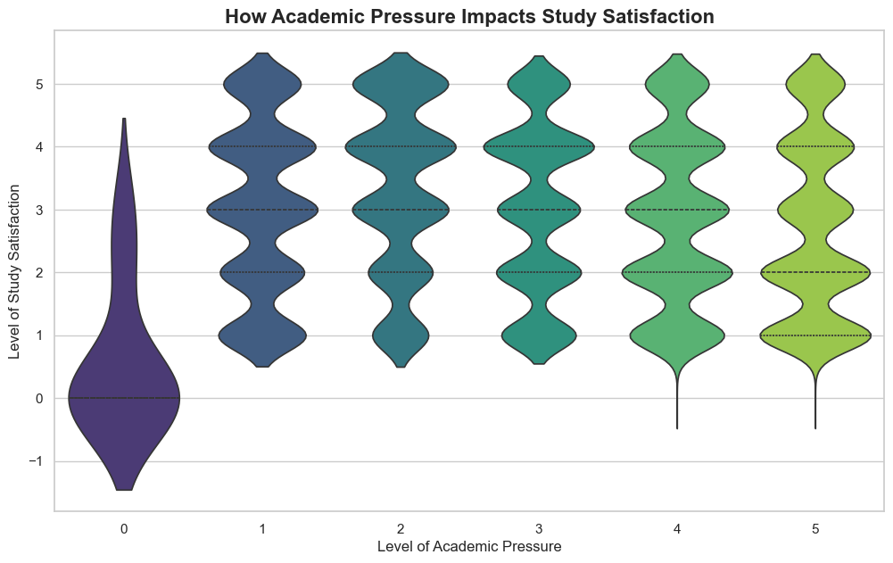
Visualization
✮Academic Pressure by Study Satisfaction
Objective:
To visually analyze how varying academic pressure levels influence the distribution and average of student study satisfaction.
Insight:
The violin plot shows that as academic pressure rises, study satisfaction consistently declines. At the highest-pressure levels, satisfaction scores cluster near the lowest values, clearly highlighting the negative effect of excessive pressure on students’ academic morale.

Slide 13
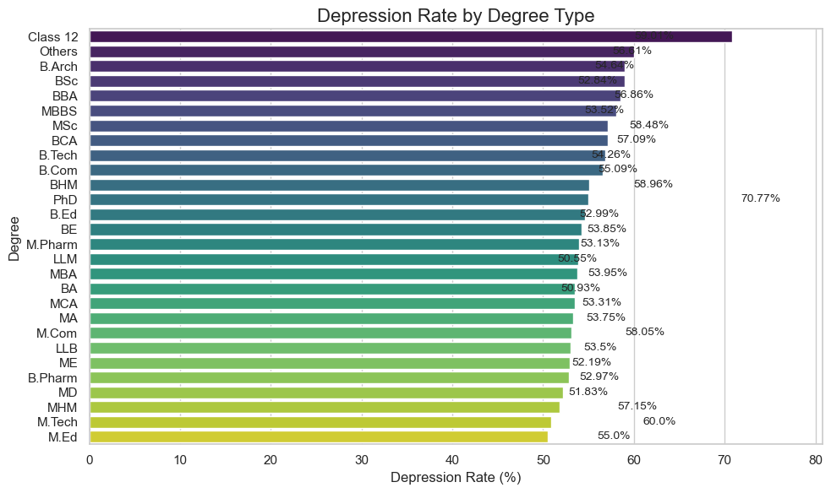
Visualization
✮ Depression Rate by Degree Type
Objective:
To get depression rate by each degree type
Insight:
There a very huge concern that out of 10 there 7 student are depressed, that can be reason due to intense academic pressure, competitive exams, and transitional stress on other side M.Ed degree have only 55% which show , possibly due to maturity, specialization, or better coping mechanisms.

Slide 14
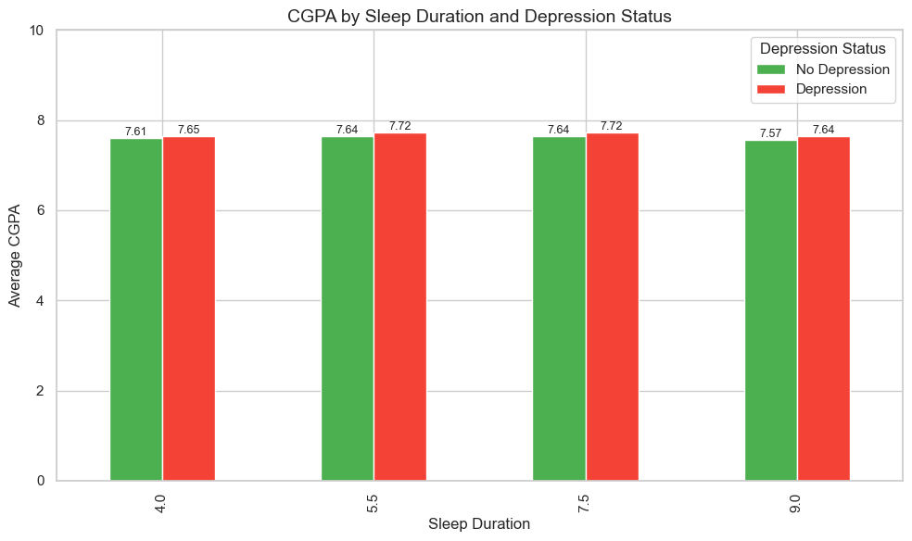
Visualization
✮CGPA by Sleep Duration with Depression
Objective:
To getting insight to sleep duration affect their CGPA compare to depressed and non depressed student
Insight:
Assumed that depressed student have affection on sleep duration and their CGPA but according our data that not huge difference

Slide 15
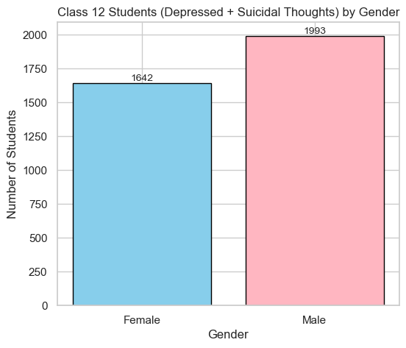
Visualization
✮Class 12 Student (Depressed + Suicidal Thoughts) by Gender
Objective:
To Show Depression correlated to Sleep Duration
Insight:
In Class 12, male & female students reported both depression and suicidal thoughts. This indicates a significant mental health concern, with male students showing a slightly higher tendency. The result suggests a need for targeted counselling and stress-management programs, especially during exam seasons.

Slide 16
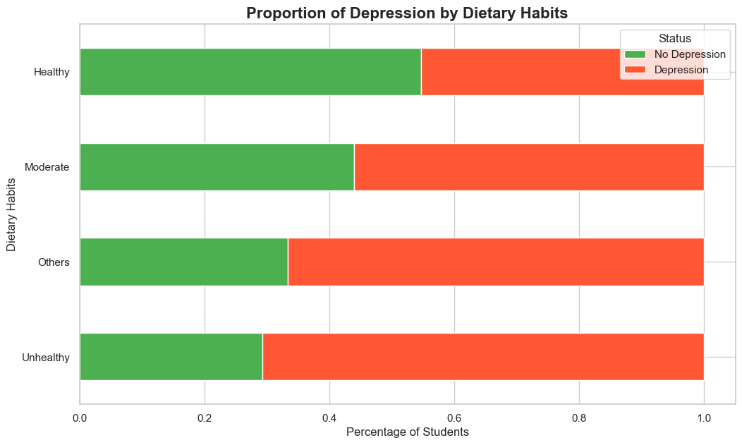
Visualization
✮ Depression by Dietary Habits in Proportion
Objective:
To compare the proportion of students with and without depression across different dietary habit categories.
Insight:
The chart highlights a clear connection between diet and mental health. Students maintaining healthy dietary habits show a notably lower rate of depression than those with unhealthy habits, emphasizing the strong link between physical well-being and emotional stability.

Slide 17
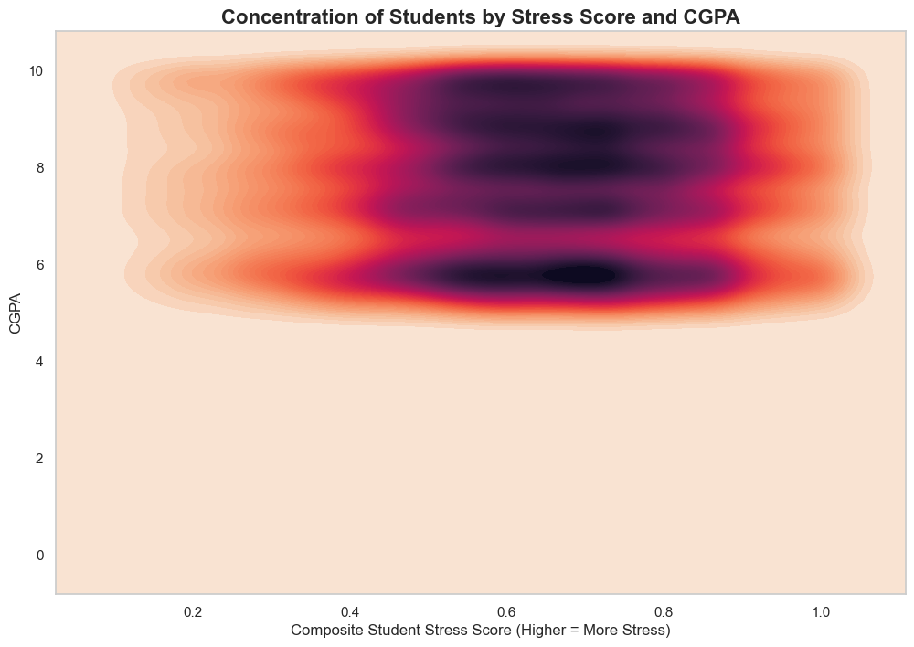
Visualization
✮Student Stress Score through CGPA
Objective:
Visualize how combined academic, financial, and sleep stress affects CGPA.
Insight:
Most students experience moderate-to-high stress, which corresponds to lower CGPA, highlighting the importance of overall well-being for academic success.

Slide 18
Final Conclusion
Severe Sleep Deprivation is the Biggest Red Flag: The clearest finding is that a lack of sleep is directly linked to depression. Students getting less than 5 hours of sleep are the most at-risk group.
Financial Stress is a Major Cause of Depression: Our data shows a strong connection between money worries and poor mental health. As financial stress increases, so does the likelihood of depression.
Young men are a High-Risk Group: Our visualization proves that male students, especially in 'Class 12', are disproportionately affected, facing higher rates of both depression and suicidal thoughts.

Slide 19
Final Conclusion
Healthy Habits Improve Academic Life: Our data shows a clear link between a 'Healthy' diet and higher study satisfaction. This suggests that students' physical well-being and lifestyle choices have a direct, positive impact on their engagement and happiness with their studies.
Family History is a Significant Risk Factor: Students with a family history of mental illness are more likely to suffer from depression themselves. This highlights a key vulnerability, indicating that a student's background is a critical factor in their overall mental health risk.

Slide 20
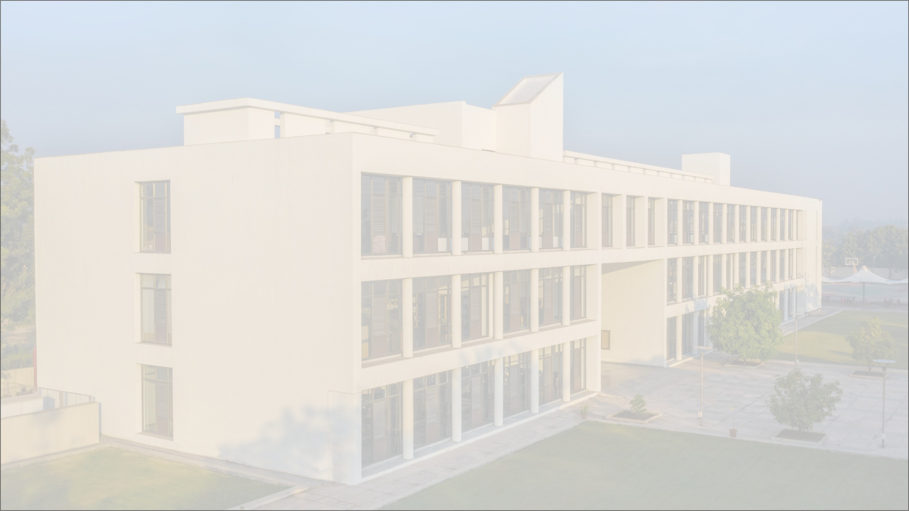
Thank You
Thank You

