Slide 1
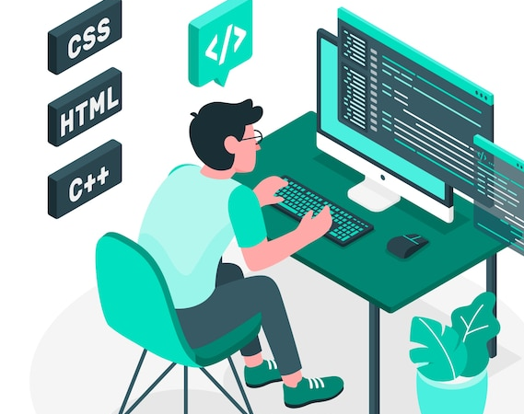
CODE SNIPPET RECOMMENDER
Team 8
Rutvik Jakhaniya | 2022202015
Praddyumn Shukla | 2022201001
Manisha Kallepalle | 2021204007
Dheeraj Nemalikanti | 2022201022

Slide 2

Project Description
Input: The developer searches for a code snippet
Output: The engine should compare and provide relevant code snippets
Code Snippets – C++, HTML added, we can add for any language

Slide 3

Technologies used
HTML, CSS, JS, Flask, Python, jQuery, MongoDB, and Bootstrap for styling

Slide 4
Homepage
User logged in
Search
Enter search criteria
Yes
No
Get
Upload Snippet
Login/Signup
View Search results
Post
Login
Signup
Get
Validate
Enter signup details
Post
Yes
No
Validate
Upload Snippet
Login Page
Post
Yes
No
Upload Snippet
Signup Page
Post

Slide 5
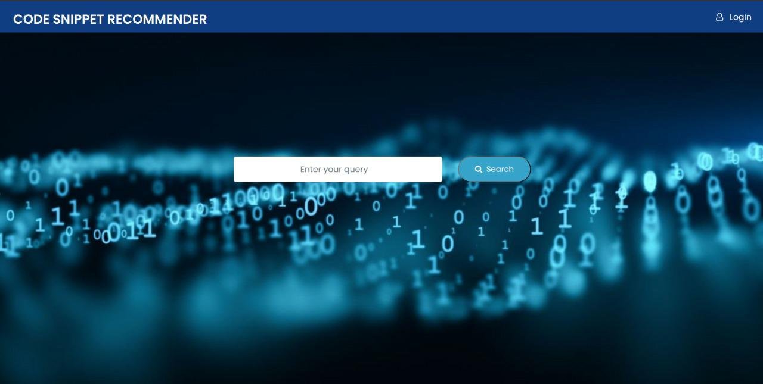
Home Page

Slide 6
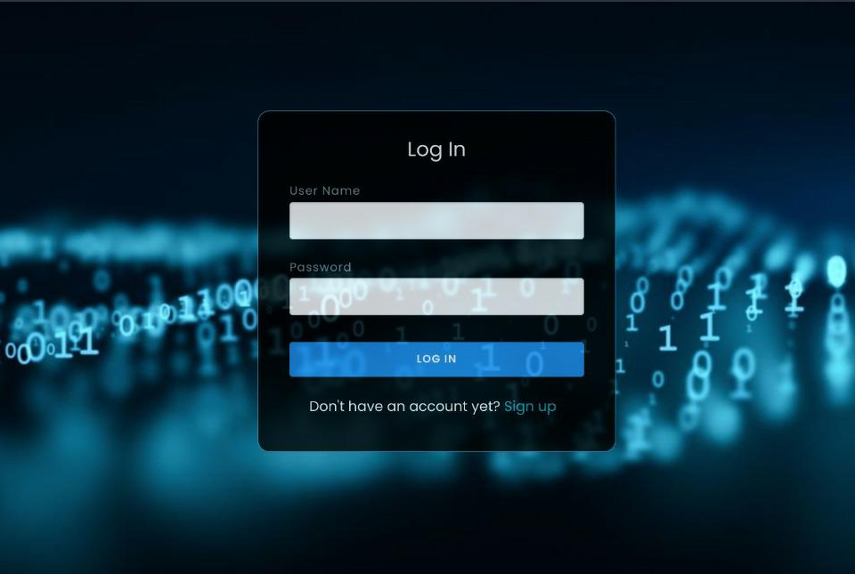
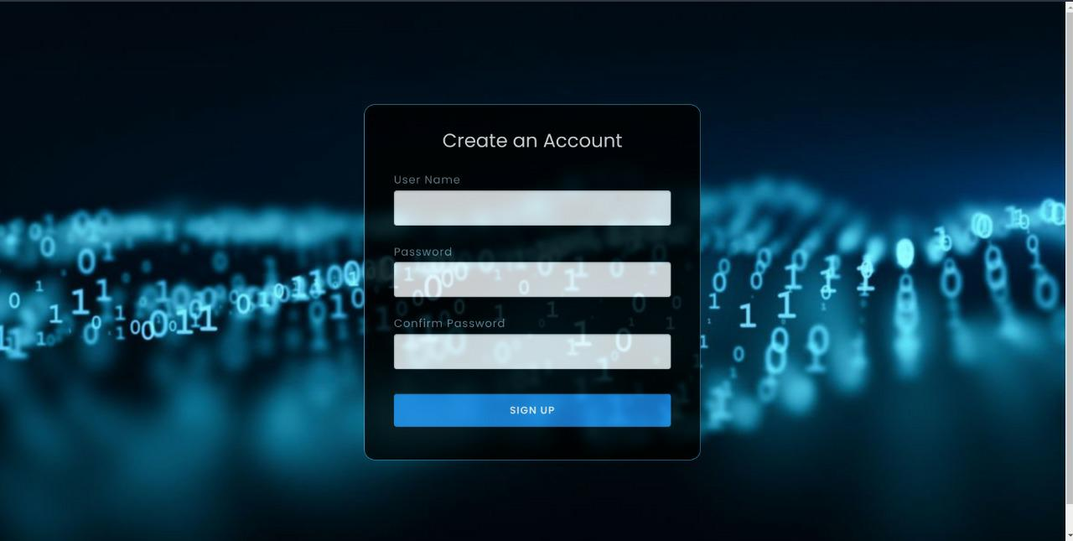
Log In and Sign Up

Slide 7
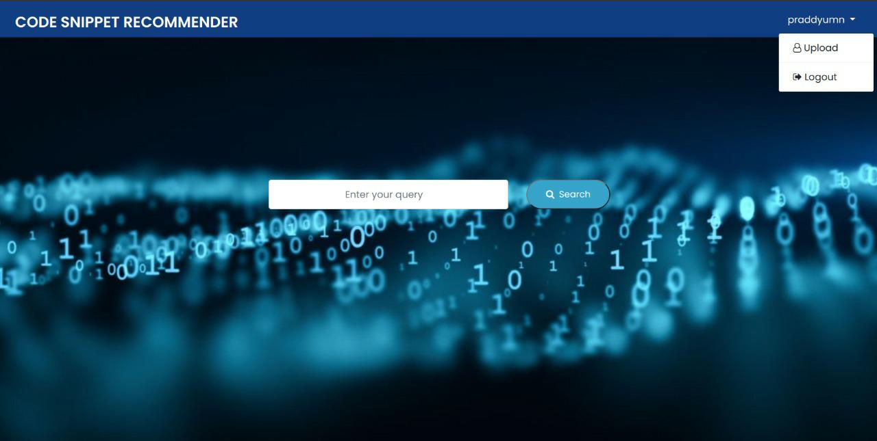
Upload and Logout options

Slide 8
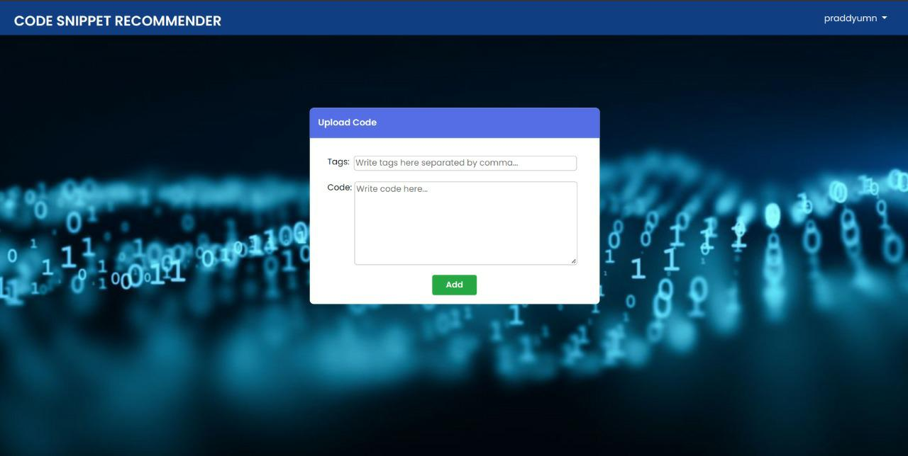
Upload Form

Slide 9

Search Box

Slide 10
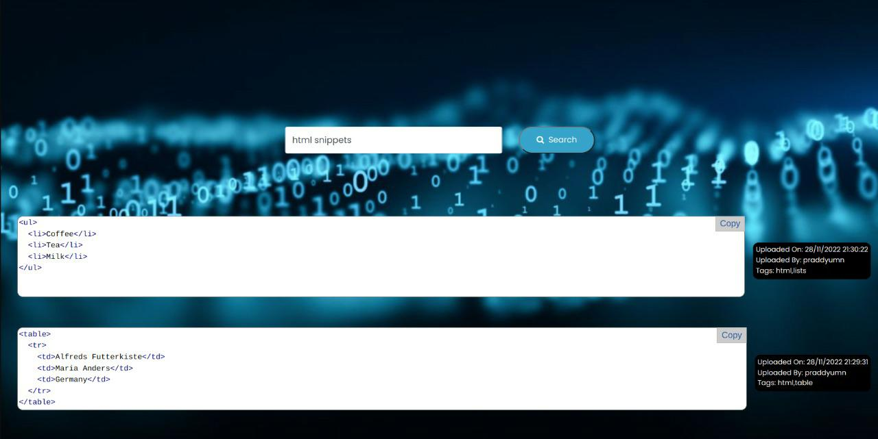
Search Results

Slide 11

Log in, signup
Upload the tags and snippets
Search the desired snippets
Snippets are sorted based on the uploaded time, the latest is displayed first
User can view the uploaded details
Copy the snippets

Slide 12

FUTURE SCOPE
User profile page and option to view the uploaded snippets and edit them.
Filter for different languages.

Slide 13

THANK YOU

