Slide 1


Slide 2

Major Project – II (01CE0807)
Review 2 (02/03/2024)
Bank Management System
Team ID: MU_CE_2023-24_067
Team Member: RUTVIK RATHOD (92000103179) (8TC2)
Guided By
Internal Guide Name: Prof. Jaydeep Ratanpara
External Guide Name: Nishant Verma
Internship Company Name: TSS Consultancy Pvt. Ltd.
Department of Computer Engineering, Faculty of Technology

Slide 3
Flow of the presentation
Bank Management System Abstract
ER Diagram
Database Design
Weekly Tasks Done Till Date
Attendance Report
References

Slide 4
Abstract
Abstract
Technologies used:
Frontend: Angular
Backend: ASP.NET Core Web API
Database: Microsoft SQL Server
The system aims to provide a user-friendly platform for managing various banking operations, including:
Customer accounts: Create, view, and manage customer accounts.
Transactions: Perform deposits, withdrawals, and transfers between accounts.
Account information: Access account details, balance inquiries, and transaction history.
Key features:
Secure authentication: Utilizes secure mechanisms for user login and authorization(JWT)
Robust data management: Leverages Microsoft SQL Server for efficient data storage and retrieval.
API-driven architecture: Employs ASP.NET Core Web API for seamless interaction between the frontend and backend.
Interactive user interface: Designed with Angular for a responsive and user-friendly experience.

Slide 5
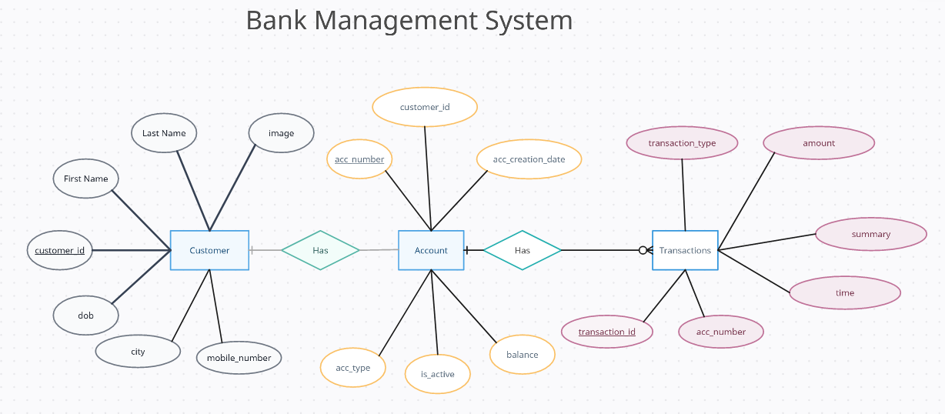
ER Diagram

Slide 6
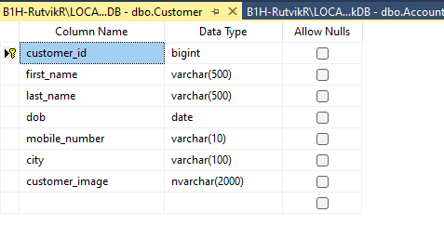
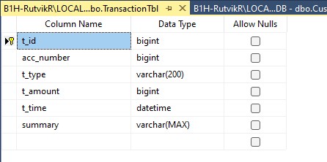
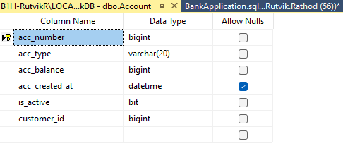
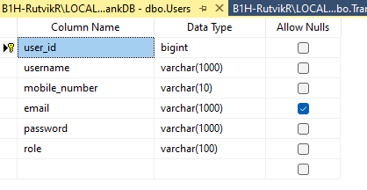
Database Design

Slide 7
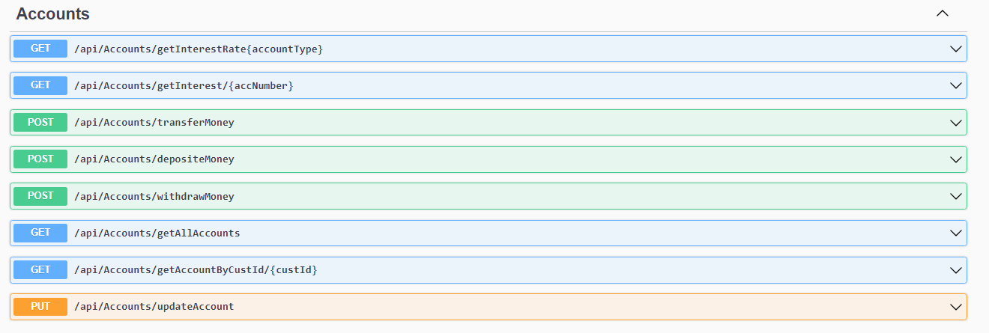
Account Services

Slide 8
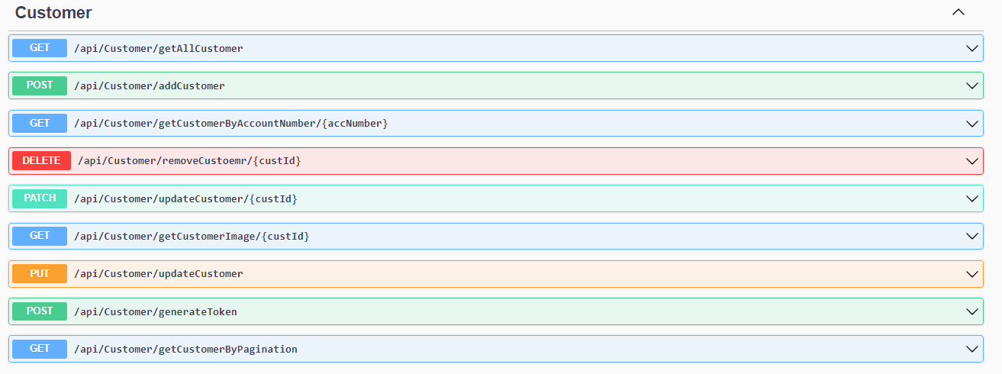
Enpoints For Customer Services

Slide 9
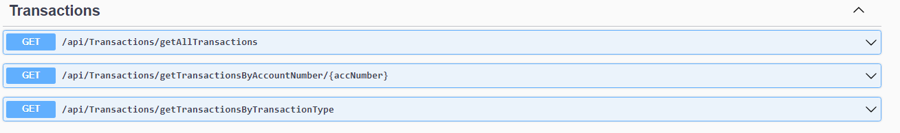
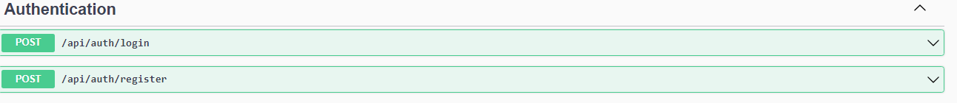
Enpoints For Transactions And Authentication

Slide 10
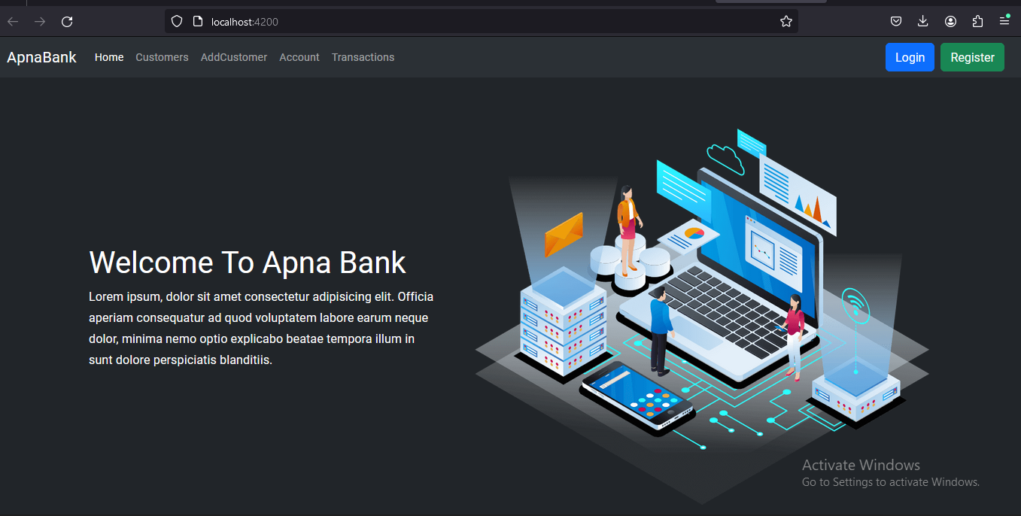
Home Page

Slide 11
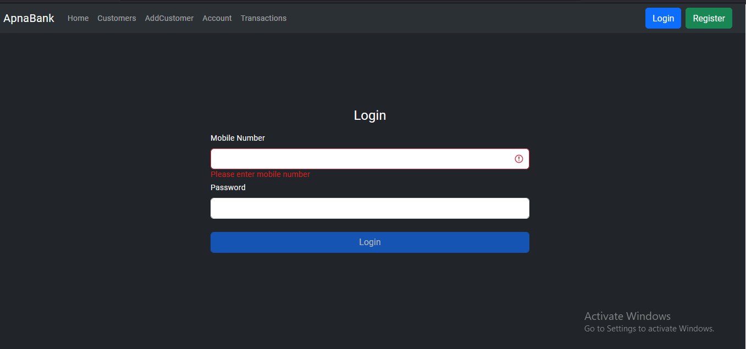
Login

Slide 12
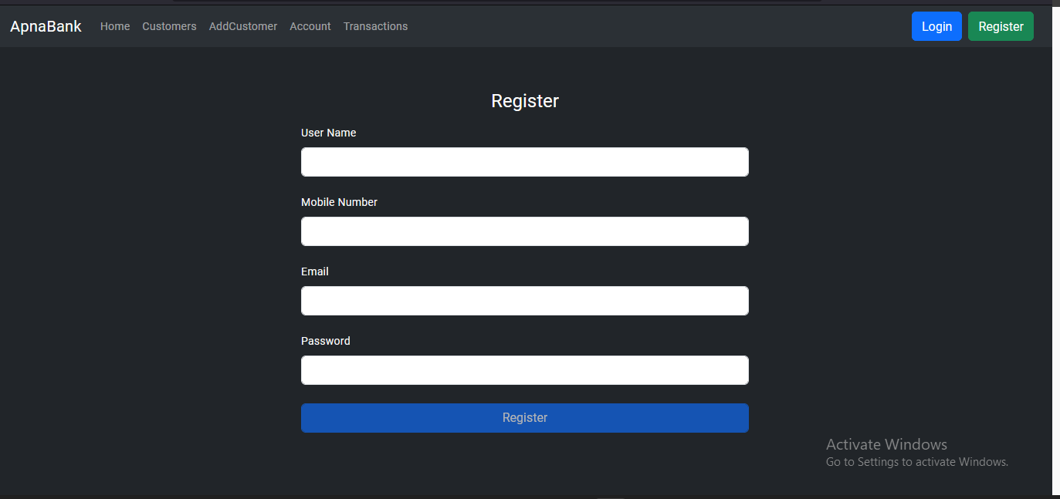
Register

Slide 13
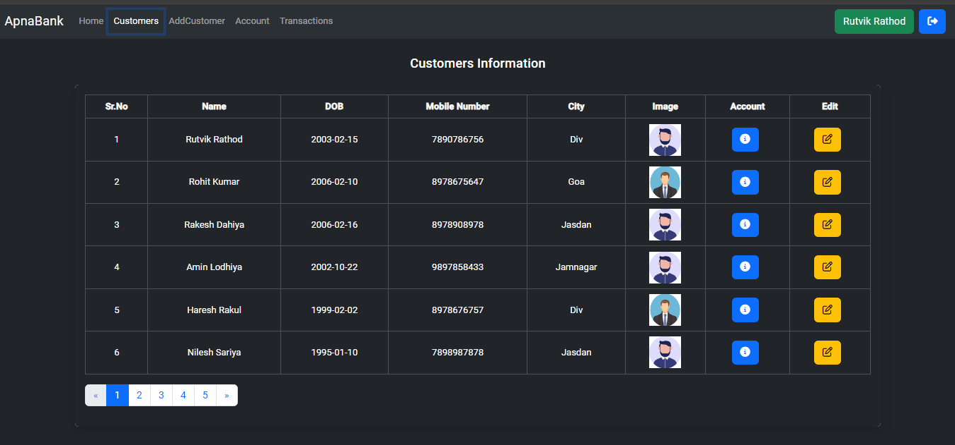
Customer Page

Slide 14
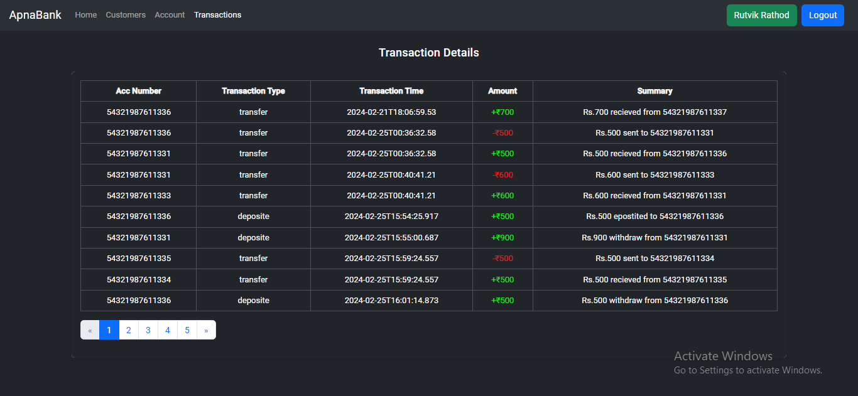
Transaction Page

Slide 15
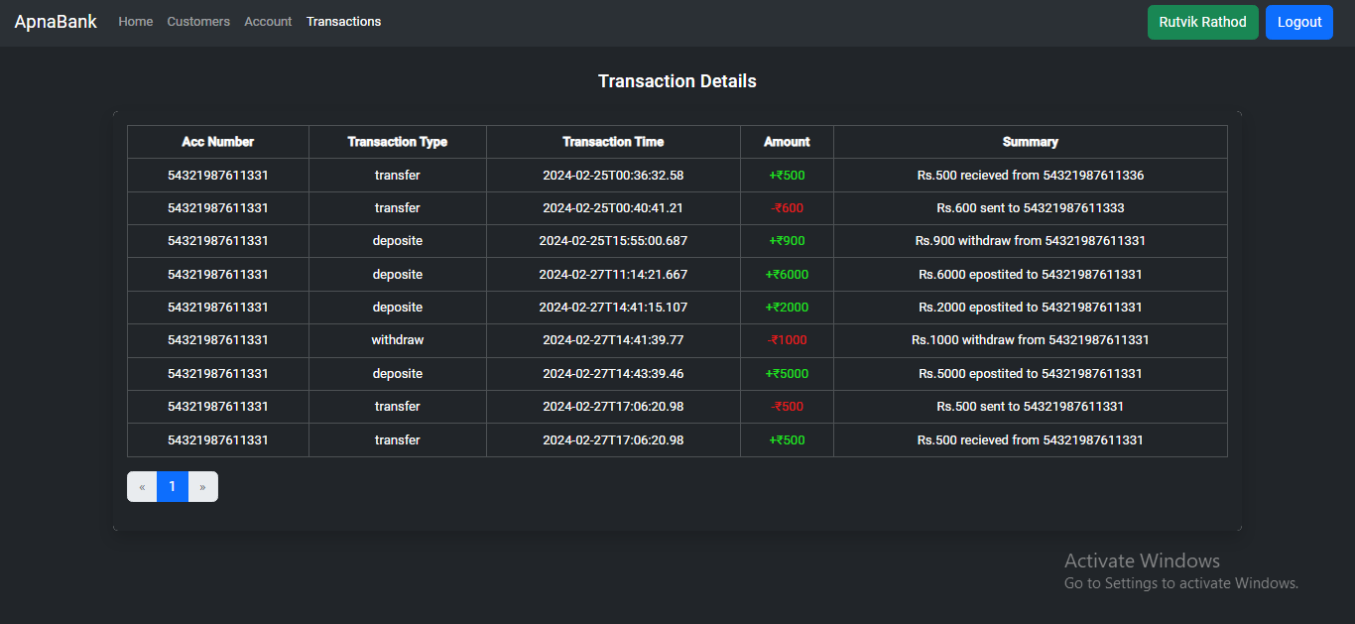
Get Transaction For Perticular Customer

Slide 16
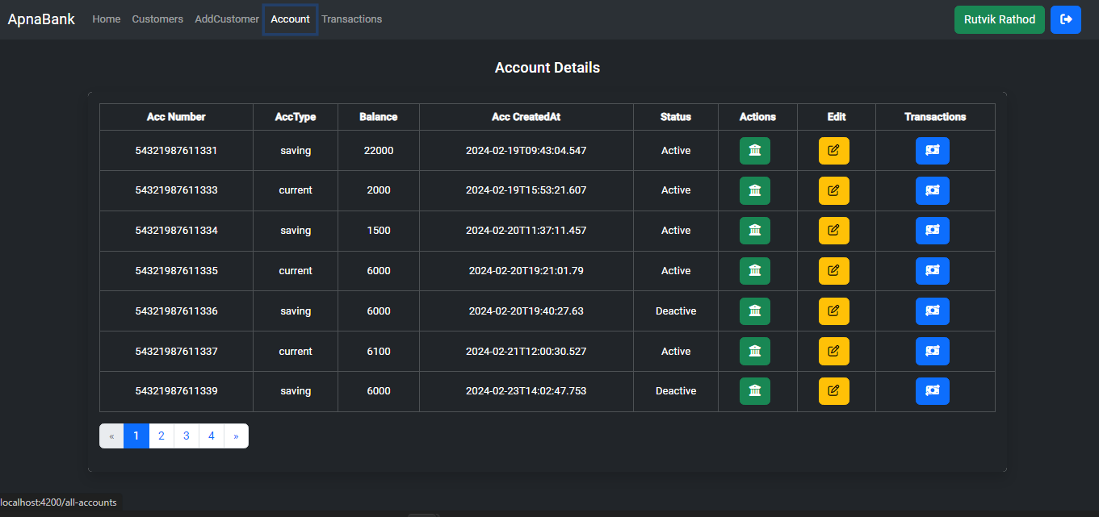
Account Page

Slide 17
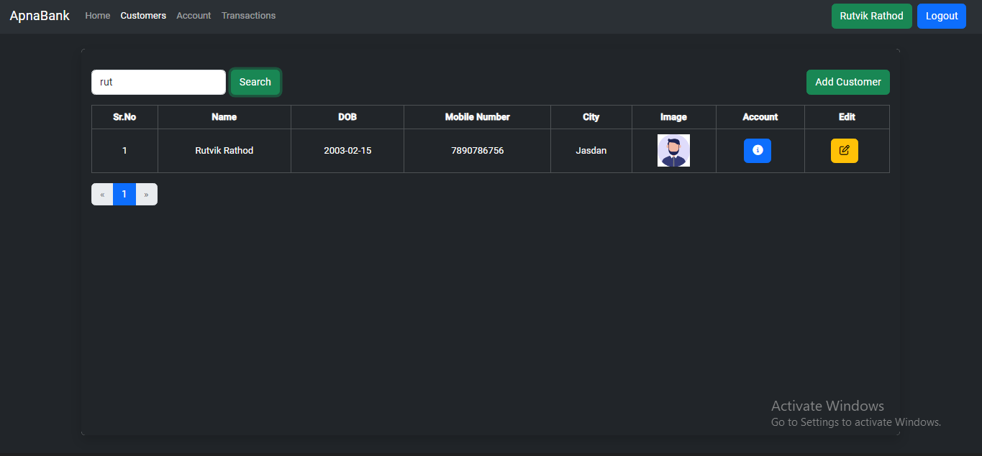
Search Customer

Slide 18
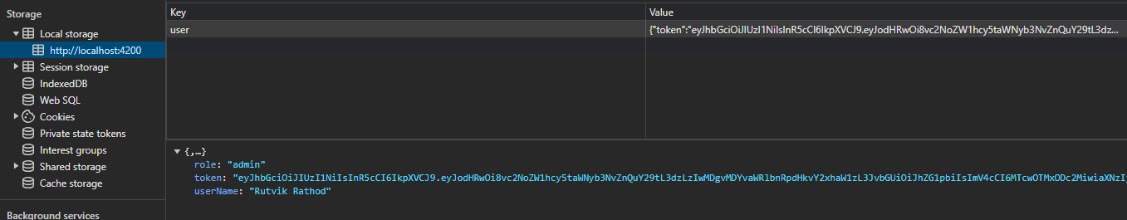
JWT Authorization

Slide 19
References
https://dotnet.microsoft.com/en-us/apps/aspnet
https://angular.io/api/common
https://material.angular.io/components/dialog

Slide 20


