Slide 1

Statistical Data Analysis for Optimized Real Estate Marketing Strategies in California: Descriptive Statistical Analysis
Leveraging Statistical Insights to Enhance Targeted Marketing Campaigns and Maximize Sales Efficiency
Rutvik Trivedi

Slide 2
Project Overview
Statistical Data Analysis
Problem Statement
Understanding the Data
Statistical Data Analysis and Visualization
Statistical Calculations
Insights
Recommendations

Slide 3
Problem Statement
Statistical Data Analysis
A real estate company operating in California aims to improve its marketing results by targeting the right audience based on data-driven decisions.
The goal is to enhance marketing efficiency without increasing the budget through a descriptive statistical analysis of the customer and sales data.

Slide 4
Understanding the DATA
Statistical Data Analysis
Dataset
The data for this analysis comes from the company’s California real estate transactions database, containing various attributes related to sales, properties, and customer demographics.
Statistical Frequency Distribution
Generation of frequency distribution tables for categorical variables. It helps visualize the data more efficiently and accurately.

Slide 5
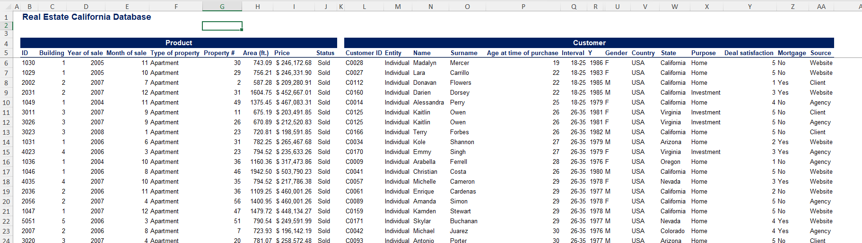
Understanding the Data
FINANCIAL ANALYSIS OVERVIEW

Slide 6
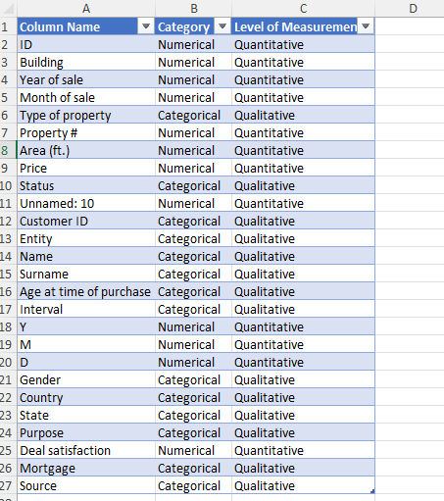
Understanding the Data
Statistical Data Analysis

Slide 7
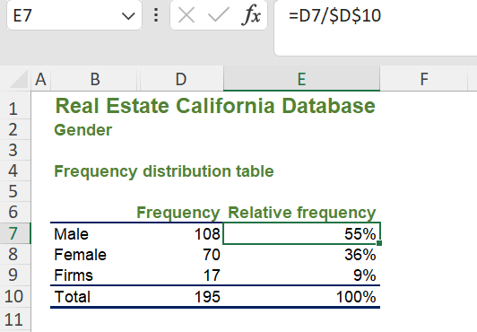
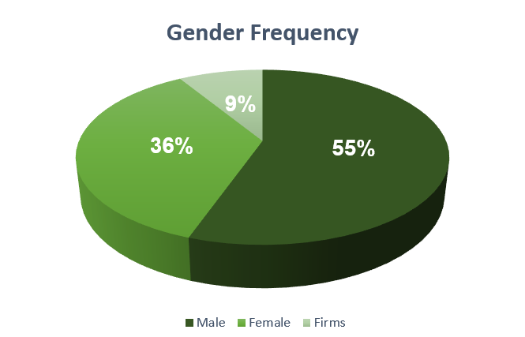
Gender Statistics and Insights
Statistical Data Analysis
Males are more likely to sign the contract and are potentially a better audience to target for our ads.
Approximately 10% of the sales came from the firms or the corporate clients

Slide 8
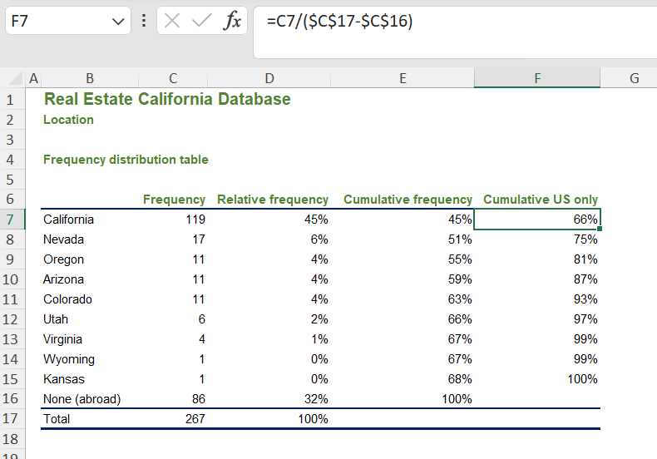
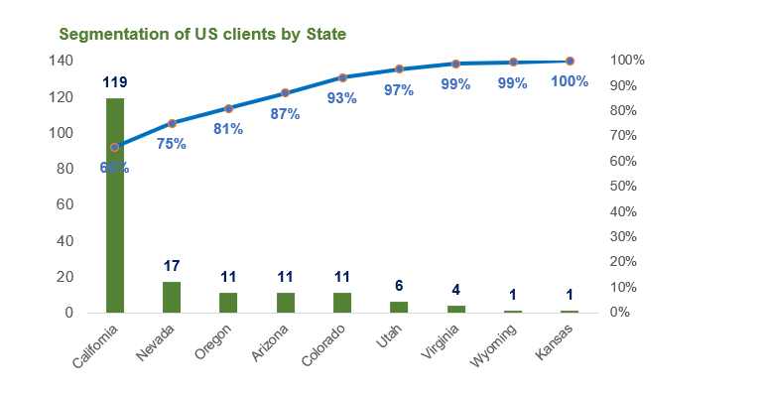
Location Statistics and Insights
Statistical Data Analysis
68% of the sales came from California with Nevada, Oregon, Arizona, and Colorado
forming 93% of the US customer base.

Slide 9
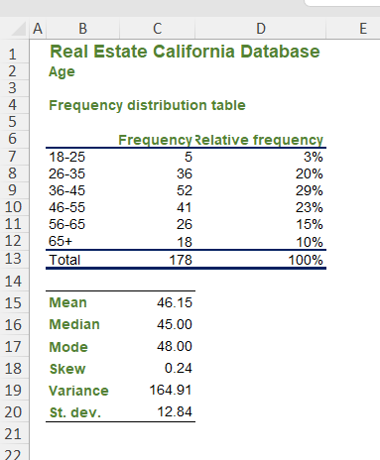
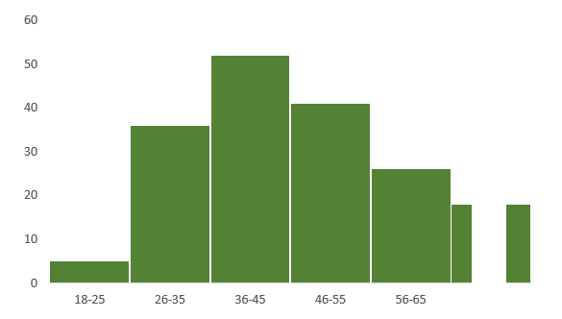
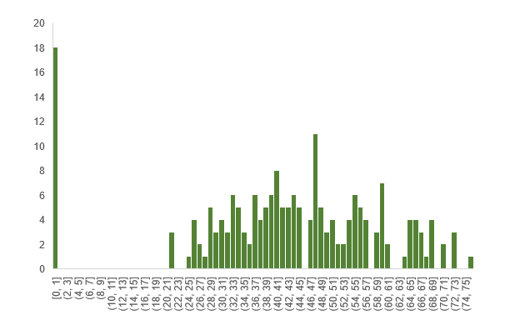
Age Statistics and Insights
Statistical Data Analysis
68% of the sales came from California with Nevada, Oregon, Arizona, and Colorado
forming 93% of the US customer base.

Slide 10
Age Statistics and Insights
Statistical Data Analysis
71% of sales were made with customers aged between 26 and 55 years old, with a mean of 46 years and a standard deviation of 13 years.
Younger people buying more properties than older people

Slide 11
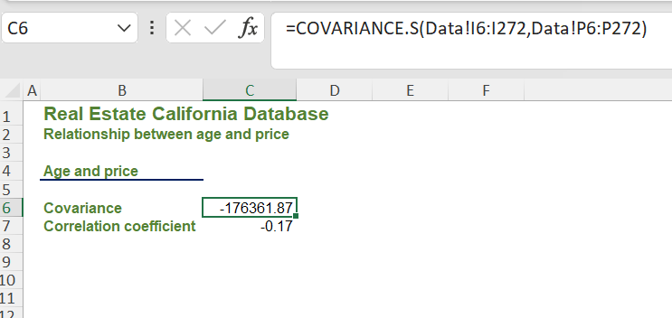
Age and Price Statistics
Statistical Data Analysis

Slide 12
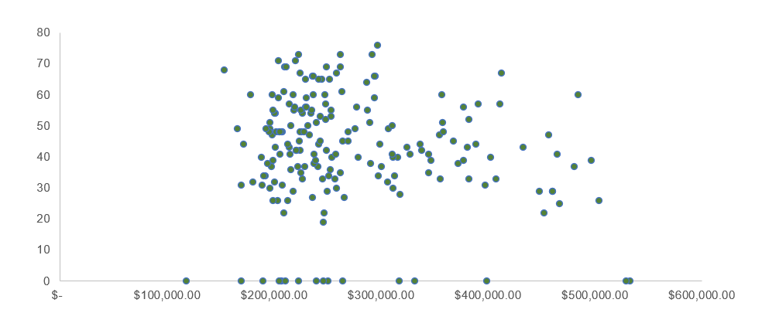
Age and Price Statistics
Statistical Data Analysis
There is no relationship between the customer's age and the price they are willing to pay.

Slide 13
Recommendations
Statistical Data Analysis
Demographics: Focus on males and age groups that have shown higher purchasing rates (26 to 55 years).
Corporate Clients: Consider targeting firms or corporate clients as they make up approximately 10% of the sales.
Geographical Focus: Concentrate marketing efforts in California, Nevada, Oregon, Arizona, and Colorado to cover 93% of the US customer base.
Property Type: Highlight apartments in the campaign, as they are the most sold property type.
Timing: Increase marketing efforts towards the end of the year to leverage seasonal buying trends.
Price Range: Emphasize mid-range properties, which align with the majority of sales.

