Slide 1

Stack Overflow Developer Survey
Capstone Project Report
IBM Data Analyst Professional Certificate
Stack Overflow Developer Survey – Dataset 2024
Rutvika Khot
12-09-2025

Slide 2



OUTLINE
Executive Summary
Introduction
Results
Visualization – Charts
Dashboard
Discussion
Findings & Implications
Conclusion
Appendix

Slide 3

EXECUTIVE SUMMARY
Top programming languages in demand:
JavaScript, HTML/CSS, SQL, Bash/Shell/PowerShell, Python
Top database skills in demand:
My SQL, Microsoft SQL Server, PostgreSQL, SQLite, MongoDB
Popular platforms:
Windows, Linux, Docker, AWS, Slack
Popular Web Frames:
jQuery, Angular/Angular.js, React.js, ASP.NET, Express
Future Technology Trend:
Python takes the third row, followed by SQL and TypeScript
Redis and Elasticsearch also place in Top 5
Android is in the Top 5 demanded platforms, the rest remains
React.js takes the first row and Vue.js is the latest addition as the last

Slide 4

INTRODUCTION
In the realm of programming and technology, several key trends have emerged in recent years.
These insights shed light on the evolving landscape of programming languages, web frameworks, and the demographics of professional developers.
Stack Overflow conducts an inclusive survey of individuals engaged in coding globally.
Covering a wide array of topics from preferred technologies to career aspirations, 2019 marks the 9th consecutive year of survey publication.
Nearly 90,000 developers participated in the 20- minute survey in 2019 Survey.
Let's explore some of the notable findings.

Slide 5

METHODOLOGY
Data is based on the survey conducted by Stack Overflow – 2024.
Familiarization with this dataset was achieved through completing IBM labs on Coursera, which encompassed topics such as Web Scraping, Dataset Exploration, Data Wrangling, Exploratory Data Analysis, and Data Visualization.
Data analysis and visualization was conducted via IBM Cognos Analytics.

Slide 6
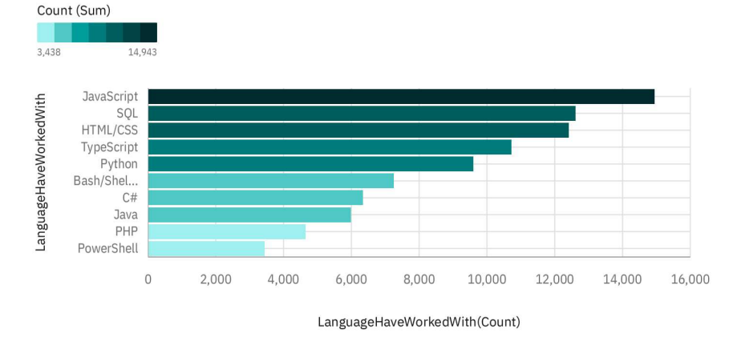
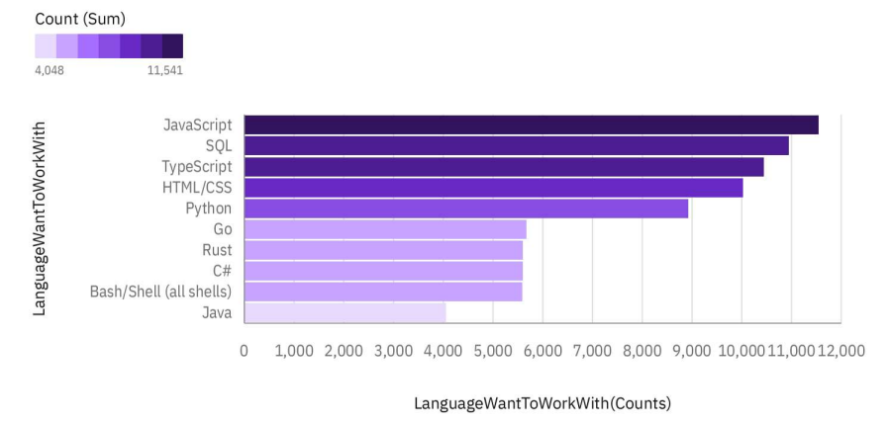
PROGRAMMING LANGUAGE TRENDS
Current Year
Next Year
< Bar chart of top 10 programming languages for the next year goes here.>

Slide 7
PROGRAMMING LANGUAGE TRENDS - FINDINGS & IMPLICATIONS
Findings
Overall demand for all languages are seems reducing a bit.
The languages like JavaScript and SQL will be in demand in future also.
Go will gain more importance among other languages.
Implications
Developers with JavaScript and SQL skills will be in great demand.
Go and Rust is gaining more demand over PHP as server side languages.
Due to .Net Core C# will be in demand and gaining more attention over Java.

Slide 8
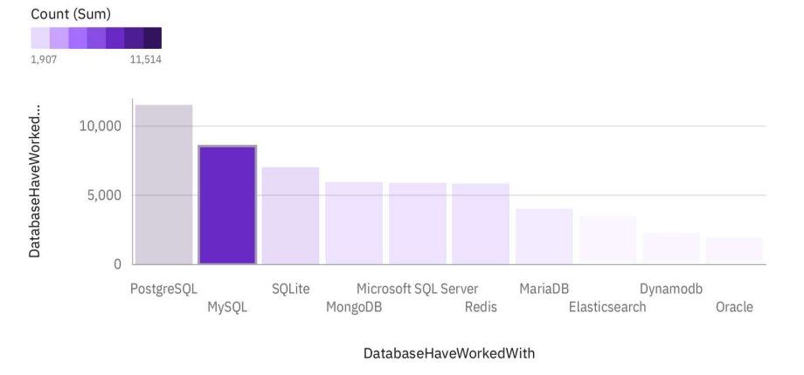
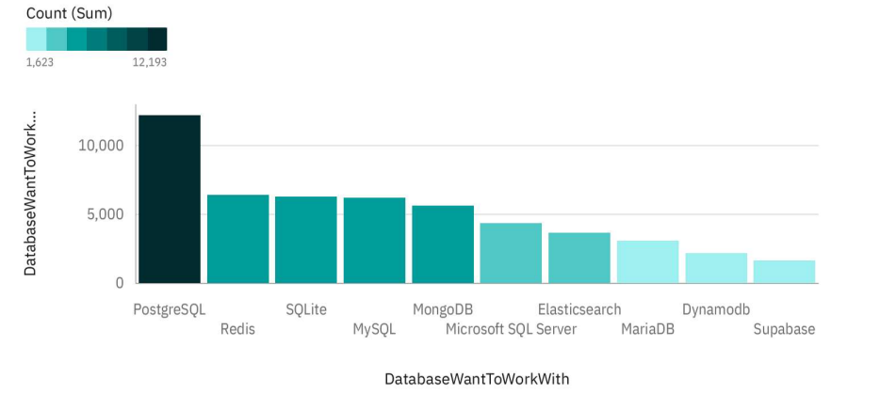
DATABASE TRENDS
Current Year
Next Year
< Bar chart of top 0 databases for the next year goes here.>

Slide 9
DATABASE TRENDS - FINDINGS & IMPLICATIONS
Findings
PostgreSQL is in demand as well as will be in demand in future.
Redis will be in demand.
There won’t be a big change in database demand compared to current year.
Implications
In memory databases are gaining more demand to RDBMS like Redis.
MongoDB for NoSQL will be in demand compared to other NoSQL databases.

Slide 10
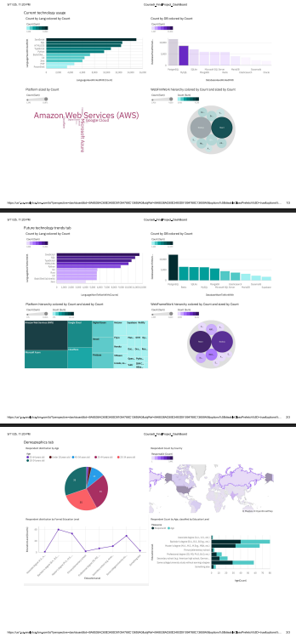

DASHBOARD

Slide 11
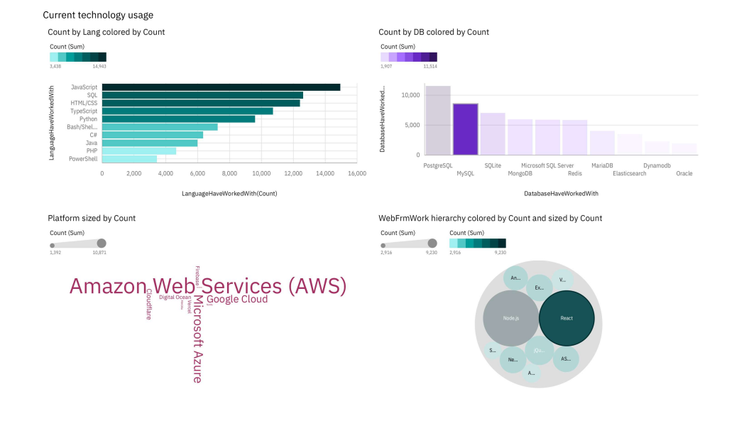
Current Technology Usage

Slide 12
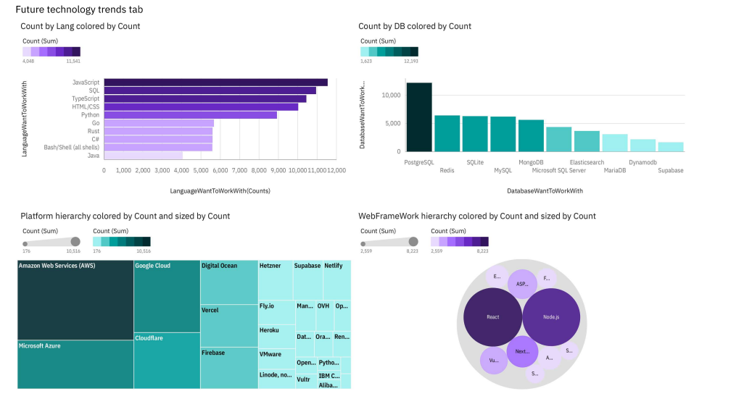
Future Technology Usage

Slide 13
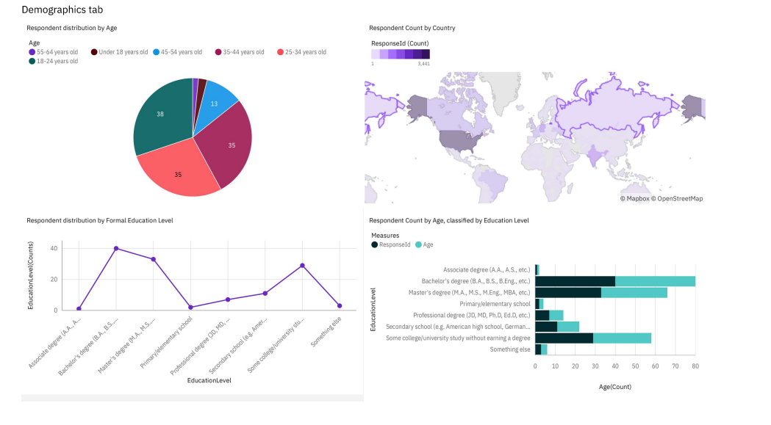
Demographics

Slide 14
DISCUSSION
The dominance of JavaScript and HTML/CSS and the adoption of MySQL as the leading database management system.
Highlights the central role of web development in the programming landscape.
Opens up discussions on the significance of client-side scripting and styling, trends in web development frameworks, and the evolving nature of web technologies.

Slide 15
OVERALL FINDINGS & IMPLICATIONS
Findings
Technology Trends: The dominance of JavaScript and HTML/CSS underscores the importance of staying updated with technology trends in web development.
Data Management: The prevalence of MySQL, PostgreSQL, and Microsoft SQL Server highlights the critical role of effective data management in software development.
Diversity of Tools: The diverse range of programming languages and database systems utilized by developers underscores the importance of understanding the strengths and weaknesses of different tools.
Implications
Web Dominance: The widespread usage of JavaScript and HTML/CSS indicates the dominance of web development in the programming ecosystem, reflecting the growing importance of online platforms and digital experiences.
Database Diversity: The variety of database management systems used highlights the importance of flexibility and adaptability in data storage solutions. Organizations must consider factors such as data structure, scalability, and performance when selecting a database system.
Industry Standardization: The popularity of certain technologies like JavaScript and MySQL suggests a degree of industry standardization, where certain tools become widely adopted due to their proven reliability and effectiveness. This can simplify collaboration and interoperability within the developer community

Slide 16

CONCLUSION
The findings underscore the dynamic nature of the programming landscape and the critical role of technology in driving innovation across industries.
As developers navigate this ever-changing terrain,
a keen understanding of diverse programming languages
database systems becomes essential to meet the demands of modern applications
ensure optimal outcomes in software development projects.

Slide 17

APPENDIX
Job Postings
Popular Languages

Slide 18
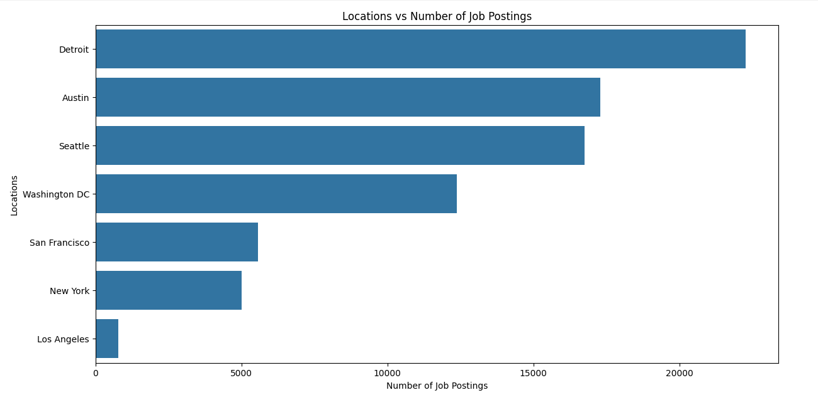
JOB POSTINGS

Slide 19
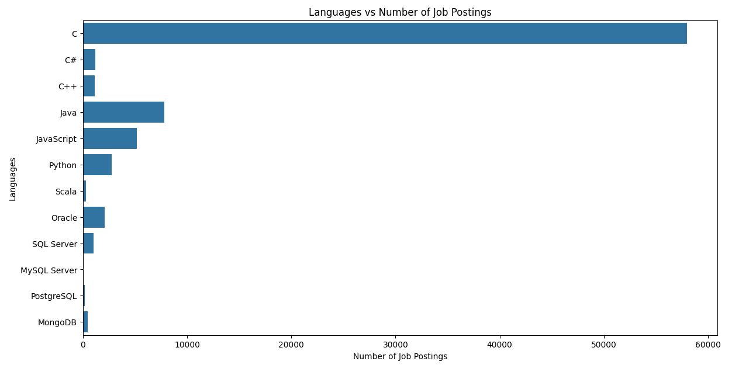
POPULAR LANGUAGES

