Slide 1

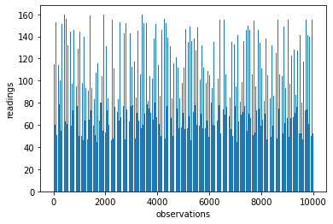
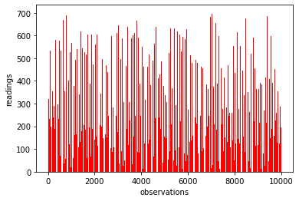
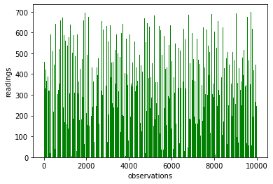
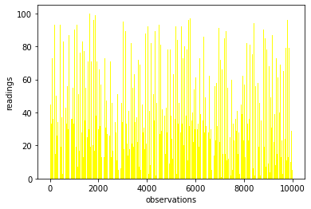
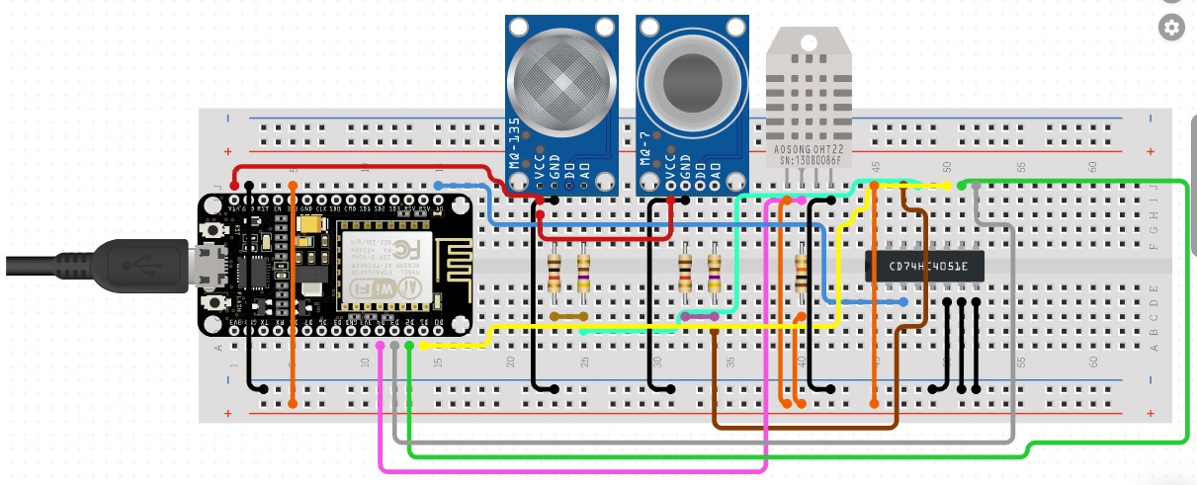
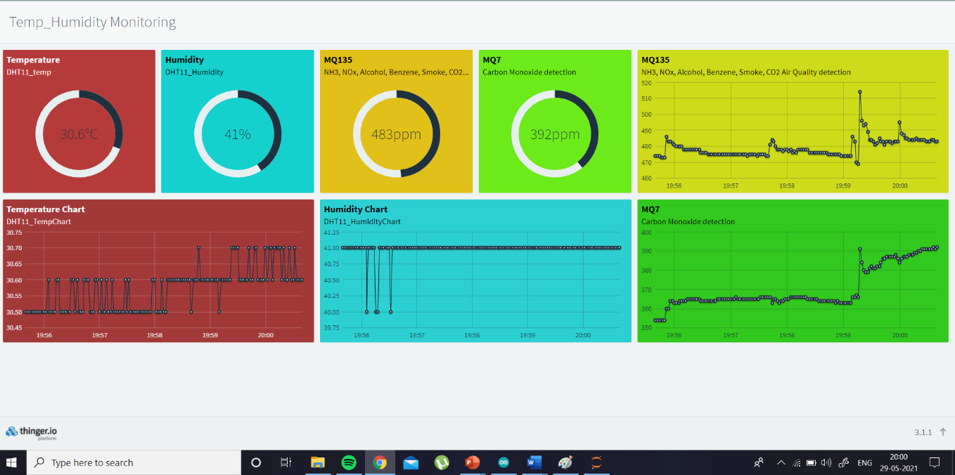
Real-Time Air Quality Monitoring and its predictions
Rutwik, Akhil and Rohith| Prof. Sangeetha S | SENSE
Motivation/ Introduction
Results
Air pollution is one of the biggest threats for the environment and affects everyone. The situation these days are so bad that in few cities like Tokyo and Delhi, people are gasping for breath. It is estimated that 7 million people die every year due to pollution. So the air in most of these areas can be termed as invisible poison. In such cases the least a person living in the area should be able to do is know how the quality of air is in their locality. If they see and understand the immediacy of the problem, they can find ways to save themselves. Here is where our project comes to play.
SCOPE of the Project
Figure-2
Figure-3
The core objective of this project is to make a device and a website such that people can have access to the information as to how bad the condition of Air is in their locality. Real-Time values are to be displayed on the website and we also explore prediction algorithms in machine and deep learning to know if the area can be termed safe or not based on the future Pollution values. We will be using IOT to send the data gathered from the sensors to the cloud server and the users can check out additional data on the website such as temperature and humidity.
Methodology
Figure-4
Figure-5
Figure 1: Configuration of Hardware components on Breadboard
For this project the hardware and software instruments we’re using are the following-
Figure-1
Figure-6
Figure 2: Recorded values of Humidity. 10000 readings are taken.
Figure 3: Recorded values of MQ135 sensor. These values comprise of detection of harmful gases like NH3, NOx, alcohol, benzene, smoke, CO2. 10000 readings are taken
Figure 4: Recorded values of MQ7 sensor. These values comprise of detection of harmful gas emitted by all of fuel-vehicles i.e Carbon monoxide. 10000 readings are taken
Figure 5: Recorded values of Temperature. 10000 readings are taken
Figure 6: Real-Time values shown of all the sensor outputs. This data can be accessed through the website
Hardware: | Software:
NodeMCU(ESP8266) MQ135 MQ7 DHT11 4051 Multiplexer BreadBoard Jumper Wires | Arduino IDE Thinger.io Visual Studio Code Jupyter Notebook(anaconda)
Conclusion/ Summary
With this project we are able to accomplish our goal that is to provide the data necessary so users can access the data about the quality of Air in their locality. For this we are able to build a hardware device that is able to interpret and send the data to the cloud. And then we were able to build a website providing information about pollution and displaying the data we collected in Real-Time. We were able to collect the data for two weeks amounting to 10000 readings. We were then able to pass this data through prediction algorithms and hence are able to determine if the area can be considered safe or not when the real-time data is given. So with this, we are able to provide valuable information to the people about an issue that might cause adverse health issues to them and their family.
Here we supply power to Vcc ports in all the sensors through NodeMCU and connect GND in the same way. We connect digital pins of DHT11 to digital pins of NodeMCU. As we have two Analog sensors and one analog port in NodeMCU, we use 4051 mux to compensate for lack of analog ports and connect MQ135 and MQ7 sensor to NodeMCU through 4051 mux. To calibrate the sensors for accuracy, we used suitable libraries.
Contact Details
imrutwik99@gmail.com
We use Arduino IDE to upload a suitable code into the NodeMCU and configure it with thinger.io so we can send a command to receive the data gathered into the cloud server.
Acknowledgments/ References
Salman, Afan Galih, Bayu Kanigoro, and Yaya Heryadi. "Weather forecasting using deep learning techniques." 2015 International Conference on Advanced Computer Science and Information Systems (ICACSIS). IEEE, 2015.
Thu, M. Y., Htun, W., Aung, Y. L., Shwe, P. E. E., & Tun, N. M. (2018, November). Smart Air Quality Monitoring System with LoRaWAN. In 2018 IEEE International Conference on Internet of Things and Intelligence System (IOTAIS) (pp. 10-15). IEEE
Kang, Ganganjot Kaur, et al. "Air quality prediction: Big data and machine learning approaches." International Journal of Environmental Science and Development 9.1 (2018): 8-16
We have in the span of two weeks able to gather data of 10000 readings of humidity, temperature, MQ135, MQ7 and whether area is safe or not determined as 1 and 0.
With the data gathered, one important feature we wanted to explore is analyzation of data and checking if we can predict the future result if an area is safe or not, based on Real-Time data supplied. For this we worked on Machine Learning and Deep Learning algorithms to achieve it. We have found that deep learning ended up giving more accurate and elaborate results compared to machine learning
Now to display the end result of this project, we made an intuitive website for proper accessiblility of data collected with some info on pollution.

