Slide 1
Exploratory Data Analysis for Machine Learning
Rutwik Patel

Slide 2
About the data
The data originally came from the Board Game Geek database, including 90,000+ board games, their description, and ratings.
This data set was collected by R for Data Science (R4DS) - Online Learning Community and posted on their GitHub in March 2019. The .csv ﬁle can be found in Tidy Tuesday repository.
R4DS selected games that have at least 50 ratings and were published between 1950 and 2016. The ﬁnal data set has 10,532 rows and 22 columns.
The data were split before this analysis: 80% train and 20% test

Slide 3
Data dictionary
playing_time | integer | Average playtime
thumbnail | string | URL thumbnail of the game
year_published | integer | Year game was published
artist | string | Artist for game art
category | string | Categories for the game (separated by commas)
compilation | string | If part of a multi-compilation - name of compilation
designer | string | Game designer
expansion | string | If there is an expansion pack - name of expansion
family | string | Family of game - equivalent to a publisher
mechanic | string | Game mechanic - how game is played, separated by comma
publisher | string | Company/person who published the game, separated by commas
average_rating | float | Average rating on Board Games Geek (1-10)
users_rated | integer | Number of users that rated the game
Variable name | Type | Description
game_id | integer | Unique game identifier
description | string | A paragraph of text describing the game
image | string | URL image of the game
max_player | integer | Maximum recommended players
max_playtime | integer | Maximum recommended playtime (min)
min_age | integer | Minimum recommended age
min_players | integer | Minimum recommended players
min_playtime | integer | Minimum recommended playtime (min)
name | string | Name of the game

Slide 4
Data exploration plan
This analysis is the initial step in an attempt to build a baseline model to predict game average ratings based on their characteristics.
Data Overview
Data Cleaning and Feature Engineering: Categorical Data
Data Cleaning and Feature Engineering: Numeric Data
Hypothesis Testing

Slide 5
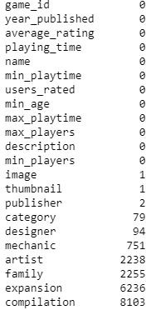
Data overview
The train set has 8,425 rows and 22 columns
There are missing data only in most of the categorical variables

Slide 6
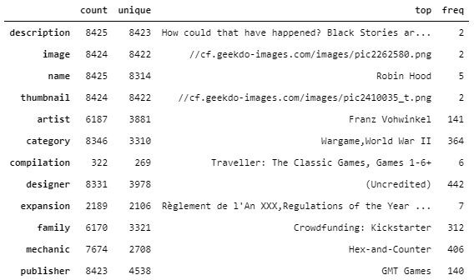
Categorical data
1. Data Cleaning:
Remove features that are not useful to discriminate the target: description, image, name, thumbnail, family, expansion, and compilation
Also remove game_id

Slide 7

Categorical data
2.
Feature engineering:
Counts derived from category aggregates
Each columns have multiple values that are separated by commas
Extract unique values and print out total number
of these values for each column
Derive new features that count number of artists,
designers, and publishers of each game
Remove columns: artists, designer, and publisher
Remove rows that have missing values

Slide 8
Categorical data
Categories derived from category aggregates
Get a set of all unique values in each variable
Create new columns based on these values
Iterate through all rows and ﬁll in dummy values for each new column
Group these dummy variables if possible
Note: One game can be assigned to more than one category/ mechanic
The next two pages represent bar plots of 44 game categories (grouped from 81 categories) and 51 game mechanics.
The data set now has 5,608 rows and 109 columns

Slide 9
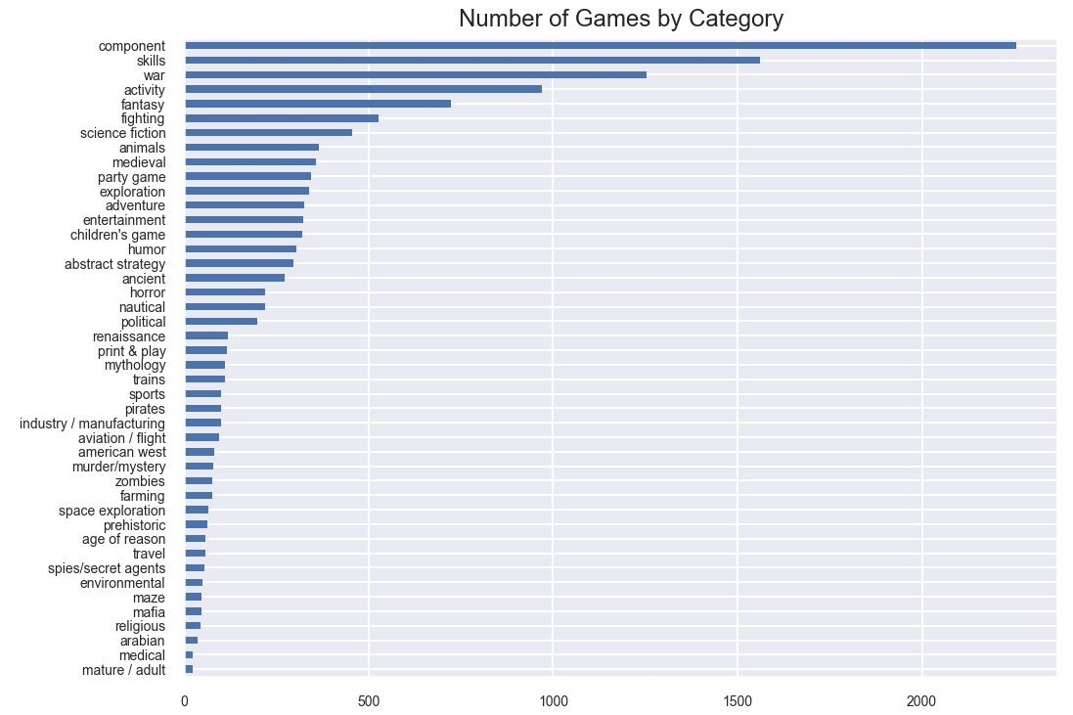

Slide 10
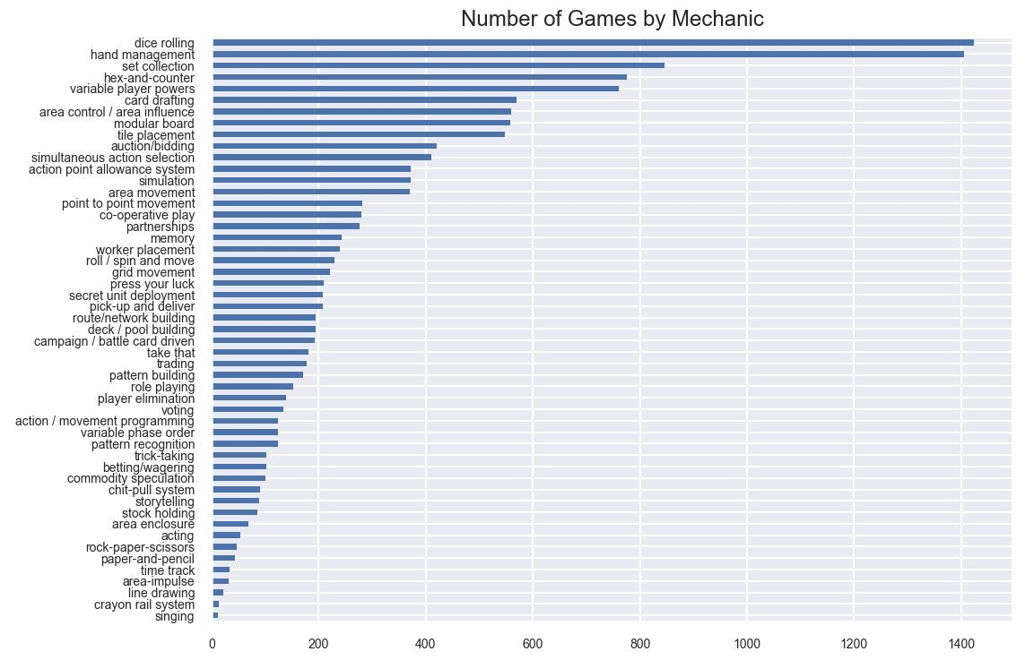

Slide 11
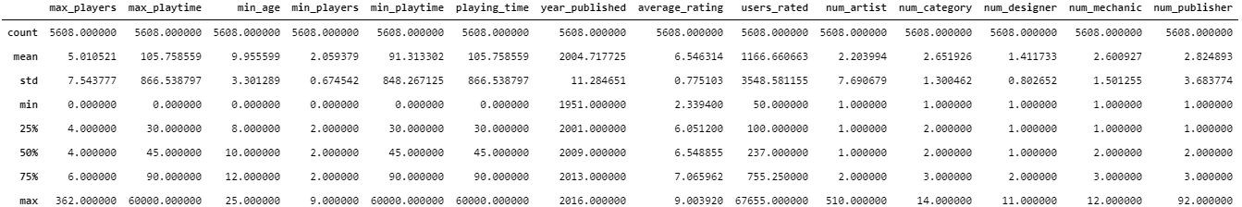
Numeric data
Data description

Slide 12
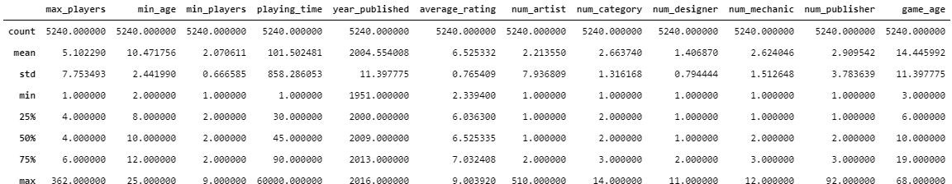
Numeric data
Data cleaning
Derive game_age from year_published
Remove max_playtime, min_playtime, and users_rated
Select data that have non zero values

Slide 13
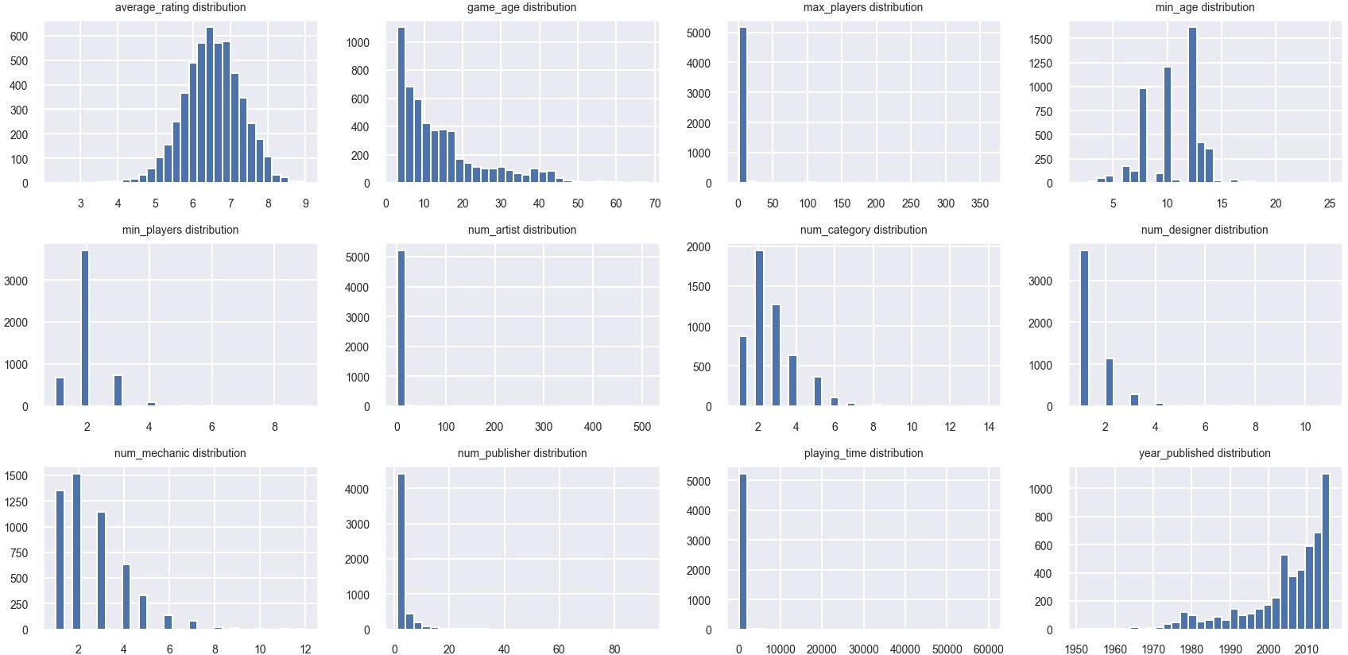
Numeric data

Slide 14
Numeric data
The target (average_rating) has a normal distribution
Most features are right skewed
Severe outliers

Slide 15
Numeric data
Feature engineering
Log transformation for skewed variables
Apply log transformation and check for skewness again.
The result shows that log transformation does not work well for num_artist, num_designer, num_publisher, and year_published
Next page present a pairplot of numeric features that have nearly normal distribution.

Slide 16
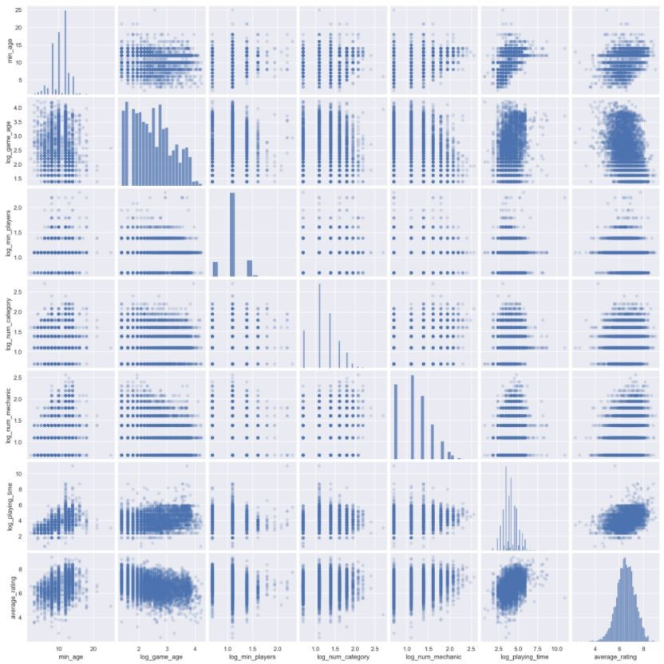
Numeric data
No strong linear relationship between the features and the target. Linear regression might not be well-suited to this problem
Might try adding polynomial and interaction terms and examine their correlation with the target

Slide 17
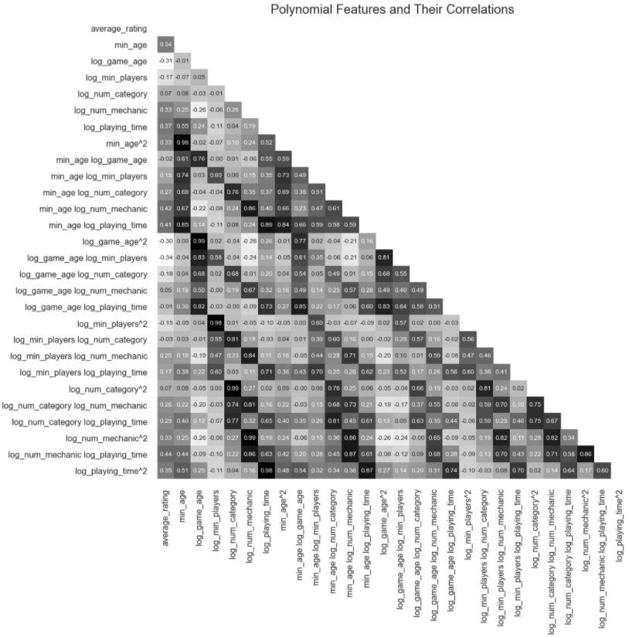
Numeric data
Adding polynomial and interaction terms
This plot shows that polynomial and interaction terms do not have signiﬁcantly higher correlations with the target comparing to the original features

Slide 18
Numeric data
Binning numeric data that cannot be scaled by log transformation
These are num_artist, num_designer, num_publisher, and year_published
Apply dummy transformation to these bins
New columns from these bins: group_artist_three_or_more, group_designer_three_or_more, group_max_players_ﬁve_or_six, group_max_players_seven_or_more, group_publisher_four_or_more, group_year_published_between_2001_and_2009, group_year_published_between_2010_and_2013, and group_year_published_between_2014_and_2016
Remove the original columns after transformation (log and binning). The data set now has 5,240 rows and 131 columns

Slide 19
Hypothesis testing
Main purpose: check if there are differences in average ratings between one group and others
Due to different variances between two groups, Welch’s t-test is used
Perform multiple tests across all categories, mechanics, and groups (derived from numeric data)
Sample of hypotheses:
H0: War games and other games have similar ratings on average
Ha: There is a difference in average ratings between war games and other games

Slide 20
Hypothesis testing
Result tables are shown in the next three pages. These values are sorted by p-values with colored bars (green for positive values and red for negative ones)
For those that have p-value < 0.05 and |t-value| > 1.96, we reject the null hypotheses
The sign of t-value suggests the direction of the test. A positive sign means that the group of interest has higher average ratings than others. On the contrary, a negative sign means that the group of interest has lower average ratings than others.

Slide 21
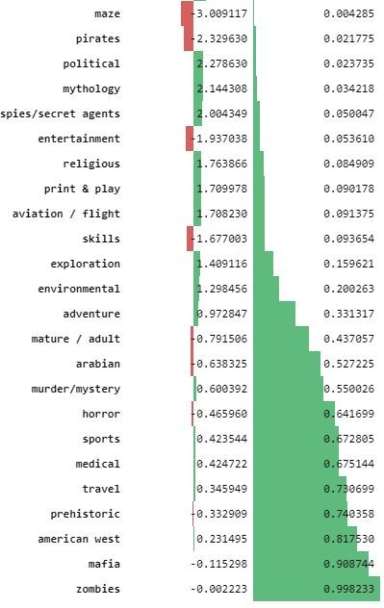
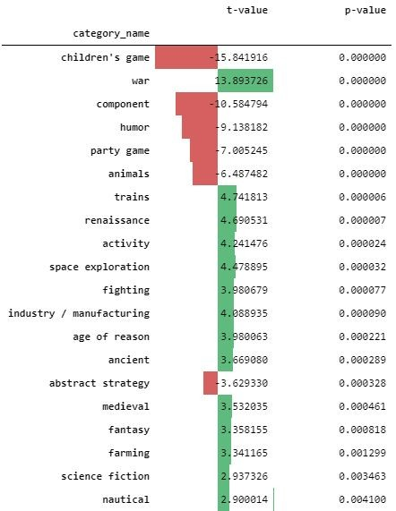

Slide 22
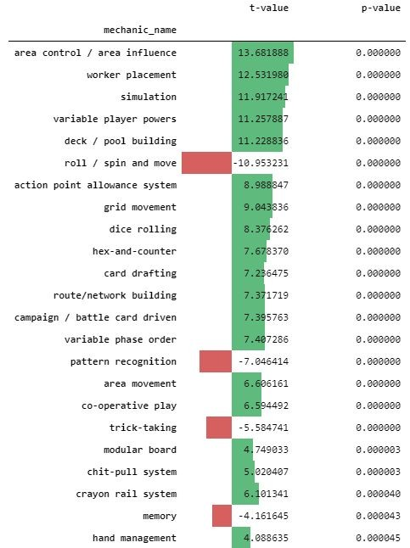
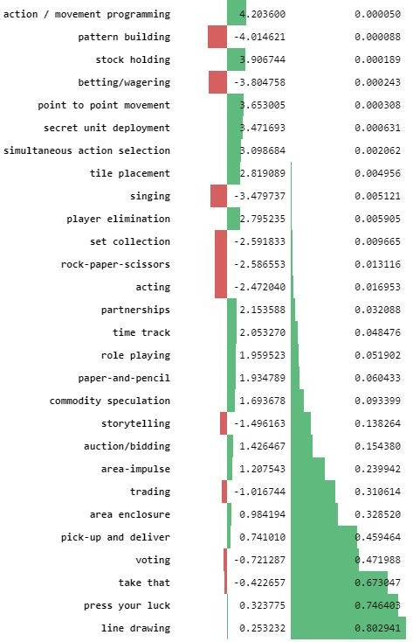

Slide 23
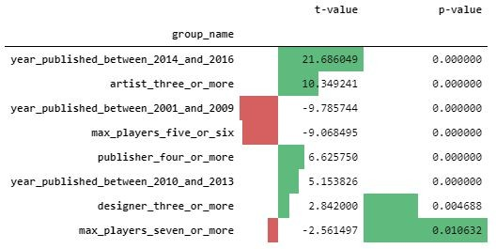
Hypothesis testing
These tables show that on average:
People like war games
People do not like children’s games and component games
People like games that use area control / area inﬂuence, worker placement, simulation, variable player powers, and deck / pool building
People do not like games that use roll / spin and move mechanic
People like games published between 2014 and 2016
People like games that were designed by three or more artists

Slide 24
Hypothesis testing
Since these features might have effects on each other, there need to be more analyses before jumping to a conclusion. For example, perhaps area control mechanic is mostly used in war games, or children’s games are mostly played by rolling and spinning. War games might be more complex and need more artists to complete.

Slide 25
Further data engineering and analyzing
Score game complexity by calculating weighted average of number of artists, number of designers, and number of publishers. Examine the relationship between this score and the target
Reduce categorical data dimensionality and create interaction terms among them or with numeric data
Apply mutual information regression for feature selection
Apply Backward Stepwise Regression
Build a pipeline to preprocess data and run the model on the test set

Slide 26
Conclusion
As shown in the analysis, linear regression might not be a good ﬁt to this data set. However, it might be good enough as a baseline model. To collect a better dataset, one might request the Board Game Geek API and retrieve other features such as weight (complexity rating), number of reviews, or explore available data from Kaggle.
Jupyter Notebook for this analysis can be found here:
https://github.com/RutwikPatel13/Exploratory-Data-Analysis-for-Machine-Learning/blob/master/Project-1.ipynb

