Slide 1
UTD Roommate Search Mobile Application

Slide 2
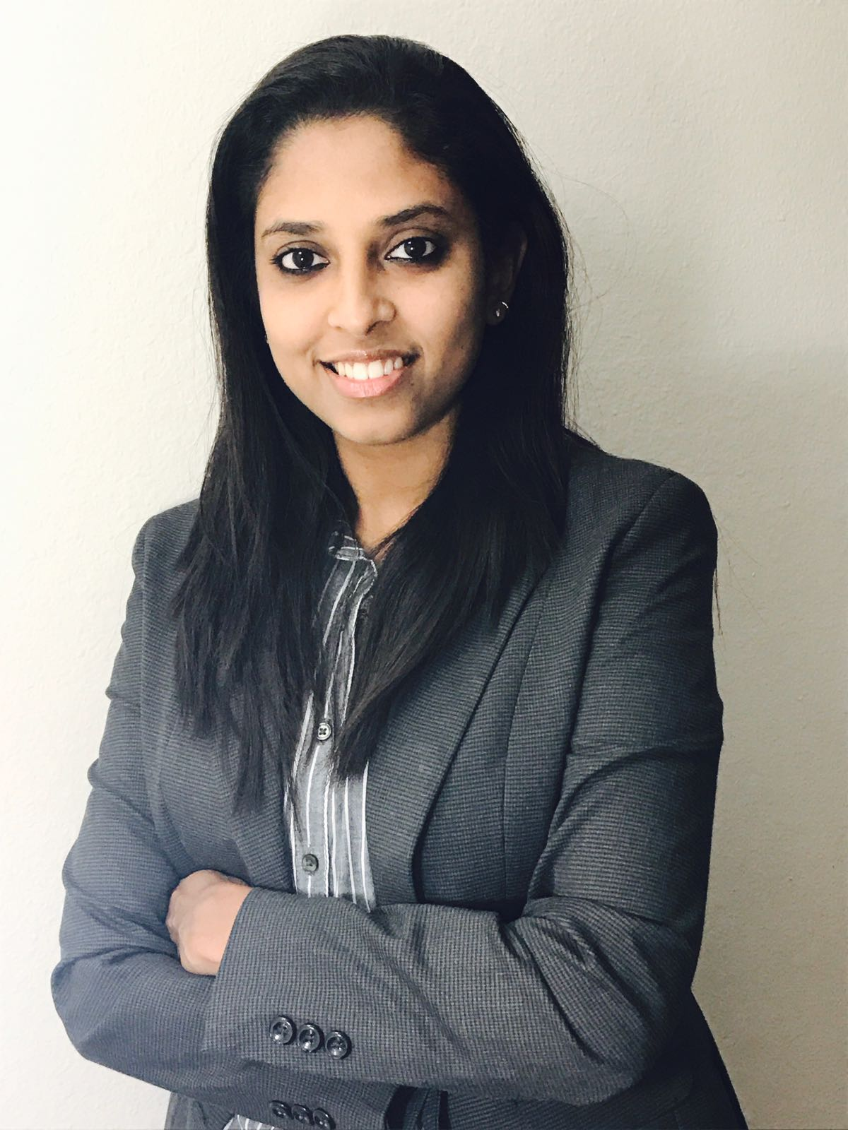

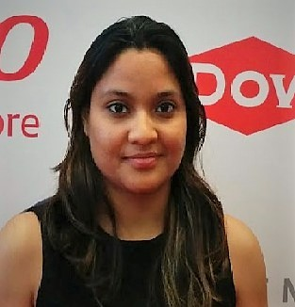
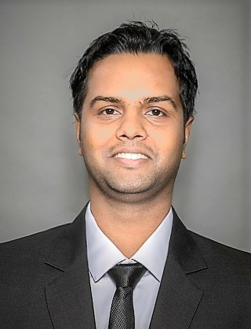
Team Members
Prema Siddu
Tejasvi Ramadas Sagar
Rutwika Mohanty
Mayank Madhav

Slide 3






Current Scenario
Need Roommate/house?
Many different sites and platforms to look at
Friends-Word of mouth

Slide 4
Features
Rating Feature
Message/Chat option
InMail notification
Filter options
Recommendation/suggestion feature
Upload docs/apartment photos
Payment gateways

Slide 5
Risks and Challenges
Technical failures such as Server failure
Insufficient data storage
Security issues.
Promotion of the application
Threat from competitors

Slide 6
Knowledge Gain
Cross platform application development.
Data warehousing and database.
Security and automation testing.
Business intelligence and analytics
Social networking and E-commerce domain knowledge.

Slide 7
Thank you!

