Slide 1
Water Quality Prediction using Machine Learning
Presented by
G RUTWIZ GANGADHAR

Slide 2
INTRODUCTION
Water quality plays a great importance in our daily life
Water is a vital resource that affects various aspects of human, health and lives.
Today’s world with rapid development, Water pollution has become more serious.
Prediction of Water quality protects the human health

Slide 3
PROBLEM STATEMENT
Today’s world with rapid development, water pollution has become more serious
Drinking impure water leads to various health issues and harmful diseases such as Diarrhea, Nausea and much more
So people need to make sure that they drink pure water
People living in major cities are concerned about water quality,calling for technology that can monitor the water quality.

Slide 4

SOLUTION
The solution is to build a model which predicts the quality of water.
Thus it can help prevention from harmful diseases.
By using this model,one can make sure whether water is pure or not.
Type to enter a caption.

Slide 5
MODELLING METHODS:
The prediction of water quality components can be done by using artiﬁcial intelligence (AI) techniques including MLP, SVM, and group method of data handling (GMDH). And also be done using machine learning(ML) techniques including Random forest regressor , Decision tree , Support Vector Machines (SVM), Neural Networks (NN), Deep Neural Networks (Deep NN) and k Nearest Neighbors (kNN), with the highest accuracy of 93% with Deep NN.
The aim of this study is prediction of water quality components is done by using machine learning methods i.e, Random forest Regressor.

Slide 6
RANDOM FOREST REGRESSION
A Random Forest is an ensemble technique capable of performing both regression and classification tasks with the use of multiple decision trees and a technique called Bootstrap and Aggregation, commonly known as bagging. This part is called Bootstrap.
Below is a step by step sample implementation of Random Forest Regression.
Step 1 : Import the required libraries.
Step 2 : Import and print the dataset.
Step 3 : Select all rows and column 1 from dataset to x and all rows and column 2 as y
Step 4 : Fit Random forest regressor to the dataset
Step 5 : Predicting a new result
Step 6 : Visualising the result

Slide 7
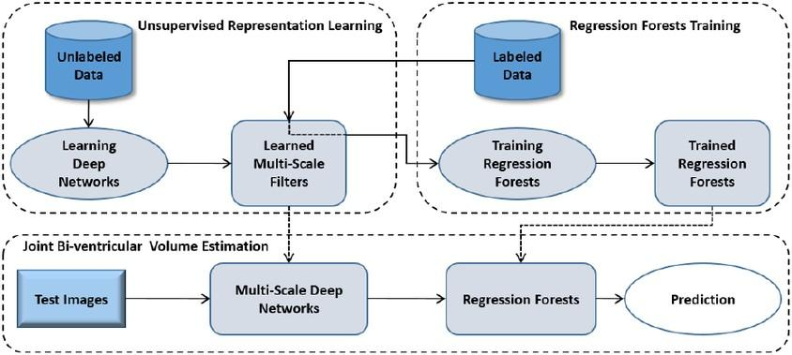
BLOCK DIAGRAM OF
RANDOM FOREST REGRESSOR

Slide 8
DATASET PREPARATION
Dataset pre-processing
Import the libraries
Import the Dataset
3.Data visualization
Taking care of Missing Data
Splitting the Data into Train and Test Model Building
Training and Testing the Model
Evaluation and the final predicting method should be such that the accuracy should probably be at most.
Application Building
1.Create an HTML Files
2.Structuring a proper Python Code

Slide 9
PREDICTION
The water quality prediction dataset is collected from water samples from various areas in India.There are 9 parameters taken in the dataset some of which are various pollutant measures columns and each column consists of the average values over a period of time.The entire dataset observations are made between 2003-2014.It is comprised of 9 variables which are:
Temp : The average values of temperature over time.
D.O(mg/l) : The average values of D.O of water over time.
PH: The average values of ph of water over time.
Conductivity: The average values of conductivity of water over time.
B.O.D: The average values of B.O.D of water over time.
Nitrate N N+: The average values of NA over time.
Fecal coliform: The average values of fecal coliform of water over time.
Total coliform: The average values of total coliform of water over time.

Slide 10
Water quality constraints to decide the purity:
Excellent: (WQI Value 95-100) – Water quality is protected with a virtual absence of impairment; conditions are very close to pristine levels.
These index values can only be obtained if all measurements meet recommended guidelines virtually all of the time.
Very Good: (WQI Value 89-94) – Water quality is protected with a slight presence of impairment; conditions are close to pristine levels.
Good: (WQI Value 80-88) – Water quality is protected with only a minor degree of impairment; conditions rarely depart from desirable levels.
Fair: (WQI Value 65-79) – Water quality is usually protected but
occasionally impaired; conditions sometimes depart from desirable levels.
Marginal: (WQI Value 45-64) – Water quality is frequently impaired; conditions often depart from desirable levels.
Poor: (WQI Value 0-44) – Water quality is almost always impaired; conditions usually depart from desirable levels.

Slide 11
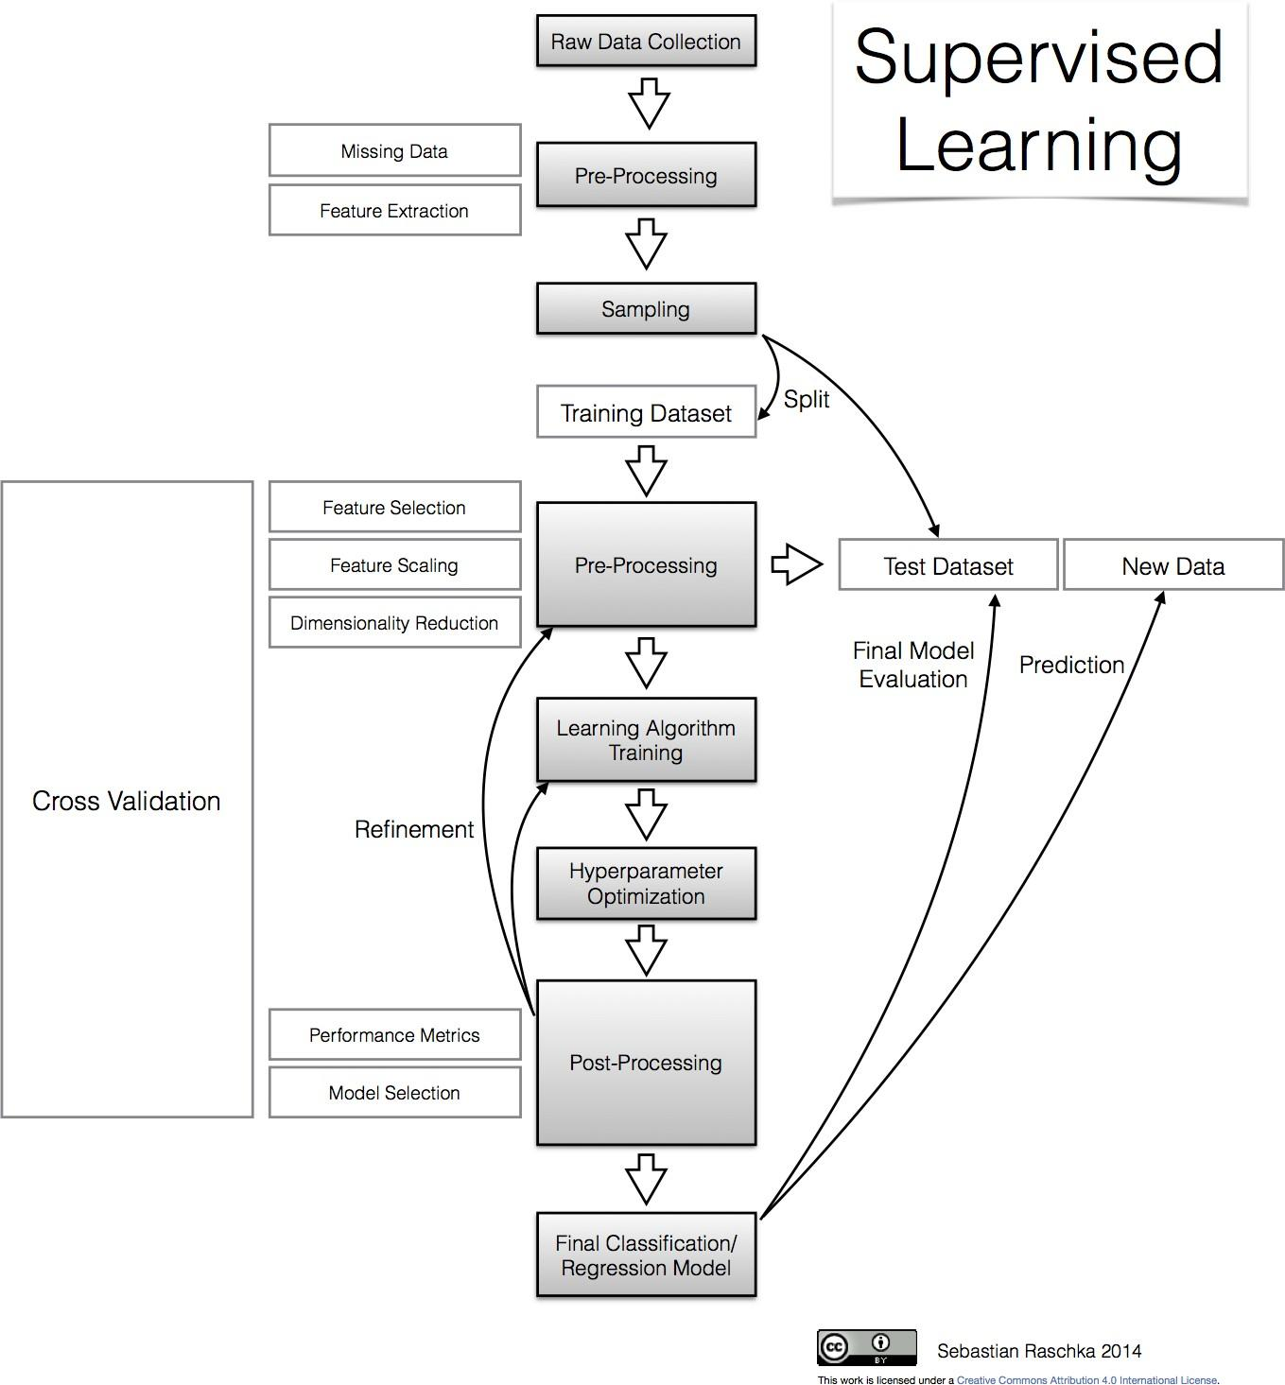


Slide 12
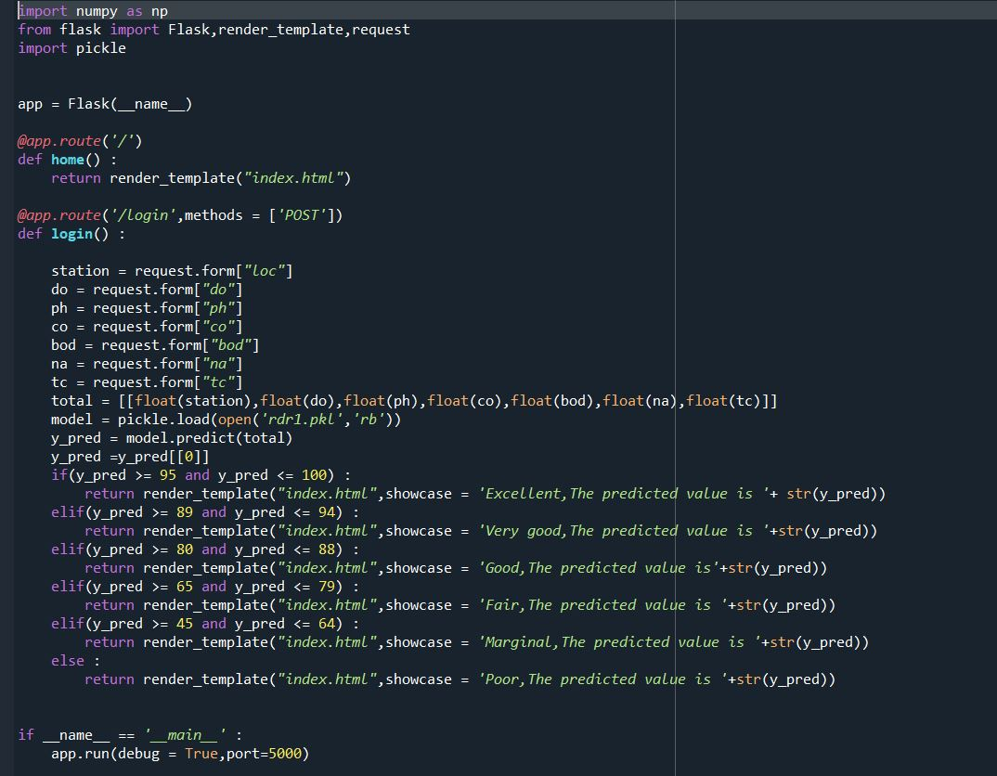
Application Building:

Slide 13
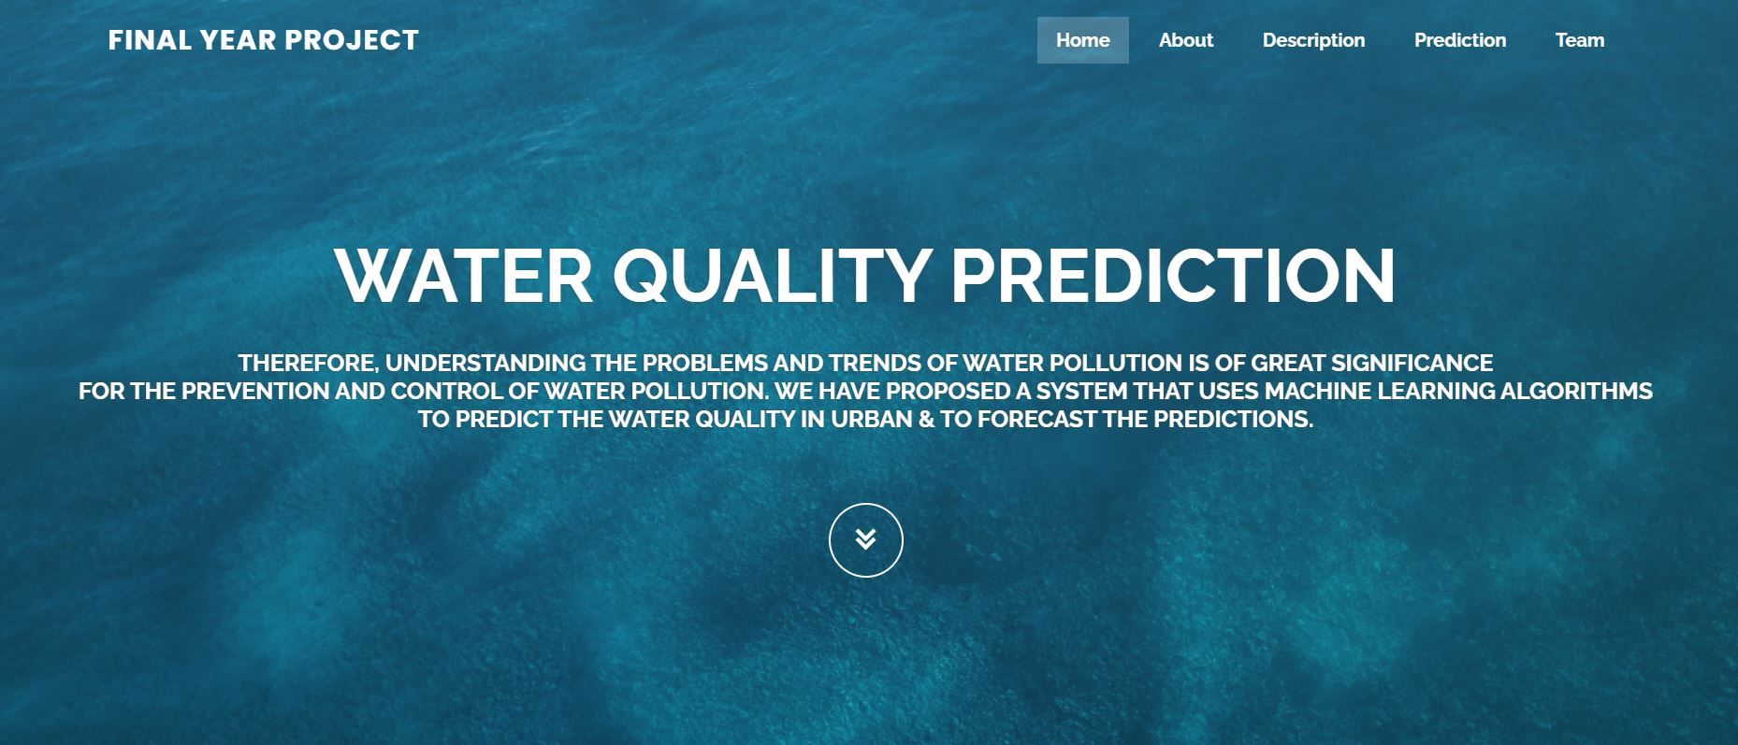
Front End Design :

Slide 14
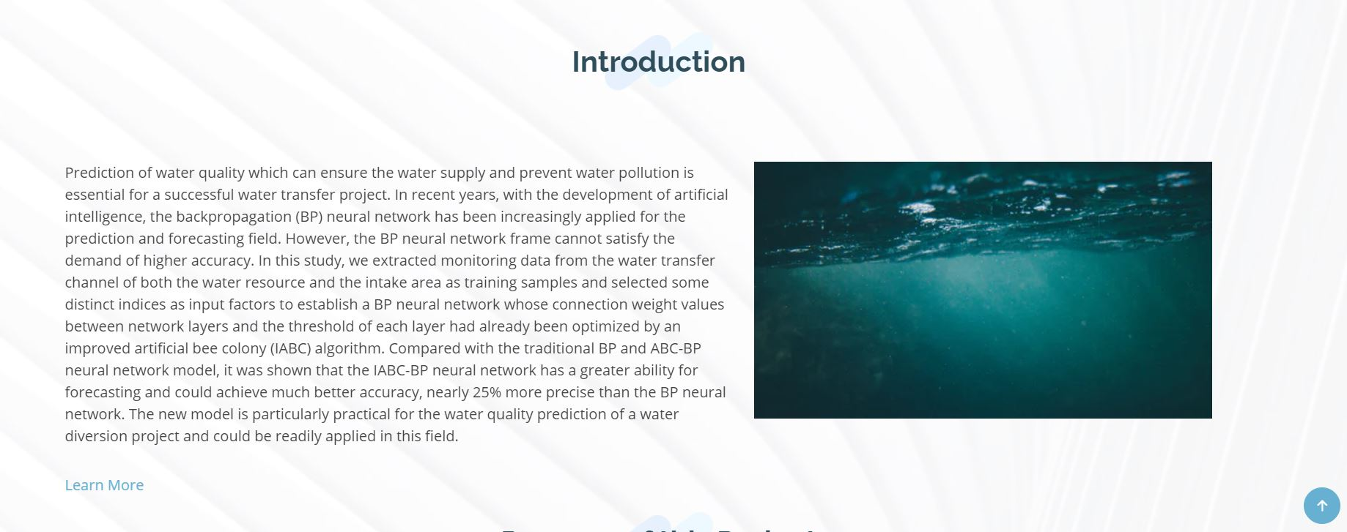

Slide 15
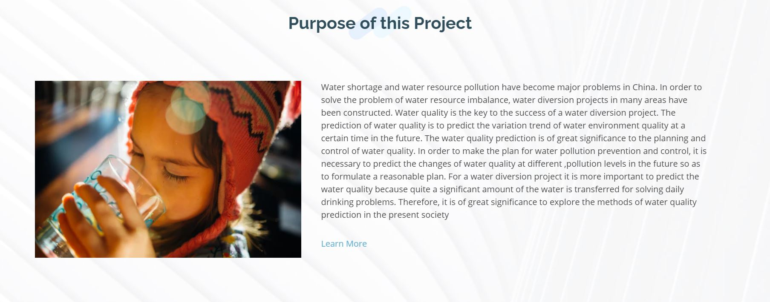

Slide 16
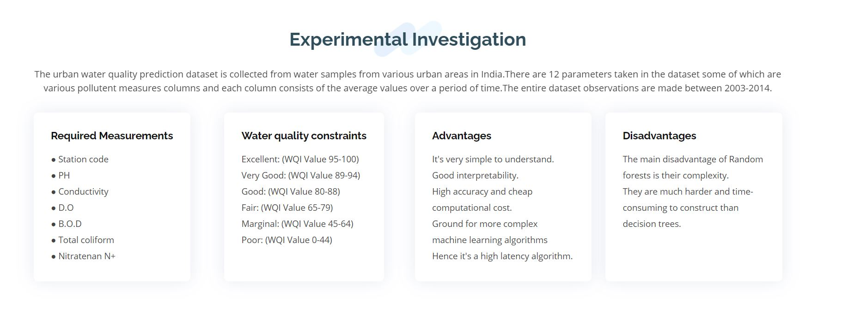

Slide 17
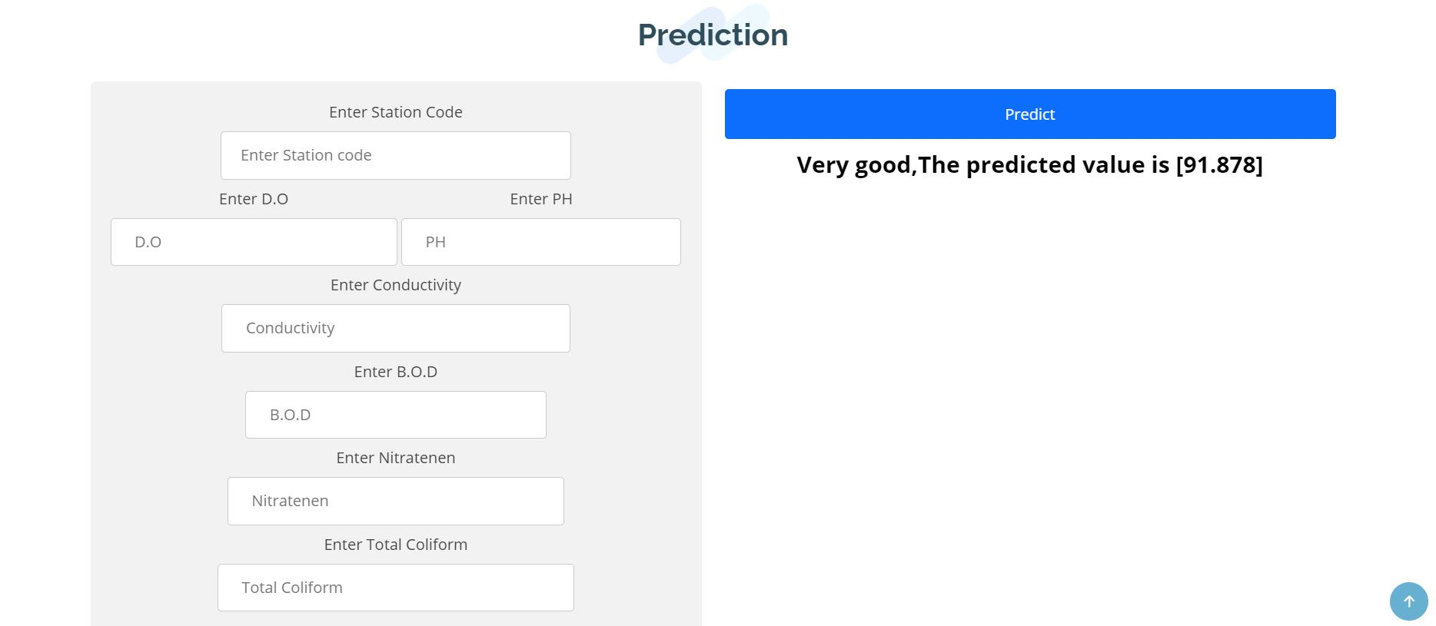

Slide 18


Slide 19
RESULT
In this project, we discovered a dataset containing required information for predicting the quality of water at various locations with its states for Water Quality
Prediction and better understood the raw data using exploratory analysis. The dataset described the quantity of various chemicals present in water over different years. We explored and understood the dataset using a suite of line plots for series data and histogram for the data distributions. We used the new understanding of the problem to consider different framings of the prediction problem, ways the data may be prepared, and modelling methods that may be used. Finally, we chose Random Forest Regression model as it offered highest accuracy. Then we implemented ous model to predict the quality of water given by various quantities like pH, D.O., Conductivity, etc . Using a local host web application we have provided an end-to-end demonstration of how you can use machine learning to determine the water quality in area based on the data of different quantities.

Slide 20
APPLICATION
The proposed solution to predict the quality of water using machine learning can be extended and can be used everywhere to check the quality of water.
The web application product can then be used to learn from the data and predict the quality of water for any sort of values of the input variables. This proposed solution is more applicable and beniﬁcial in India.

Slide 21
FUTURE SCOPE
Among various sources of water supply, due to easy access, rivers have been used more frequently for the development of human societies. Using other water resources such as groundwater and seawater sometimes assisted with problems. So, this system can predict the quality of water whether its is fair, good, or excellent so that many people can use the water for various purposes .

Slide 22

THANK YOU

