Slide 1

King County Housing Data

Slide 2
Goal
What are the greatest influencers when it comes to buying a house in king County?
How to predict the price of the house?

Slide 3
Data Set
The Data set consists of more than 21000 houses data
Id
Price
Grade
Zip code
Floors
Bedrooms
Waterfront
Sqft_ living
bathrooms,
date sold etc

Slide 4
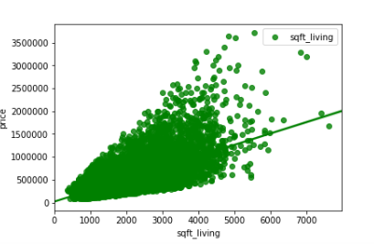
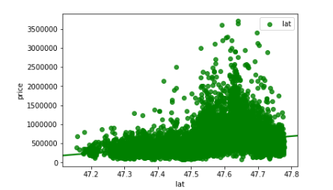
The Process
Performing Exploratory Analysis
Removing outliers, Null values
Treating the categorical and continuous variables
Performing Linear regression on various features

Slide 5
Model Results & Influential features
Our model accuracy is 78%
The most important features in predicting house price are
Square foot living
Condition
Location(Latitude)
Bedrooms
View
Renovated

Slide 6
Recommendation
Check for location as location plays important role. Maybe the city area.
Go for houses with more bedrooms and more square foot living area.
Check for the condition of the house. Your hint to check condition would be if the house is really cheap compared to other houses with same features.
If the house is viewed more then maybe you should check that particular house.

