Slide 1
Program for Analysis of Context-Free Grammars
By
Ruubesh Govindaraj (GOV0005)

Slide 2
Lack of accessible tools and steep learning curve
Implemented the program using Python and Tkinter
Features of the application
- Automatic and manual derivation
- Creating and editing grammars
- Performing transformations
- Computing FIRST and FOLLOW sets
- Detecting grammar properties and
different kinds of conflicts

Slide 3
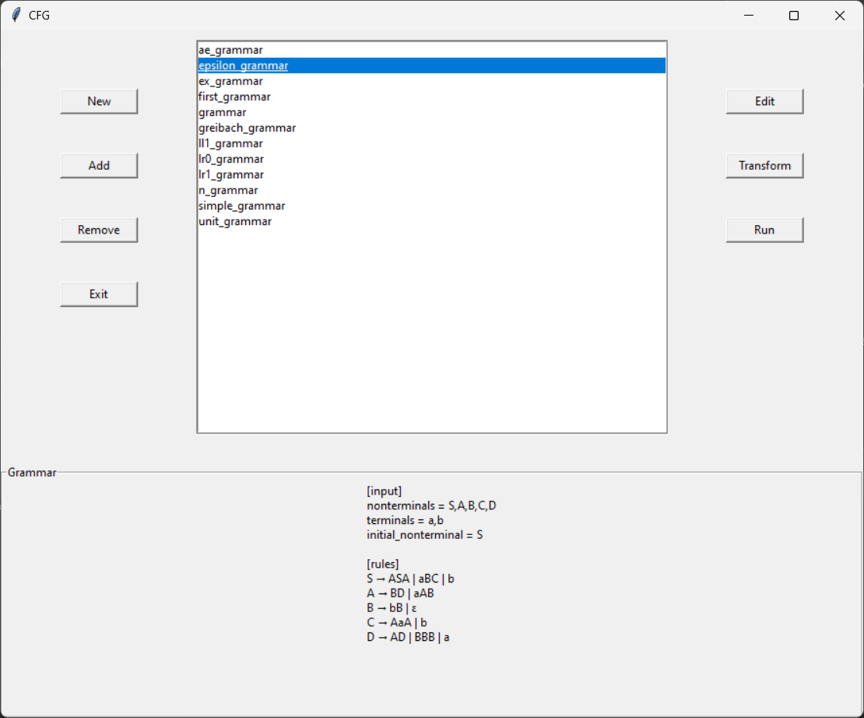

Slide 4
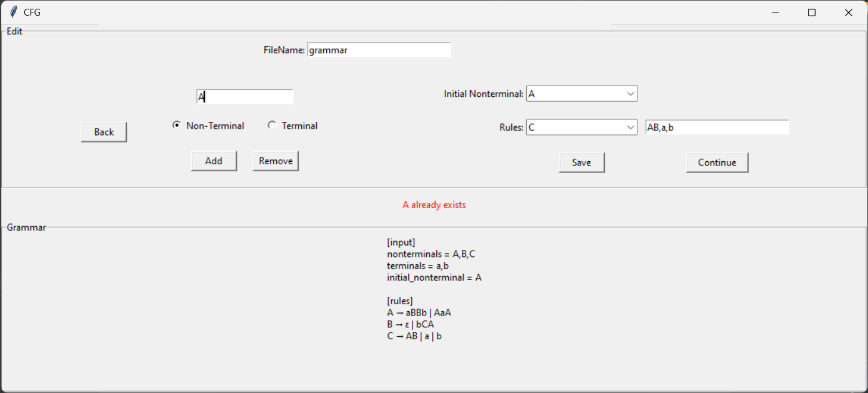

Slide 5
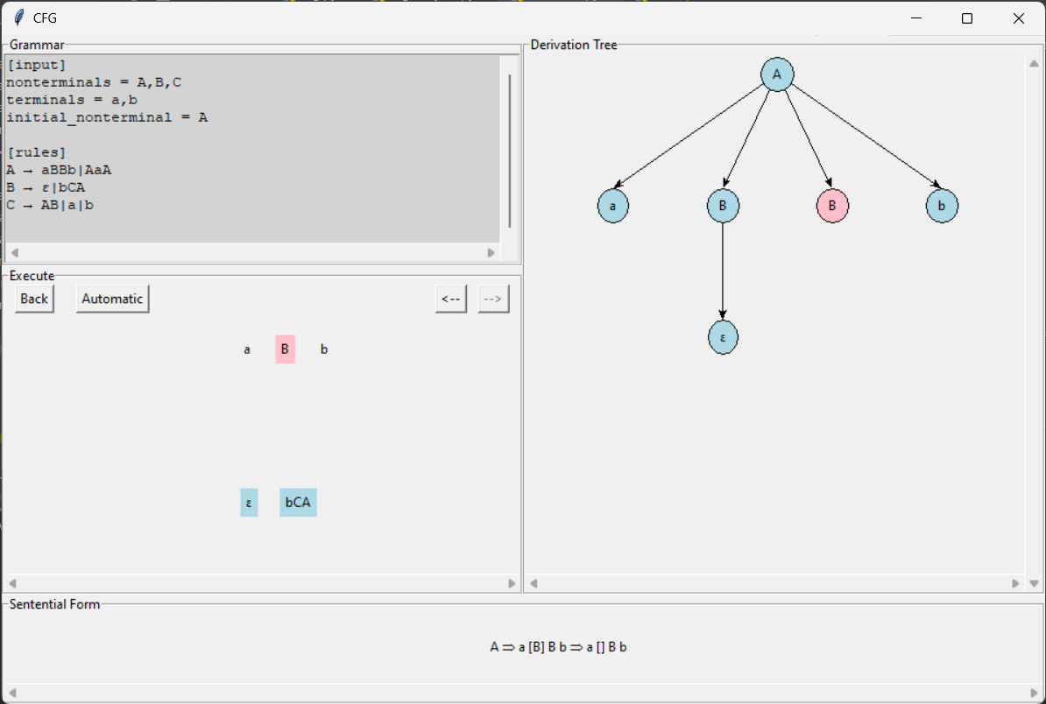

Slide 6
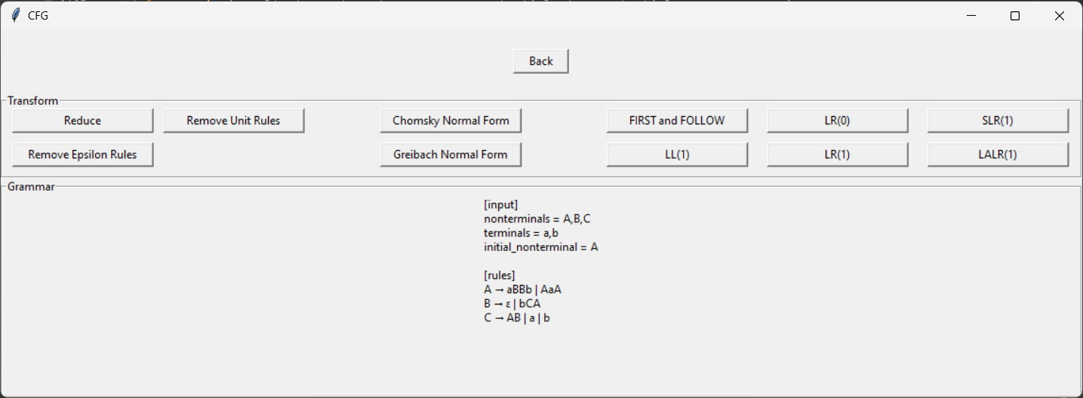

Slide 7
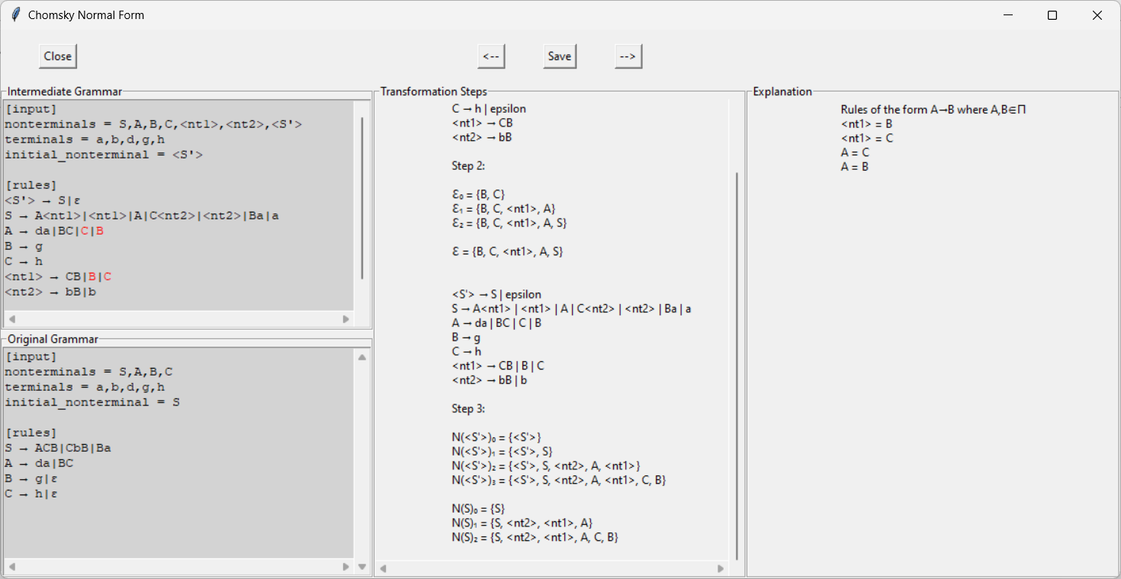

Slide 8
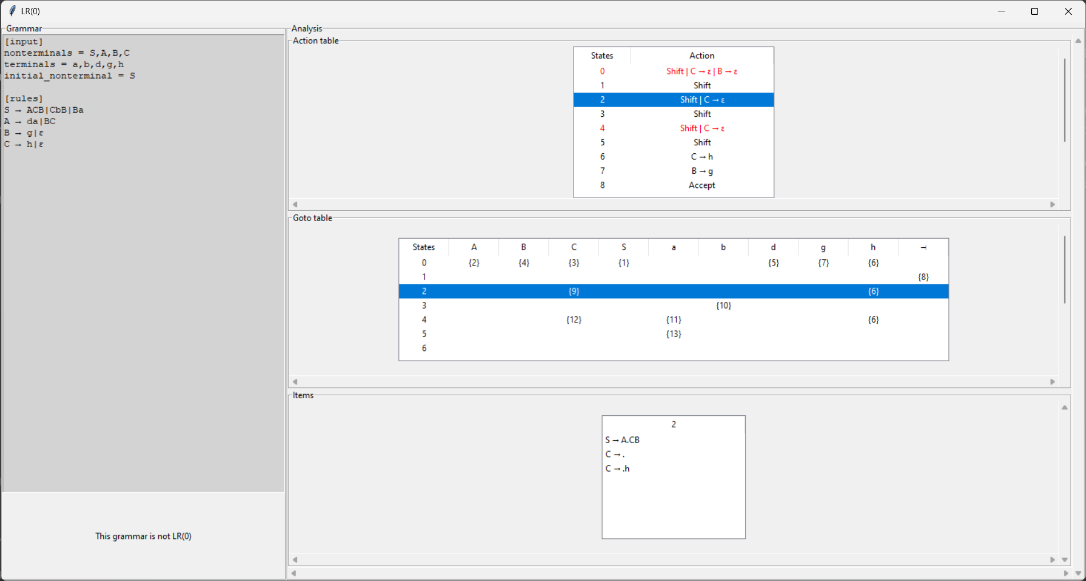

Slide 9
Technologies Used
python
tkinter
re
configparser
os
itertools
copy
Tempfile
shutil

Slide 10
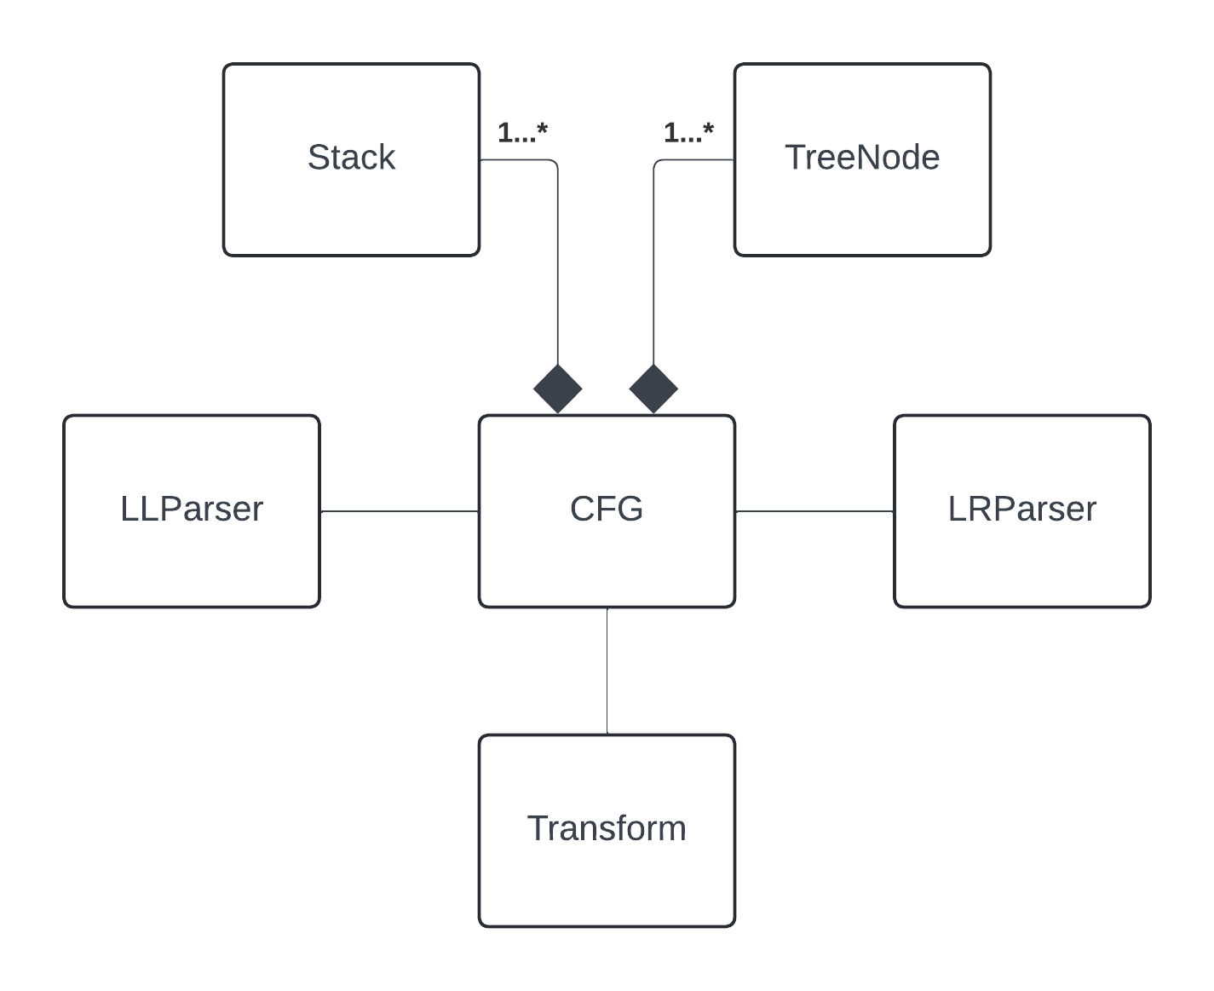

Slide 11
Conclusion
User-friendly tool
Transparency and usability

Slide 12
Thank you for your attention

