Slide 1

HackAThon TSMD
Ruud Wagemaker

Slide 2


Introduction to the problem

Slide 3
Introduction to the problem

Slide 4
Introduction to the problem

Slide 5
Introduction to the problem

Slide 6
Introduction to the problem

Slide 7
Introduction to the problem

Slide 8
Introduction to the problem

Slide 9
Introduction to the problem

Slide 10
Introduction to the problem

Slide 11
Introduction to the problem

Slide 12
Introduction to the problem

Slide 13

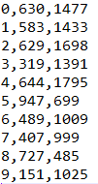
Input Output
Location Money Bin
Solution 1
Solution 2
Go from 0 to
Customer ID
Go from 5 to
Y coordinate
X coordinate

Slide 14
Goal
Minimize the longest of the two routes
Send output file to ruud.wagemaker@ortec.com

Slide 15
GitHub
Find files at https://github.com/RuudWag/TSMD
5 cases with:
10
100
1000
5000
10000
Basic implementation of C++, C# and python

Slide 16
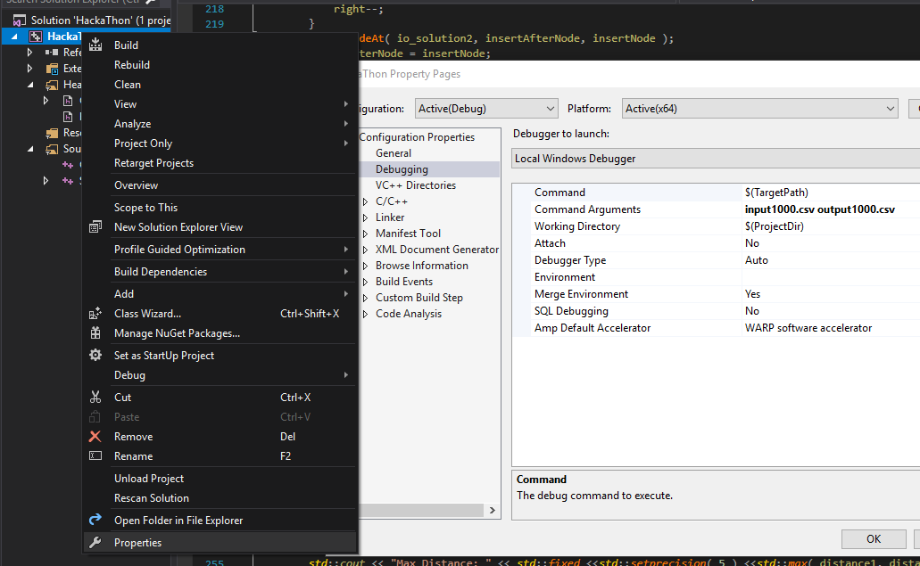
C++
Set command arguments
Press play

Slide 17
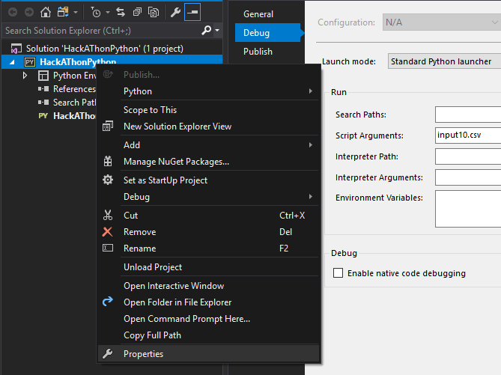

Python
Set command arguments
Press start

Slide 18

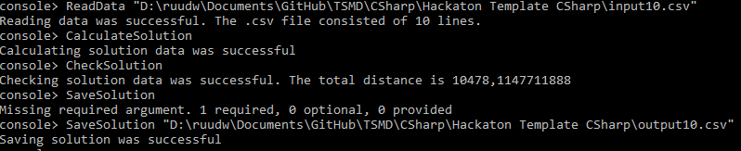
C#
Press start
Use console to read/save data and start calculateSolution

Slide 19
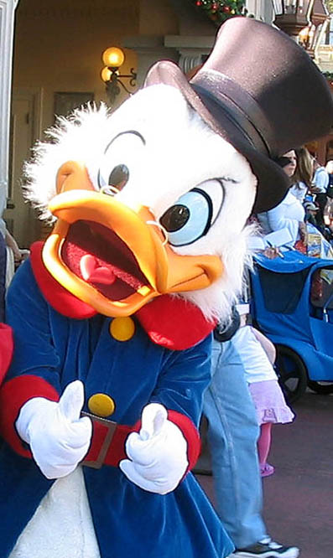
Good Luck!

