Slide 1
GOVERNMENT CHALLENGE · SOLUTION PRESENTATION
SENTINEL VISION
Unified CCTV Intelligence & Real-Time Smart Policing Platform
Camera integration · AI video analytics · ANPR · Alerts & incidents · Evidence · GIS · Self-Heal
Every capability shown is implemented in the repository and labelled Current, Demonstrated or Future.
github.com/RuudyLinux/SENTINEL-AI · September 2026
Notes:
Introduce SENTINEL VISION and say up front that everything shown is labelled current, demonstrated or future.

Slide 2
PROBLEM
The problem control rooms face today
Fragmented CCTV
Cameras sit behind different vendors, recorders and VMS products, each with its own screen.
Manual monitoring burden
Operators watch many feeds at once; attention does not grow with camera count.
Delayed identification
A watch-listed vehicle or a restricted-area intrusion is often found after the fact.
Hard investigations
Tracing a vehicle means scrubbing footage camera by camera and collecting evidence by hand.
Camera health
Streams drop, credentials fail and bandwidth varies, often without anyone noticing.
SENTINEL VISION · Unified CCTV Intelligence & Real-Time Smart Policing Platform
2

Slide 3
SOLUTION
SENTINEL VISION in one sentence
One web platform that connects cameras from any source, watches them with AI, raises alerts when rules are broken, and hands operators verifiable evidence and a map to act on.
Connect
Detect
Decide
One camera registry for webcam, video, RTSP and the Sentinel Grid
People, vehicles and number plates, per camera
Zones, watchlists and loitering rules raise alerts
Respond
Prove
Stay up
Alerts grow into correlated incidents
Hashed snapshots, clips and incident evidence packages
Self-Heal reconnects cameras and reports what failed
SENTINEL VISION · Unified CCTV Intelligence & Real-Time Smart Policing Platform
3

Slide 4
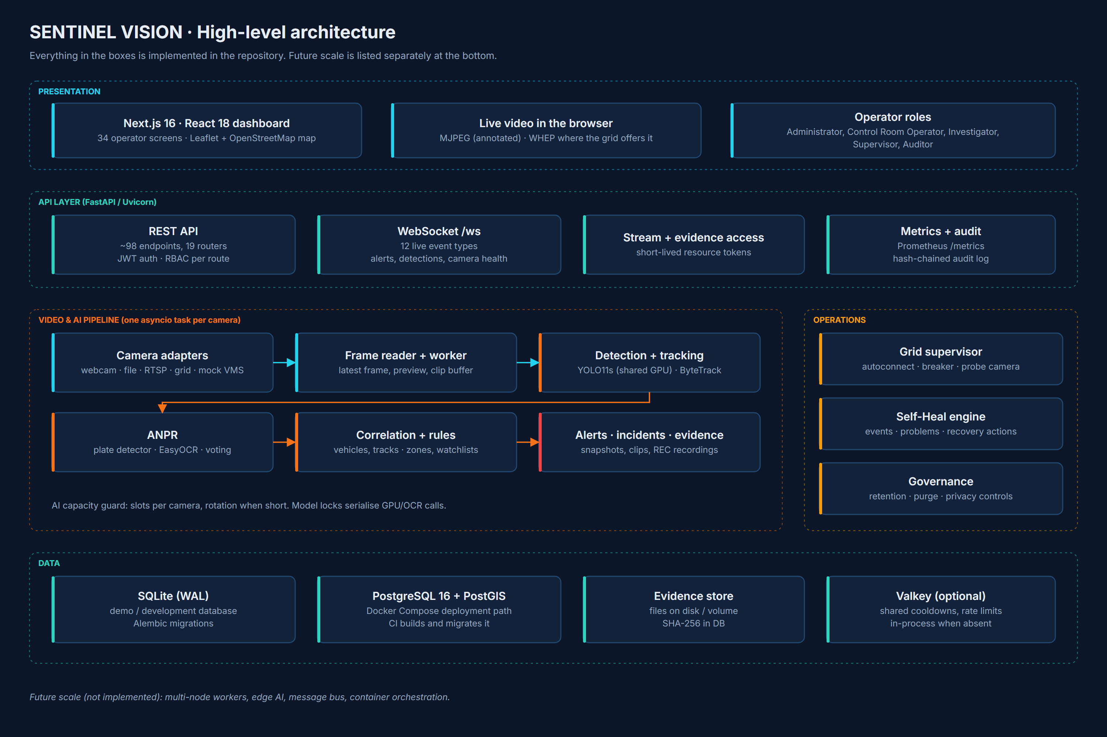
ARCHITECTURE
Solution architecture
Four tiers: Next.js dashboard · FastAPI REST + WebSocket · per-camera AI pipeline · SQLite / PostgreSQL + evidence store. Everything shown is implemented.
SENTINEL VISION · Unified CCTV Intelligence & Real-Time Smart Policing Platform
4

Slide 5
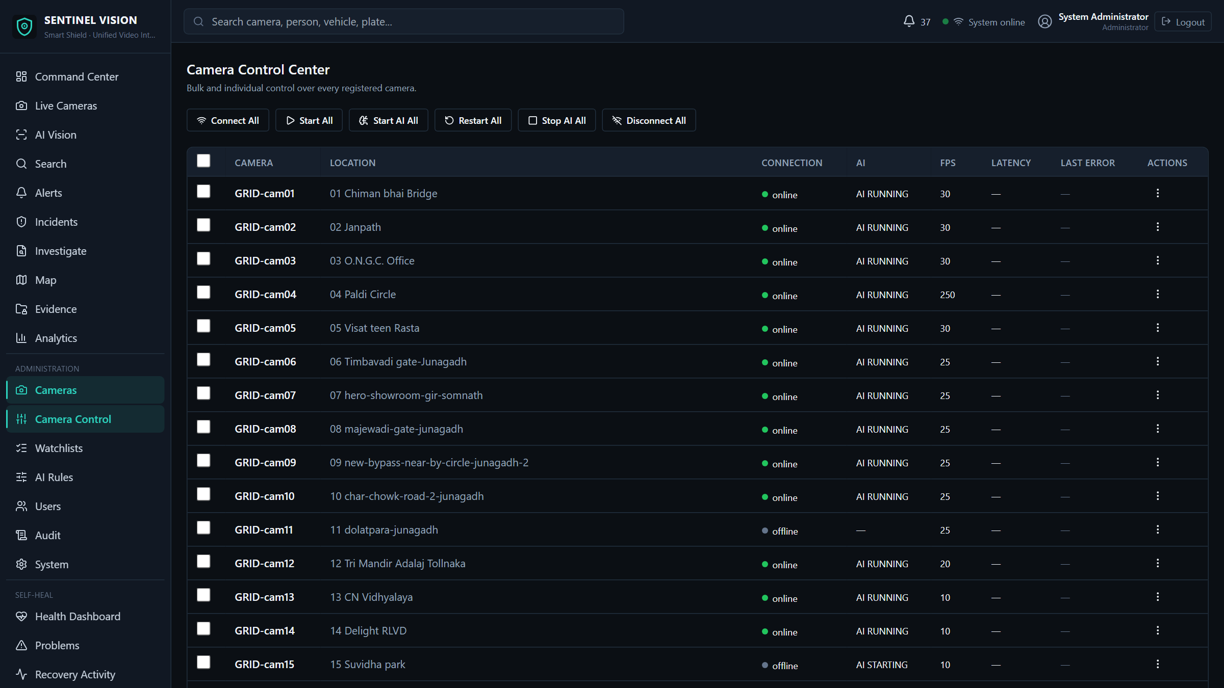
CAMERA INTEGRATION
CCTV and camera integration
Central camera registry
CURRENT
Every camera in one catalogue with location, status and AI switches.
Camera adapters
CURRENT
Webcam, uploaded video, RTSP (TCP or UDP), mock VMS behind one interface.
Sentinel Grid
DEMONSTRATED
Catalogue sync of 30 cameras, autoconnect, bulk control. Streaming is partial today (see slide 12).
VMS federation
FUTURE
New VMS products join as adapters; ONVIF is an interface stub.
SENTINEL VISION · Unified CCTV Intelligence & Real-Time Smart Policing Platform
5

Slide 6
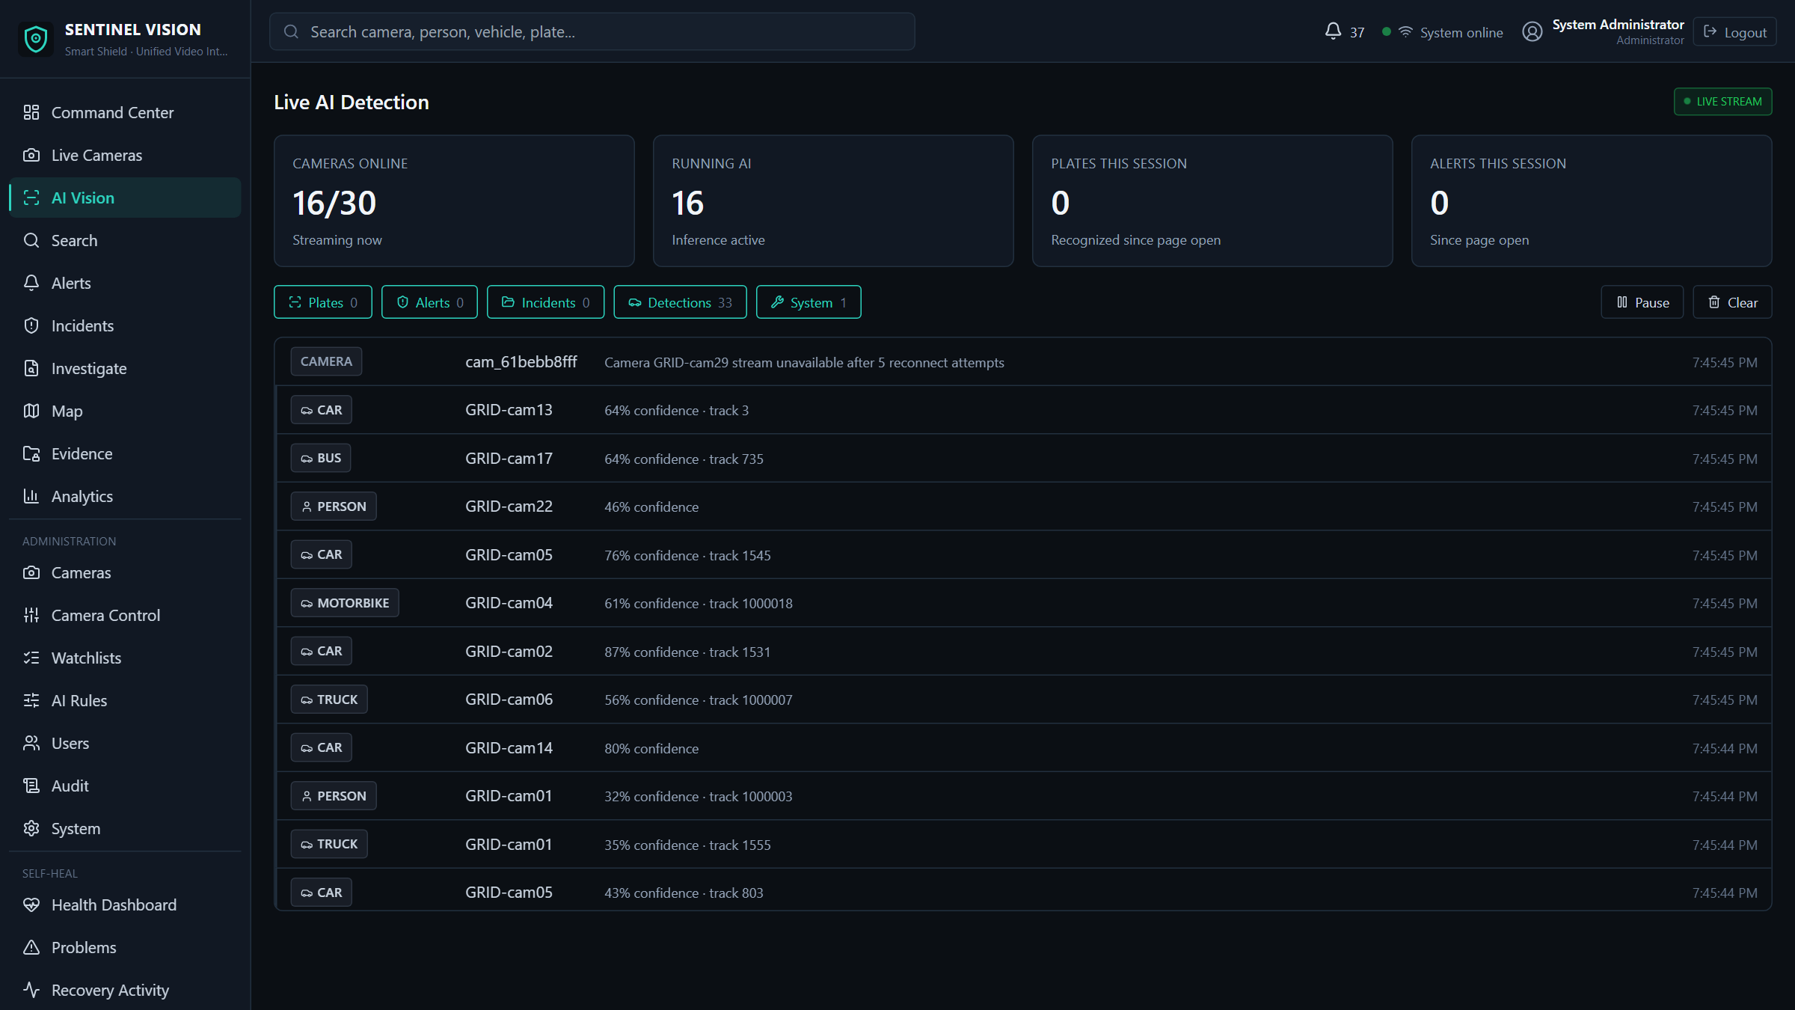
AI VIDEO ANALYTICS
AI video analytics
Ultralytics YOLO11s
CURRENT
Person and vehicle detection at 960 px on one shared GPU model (successor to the earlier YOLOv8s baseline).
ByteTrack
CURRENT
A tracker per camera, so every object keeps one ID across frames.
EasyOCR ANPR
CURRENT
A plate detector finds the plate; EasyOCR reads it; reads are voted across frames.
Selective analytics
CURRENT
Person, vehicle and ANPR switched per camera; AI slots rotate when hardware is short.
SENTINEL VISION · Unified CCTV Intelligence & Real-Time Smart Policing Platform
6

Slide 7
EVENT PROCESSING
Intelligent event processing
Detection
Tracking
OCR
Rules
Alert
Incident
YOLO11s finds people and vehicles
ByteTrack keeps one ID per object
Plate read, voted across frames
Zones · watchlists · loitering · risk score
Reasons, severity, pushed live
CRITICAL alerts open or join one
A one-frame plate read is stored but goes to review; CRITICAL watchlist alerts need corroboration across frames.
Cooldowns per camera, rule and track stop one object raising the same alert every frame.
One vehicle crossing several cameras becomes one incident whose title and priority grow with it.
SENTINEL VISION · Unified CCTV Intelligence & Real-Time Smart Policing Platform
7

Slide 8
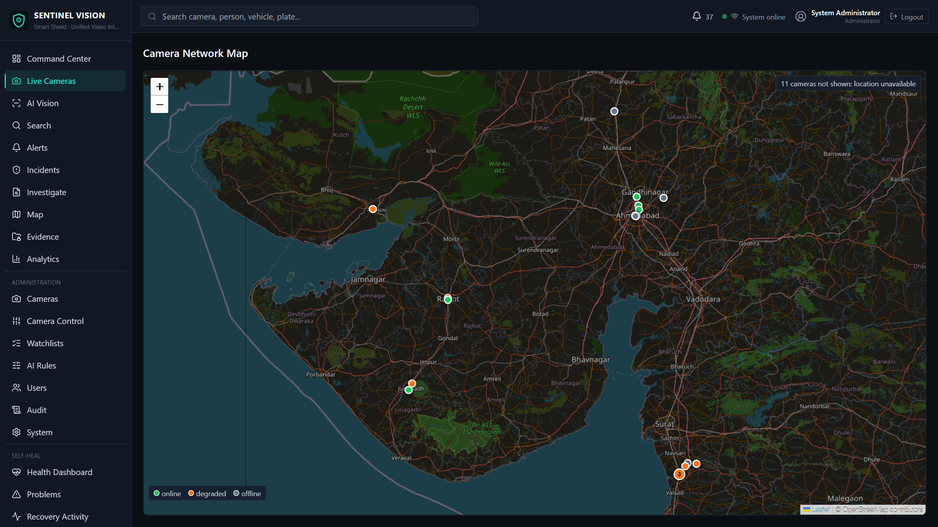
GIS
GIS and camera intelligence
19 of 30 grid cameras mapped
CURRENT
Positions looked up in OpenStreetMap from each camera's place name.
11 intentionally not mapped
LIMITATION
No reliable match, so they are not guessed; the map says so.
Clustered markers + legend
CURRENT
Cameras sharing a spot (three in Bilimora) form one marker; amber = degraded.
Vehicle journey map
CURRENT
Sightings drawn on camera positions; GRID-cam06 verified at Timbavadi, Junagadh.
SENTINEL VISION · Unified CCTV Intelligence & Real-Time Smart Policing Platform
8

Slide 9
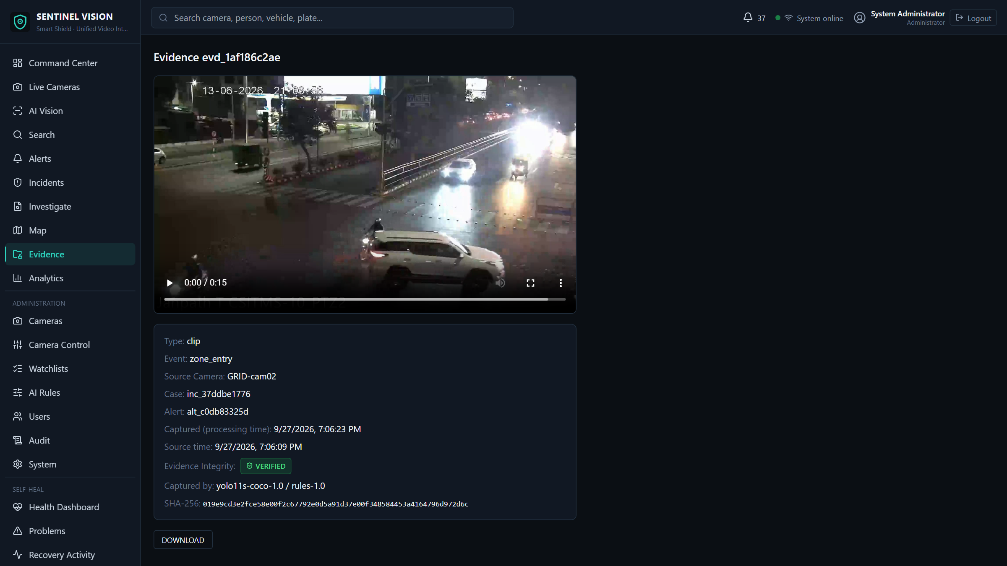
ALERTS & EVIDENCE
Alerts, incidents and evidence
Alerts
CURRENT
Reasons, severity and risk factors; acknowledge, escalate or dismiss.
Incidents
CURRENT
Correlated across cameras, with notes and a summary.
Evidence
DEMONSTRATED
Snapshot per alert, event clips, operator REC recordings; SHA-256 at capture, VERIFIED on access.
Evidence package
CURRENT
Per incident, JSON or PDF, optional plate redaction; every access audited.
SENTINEL VISION · Unified CCTV Intelligence & Real-Time Smart Policing Platform
9

Slide 10
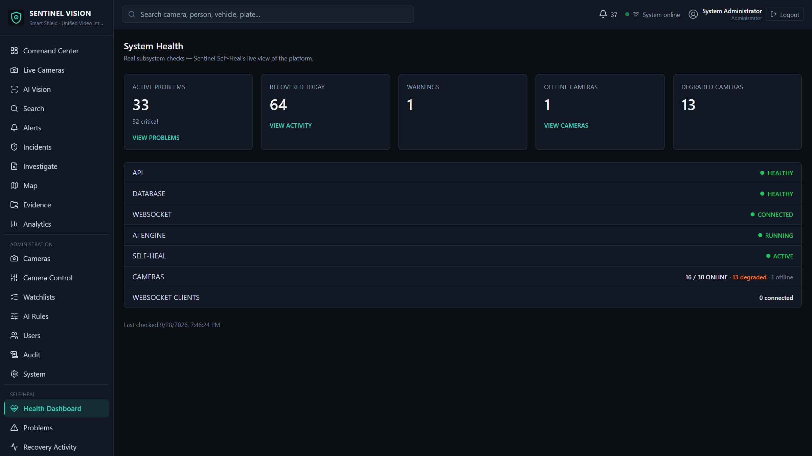
RELIABILITY
Self-Heal and reliability
Camera health
CURRENT
Each camera reports CONNECTED, PROCESSING, DEGRADED, RECONNECTING or AUTH_ERROR.
Reconnect + backoff
CURRENT
Per-camera backoff; a grid-wide breaker pauses 5 to 60 min and probes with one camera first.
Database retry
CURRENT
Locked writes are rolled back, reapplied and logged as Self-Heal events.
Failure isolation
CURRENT
One camera crashing never stops the others; the dashboard WebSocket reconnects itself.
SENTINEL VISION · Unified CCTV Intelligence & Real-Time Smart Policing Platform
10

Slide 11
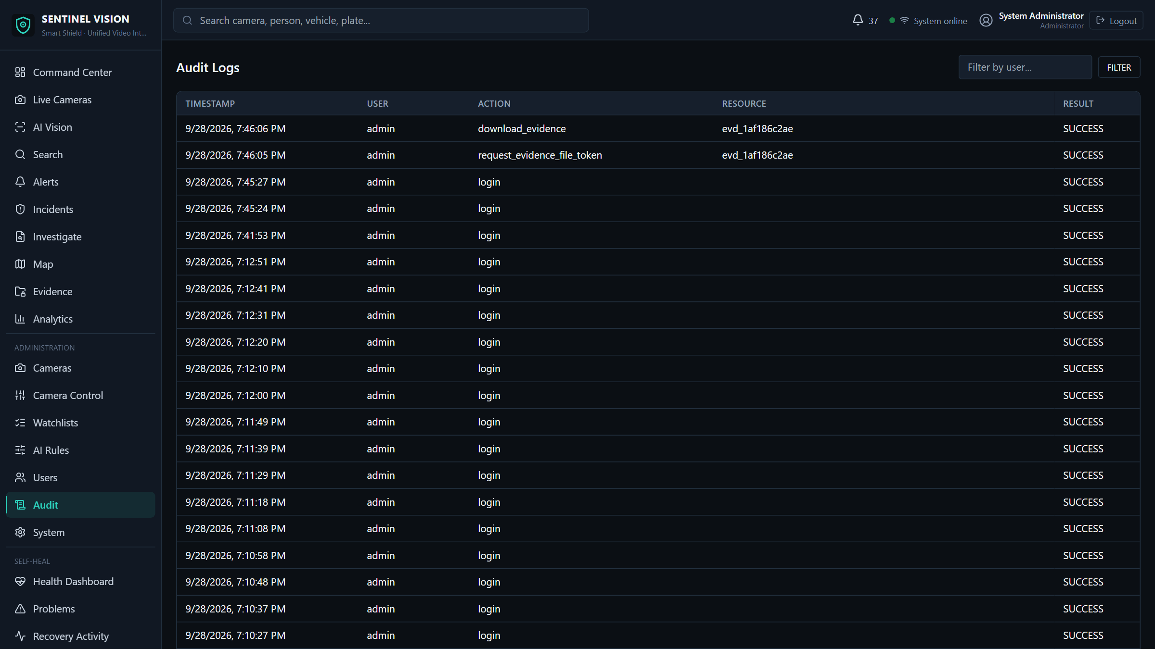
SECURITY
Security by design
Authentication
CURRENT
bcrypt password hashes, JWT sessions, login rate limiting.
RBAC
CURRENT
Five roles checked on every API route: Administrator, Control Room Operator, Investigator, Supervisor, Auditor.
Resource tokens
CURRENT
Short-lived signed tokens for live streams (1 h) and evidence files (5 min).
Audit trail
CURRENT
Hash-chained audit log; a verify endpoint detects any edited or deleted row.
SENTINEL VISION · Unified CCTV Intelligence & Real-Time Smart Policing Platform
11

Slide 12
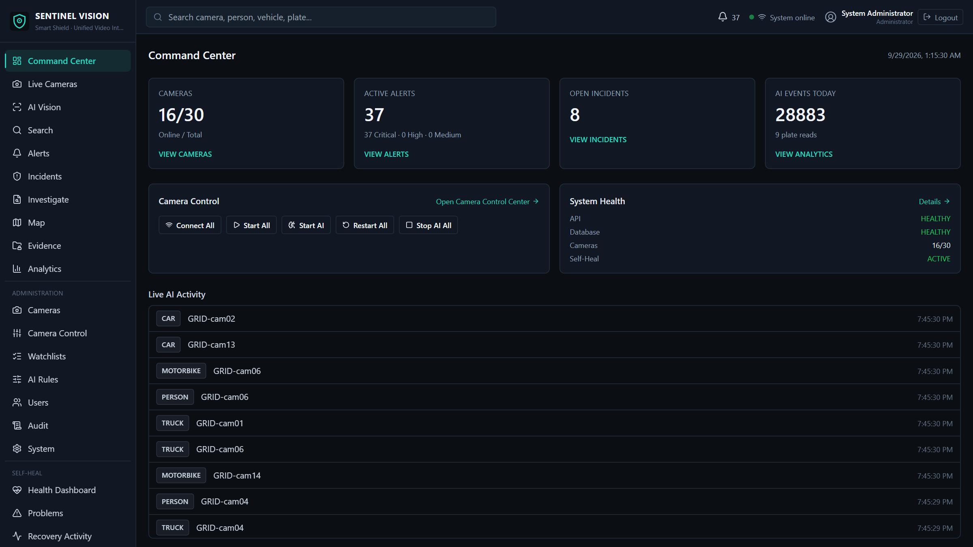
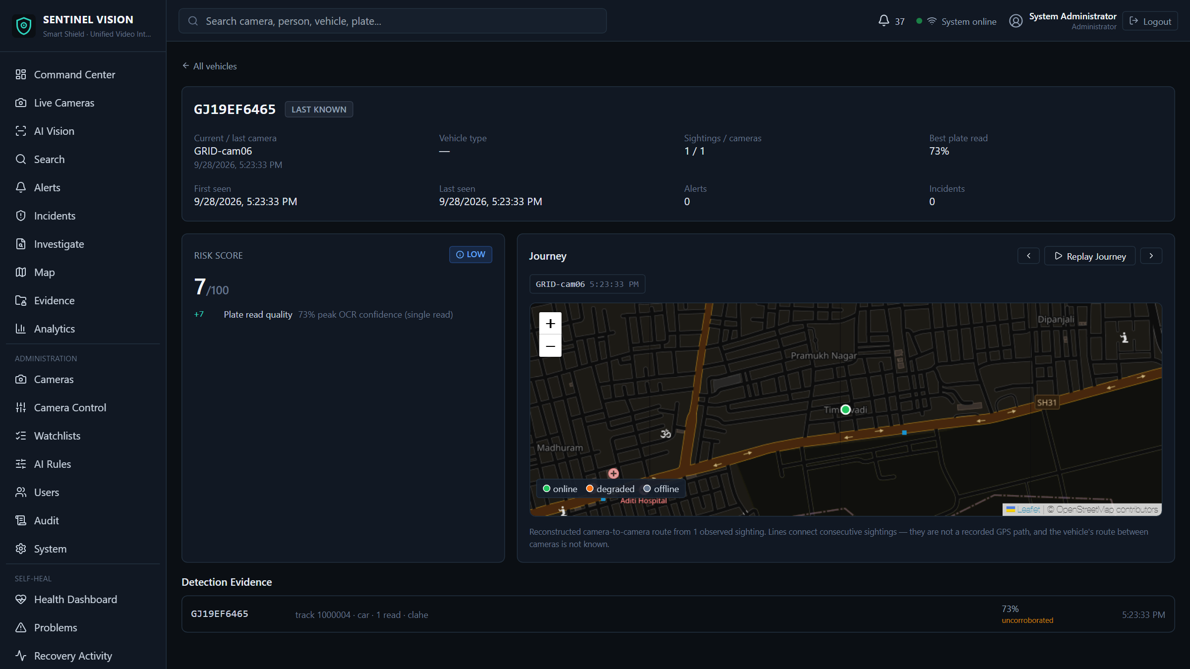
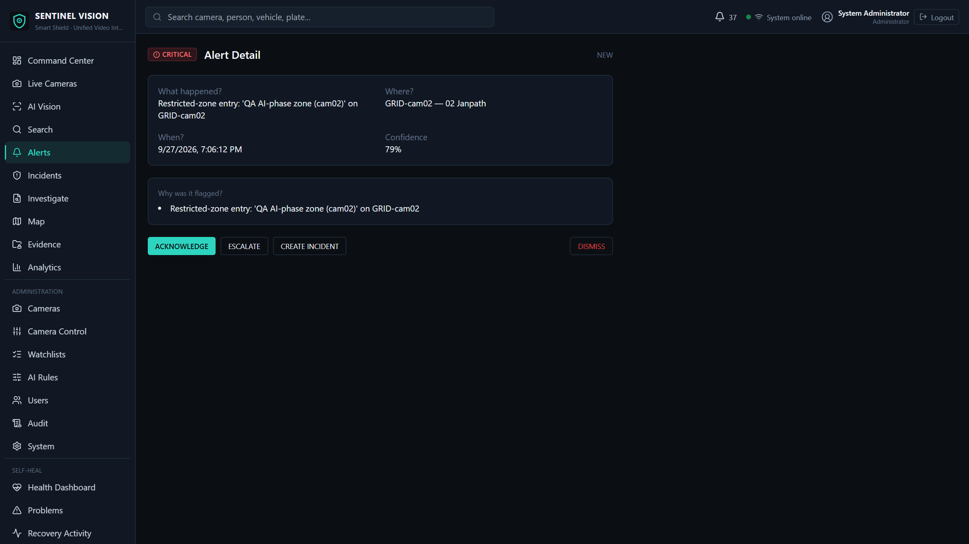
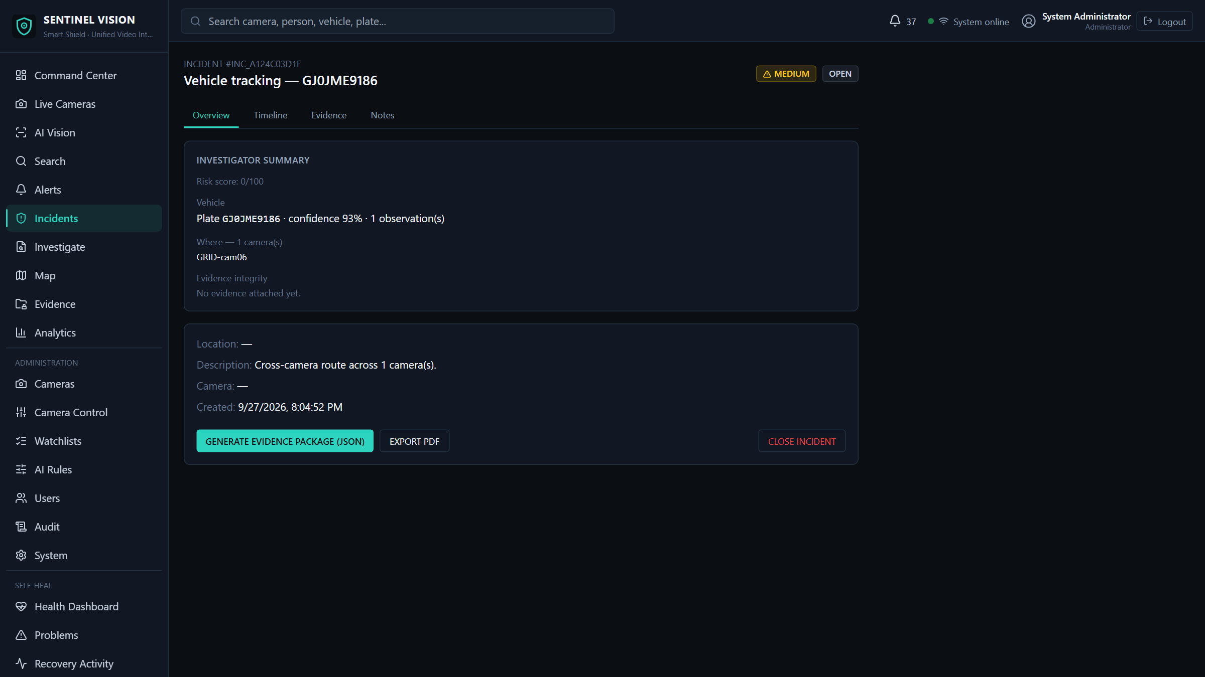
CURRENT DEMONSTRATION
What works today
Demonstrated
Login, dashboard, camera registry and map, live AI detection and tracking, ANPR, zone alerts, incidents, evidence with integrity check, Self-Heal screens.
Command centre
Vehicle journey
Known limits
Grid streaming is partial: about 29 cameras degraded and about 3.4 Mbit/s observed recently. SQLite is single-writer; a login-contention fix is tested but not yet re-verified with 30 live grid streams.
Alert detail
Incident
SENTINEL VISION · Unified CCTV Intelligence & Real-Time Smart Policing Platform
12

Slide 13
SCALE
From today to larger deployments
Current implementation
Planned / future scale
■ Single backend process, one asyncio task per camera
■ SQLite (WAL) for the demo
■ PostgreSQL 16 + PostGIS in Docker Compose, built and migrated by CI
■ Valkey for shared cooldowns and rate limits (optional)
■ Tested: 1101 backend tests, 23 frontend unit tests, 10 browser tests
■ PostgreSQL as the default database, load-tested with a live fleet
■ Separate AI worker processes / nodes per camera group
■ Event streaming between ingestion, analytics and alerting
■ Edge AI at camera clusters sending events, not full video
■ More VMS adapters (ONVIF, vendor SDKs); container orchestration
SENTINEL VISION · Unified CCTV Intelligence & Real-Time Smart Policing Platform
13

Slide 14
IMPACT
Expected benefits and how to measure them
Expected benefits
Evaluation metrics for a pilot
■ Operators work from alerts instead of watching every feed
■ Faster identification of watch-listed vehicles and zone intrusions
■ Investigations start from a vehicle journey and an evidence package
■ Camera failures are visible and mostly self-recovering
■ Every action and evidence access is accountable
■ Time from event to operator alert
■ False alerts per camera-hour
■ Plate read rate and plate accuracy on the pilot's own cameras
■ Camera uptime and time to recover
■ Time to assemble an incident's evidence
SENTINEL VISION · Unified CCTV Intelligence & Real-Time Smart Policing Platform
14

Slide 15
CONCLUSION
SENTINEL VISION
A working, tested CCTV intelligence platform: cameras from mixed sources, AI detection, tracking and plate reading, rule-based alerts and incidents, verifiable evidence, a camera map and Self-Heal, secured with RBAC and a tamper-evident audit trail.
Built and demonstrated on real footage from a 30-camera grid
Honest about limits: partial grid streaming, SQLite demo database, 19 of 30 cameras mapped
Clear next step: a pilot on PostgreSQL with separate AI workers
Thank you · github.com/RuudyLinux/SENTINEL-AI
SENTINEL VISION · Unified CCTV Intelligence & Real-Time Smart Policing Platform
15

