Slide 1
ResT API DesigN
BY SİNEM SEVDİK

Slide 2
Rest Api
REST is acronym for REpresentational State Transfer. It is architectural style for distributed hypermedia systems and was first presented by Roy Fielding in 2000 in his famous dissertation.
Like any other architectural style, REST also does have it’s own 6 guiding constraints which must be satisfied if an interface needs to be referred as RESTful. These principles are listed below.

Slide 3
Guiding Principles of REST
Client–server
Stateless
Cacheable
Layered system
Uniform interface
Code on demand (optional)

Slide 4
REST Resource Naming Best Practices
Use nouns to represent resources
Consistency is the key
Never use CRUD function names in uris
Use query component to filter URI collection

Slide 5
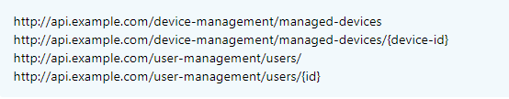
Use nouns to represent resources

Slide 6
Consistency is the key
Use forward slash (/) to indicate a hierarchical relationships
http://api.example.com/device-management/managed-devices/{id}
Use hyphens (-) to improve the readability of uris
- more readable
http://api.example.com/inventory-management/managed-entities/{id}/install-script-location
- less readable
http://api.example.com/inventory-management/managedentities/{id}/installscriptlocation

Slide 7
Do not use underscores ( _ )
- More readable
http://api.example.com/inventory-management/managed-entities/{id}/install-script-location
- More error prone
http://api.example.com/inventory_management/managed_entities/{id}/install_script_location
Use lowercase letters in uris
http://api.example.org/my-folder/my-doc //1
HTTP://API.EXAMPLE.ORG/my-folder/my-doc //2
http://api.example.org/My-Folder/my-doc //3

Slide 8
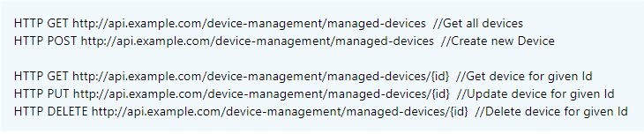
Never use CRUD function names in URIs

Slide 9
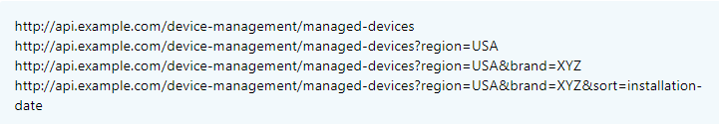
Use query component to filter URI collection

Slide 10
REST API DESIGN Defınıtıons
Verbs & Let the HTTP verb define action & HTTP status codes
Version your apis
API root URL
Filter and sort
Stateless authentication & authorization
Idempotency
Swagger for documentation
Caching

Slide 11
VERBS - HTTP Methods
HTTP GET
HTTP POST
HTTP PUT
HTTP DELETE
HTTP PATCH
OPTIONS

Slide 12
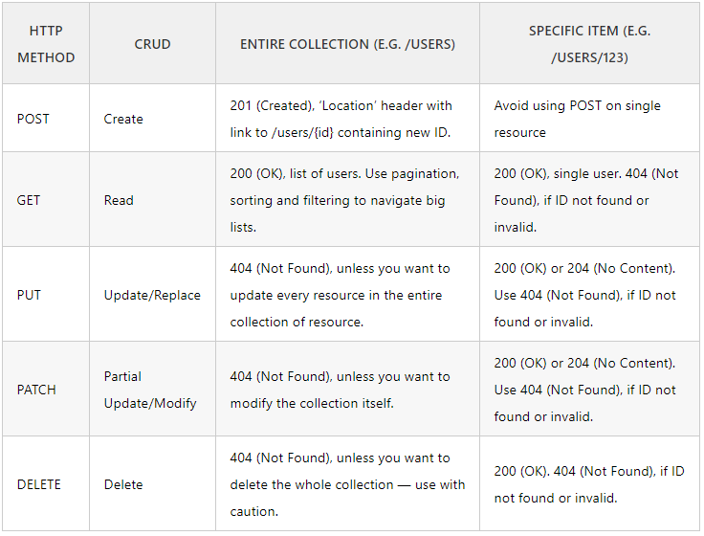

Slide 13
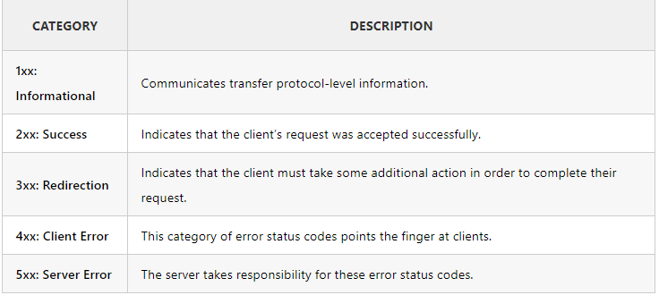
HTTP Status Codes

Slide 14
2xx success
200 OK: returned by a successful GET or DELETE operation. PUT or POST can also use this, if the service does not want to return a resource back to the client after creation or modification.
201 created: response for a successful resource creation by a post request.
3xx redirection
304 not modified: used if HTTP caching header is implemented.
4xx client errors
400 bad request: when an HTTP request body can’t be parsed. For example, if an API is expecting a body in a JSON format for a POST request, but the body of the request is malformed.
401 unauthorized: authentication is unsuccessful (or credentials have not been provided) while accessing the api.
403 forbidden: if a user is not authorized to perform an action although authentication information is correct.
404 not found: if the requested resource is not available on the server.
405 method not allowed: if the user is trying to violate an api contract, for example, trying to update a resource by using a post method.
5xx server errors
These errors occur due to server failures or issues with the underlying infrastructure.

Slide 15
Version Your APIs
Apis only need to be up-versioned when a breaking change is made. Breaking changes include:
A change in the format of the response data for one or more calls
A change in the response type (i.E. Changing an integer to a float)
Removing any part of the API.
How to Version?
URI Versioning
http://api.example.com/v1
http://apiv1.example.com
Versioning using Custom Request Header
Accept-version: v1
Accept-version: v2
Versioning using Accept header
Accept: application/vnd.example.v1+json
Accept: application/vnd.example+json;version=1.0

Slide 16
API Root URL
When a developer (read as code archaeologist) inherits an old project using your API and needs to build new features, they may not know about your service at all. Perhaps all they know is a list of urls which the consumer calls out to. It’s important that the root entry point into your API is as simple as possible, as a long complex URL will appear daunting and can turn developers away.
Here are two common url roots:
Https://example.org/api/v1/*
Https://api.example.com/v1/*
If your application is huge, or you anticipate it becoming huge, putting the API on its own subdomain (e.G. Api.) Is a good choice. This can allow for some more flexible scalability down the road.

Slide 17
Filter and Sort
Don’t create different uris for fetching resources with filtering, searching, or sorting parameters. Try to keep the URI simple, and add query parameters to depict parameters or criteria to fetch a resource (single type of resource)
Filtering:
Use query parameters defined in URL for filtering a resource from server. For example, if we would like to fetch all published posts by user you can design an API such as:
Get /users/123/posts?state=published&ta=scala
Sorting:
ASC and DESC sorting parameters can be passed in URL such as:
GET /users/123/posts?sort=-updated_at

Slide 18
Stateless Authentication & Authorization
REST apis should be stateless. Every request should be self-sufficient and must be fulfilled without knowledge of the prior request. This happens in the case of authorizing a user action.
This doesn’t limit apis to a user as an authorized person, as it allows service-to-service authorization as well. For user authorization, JWT (JSON web token) with oauth2 provides a way to achieve this. Additionally, for service-to-service communication, try to have the encrypted api-key passed in the header.

Slide 19
Idempotent REST APIs
In the context of REST apis, when making multiple identical requests has the same effect as making a single request – then that REST API is called idempotent.
If you follow REST principles in designing API, you will have automatically idempotent REST APIs for GET, PUT, DELETE, HEAD, OPTIONS and TRACE HTTP methods. Only POST APIs will not be idempotent.
HTTP POST
Generally – not necessarily – POST APIs are used to create a new resource on server. So when you invoke the same POST request N times, you will have N new resources on the server. So, POST is not idempotent.
HTTP GET, HEAD, OPTIONS and TRACE
GET, HEAD, OPTIONS and TRACE methods NEVER change the resource state on server. They are purely for retrieving the resource representation or meta data at that point of time. So invoking multiple requests will not have any write operation on server, so GET, HEAD, OPTIONS and TRACE are idempotent.
HTTP PUT
Generally – not necessarily – PUT APIs are used to update the resource state. If you invoke a PUT API N times, the very first request will update the resource; then rest N-1 requests will just overwrite the same resource state again and again – effectively not changing anything. Hence, PUT is idempotent.
HTTP DELETE
When you invoke N similar DELETE requests, first request will delete the resource and response will be 200 (OK) or 204 (No Content). Other N-1 requests will return 404 (Not Found). Clearly, the response is different from first request, but there is no change of state for any resource on server side because original resource is already deleted. So, DELETE is idempotent.

Slide 20
Caching REST API Response
Optimizing the network using caching improves the overall quality-of-service in following ways:
Reduce bandwidth
Reduce latency
Reduce load on servers
Hide network failures
Caching in REST APIs
Expires
Expires: Fri, 20 May 2016 19:20:49 IST
Cache-Control
Cache-Control: max-age=3600
Etag
ETag: "abcd1234567n34jv"
Last-Modified
Last-Modified: Fri, 10 May 2016 09:17:49 IST

Slide 21
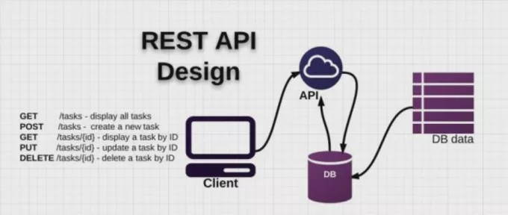
REST API DESIGN

Slide 22
How to design a REST API?
Steps in designing REST Services :
Identify Object Model
Create Model URIs
Determine Representations
Assign HTTP Methods

Slide 23
Identify Object Model
The very first step in designing a REST API based application is – identifying the objects which will be presented as resources.
For a network based application, object modeling is pretty much simpler. There can be many things such as devices, managed entities, routers, modems etc. For simplicity sake, we will consider only two resources i.E.
Devices
Configurations
Here configuration is sub-resource of a device. A device can have many configuration options.

Slide 24
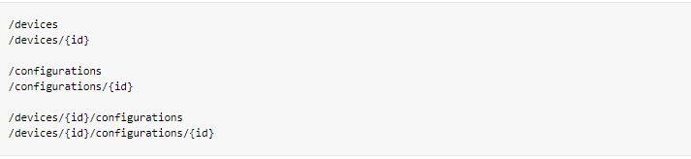
Create Model URIs
In our application, a device is a top-level resource. And configuration is sub-resource under device. Let’s write down the uris.
Notice that these URIs do not use any verb or operation. It’s very important to not include any verb in URIs. URIs should all be nouns only.

Slide 25
Determine Representations
Now when resource uris have been decided, let’s work on their representations. Mostly representations are defined in either XML or JSON format.
Resource uris are all nouns.
Uris are usually in two forms – collection of resources and singular resource.
Collection may be in two forms primary collection and secondary collection. Secondary collection is sub-collection from a primary collection only.
Each resource/collection contain at least one link i.E. To itself.
Collections contain only most important information about resources.
To get complete information about a resource, you need to access through its specific resource uri only.

Slide 26
Assign HTTP Methods
Browse all devices or configurations [primary collection]
HTTP GET /devices
HTTP GET /configurations
If the collection size is large, you can apply paging and filtering as well. e.g. Below requests will fetch first 20 records from collection.
HTTP GET /devices?startIndex=0&size=20
HTTP GET /configurations?startIndex=0&size=20
Browse all devices or configurations [secondary collection]
HTTP GET /devices/{id}/configurations
Browse single device or configuration [Primary Collection]
HTTP GET /devices/{id}
HTTP GET /configurations/{id}
Browse single device or configuration [Secondary Collection]
HTTP GET /devices/{id}/configurations/{id}

Slide 27
Create a device or configuration
HTTP POST /devices
HTTP POST /configurations
Update a device or configuration
HTTP PUT /devices/{id}
HTTP PUT /configurations/{id}
Remove a device or configuration
HTTP DELETE /devices/{id}
HTTP DELETE /configurations/{id}
Applying or Removing a configuration from a device
//Apply Configuration on a device
HTTP PUT /devices/{id}/configurations
//Remove Configuration on a device
HTTP DELETE /devices/{id}/configurations/{id}

Slide 28
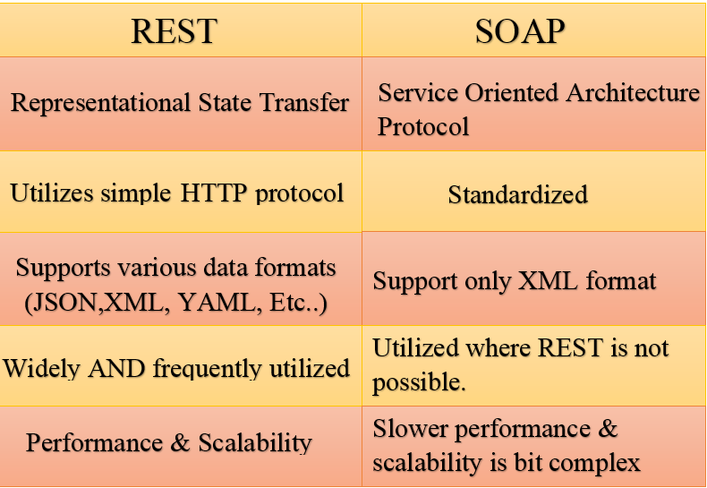
REST x SOAP

