Slide 1
Rule Engines And Drools

Slide 2
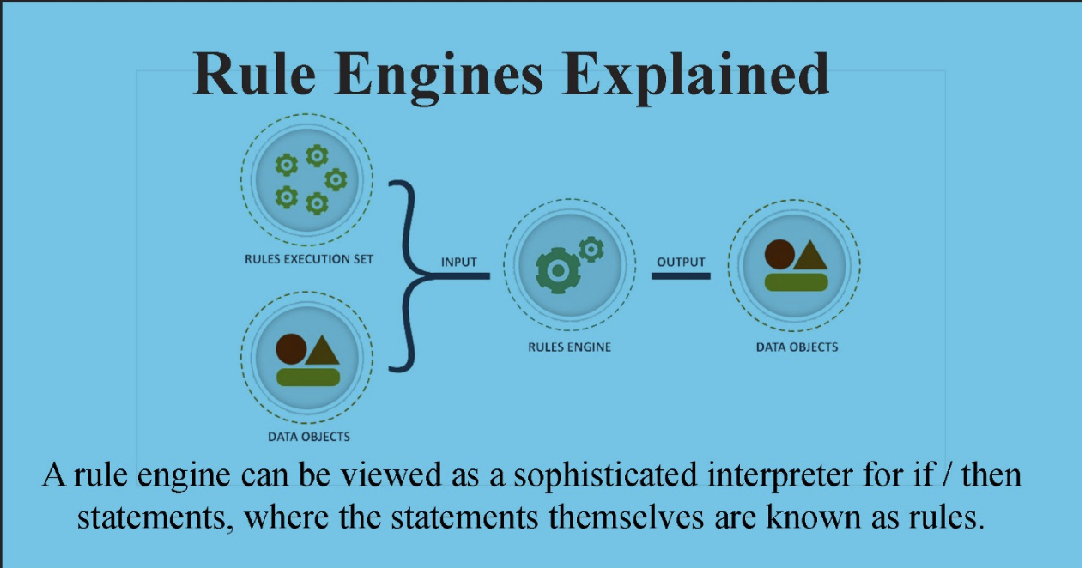
What is Rule Engine

Slide 3
Java Rule Engine API (JSR 94)
javax.rules, also known as JSR-94, is a Java runtime api for rule engines. It provides a very simple model of interaction with the rule engine itself, and a somewhat more involved mechanism for administering sets of rules.

Slide 4
When Shouldn’t Rule Engines Be Used
The logic behind the rules is quite simple
If the problem at hand doesn’t change too often
If it’s possible to divide the problem into a smaller set of conditions

Slide 5
When Should Rule Engines Be Used
The problem at hand is too complex to be solved through traditional solutions
You’re aiming to inculcate greater flexibility into your code while reducing complexity
You wish to separate business logic from application data and code
You wish to create a central knowledge repository and reuse as much code as possible
The problem may not be complex, but you can't see a non-fragile way of building it.
The logic changes often

Slide 6
What is Your Alternatives
Drools
OpenL Tablets
Easy Rules
RuleBook

Slide 7
OpenL Tablets
OpenL Tablets is a business rules management system and a business rules engine based on Excel decision tables. Since the format of tables used by this framework is familiar to business users, it bridges the gap between business users and developers.
https://github.com/openl-tablets/openl-tablets

Slide 8
EasyRules
Easy Rules is a simple Java rules engine providing a lightweight and POJO based framework to define business. It can create complex rules from primitive ones by using the composite pattern.
This framework, in contrast to the most traditional rules engines, doesn’t make use of XML files or any Domain Specific Language files to segregate rules from the application. It uses annotation-based classes and methods for injecting business logic into the application.
https://github.com/j-easy/easy-rules

Slide 9
RuleBook
RuleBook is a Java framework that leverages Java 8 lambdas and the Chain of Responsibility Pattern to define rules using simple BDD approach.
Like most rules engines, RuleBook makes use of the concept of “Facts”, which is data supplied to rules. RuleBook allows rules to modify the state of facts, which then can be read and modified by rules further down the chain. For those rules that read in data (Facts) of one type and output a result of a different type, RuleBook has Decisions.
https://github.com/rulebook-rules/rulebook#21-a-helloworld-example

Slide 10
Drools – Why Should We Use Drools
Drools is open source.
It provides forward and backward chaining of rules execution
It provides template base rule definitions
It is implemented using JSR-94
It has decision table facility
Its rules are human readable
It is integrated with Spring

Slide 11
Knowledge Is Everything
KIE (Knowledge Is Everything) is an umbrella project introduced to bring our related technologies together under one roof. It also acts as the core shared between our projects.
KIE contains the following different but related projects offering a complete portfolio of solutions for business automation and management:
Drools
jBPM
OptaPlanner
Business Central
UberFire

Slide 12
Stateless Kie Session
The facts/working memory is inserted to Knowledge base session before firing rules. These facts can be set by calling public methods on an object while executing rules and after setting these objects are returned back with changed values.
Any changes in the facts while executing rules, for example insert(xyz) or modify(xyz), is not made aware to the rule engine.

Slide 13
Stateful Kie Session
The facts/working memory is inserted to Knowledge base session before firing rules and after the rules are fired dispose() has to be called to avoid memory leaks.
Any changes in the facts while executing rules, for example insert(xyz) or modify(xyz), is made aware to the rule engine.

Slide 14
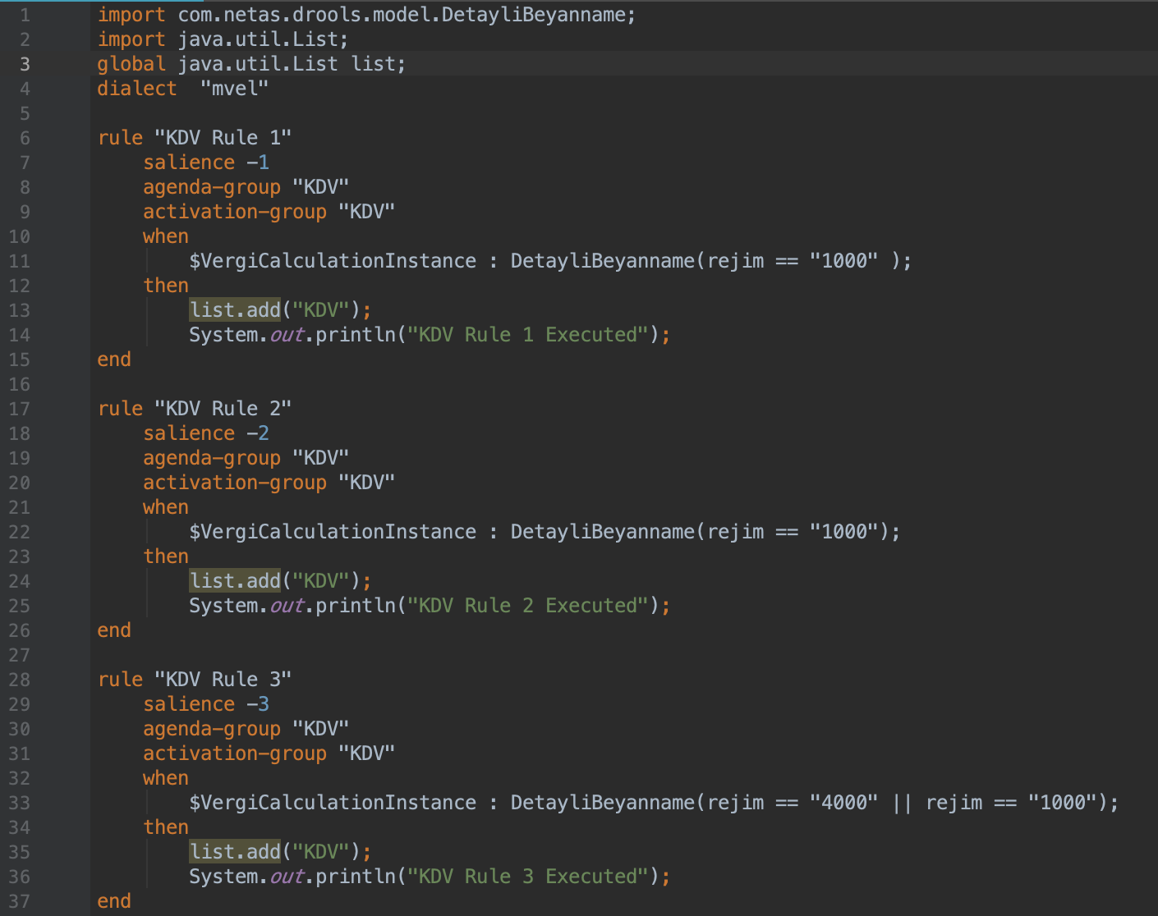
.DRL - 1
package – this is the package name we specify in the kmodule.xml, the rule file is located inside this package
import – this is similar to Java import statement, here we need to specify the classes which we are inserting in the KnowledgeSession
global – this is used to define a global level variable for a session; this can be used to pass input parameter or to get an output parameter to summarize the information for a session

Slide 15
.DRL - 2
dialect – a dialect specifies the syntax employed in the expressions in the condition section or action section. By default the dialect is Java. Drools also support dialect mvel; it is an expression language for Java-based applications. It supports the field and method/getter access
rule – this defines a rule block with a rule name
when – this specifies a rule condition, in this example the conditions which are checked are Applicant having experienceInYears more than ten years and currentSalary in a certain range
then – this block executes the action when the conditions in the when block met.

Slide 16
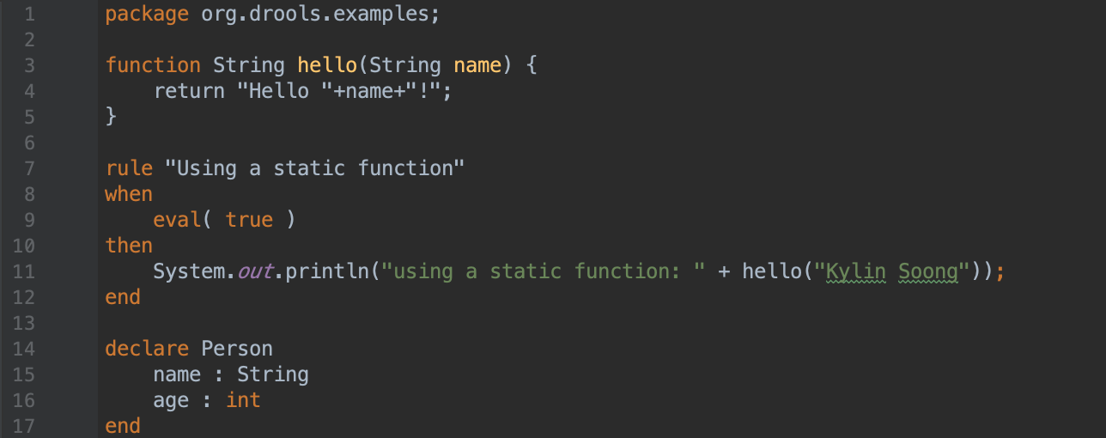
.DRL - Functions

Slide 17
DEMO

Slide 18
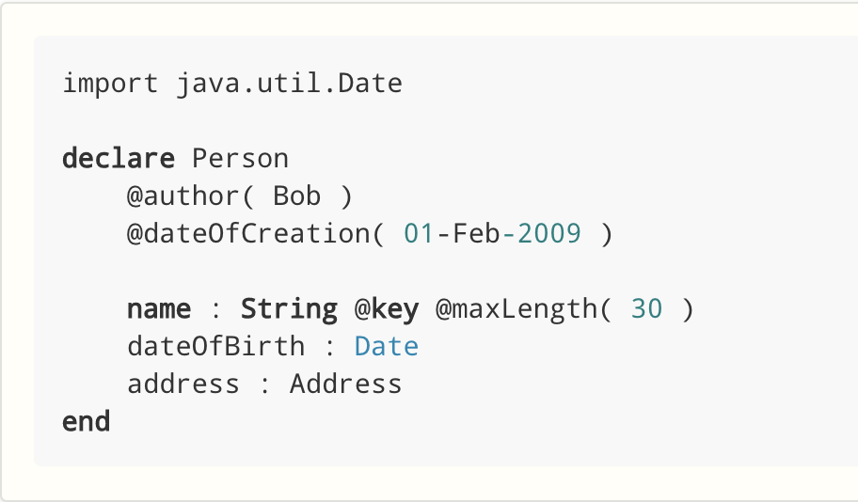
.DRL - Type Declarations
Declaring new types: Drools works out of the box with plain Java objects as facts. Sometimes, however, users may want to define the model directly to the Drools engine, without worrying about creating models in a lower level language like Java. At other times, there is a domain model already built, but eventually the user wants or needs to complement this model with additional entities that are used mainly during the reasoning process.
Declaring metadata: facts may have meta information associated to them. Examples of meta information include any kind of data that is not represented by the fact attributes and is consistent among all instances of that fact type. This meta information may be queried at runtime by the Drools engine and used in the reasoning process.

Slide 19
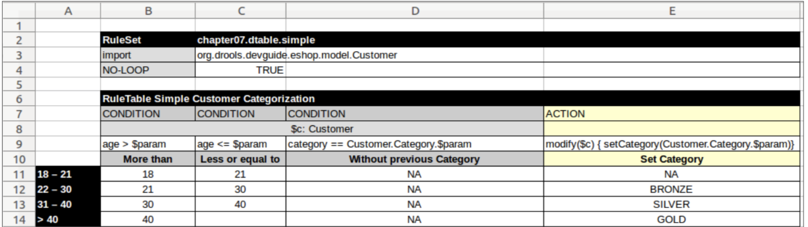
Decision Tables
A decision table in Drools is a document stored in an XLS (Microsoft Excel) or CSV (Comma Separated Value) formatted file, which defines a set of rules using a very compact syntax.

Slide 20
DEMO

Slide 21
Rule Attributes
no-loop, When a rule’s consequence modifies a fact it may cause the rule to activate again, causing an infinite loop. Setting no-loop to true will skip the creation of another Activation for the rule with the current set of facts.
ruleflow-group, Ruleflow is a Drools feature that lets you exercise control over the firing of rules. Rules that are assembled by the same ruleflow-group identifier fire only when their group is active.
lock-on-active, Whenever a ruleflow-group becomes active or an agenda-group receives the focus, any rule within that group that has lock-on-active set to true will not be activated any more; irrespective of the origin of the update, the activation of a matching rule is discarded. This is a stronger version of no-loop, because the change could now be caused not only by the rule itself. It’s ideal for calculation rules where you have a number of rules that modify a fact and you don’t want any rule re-matching and firing again. Only when the ruleflow-group is no longer active or the agenda-group loses the focus those rules with lock-on-active set to true become eligible again for their activations to be placed onto the agenda.
Salience, Each rule has an integer salience attribute which defaults to zero and can be negative or positive. Salience is a form of priority where rules with higher salience values are given higher priority when ordered in the Activation queue.
agenda-group, Agenda groups allow the user to partition the Agenda providing more execution control. Only rules in the agenda group that has acquired the focus are allowed to fire.
auto-focus, When a rule is activated where the auto-focus value is true and the rule’s agenda group does not have focus yet, then it is given focus, allowing the rule to potentially fire.

Slide 22
Rule Attributes
activation-group, Rules that belong to the same activation-group, identified by this attribute’s string value, will only fire exclusively. More precisely, the first rule in an activation-group to fire will cancel all pending activations of all rules in the group, i.e., stop them from firing.
date-effective, A rule can only activate if the current date and time is after date-effective attribute.
date-expires, A rule cannot activate if the current date and time is after the date-expires attribute.
Duration, The duration dictates that the rule will fire after a specified duration, if it is still true.

Slide 23
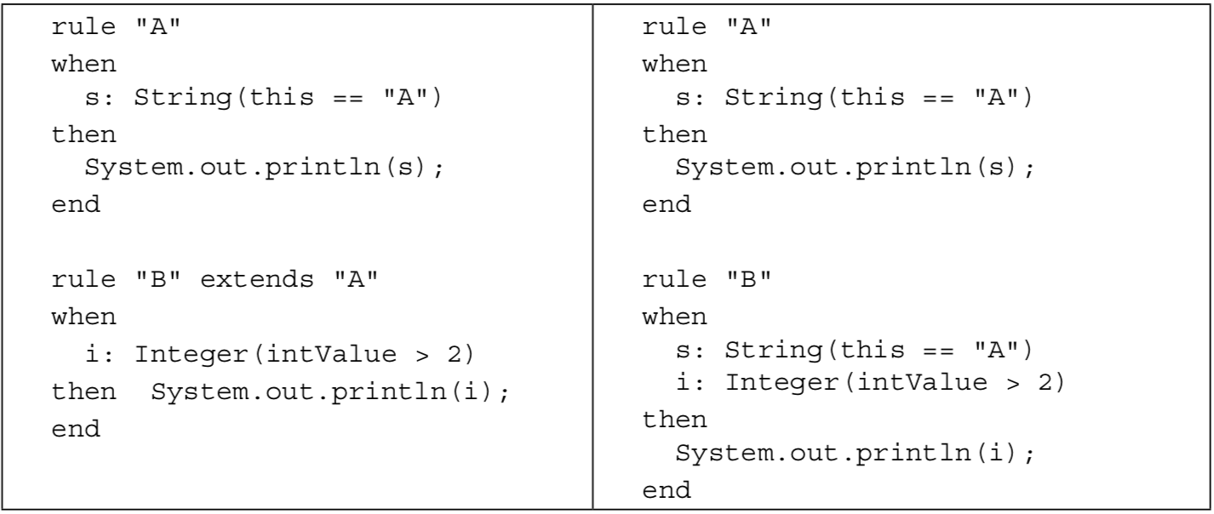
Rule Inheritance
One last important aspect of rule creation is the possibility of having a rule hierarchy. Just like classes, rules allow inheritance between them. If rule B inherits rule A, it will be the same as having all the conditions in rule A at the beginning of the conditions of rule B. The following table shows two rules using inheritance and their equivalent without it:

Slide 24
DEMO

Slide 25
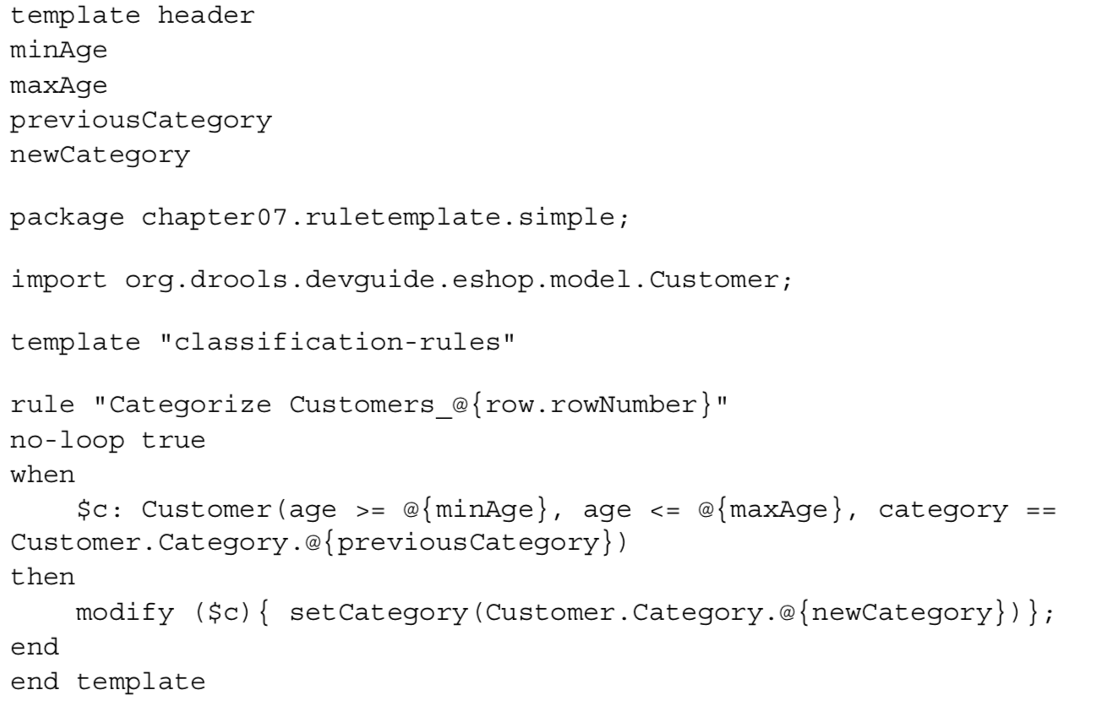
Rule Templates
A Drools rule template is a text file containing special keywords to demarcate the different sections of the template and to define what the variables inside a template are and where should they be used.

