Slide 1
UNIT TESTıng

Slide 2
WHAT IS UNIT TESTING?
WHAT ARE THE BENEFITS OF UNIT TESTING ?
BEST PRACTICE OF UNIT TESTING
UNIT TESTING COMMON MISTAKES
WHAT IS JUNIT?
OVERVIEW TO JUNIT5
WHAT IS MOCKING IN TESTING?
7 POPULAR UNIT TESTING NAMING CONVENTIONS
JACOCO

Slide 3
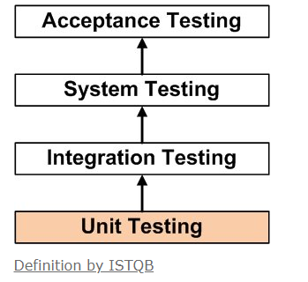
WHAT IS UNIT TESTING?
UNIT TESTING is a level of software testing where individual units/ components of a software are tested. The purpose is to validate that each unit of the software performs as designed. Unit testings are performed by using White Box Testing.
NOTE: ISTQB (International Software Testing Qualifications Board)

Slide 4
WHAT ARE THE BENEFITS OF UNIT TESTING ?
Unit testing increases confidence in changing/ maintaining code.
Codes are more reusable.
Debugging is easy.
Unit testing provides documentation of the system.
Since the bugs are found early, unit testing helps reduce the cost of bug fixes.

Slide 5
BEST PRACTICE OF UNIT TESTING
Arrange, Act, Assert
One Assert Per Test Method
Avoid Test Interdependence
Keep It Short, Sweet, and Visible
Add Them to the Build

Slide 6
UNIT TESTING COMMON MISTAKES
Testing all of the things in one test method.
Not running the tests on a regular basis or altering them as requirements change
Do not mock out the database
Naming is important

Slide 7
WHAT IS JUNIT?
Unit is an open source framework designed for the purpose of writing and running tests in the Java programming language. JUnit has a graphical user interface (GUI), making it possible to write and test source code quickly and easily.

Slide 8
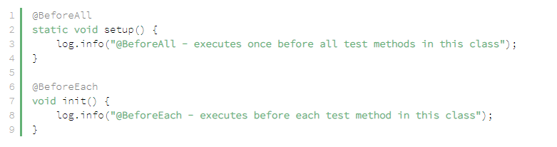
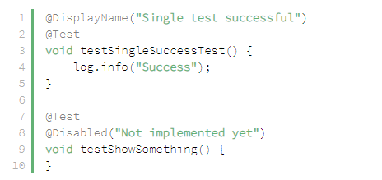
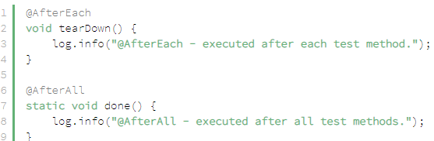
OVERVIEW TO JUNIT5

Slide 9
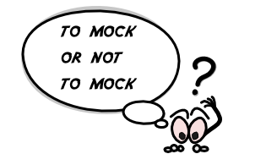
WHAT IS MOCKING IN TESTING?
A object that you want to test may have dependencies on other complex objects. To isolate the behavior of the object you want to test you replace the other objects by mocks that simulate the behavior of the real objects. So in simple words, mocking is creating objects that simulate the behavior of real objects.

Slide 10
7 POPULAR UNIT TESTING NAMING CONVENTIONS
MethodName_StateUnderTest_ExpectedBehavior:
isAdult_AgeLessThan18_False
MethodName_ExpectedBehavior_StateUnderTest
isAdult_False_AgeLessThan18
test[Feature being tested]:
testIsNotAnAdultIfAgeLessThan18
Feature to be tested:
IsNotAnAdultIfAgeLessThan18
Should_ExpectedBehavior_When_StateUnderTest:
Should_ThrowException_When_AgeLessThan18
When_StateUnderTest_Expect_ExpectedBehavior:
When_AgeLessThan18_Expect_isAdultAsFalse
Given_Preconditions_When_StateUnderTest_Then_ExpectedBehavior
Given_UserIsAuthenticated_When_InvalidAccountNumberIsUsedToWithdrawMoney_Then_TransactionsWillFail

Slide 11
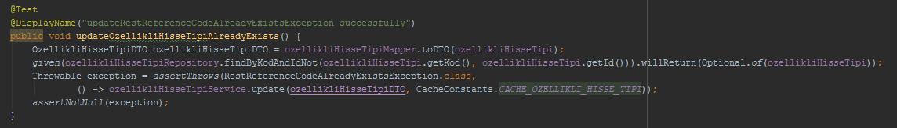
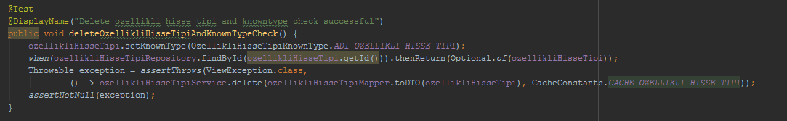
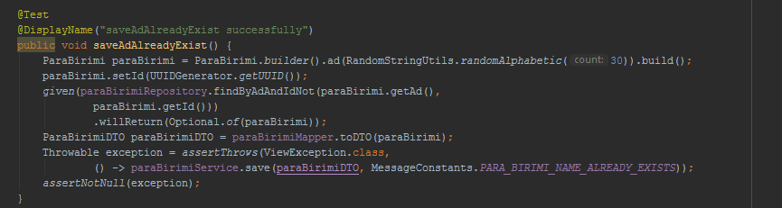
HOW DID WE NAMED OUR UNIT TESTS?

Slide 12
JACOCO
We use the JaCoCo Maven plugin for two purposes: It provides us an access to the JaCoCo runtime agent which records execution coverage data. It creates code coverage reports from the execution data recorded by the JaCoCo runtime agent.
Red diamond means that no branches have been exercised during the test phase.
Yellow diamond shows that the code is partially covered some branches have not been exercised.
Green diamond means that all branches have been exercised during the test.

Slide 13
RESOURCES
http://softwaretestingfundamentals.com/unit-testing/
http://softwaretestingfundamentals.com/white-box-testing/
https://www.baeldung.com/junit-5
https://dzone.com/articles/7-popular-unit-test-naming
https://dzone.com/articles/top-8-benefits-of-unit-testing
https://www.mkyong.com/maven/maven-jacoco-code-coverage-example/
https://www.baeldung.com/jacoco
https://searchsoftwarequality.techtarget.com/definition/JUnit
https://medium.com/@piraveenaparalogarajah/what-is-mocking-in-testing-d4b0f2dbe20a

