Slide 1
Kubernetes Failure Stories
World’s Worst Case Scenario on Kubernetes

Slide 2
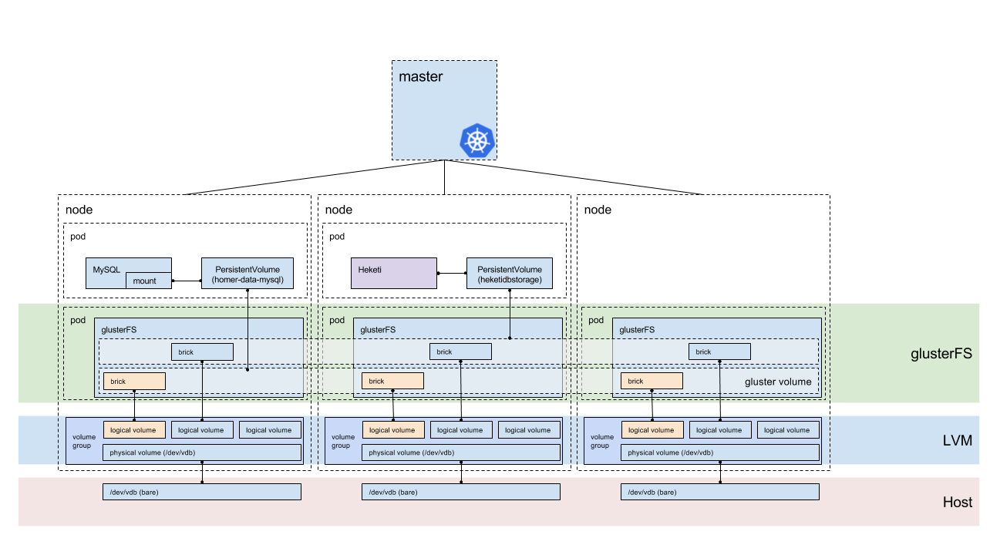
Topology

Slide 3
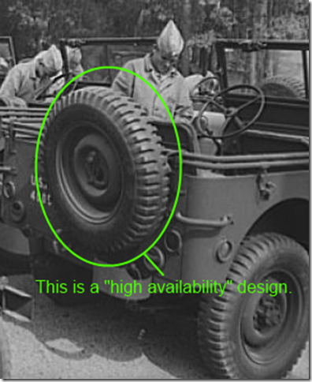
8 Fallacies of Distrubuted System
The network is reliable.
Latency is zero.
Bandwidth is infinite.
The newtork is secure.
Topology doesn’t change.
There is one administrator.
Transport cost is zero.
The newtork is homogeneous.

Slide 4
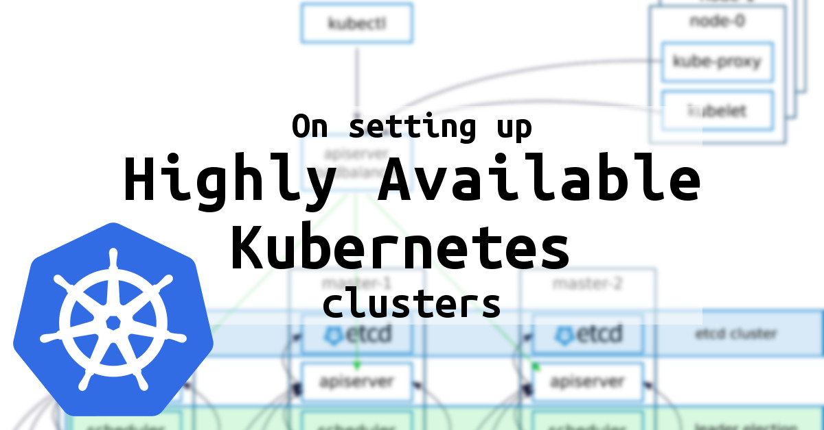
8 Fallacies of Distrubuted System
The network is reliable. → App needs error handling/retry.
Latency is zero. → App should minimize # of request.
Bandwidth is infinite. → App should send small payloads.
The network is secure. → App must secure its data/authenticate request.
Topology doesn’t change. → Changes affect latency, bandwith, endpoints.
There is one administrator. → Changes affect ability to reach destination.
Transport cost is zero. → Costs must be budgeted.
The newtork is homogeneous. → Affects reliability, latency, bandwith.

Slide 5

Fallacies of Cloud Architecture
The API call you will make succeed.
The next API call you will make succeed.
Deleting resources is the same as adding new.
Your cloud provider will have no outages.
The dependencies between your services are clear.

Slide 6
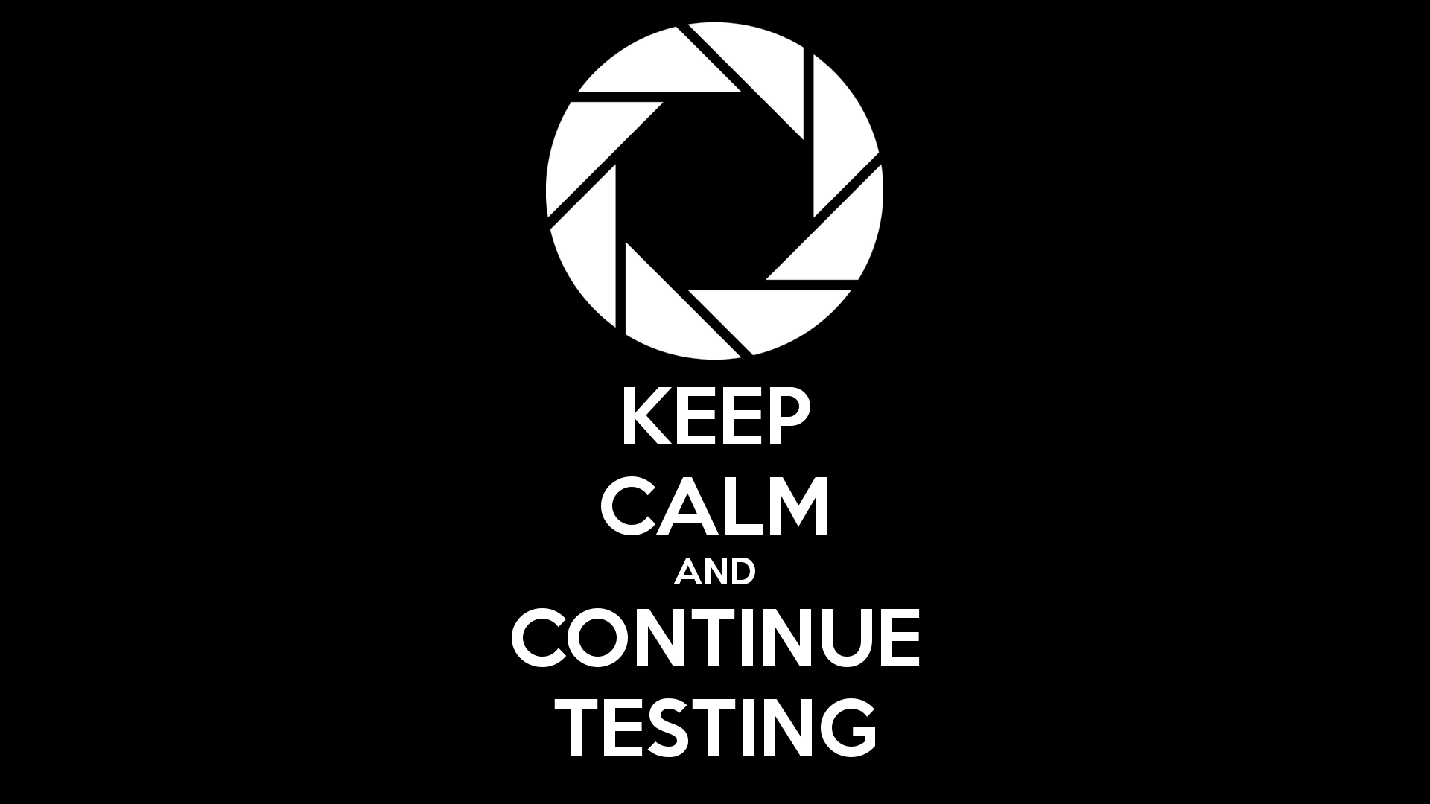
Test All The Things
Continuous Integration Tests
Continuous Deployment of Cluster Updates
Load Test
Chaos Test
Smoke Test

Slide 7
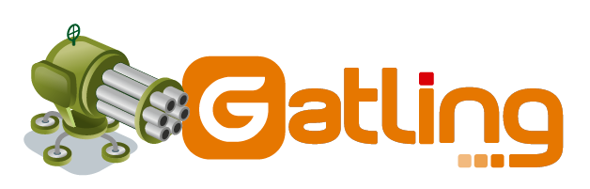



Load Test
Lots of request to the API server
Lots of Pods running
Write/Reads to the data storage
Why Should We Practice?
Observe the impact on running applications.

Slide 8
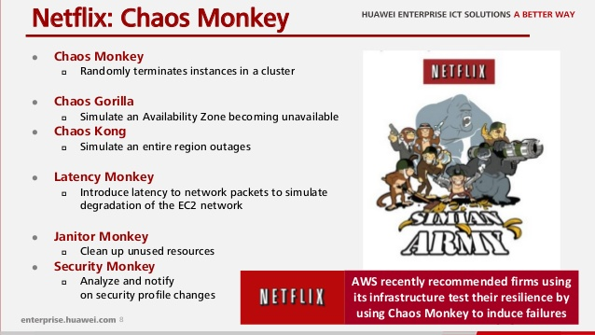
Chaos Test
Random shutdown of Kubernetes components.
Random shutdown of Hosted nodes
Netflix’s principles of Chaos Engineering
O’Reilly Chaos Engineering
Must be Read
http://principlesofchaos.org/
https://www.oreilly.com/library/view/chaos-engineering/9781491988459/

Slide 9

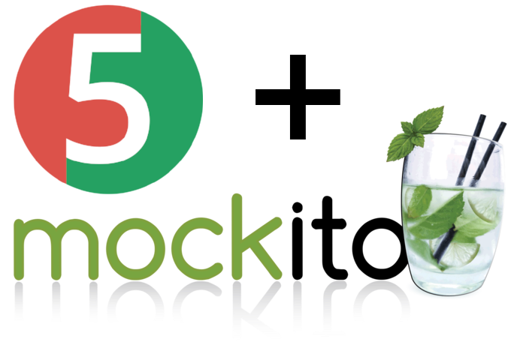
Smoke Test
If we had deployed the ElastAlert update using a pipeline, we could have added a ‘smoke test’ step after the deploy. This could have signalled excessive memory usage, or pod restarts due to the pod exceeding configured memory limits.

Slide 10
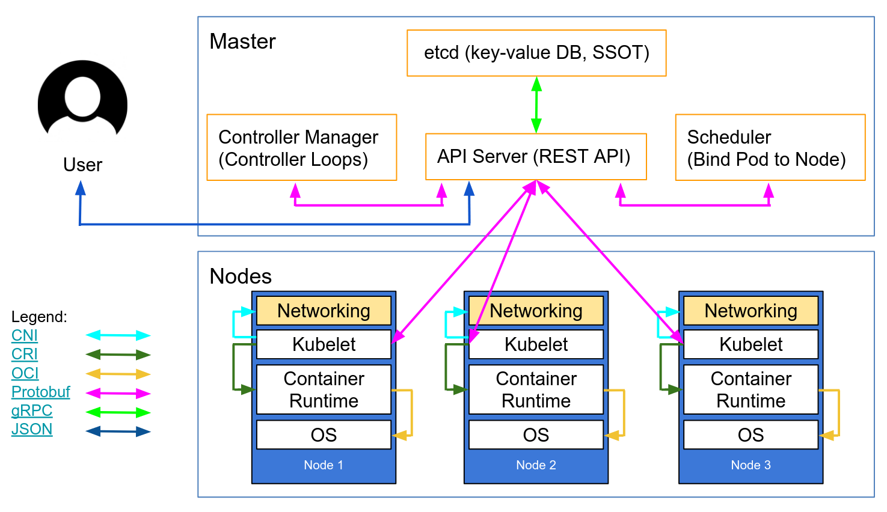
When Making API Calls
Every API call can fail Retry (with backoff) Circuit breakers Fallbacks
Don’t scale down / delete resources fast!
Deal with rate limiting
Deal with «weird» values due to a broken cloud provider feature.

Slide 11
A Million Ways to Crash Your Cluster?
Switch to latest Docker to fix issues with Docker deamon freezing.
Redesign of DNS setup due to high DNS latencies (5s), switch from kube-dns to node-local dnsmasq+CoreDNS
Disabling CPU throttling (CFS quota) to avoid latency issues
Quick fix for timeouts using etcd-Proxy: client-go still seems to have issues with timeouts.
Incompatible Kubernetes changes.
Graceful Pod shutdown and race conditions (endpoints, Ingress)

Slide 12
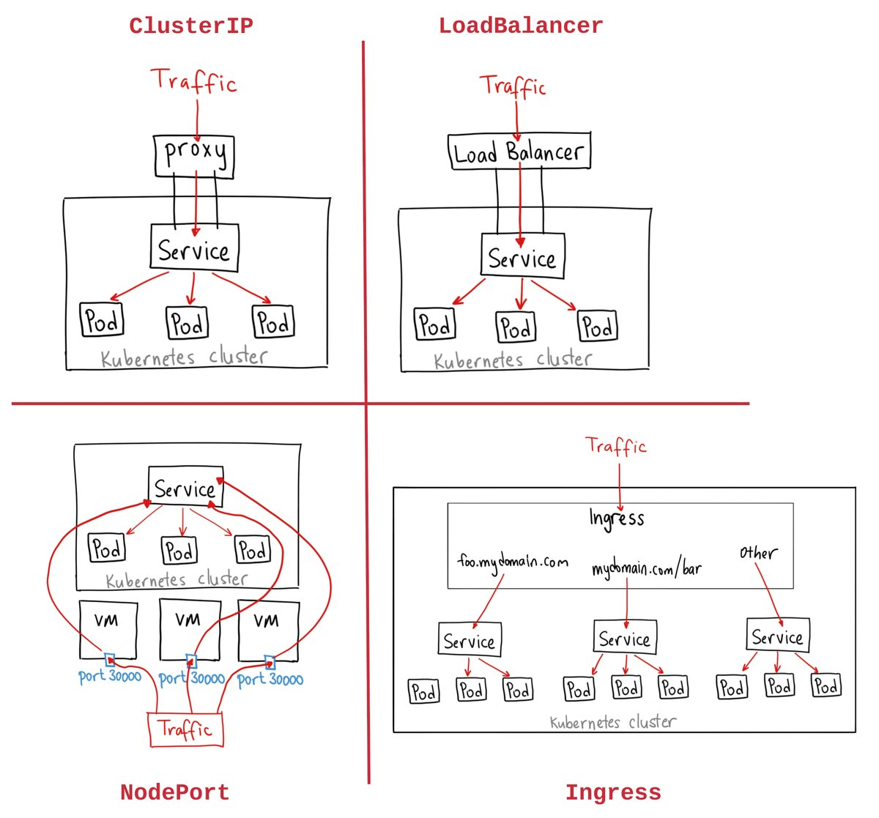
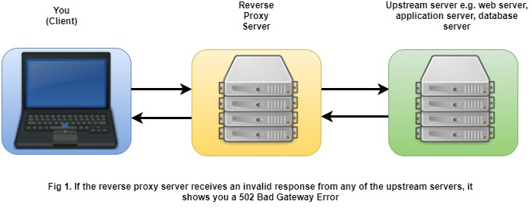
HTTP 502 Bad Gateway
502’s during cluster updates: race condition during network setup.

Slide 13
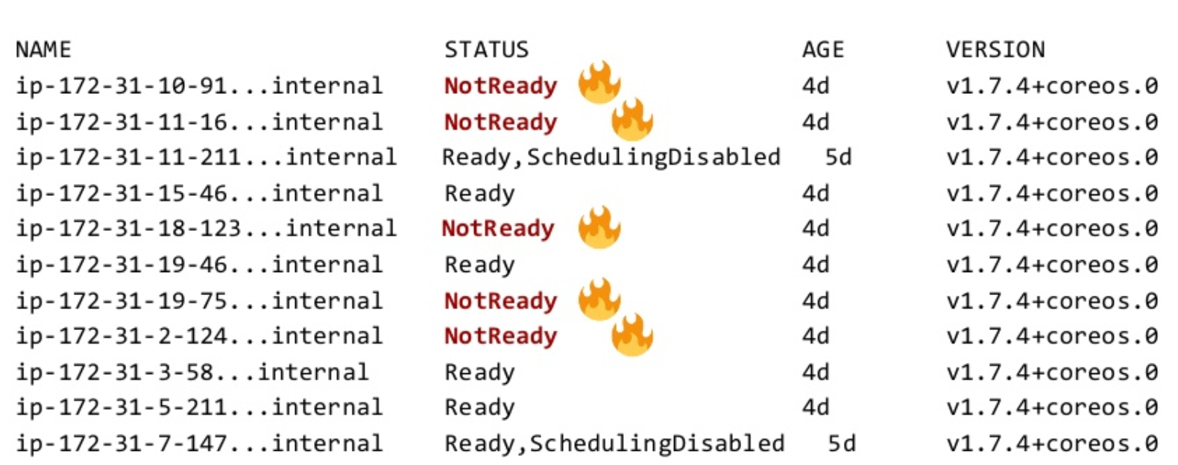
Incident #1
Less than 20% of Nodes Available
Trail of Clues * Recovered automatically after 15 minutes. * Nodes unhealthy at same time, recover at same time. * API server is behind AWS ELB * Seems to happen to others, too * Some report it happening ~every month.

Slide 14
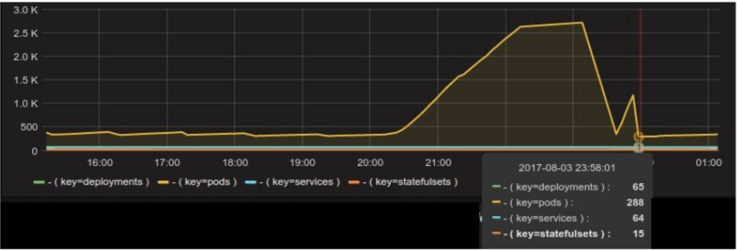
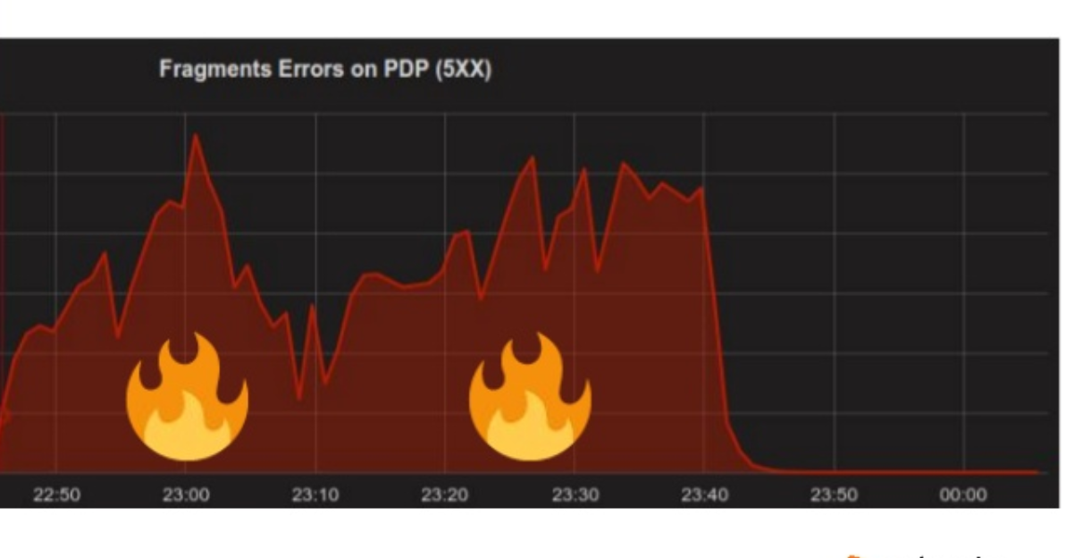
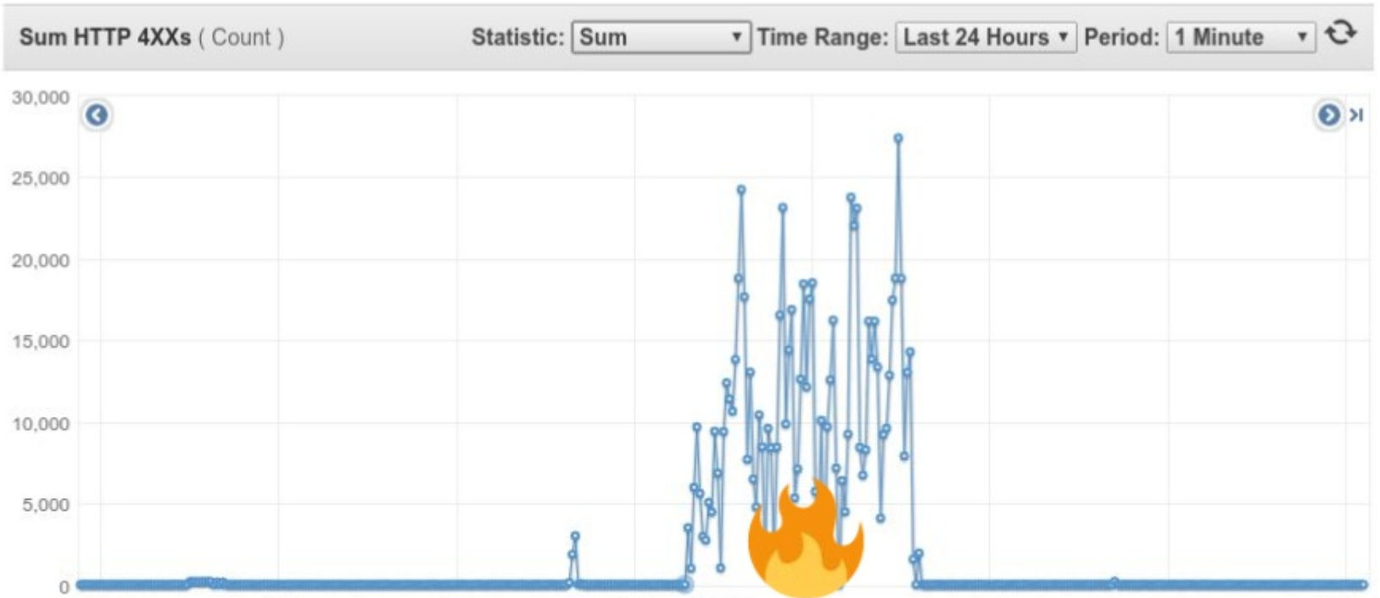
Incident #2
Customer Impact
High Load

Slide 15
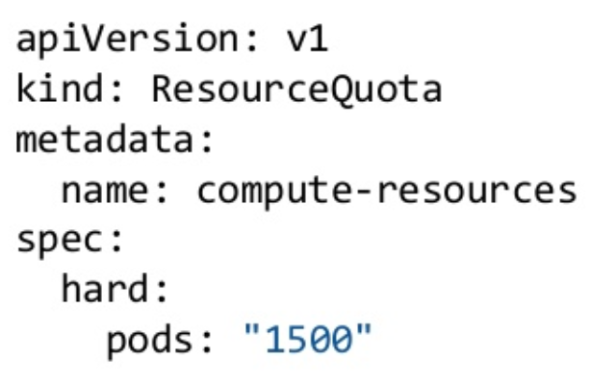
Incident #2
Contributing Factors Wrong CronJob manifes and no automatic job cleanup. Reliance on Kubernetes API server availability. Ingress routes not kept as-is in case of outage. No quota for number of pods.

Slide 16
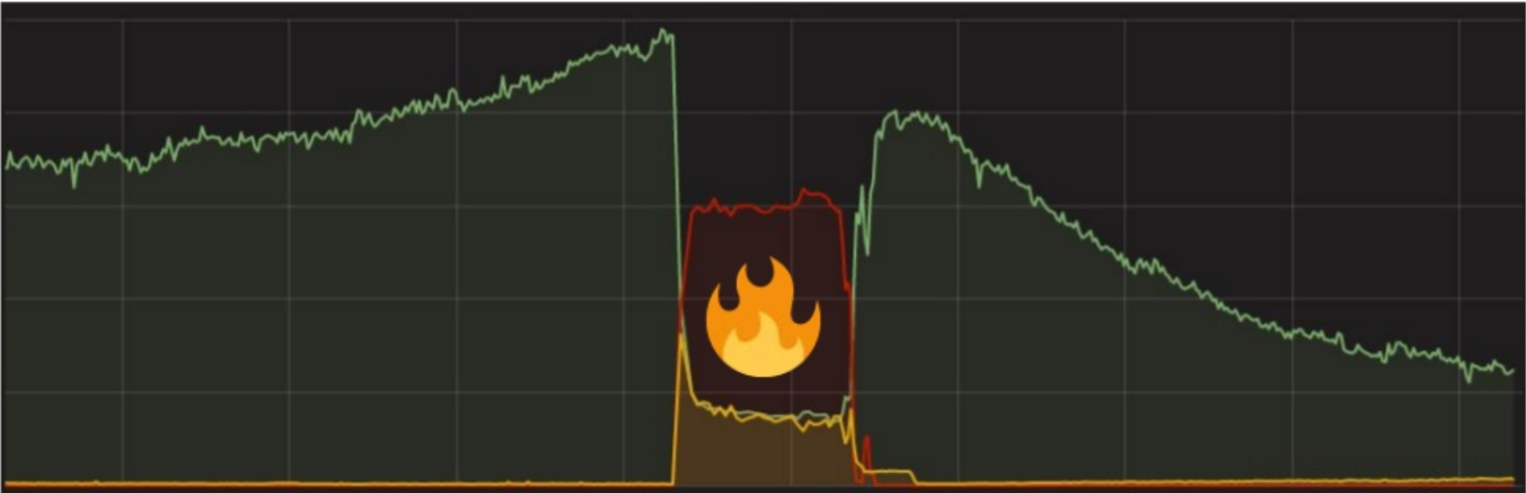
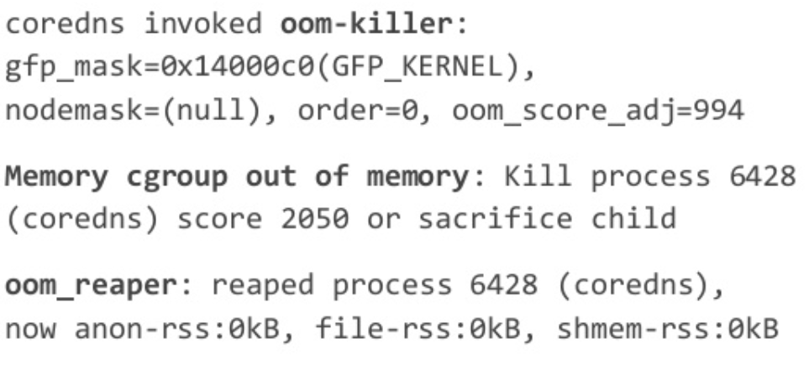
Incident #3
Ingress Errors / CoreDNS OOMKill Possible Solution: Memory Increase
Contributing Factors HTTP Retries No DNS caching Kubernetes ndots:5 problem Short maximum lifetime of HTTP connections Fixed memory limit for CoreDNS Monitoring affected by DNS Outage.

Slide 17
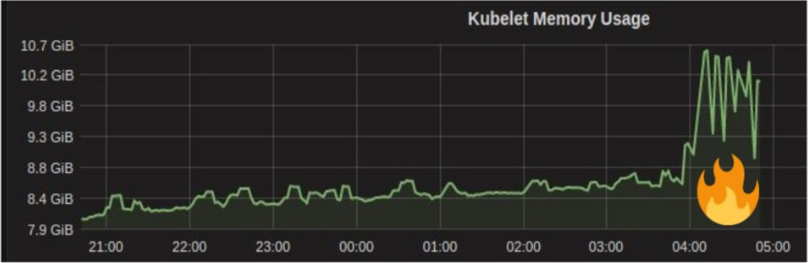
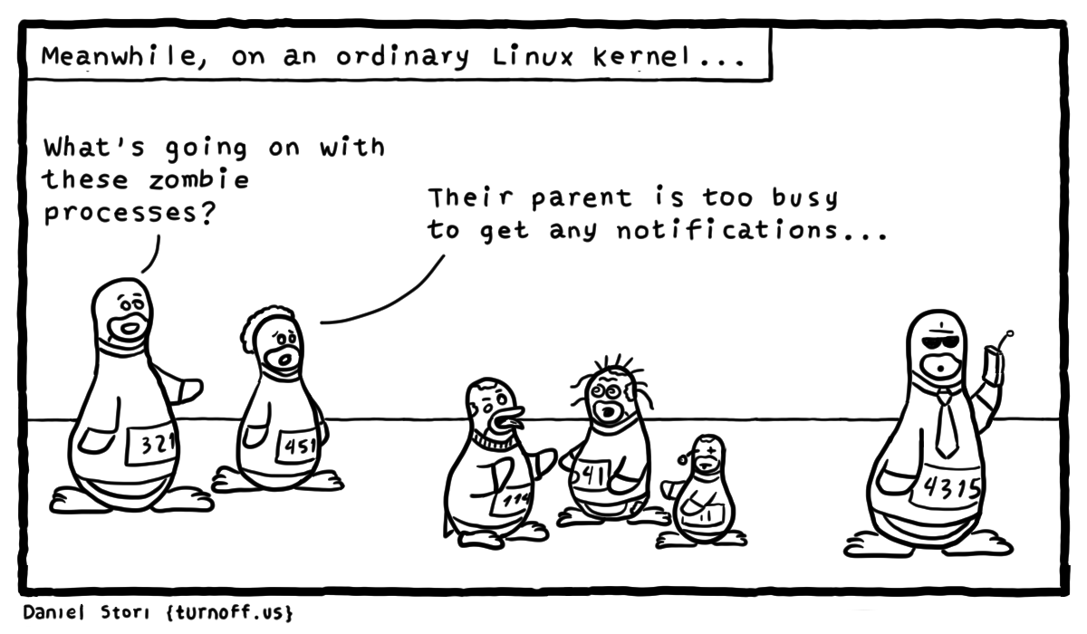
Incident #4
Kernel OOM Killer / Kubelet Memory

Slide 18
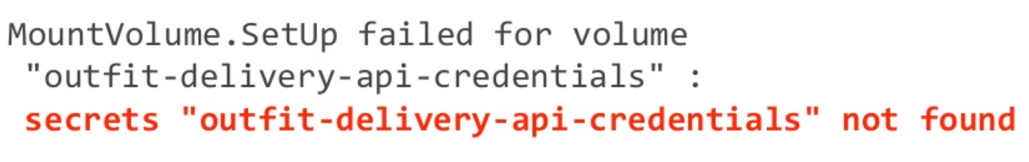
Incident #5
Pod Creation / Wrong Configuration

Slide 19
Incident #6
Grafana Dashboard Affected by Cluster Problems
Consider exporting metrics outside of cluster and move Grafana out of cluster as well.
An advantage might be having a single go-to point for dashboards for multiple clusters.
Out-of-cluster location could be EC2 but also a separate Kubernetes cluster.

Slide 20


Lessons Learned
Improve high level alerting from outside of clusters. We should know that there is something wrong with the cluster before, or at least at the same time as applications in the clusters start to be affected.
Improve incident response processes and tooling. It can happen that automatic paging fails for whatever reason. In this case it should be simple for any on-call engineers to escalate directly to other teams without going to a different tool. One idea we are pursuing is to simplify the escalation process via a chat bot.

Slide 21
That’s Not All
You think Kubernetes the hard way is hard,
The hard part was never only the setup,
Sometimes you will have to break things to learn.
Thank You!

