Slide 1
ReactJS
METEHAN KARA

Slide 2
WHAT IS ReactJS ?
An open source javascript library for building user interfaces
ReactJS uses components
It is possible to use HTML, CSS and javascript in a component
without external scripts or files
It is asyncronous
Created by Facebook

Slide 3
WHY SHOULD WE USE ReactJS ?
Create reuseable UI components
Fast and simple
Easy to learn and more support
Compatibility with other languages and technologies
React Native (IOS & Android)
Redux
Great developer tools
Virtual DOM
JSX syntax

Slide 4
REUSABLE UI COMPONENTS
HTML & BOOSTRAP
<div class="card" style="width: 20rem;"> <img class="card-img-top" src="..." alt="Card image cap"> <div class="card-block"> <h4 class="card-title">Card title</h4> <p class="card-text">Some quick example text to build on the card title and make up the bulk of the card's content.</p> <a href="#" class="btn btn-primary">Go somewhere</a> </div> </div>
ReactJS
var Card = React.createClass({ render: function() { return (
<div className="card" style={{width: '20rem’}}> <img className="card-img" src="..." alt="Card image cap" /> <div className="card-block"> <h4 className="card-title">{this.props.title}</h4> <p className="card-text">{this.props.content}</p> <a href="#" className="btn btn-primary">Go somewhere</a> </div> </div> ); } });
USAGE: <Card title = ”Card Title” content = ”Card Content” />
[1]

Slide 5
VIRTUAL DOM
[2]

Slide 6
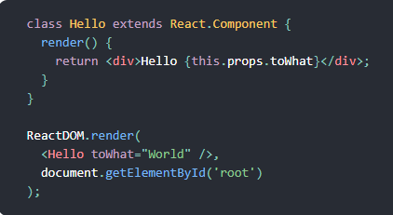
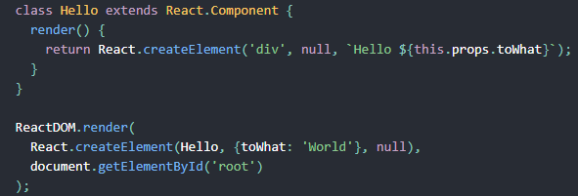
JSX SYNTAX
React with JSX
React without JSX
[3]

Slide 7
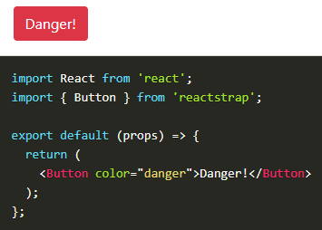
HOW TO SETUP ReactJS ?
Install NodeJs and npm (Node Package Manager) “npm makes it easy for JavaScript developers to share and reuse code, and it makes it easy to update the code that you’re sharing” — npmjs.org
npm install react --save
npm install react-dom --save
npm install webpack --save (module bundler)
npm install babel-core –save-dev (javascript compiler/transpiler)
# npm install –g create-react-app HelloWorldReactApp
# npm install –save reactstrap react react-dom
[4]

Slide 8
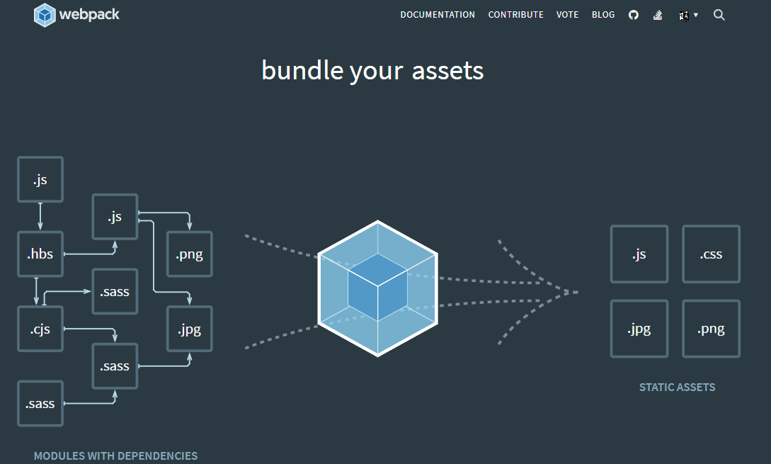
[5]

Slide 9
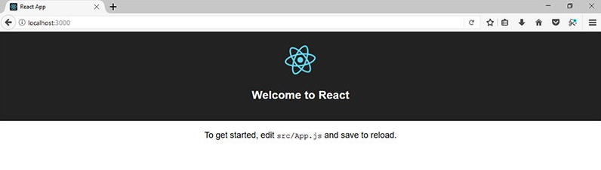
FIRST PAGE OF ReactJS

Slide 10
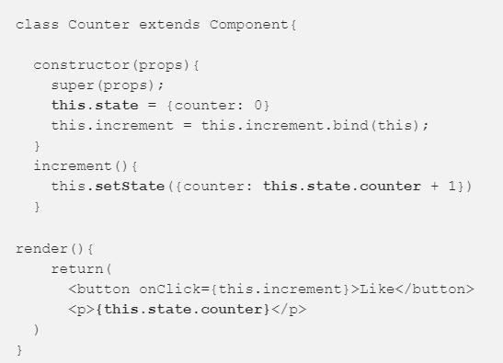
ReactJS - State
[6]

Slide 11
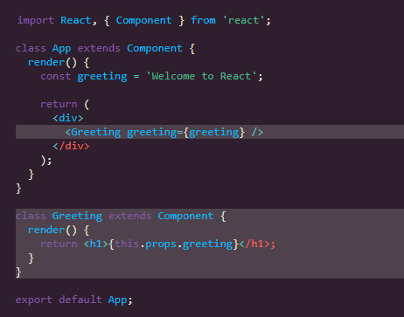
ReactJS - Props
[7]

Slide 12
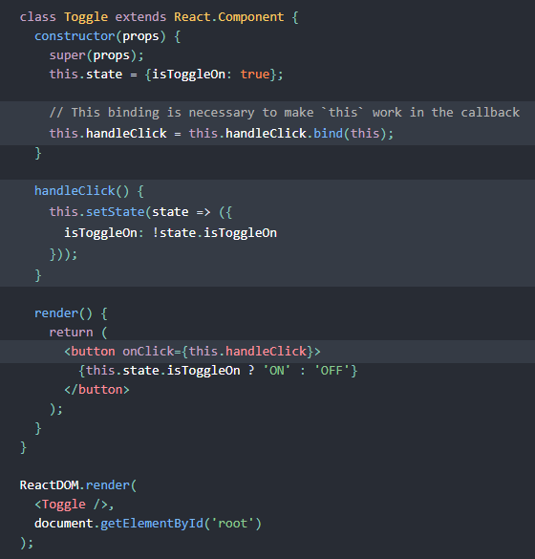
ReactJS – Handling Events
[8]

Slide 13
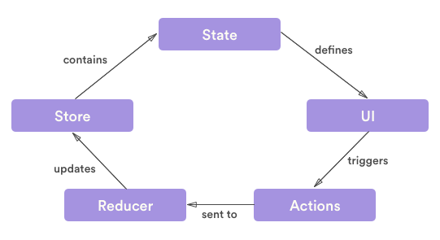
ReactJS + Redux
[9]

Slide 14
RESOURCES
[1] https://medium.com/türkiye/nedir-bu-react-neden-kullanmalıyız-nasıl-başlarız-neler-yapabiliriz-f473e3ae0a7e
[2] https://medium.com/naukri-engineering/naukriengineering-virtual-dom-fa8019c626b
[3] https://reactjs.org/docs/react-without-jsx.html
[4] https://reactstrap.github.io/
[5] https://webpack.js.org/
[6] https://blog.cloudboost.io/props-vs-state-in-react-js-9c186dcf39b8
[7] https://www.robinwieruch.de/react-pass-props-to-component/
[8] https://reactjs.org/docs/handling-events.html
[9] https://dev.to/radiumsharma06/abc-of-redux-5461

