Slide 1
Simplicity in Software Engineering

Slide 2
Simplicity
Simple can be harder than complex: You have to work hard to get your thinking clean to make it simple. But it’s worth it in the end because once you get there, you can move mountains. — Steve Jobs
Simplicity is a prerequisite for reliability.— Edsger Dijkstra

Slide 3
Simplicity
Non-technical Factors
Users
Business and stakeholders
The needs/interests of engineers, designers, product owners
Financial constraints
But the complexity of the whole increases much more than linearly.
While keeping user experience simple, we may encounter over engineering.

Slide 4
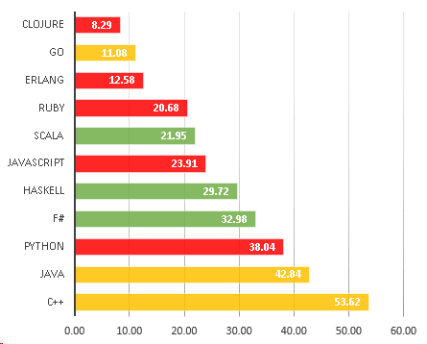
Effects of Simplicity on Programming Languages
The correlation between languages and lower bug density matches on simplicity:
The data shows a gap between languages that focus on simplicity versus ones that don’t.
A programming language is low level when its programs require attention to the irrelevant. — Alan Perlis
https://labs.ig.com/static-typing-promise

Slide 5
Over Engineering Problem
How do you know your code is over engineered?
When a well experienced coder, which has been working on that piece of code for at least an year, still takes way more than necessary/affordable to figure out where/how a specific feature Works, there is over engineering.
Use a factory only if it is making more than one type of objects
Use an interface if it is actually going to be implemented by more than one class
From Premature Generalization (will discuss later)
Over Engineering symptoms according to stackoverflow.com https://stackoverflow.com/questions/1941770/concrete-symptoms-of-over-engineering

Slide 6
Over Engineering Problem
Over engineering code is a common plague that leads to a number of unwanted side effects in your software.
Impacts:
unnecessary complexity => less agility in software
more code, more bugs
more code, more unit tests, more development time
performance impacts
longer catch up time for newcomers
difficult maintenance, fixing bugs requires more time than normal
small changes require big efforts and are prone to having many bugs
unwanted features are present even though there is not reference in requirements/backlogs and so you have to maintain them even if they are not used
false perception of complexity in the code that leads to over inflated estimates for fixes, changes.
extending an over engineered project makes extensions more complex than necessary
dismantling of over engineered code takes way longer than it took to over engineer it
Need for complete rewrite over time to reduce unneeded complexity when maintenance times become higher than rewrite time
The solution is to make it simple.

Slide 7
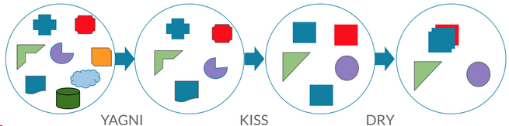
Avoiding Over Engineering
KISS : Keep It Simple, Stupid
The KISS principle states that most systems work best if they are kept simple rather than made complicated; therefore, simplicity should be a key goal in design, and unnecessary complexity should be avoided.
YAGNI : You Aren’t Gonna Need It
You aren't gonna need it is a principle of extreme programming (XP) that states a programmer should not add functionality until deemed necessary. XP co-founder Ron Jeffries has written: "Always implement things when you actually need them, never when you just foresee that you need them.”
DRY : Don’t Repeat Yourself
Don't repeat yourself is a principle of software development aimed at reducing repetition of software patterns, replacing it with abstractions or using data normalization to avoid redundancy.
SOLID

Slide 8
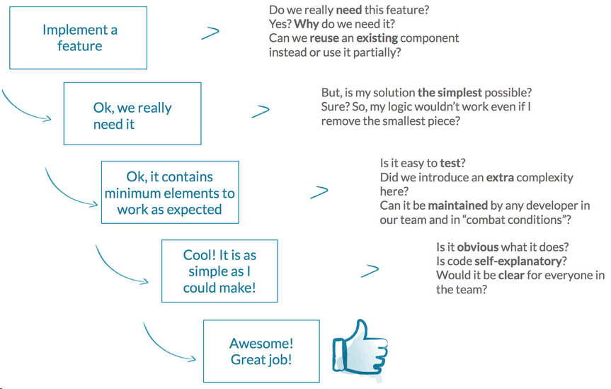

Slide 9
Simplicity Principles - SOLID
S is for Single Responsibility Principle
The single responsibility principle (SRP) asserts that a class or module should do one thing only. For example, consider a class that opens a connection to the database, pulls out some table data, and writes the data to a file. This class has multiple reasons to change: adoption of a new database, modified file output format, deciding to use an ORM, etc. In terms of the SRP, we'd say that this class is doing too much.

Slide 10
Simplicity Principles - SOLID
O is for Open/Closed Principle
The Open/Closed Principle states that code entities should be open for extension, but closed for modification. To put this more concretely, you should write a class that does what it needs to flawlessly and not assuming that people should come in and change it later. It's closed for modification, but it can be extended by, for instance, inheriting from it and overriding or extending certain behaviors. An example of running afoul of the open-closed principle would be to have a switch statement somewhere that you needed to go in and add to every time you wanted to add a menu option to your application.
Another example is, it's not as though Apple, Google, and Microsoft put the OS source code up on GitHub and invite you to dive in and start building games and flashlight functionality. Rather, they make the core phone functionality closed for modification and they open it to an extension.

Slide 11
Simplicity Principles - SOLID
L is for Liskov Substitution Principle
The Liskov Substitution Principle (LSP) is the one here that is most unique to object-oriented programming. The LSP says, basically, that any child type of a parent type should be able to stand in for that parent without things blowing up.
In other words, if you have a class, Animal, with a MakeNoise() method, then any subclass of Animal should reasonably implement MakeNoise(). Cats should meow, dogs should bark, etc. What you wouldn't do is define a MuteMouse class that throws IDontActuallyMakeNoiseException. This violates the LSP, and the argument would be that this class has no business inheriting from Animal.
To picture this, imagine cooking yourself a stew. If you're anything like me, you'd only put things in there that were edible because you would want to eat the stew without picking through each bite, asking yourself repeatedly, "is this edible?"

Slide 12
Simplicity Principles - SOLID
I is for Interface Segregation Principle
The Interface Segregation Principle (ISP) says that you should favor many, smaller, client-specific interfaces over one larger, more monolithic interface. In short, you don't want to force clients to depend on things they don't actually need. Imagine your code consuming some big, fat interface and having to re-compile/deploy with annoying frequency because some method you don't even care about got a new signature.
To picture this in the real world, think of going down to your local corner restaurant and checking out the menu. You'll see all of the normal menu mainstays, and then something that's just called "soup of the day." Why do they do this? Because the soup changes a lot and there's no sense reprinting the menus every day. Clients that don't care about the soup needn't even be concerned, and clients that do use a different interface -- asking the server.

Slide 13
Simplicity Principles - SOLID
D is for Dependency Inversion
The Dependency Inversion Principle (DIP) encourages you to write code that depends upon abstractions rather than upon concrete details. You can recognize this in the code you read by looking for a class or method that takes something generic like "Stream" and performs operations on it, as opposed to instantiating a specific Filestream or Stringstream or whatever. This gives the code in question a lot more flexibility -- you can swap in anything that conforms to the Stream abstraction and it will still work.
To visualize this in your day to day, go down to your local store and pay for something with a credit card. The clerk doesn't examine your card and get out the "Visa Machine" after seeing that your card is a Visa. He just takes your card, whatever it is, and swipes it. Both you and the clerk depend on the credit card abstraction without worrying about specifics.

Slide 14
What Makes it Simple?
What makes something simple is hard to pin down. Part of this is because simplicity is somewhat subjective. Part of this is because the interpretation of simplicity is dependent on experience. Something simple and obvious to a trained mathematician may not be so simple for a biologist — and vice versa.

Slide 15
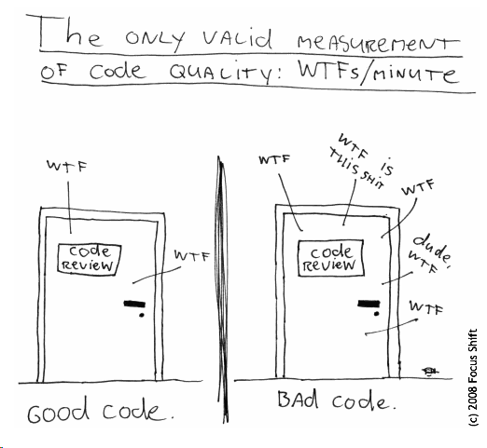
Complexity is Inevitable
In any meaningful software program, complexity is inevitable. Software systems must evolve, or they become obsolete. As they evolve, they inevitably add complexity in the form of new or changed features. So, as it turns out, it is in our interest to introduce complexity into our software.

Slide 16
Clean Code
Code Maintainability: Writing Clean Code is writing good literature. It reflects you.
Code Readability: Writing Clean Code is explaining the Physics. The code should implicitly explain in small details exhibiting simplicity what the magical functions does.
Code Smell Repellent : Writing Clean Code is like wine-making. It may take ceremonies but in the end you will feel comfortable with the code (at the least). Bugs will find it hard to hide.
Code Epithet: Once you commit with version control. The name gets etched with the code forever.

Slide 17
Simplicity Example
All non-trivial abstractions, to some degree, are leaky. — Joel Spolsky
We can see a modern-day example of this with React JS. One of the main intentions of React is to abstract away the DOM. However, React provides refs for those cases where you may need to interact with the DOM. To do so, of course, you must understand how to interact with the DOM. This means that the abstraction has failed. In fact, it introduces the additional complexity of having to understand how to “escape” React to interact with the DOM.

Slide 18
Aspects of a simple program
Comprehension and problem solving are manageable once the principles underlying the system are well understood.
The system makes use of well-known cultural markers to ease comprehension.
It maintains design consistency.
It makes good use of semantics.
It balances the needs of flexibility with the boundaries and domain of the system.
Complexity is limited as much as possible.
Unnecessary complexity is identified, and removed.

Slide 19
Protecting Against Unnecessary Complexity
Haste Makes Waste
When any… project is nearing completion, there is always a mad rush to get new features added… The rush is mad indeed, because it leads into a trap…— Tony Hoare
Allow time for design.
Allow time for good coding practices.
Allow time for refactoring.

Slide 20
Avoid The Latest Tech Trap
Chasing after the latest and greatest introduces chaos as programmers struggle to learn the methodology, language, or framework that will finally allow them to do things the “right” way.
Thoughtfulness, and a willingness to not follow the bandwagon simply because it’s popular, can go a long way towards protecting the sanity of your code.

Slide 21
Follow the Standard Procedures
Code Reviews — perhaps one of the most powerful tools in a software team’s tool box. Make sure your code reviews are well thought out, and well executed.
Design Reviews — don’t just review code, review designs as well.
Enough Design Upfront — don’t just sit down and code. Look at how your system is designed. Follow those design patterns to ensure your designs stay consistent over time.
Have a grand plan for how your system will function. Define aspects at a high-level such as: How will you handle asynchronicity in your application? How will you manage fault tolerance? How will you manage data consistency?
Make sure your requirements are good.

Slide 22
Over Engineering Problem
How do you know your code is over engineered?
When a well experienced coder, which has been working on that piece of code for at least an year, still takes way more than necessary/affordable to figure out where/how a specific feature works.
Use a factory only if it is making more than one type of objects
Use an interface if it is actually going to be implemented by more than one class
From Premature Generalization
Over Engineering symptoms according to stackoverflow.com https://stackoverflow.com/questions/1941770/concrete-symptoms-of-over-engineering

Slide 23
Generalizations
Macros and Subroutines
Extra Parameters.
Overloading.
Abstract Classes.
Templates.
Libraries.

Slide 24
Generalizations
Macros and Subroutines. When you use the same piece of code in two places, you convert that piece of code into a subroutine or macro, so that its body only needs to be written once. You use parameters to move data in and out of the subroutine or macro.
public GenericDTO saveRecordAsNew(GenericDTO anotherDTO) {
return getGenericDTO(anotherDTO, true, 245L);
}
public GenericDTO saveRecordAsOld(GenericDTO anotherDTO) {
return getGenericDTO(anotherDTO, false, 123L);
}
private GenericDTO getGenericDTO(GenericDTO anotherDTO, boolean isNew, long id) {
GenericDTO newDTO = new GenericDTO();
anotherDTO.setNew(isNew);
anotherDTO.setId(id);
return anotherDTO.copyProperties();
}
public GenericDTO saveRecordAsNew(GenericDTO anotherDTO) {
GenericDTO newDTO = new GenericDTO();
anotherDTO.setNew(true);
anotherDTO.setId(245L);
return anotherDTO.copyProperties();
}
public GenericDTO saveRecordAsOld(GenericDTO anotherDTO) {
GenericDTO newDTO = new GenericDTO();
anotherDTO.setNew(false);
anotherDTO.setId(123L);
return anotherDTO.copyProperties();
}

Slide 25
Generalizations
Extra Parameters. Sometimes you can merge two functions with similar parameter lists into one that takes an additional parameter to tell it which of the two original functions it is supposed to behave like.
public GenericDTO saveRecord(GenericDTO anotherDTO) {
anotherDTO.setNew(true);
return save(anotherDTO);
}
public GenericDTO updateRecord(GenericDTO anotherDTO) {
anotherDTO.setNew(false);
return save(anotherDTO);
}
Can be changed to:
public GenericDTO saveOrUpdateRecord(GenericDTO anotherDTO, boolean isNew) {
anotherDTO.setNew(isNew);
return save(anotherDTO);
}

Slide 26
Generalizations
Overloading. Whenever you have two functions with different parameters but the same name, you're using the same name because you believe the functions are similar in some way. This constitutes a generalization, even though in this case the computer doesn't really benefit from it.
private GenericDTO createAndSaveGenericDTO(boolean isNew) {
GenericDTO anotherDTO = new GenericDTO();
anotherDTO.setId(UUIDGenerator.getUUID());
anotherDTO.setNew(isNew);
return saveGenericDTO(isNew, anotherDTO);
}
private GenericDTO saveGenericDTO(boolean isNew, GenericDTO anotherDTO) {
return anotherDTO.copyProperties();
}

Slide 27
Generalizations
Abstract Classes. Abstract classes isolate the common characteristics of their descendants.
public abstract class Person {
private String name;
private String gender;
public Person(String nm, String gen){
this.name=nm;
this.gender=gen;
}
//abstract method
public abstract void work();
@Override
public String toString(){
return "Name="+this.name+"::Gender="+this.gender;
}
public void changeName(String newName) {
this.name = newName;
}
}

Slide 28
Generalizations
Templates. Templates allow functions and classes to be parameterized by type.
public class BaseService<Entity, DTO, ID extends Serializable, USER_IDENTIFIER> {
@Autowired
protected BaseRepository<Entity, ID> dao;
@Autowired
protected BaseMapper<Entity, DTO> mapper;
@Transactional
public DTO save(DTO dto) {
((Identifier) dto).setId(UUIDGenerator.getUUID());
Entity entity = mapper.toEntity(dto);
entity = dao.save(entity);
dao.flushAndClear();
return mapper.toDTO(entity);
}
}

Slide 29
Generalizations
Libraries. Placing a piece of code in a library allows it to be used by more than one program.
import java.util.UUID;
public final class UUIDGenerator {
private UUIDGenerator() {
throw new IllegalStateException("UUIDGenerator not initable.");
}
public static String getUUID() {
return UUID.randomUUID().toString();
}
}

Slide 30
Generalizations Done Wrong
A function that is not clearly named - if you need to read the method to know what it does, it wants refactoring
public void changeName(String newName) {
this.name = newName + " " + UUIDGenerator.getUUID();
}
Should be changed to:
public void changeNameAndAppendUUID(String newName) {
this.name = newName + " " + UUIDGenerator.getUUID();
}

Slide 31
Generalizations Done Wrong
A function parameter which is always given the same value
public GenericDTO saveRecordAsNew(GenericDTO anotherDTO) {
fillIdAndGetGenericDTO(true);
// do stuff
}
public GenericDTO saveRecordAsOld(GenericDTO anotherDTO) {
fillIdAndGetGenericDTO(true);
// do stuff
}
private GenericDTO fillIdAndGetGenericDTO(boolean isNew) {
GenericDTO anotherDTO = new GenericDTO();
anotherDTO.setId(UUIDGenerator.getUUID());
anotherDTO.setNew(isNew);
return anotherDTO;
}
public GenericDTO saveRecordAsNew(GenericDTO anotherDTO) {
fillIdAndGetGenericDTO();
// do stuff
}
public GenericDTO saveRecordAsOld(GenericDTO anotherDTO) {
fillIdAndGetGenericDTO();
// do stuff
}
private GenericDTO fillIdAndGetGenericDTO() {
GenericDTO anotherDTO = new GenericDTO();
anotherDTO.setId(UUIDGenerator.getUUID());
anotherDTO.setNew(true);
return anotherDTO;
}

Slide 32
Generalizations Done Wrong
Overloaded functions that do not behave even conceptually similarly
public class Person {
private String name;
private String gender;
@Override
public String toString(){
this.gender = "MALE";
return "Name="+this.name+"::Gender="+this.gender;
}
}

Slide 33
Generalizations Done Wrong
An abstract class with only one descendant
A template which makes sense with only one type argument
A library which is used by only one program

Slide 34
Generalizations - When to do
A programmer can generalize by refactoring, when the code he/she is generalizing is already in hand. This guarantees that the generalization will be useful - at the cost of doing without it until the code is already written!

Slide 35
Generalizations - When to do
A programmer can generalize when he/she knows he/she is going to need it. He/She may not have written the code yet, but he/she knows that he/she is going to, probably within the next few days. In this case, generalization now can be a big timesaver over refactoring later.

Slide 36
Generalizations - When to do
A programmer can generalize when he/she thinks, but is not sure, he/she is going to need it. This paves the way for a possibly inappropriate generalization. When the generalization turns out to be inappropriate, we call it premature - especially if it gets caught in a code freeze or an interface-to-the-code freeze. (But when it's appropriate, we call it foresight.)

Slide 37
Generalizations That We Need To Avoid
Learn the deepest darkest corners of your language and find its most obscure features.
Guess the entire structure of the program on paper, and then commit the most important part of that guess to code. Long before you ever have a single "User Story" to satisfy.
Invest the core totally in those most obscure features. It's the core, so it has to be advanced and powerful, right?
Complicate the hell out of that core by snarling those unreadable undiagnosable language features up into a ton of YouAreGonnaNeedIt guesswork that adds no value whatsoever. Make entire layers full of extensible templates, virtual functions, and obese macros - then never extend these or encounter a reason to. (ObfuscatedCode.)
Enforce extreme sensitivity not just to your compiler, but to its current version. Cripple the PrecompiledHeader facility; make source-level debugging a nightmare. Use your imagination. If you write C++, invent your own String class, then overload 'new' inside that and put the reference counting stuff there.
Now don't document anything. If anyone asks, document the requirements, or simply produce a useless snow-job. Observe that, from the outside, on paper, this looks just like a healthy Spiral development model. If you don't look too closely.
Don't put in any Unit Tests out there either, because folks might use them to Refactor & simplify your EasterEgg out of existence.
Spawn a whole bunch of new modules, each of which "extends" the core. Which really means they "couple with" the core. Start adding the features to these modules, to lock in their dependency on the core.

Slide 38
Summary
Simplicity is far from simple. It’s also important to remember that it is a means to an end, and not the end itself. The end being quality software that is easy to use, and easy to work with.
To date, keeping systems simple has been one of the most effective ways that humans have managed working with software. Simplicity is as much a process and practice, as it is a set of principles, guidelines, or a philosophy. It’s something that should be championed and managed by the entire organization.

Slide 39
Resources and Further Readings
https://itnext.io/why-simple-is-so-complex-362bc835b763
http://wiki.c2.com/?PrematureGeneralization
https://www.paulstephenborile.com/2017/06/whats-wrong-word-simple-engineering-code/
https://tech.kartenmacherei.de/simplicity-in-software-engineering-is-not-simple-979cf098e4b1
http://wiki.c2.com/?JobSecurity
https://dzone.com/articles/the-solid-principles-in-real-life
https://medium.com/programming-hacks/basics-of-writing-clean-code-c1e79f3315d3

