Slide 1

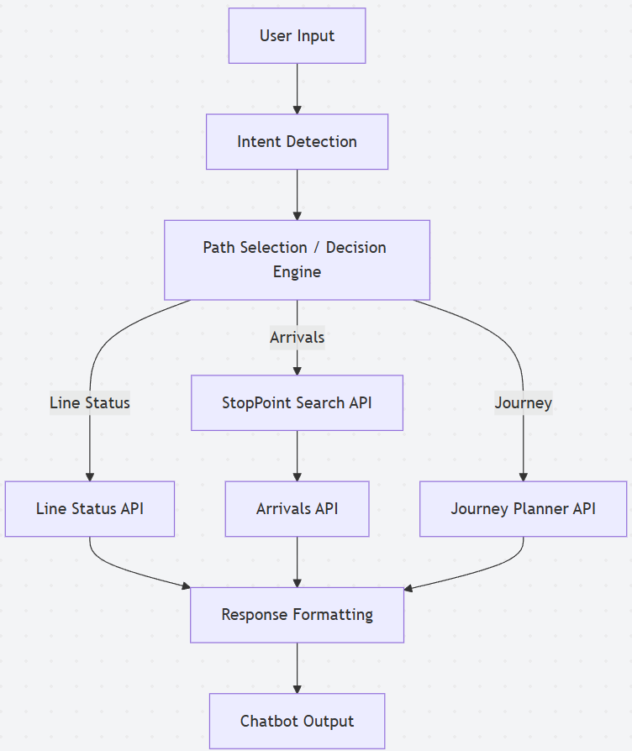
Intent-Driven Chatbot for Real-Time Transport Information using TfL API
Ruwanima Edirisinghe
INTRODUCTION
Urban transport systems generate large volumes of real-time data; however, access to this information remains fragmented across multiple platforms.
Existing solutions rely on static interfaces, requiring users to manually navigate multiple sources.
This project proposes a conversational chatbot that enables users to retrieve real-time transport information through natural language interaction.
System Architecture
Problem Statement
Users face difficulties accessing transport data efficiently due to non-conversational interfaces and fragmented systems.
This leads to delays in decision-making, particularly in time-sensitive travel scenarios.
OBJECTIVES
• Develop an intent-driven chatbot
• Integrate real-time transport APIs
• Implement modular architecture
• Evaluate system performance
Methodology
An iterative development approach was adopted.
Initial prototyping was conducted using Make.com.
The system was later migrated to Rivet to enable modular workflow design.
The chatbot uses:
• Rule-based intent detection
• API integration using REST
• JavaScript for response processing
API INTEGRATION
The chatbot integrates multiple TfL API endpoints: • Line Status API • StopPoint Search API • Arrivals API • Journey Planner API Multi-step API orchestration is required for tasks such as arrival prediction.
The system follows a layered architecture where user input is processed through intent detection and routed to appropriate TfL API endpoints.
RESULTS
The system successfully retrieves real-time data and provides structured responses.
Testing confirmed:
• Accurate line status retrieval
• Reliable arrival predictions
• Functional journey planning
REFERENCES
[1] Transport for London, “Unified API Documentation,” 2024. [Online]. Available: https://api.tfl.gov.uk
[2] D. Jurafsky and J. H. Martin, *Speech and Language Processing*, 3rd ed. Stanford, CA, USA: Stanford University, 2023. [Online]. Available: https://web.stanford.edu/~jurafsky/slp3/
[3] R. Fielding, “Architectural Styles and the Design of Network-based Software Architectures,” Ph.D. dissertation, University of California, Irvine, 2000. [Online]. Available: https://www.ics.uci.edu/~fielding/pubs/dissertation/top.htm
CHALLENGES
• Ambiguous station names → resolved using disambiguation logic
• Complex JSON responses → handled via data parsing
• Intent misclassification → improved through iteration

