Slide 1
CAPP30122 Project
Mengchen Shi
Ruxin Chen
Shuting Chen

Slide 2
Overview
Objective & Motivation
Data Source
Functions & Implementation
Project Timeline

Slide 3









Slide 4
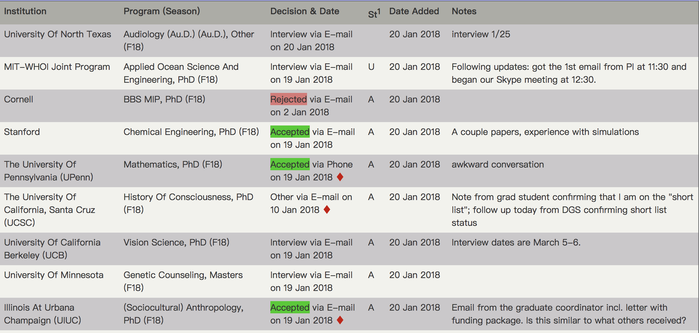
Data Source
“Results Search” on GradCafe: https://thegradcafe.com/survey/
Including previous application results for different graduate schools and programs since 2006
Visualized web page:

Slide 5
Two functional goals:
Qualification Evaluation:
Inputs (user’s background):
Target school
Field of Study
GPA
GRE score
GRE subject
Status(A: American; U: International,
with US degree; I: International,
without US degree; O: Other; ?: Unknown)
Outputs - application cases:
Institution
Program
Decision & Date
Status
GPA
GRE V
GRE Q
GRE W
Notes
Target Program Exploration:
Inputs (user’s background):
Program of interests
Outputs:
application cases
A visualized overview of application cases

Slide 6

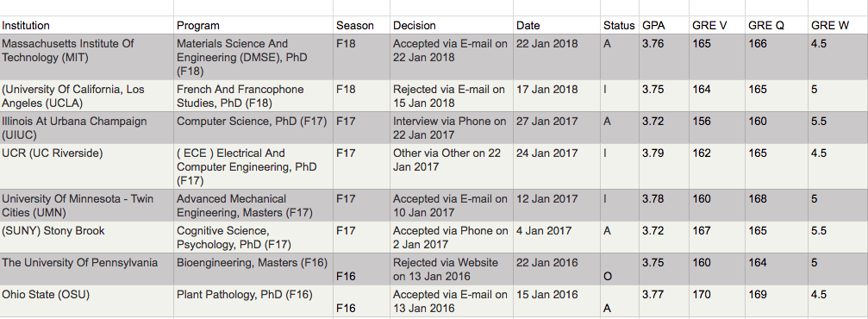
Qualification Evaluation
Field of Study
Target School
GRE score
GPA: 3.7

Slide 7
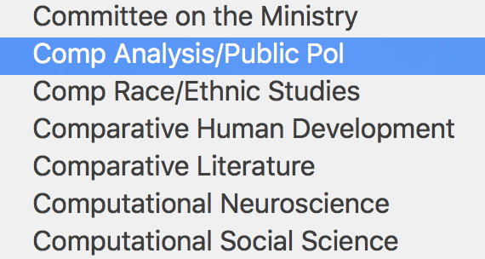
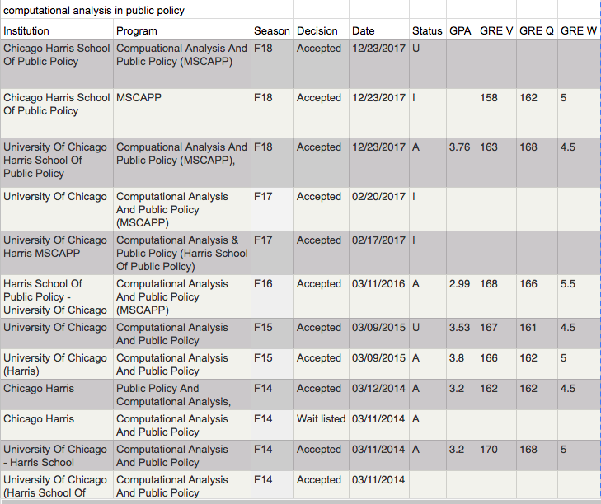
Target Program Exploration:
The University of Chicago
Target program
Create an overview
Notes:
The second function of our program is to explore programs that you are interested in. For example, you are interested in CAPP in UChicago, and you type in the name of CAPP, then a list of historical application cases will be presented. Click the “create an overview” button, a visualized overview of the statistics of CAPP will be created automatically, and can be downloaded by users. The overview includes average GPA, GRE scores, proportion of international students, and the trends overs years etc. To achieve this function, we would build a program using plotting libraries in python to analyze data.

Slide 8
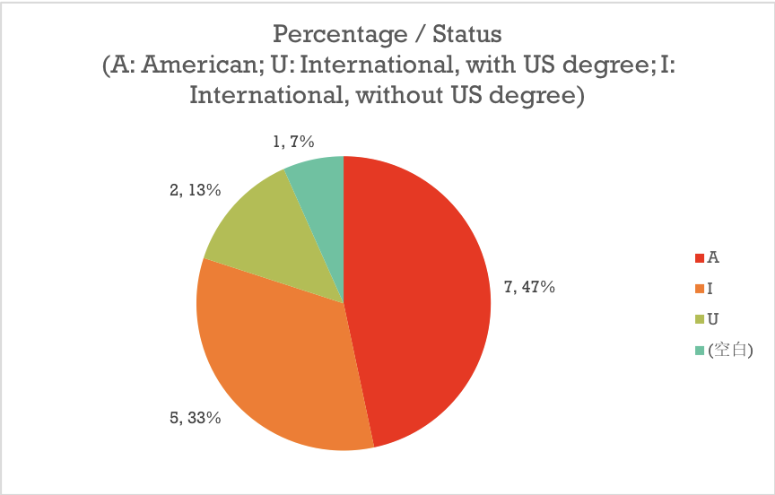
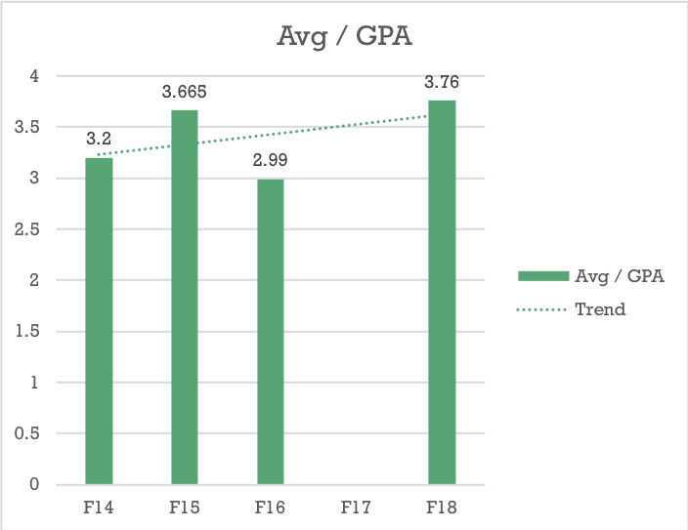
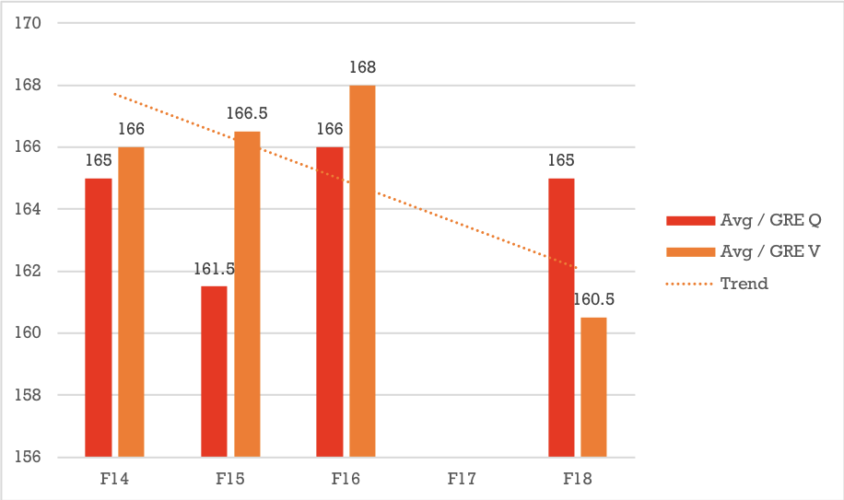
Overview of Computational Analysis & Public Policy (MSCAPP)
N/A

Slide 9
Implementation
Obstacles:
Not standardized data source
Against crawler
Tasks:
Web crawling
Data storage
Data cleaning
Interface design
Data visualization
Notes:
In general we have 5 tasks to complete our functions. They are ...
There are two major obstacles:
The first is that GradCafe might have measures against crawler.
The second is that data are not standardized so that we would have hard time classifying universities and graduate programs.

Slide 10
Project Timeline
Week 4 (1/22/2018 - 1/28/2018):
Study the html structure of GradCafe website and get familiar with its data characteristics. Then we would design the logistics of the program, break the project into small parts.
Week 5 (1/29/2018 - 2/4/2018):
We would design web crawler algorithms, grab a small sample dataset, use the dataset to test project feasibility, and revise our crawler accordingly.
Week 6 (2/5/2018 - 2/11/2018):
We would finish our crawler and scraping the actual datasets. In the meanwhile, we would design functions to analyze and visualize data.
Week 7 (2/12/2018 - 2/18/2018):
We would design user interface and implement the program with the datasets we collected.
Week 8 (2/19/2018 - 2/25/2018):
We would revise our project implementation based on project progress and do further data analysis to present visualized overviews.

Slide 11
Thank you!

