Slide 1
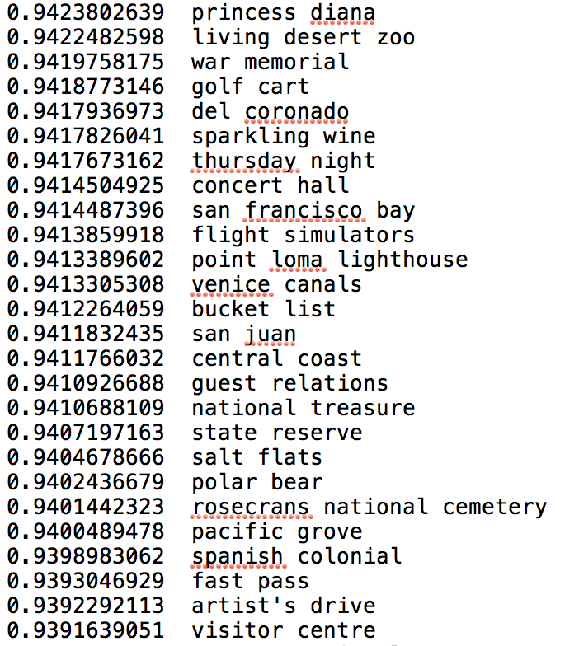
NLP step 1
Phrases as raw material
We tried the approach from the paper
“Mining Quality Phrases from Massive Text Corpora”, by Liu et. al. at the Univeristy of Illinois and Microsoft.
An open source implementation of their algorithm called AutoPhrase .
200 * 189 reviews as input
17,675 potential phrases in totoal
We used a threshold of 0.5 for phrasiness, which reduced the list to approximately 2670 potential phrases
how likely
to be a phrase
phrases
Notes:
What we want to achieve is to extract key words/ features from reviews of each attraction and cluster attractions according to their features.
Since single words cannot fully express a feature, we want to extract phrases instead.
We tried...
As we can see, the phrases can show some features of the attractions. For example, “sparkling wine” indicate that travelers can expect to taste some sparking wine at the attraction.

Slide 2
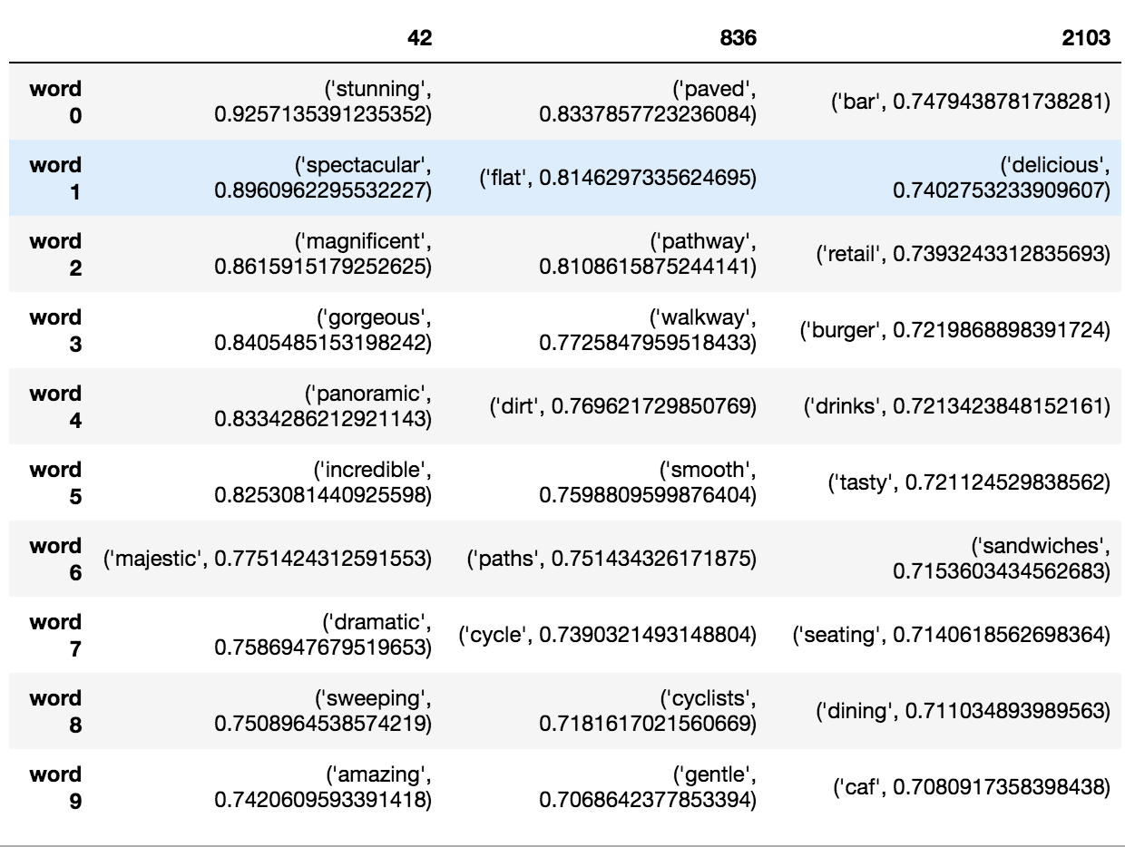
NLP step 2
word2vec algorithm:
find neighbor words
The word2vec algorithm from Mikolov and other Google researchers is perfect for this case.
Given a corpus of text, it maps each word into a numerical vector of say 300 dimensions. The mapping is done in a way that put words that are used in a similar way in the corpus are near each other in the vector space.
Again, take 200 * 189 review text as training data, and build a word2vec model.
fantastic
pathways
restaurant

Slide 3
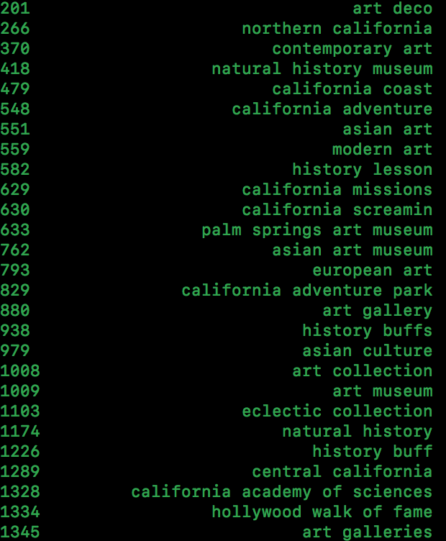
NLP step 3
Clustering phrases into tight topics
agglomerative clustering routine in the python sklearn.
We cluster phrases from what we get from step1, and get not ideal results. Ideally, combine the neighbor words from step2 with phrases from step1 and then cluster them.
The overall combination process forms a tree of nodes.
These clusters can be treated as general features for different kinds of attractions and can enable users to choose the kind they prefer.
Eg. Treat the tree node No.14 as a feature abnd name it “golf”.
pebble beach golf club
11
torrey pines golf course
pebble beach golf course
pebble beach golf
13
14
A golf course
The golf courses
10
A golf
golf courses
12
golf club
the golf

Slide 4
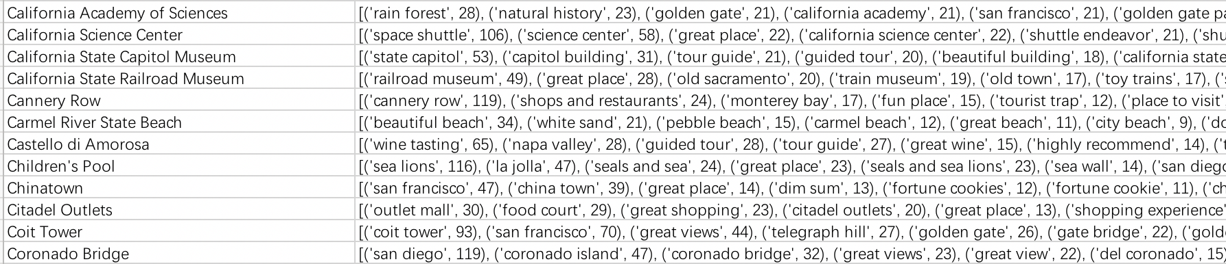
NLP step 4
Match phrases to attractions
Learn from PA5:
Hash table
Find the attractions that frequently mention the phrases in a cluster. These attractions would be the member of the collection formed by a given cluster.

