Slide 1


Optimal Private Payoff Manipulation against Commitment in Extensive-form Games
Yurong Chen¹, Xiaotie Deng¹, Yuhao Li²
¹Center on Frontiers of Computing Studies, Peking University
² Computer Science Department, Oxford University
³ Computer Science Department, Columbia University
Notes:
Hello everyone, the title of my talk optimal private payoff manipulation against commitment in extensive-form games.
It is about how a follower can misreport his payoff function optimally, to distort the leader's commitment and gain higher actual utility.
This is a joint work with Xiaotie Deng and Yuhao Li.

Slide 2






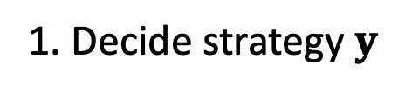




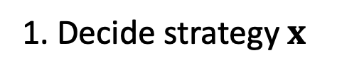



Two-player Extensive-form Games with perfect information
1. Decide strategy $x$
Player 1
Player 2
Leaf nodes
1. Decide strategy $y$
Player 2
Player 1
Subgame perfect equilibrium (SPE)
Independently (simultaneously) decide strategies
$$U^{2}$$
$$8$$
$$4$$
$$2$$
$$1$$
$$U^{1}$$
$$1$$
$$3$$
$$4$$
$$2$$
Backward Induction
An extensive-form game $\left(T_{root},U^{L},U^{F}\right)$
Notes:
Consider a two-player extensive-form game with perfect information.
It can be represented by a game tree. At each node, a designated player chooses an edge, and therefore a subgame to play. Players will get utilities at leaf nodes. In the example shown right, player 1 acts at the root node, while player 2 acts at the two internal nodes.
Possibly the commonly-known solution concept in extensive-form games with perfect information is subgame perfect equilibrium.
As a refinement of Nash equilibrium, players actually need to independently and simultaneously decide their action at each node for them to act.
And it forms a Nash equilibrium at each subgame.
In the SPE of the right example, at two internal nodes, player 2 will choose going to the leaf nodes that yields most actual utility, with the prediction of player 2's behavior, player 1 will go right. Player 2 will get 2 in the SPE. However, you can see if player 1 goes to left, player's utility can be strictly higher. But how can we achieve this?

Slide 3



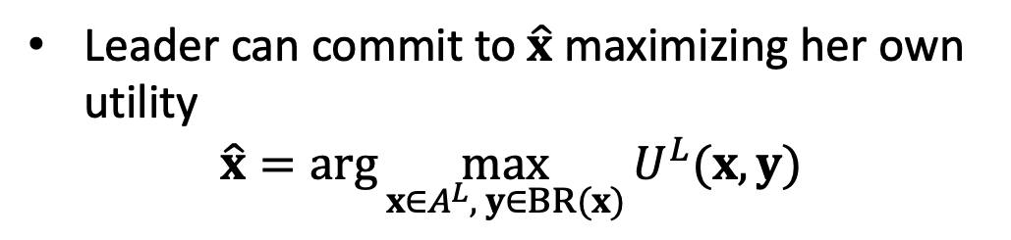

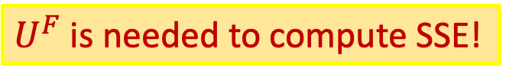






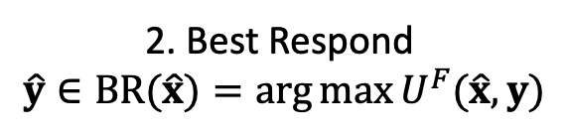



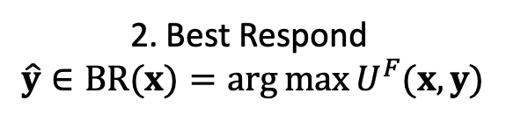


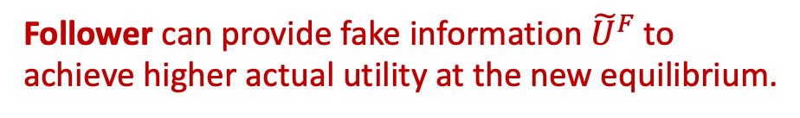


0. Leader learns ${\tilde{U}}^{F}$ by interacting with Follower
0. Leader learns $U^{F}$ by interacting with Follower
Follower can provide fake information ${\tilde{U}}^{F}$ to achieve higher actual utility at the new equilibrium.
When Player 2 can commit
Player 1
Follower
Leader
1. Commit to a optimal $\hat{x}$ first
Player 2
1. Commit to a strategy $x$ first
Practical Examples:
Price discrimination game between e-commerce and customers.
Simple Manipulation: e.g., Switch credit cards (Mahdawi’18).
Leaf nodes
2. Best Respond
$$\hat{y}∈BR(\hat{x})=\arg{\max{U^{F}(\hat{x},y)}}$$
2. Best Respond
$$\hat{y}∈BR(x)=\arg{\max{U^{F}(x,y)}}$$
Leader
Follower
Player 2
Player 1
Leader can commit to $\hat{x}$ maximizing her own utility
$$\hat{x}=\arg{\max_{x{∈A}^{L}, y∈BR(x)}{U^{L}(x,y)}}$$
E-commerce Platform (Leader)
Consumer (Follower)
$$U^{2}$$
$$8$$
$$4$$
$$2$$
$$1$$
$$U^{L}$$
$$U^{F}$$
$$1$$
$$3$$
$$4$$
$$2$$
$$U^{1}$$
$\left(\hat{x},\hat{y}∈BR\left(\hat{x}\right)\right)$: Strong Stackelberg Equilibrium (SSE)
An extensive-form game $\left(T_{root},U^{L},U^{F}\right)$
$${\tilde{U}}^{F}$$
$$−9$$
$$−9$$
$$0$$
$$−1$$
First-mover advantage: Gain no less than in Subgame Perfect Equilibrium
$U^{F}$ is needed to compute SSE!
Inducible
Notes:
It turns out this can be achieved when player 2 has commitment power.
In this case, we shall call player 2 leader
and player 1 follower.
Leader will commit to strategy x before follower
and follower will best respond with strategies, that maximizes his utility, given leader strategy x.
For example, the leader can first credibly tell follower, that she will go right at two internal nodes.
Then follower will best respond by going left. The leader can get 4, greater than he get under SPE.
Actually, this is also his optimal commitment. Based on the prediction that follower will best respond, leader can compute his optimal strategy to commit by solving an optimization problem.
Note that in the optimization problem we solve, when follower has multiple best responses, he will choose the one that favors the leader.
the pair of a leader's optimal commitment and follower's corresponding best response is called Strong Stackelberg Equilibrium, which is SSE for short.
As we see in the left example, the player with commitment power has the so-called first-mover advantage: She can gain potentially more than he did in subgame perfect equilibrium.
However, we note that to solve the optimization problem and find the optimal commitments
Leader needs to know follower's utility information, which is usually follower's private information in most real scenarios.
Thus the game actually begins as such,
before commiting to a strategy, the leader first needs to learn UF by interacting with the follower.
This then leaves the follower a chance to provide fake information tilde UF to the leader, to induce a leader's commitment that gives the follower higher actual utility. (so she will commits to a strategy that gives the follower higher actual utility. )
In the right example, if the follower misreport a function as the blue one. The follower appears that he will never best respond with going left, the leader can only care about the actions in the second subtree.Her optimal commitment in this case is to go left.
Then the follower best respond with going right, this strategy pair leads to the leaf node with follower utility 4, which is greater than that on the orginal leaf node, 3.
Since any pure strategy pair leads to a unique leaf node, and players get utilities at leaf node, we shall call a leaf node is inducible, if there exists a function tilde UF, such that an SSE of the game , induced by tilde UF, leads to that leaf node.
Practical examples include that some e-commerce platforms will learn and construct customers' user profiles, and thus charge different customers different prices for similar services. And there are evidences that customers can do some simple manipulations, like switch credit cards to avoid high prices charged by the platforms.

Slide 4
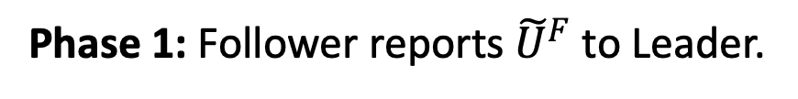
Model
Model: Two-phase Game
Phase 1: Follower reports ${\tilde{U}}^{F}$ to Leader.
Phase 2: Leader outputs an SSE of $(T_{root},U^{L},{\tilde{U}}^{F})$.
Leader
Follower
Leader has the power to select equilibrium
Different equilibria yields same utility for the leader, but different for the follower.

Slide 5
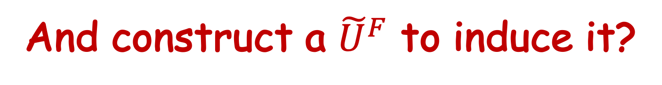
Question here:
How to find an optimal inducible leaf node?
And construct a ${\tilde{U}}^{F}$ to induce it?
$\underset{⇒}{Poly number of leaf nodes}$ Characterize all the inducible leaf nodes
Notes:
A question we ask from the follower's point of view is, how can we find an optimal leaf node and construct a payoff function tilde UF to induce it. Is it polynomial-time tractable?
Notice that in the current setting, it suffices to characterize all the inducible leaf nodes, and then we can just traverse all the leaf nodes and get the optimal one.

Slide 6
First Idea on How to Manipulate
How should a follower construct a payoff function to induce some leaf node $z$?
The set of feasible strategy profiles $(x,y∈BR(x))$: Leader can make the game end in via commitment.
Make a strategy profile of $z$ feasible
Restrict other feasible strategy profiles to those yielding leader utility no higher than $z$.
How can we assure this?
Maximin value $M^{L}\left(root\right)$: the highest value Leader can assure herself…
And also
The least value the leader can get via optimal commitment: Just commit to his maximin strategies.
The highest value the leader can get in zero-sum games via commitment.
Notes:
So, first, let us first think about, if I, the follower, want to induce some leaf node z, how should I construct a payoff function, so that z will be the outcome of an SSE of the induced game?
We can first go back to the definition, and define feasible strategy profiles to be the pair of leader's strategy and the follower's corresponding best responses. Then the set of feasible strategy profiles are all the possibilities that the leader can make the game end in via commitment. And an SSE is the feasible strategy profile with the highest leader utility.
We first need to make sure that, at least one strategy profile that leads to z is feasible.
And then try to restrict the set of other feasible strategy profiles, to the ones with as low leader utilities as possible, or at least utilities no higher than z.
So how can we assure this?
The first idea in my mind is the leader's maximin value. It is known that its the highest value leader can assure herself and also in normal-form zero-sum game, its leader's equilibrium utility.
And in our case, it is the least value leader can get via optimal commitment, and is her utility under optimal commitment.

Slide 7
First Idea on How to Manipulate (con’t)
Proposition 1. Given leaf node $z$, if there exists an SSE of game $\left(T_{root} , U^{L}, U^{F}\right)$ leading to $z$, then $U^{L}\left(z\right)≥M^{L}\left(root\right)$ and $U^{F}\left(p\right)≥M^{F}\left(root\right)$.
$U^{L}\left(z\right)≥M^{L}\left(root\right)$: A necessary condition for $z$ to be inducible.
Also a sufficient condition.
Proposition 2. Given zero-sum game $\left(T_{root} , U^{L}, U^{F}=−U^{L}\right)$,
$$\max_{x, y∈BR(x)}{U^{L}\left(x,y\right)=M^{L}\left(root\right)}.$$
Intuitively, we make the other parts of the game zero-sum.
And still make $z$ achievable via commitment.
Notes:
需要顺一下
The first proposition says that, if z is an outcome led by some SSE, then players' utilities will be no less than their maximin value.
Therefore, no less than the leader's maximin value is a necessary condition for a leaf node to be inducible.
But actually, it is also a sufficient condition.
Proposition 2 means that a leader can get at most her maximin value in zero-sum games via commitment.
So intuitively, to construct a payoff function to induce some leaf node, we make the other parts of the game zero-sum, so the leader's utility by committing to strategies that will not lead to z is at most her maximin value.
But we still need to make sure that there exists some feasible strategy profile leading to z.

Slide 8









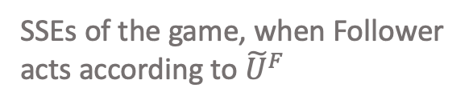



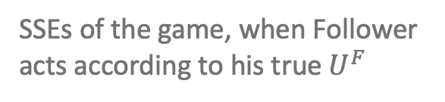








Inducibility & Pure commitment Case
Theorem 1. $z$ is inducible if and only if $U^{L}\left(z\right)≥M^{L}\left(root\right).$
Example: Follower deceives to gain better actual utility
Tips for deception
Follower
Leader
appears to be fully competitive;
Only show sign of cooperation on the desired path.
use constant-sum subgames and games with constant worst utilities to restrict the feasible strategy profiles;
Leaf nodes
$$U^{L}$$
$$8$$
$$4$$
$$2$$
$$1$$
$$U^{L}$$
$$8$$
$$4$$
$$2$$
$$1$$
$$U^{F}$$
$$1$$
$$3$$
$$4$$
$$2$$
$$−9$$
$$−9$$
$$0$$
$$−1$$
$${\tilde{U}}^{F}$$
SSEs of the game, when Follower acts according to his true $U^{F}$
SSEs of the game, when Follower acts according to ${\tilde{U}}^{F}$
Notes:
In the current case, theorem 1 told us that this can always be achieved when leader's utility at z is greater than or equal to her maximin value.
Let's come back to the example shown at the beginning.
When Follower truthfully report, the SSE will make the game end in the second leaf node.
If the follower wants to induce the third leaf node. Notice that the leader is willing to commit to strategies with which the follower best respond by going left. Since her utilities at the first subtree is strictly higher than those at the second subtree.
Therefore, we will assign the leaf nodes in the first subtree the worst utilities, so as to signal that the follower will always chooses to go right. The leader can only commits to go left in the second subtree, and follower gets what he wants.
Look at the example, and here are some tips for deception, first, we need to appears to be fully competitive;
And we use constant-sum subgames and games with constant worst utilities to restrict the feasible strategy profiles.

Slide 9

















Extension – Behavioral Commitment
Follower
Leader
Leaf nodes
Allows randomization over edges
$$\frac{1}{2}$$
$$\frac{1}{2}$$
$$U^{L}$$
$$8$$
$$4$$
$$2$$
$$1$$
$$U^{L}$$
$$8$$
$$4$$
$$2$$
$$1$$
$$U^{F}$$
$$1$$
$$3$$
$$4$$
$$2$$
$$U^{F}$$
$$1$$
$$3$$
$$4$$
$$2$$
$$p$$
$$1/2$$
$$1/2$$
$$0$$
$$0$$
We assume follower always best-respond with pure strategies.
Inducible
Distribution over leaf nodes:
Determine players’ utilities. What players really care.
Notes:
Until now, we have been discussing the basic and simple setting, where leader only commits to pure strategies. That is, a strategy that specify one edge at each node for her to act.
When the leader can commits to behavioral strategies, which is he can choose a distribution over edges.
Then the leader's optimal commitment in this case is to uniformly go to each leaf node at the first subtree, and go to right with probability 1 at the second subtree.
At this time, the follower's expected utilities are all 2 whether he goes right or left. As we assume the follower break ties of the leader, he will best respond by going left.
Leader will get 6 via optimal behavioral commitment, strictly higher than he get via optimal pure commitment.
Notice that as the follower will get the same under all kinds of best responses, we always assume he best-respond with pure strategies.
And the SSE with behavioral commitment shown in the right figure actually uniquely determines a probability distribution over leaf nodes, with 1/2 probability to achieve the first two leaf nodes. Since it is these distributions that determine players' expected utilities and what players really care. We shall view distribution as the final outcome the follower aims to achieve via manipulation. It is a natural extension of leaf nodes via pure commitment.
And similarly we shall call such distribution p is inducible, if there exists a payoff function, such that an SSE of the induced game will lead to p.

Slide 10
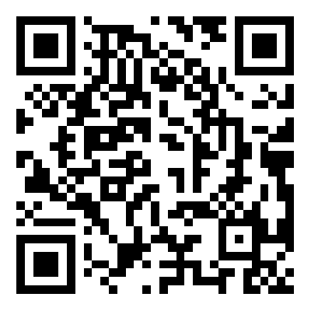










Maximin Value is NOT ENOUGH for characterization
Follower
Leader
Leaf nodes
$$U^{L}$$
$$8$$
$$4$$
$$U^{L}$$
$$8$$
$$4$$
$$8$$
$$4$$
$$2$$
$$1$$
$$2$$
$$1$$
No need for Leader to randomize on subgames with worse utilities.
Inducibility need to be held on subtrees.
This attributes to the Tree structure, specially owned by extensive-form games.
For specific characterization, please see our full paper on Arxiv.
Notes:
In the pure & commitment setting, we have shown that maximin value can fully characterize all the inducible leaf nodes. It no longer hold, however, in the general settings. Maximin value is not enough for characterization.
In the first example, the game tree and utility functions remain the same, but it becomes the leader acts at root node, while follower acts at internal nodes. It is obvious that going to left is always leader's optimal commitment, so even though some randomization over leaf nodes lead to utility greater than maximin value, there is no need for leader to put non-zero utility on the right edge.
Now we put the first example into a subgame of a new game. One can check that to be inducible on the whole game tree, a distribution must also be inducible on the subgame tree.
We note that all these conditions are due to the tree structure of extensive-form games.
We will not elaborate on the specific characterization, but refer to our full paper on Arxiv for more detals.

Slide 11








Maximin Value is NOT ENOUGH for characterization
Follower
Leader
Leaf nodes
$$U^{L}$$
$$8$$
$$4$$
$$U^{L}$$
$$8$$
$$4$$
$$8$$
$$4$$
$$2$$
$$1$$
$$2$$
$$1$$
No need for Leader to randomize on subgames with worse utilities.
Inducibility need to be held on subtrees.
Propositions still hold.
Optimal manipulation is still polynomial-time tractable.
Follower gains NO LESS under behavioral case than pure case, via optimal manipulation.
Notes:
In the inducibility and behavioral setting, we are able to show the previous propositions still hold. We use them to fully characterize all the inducible distributions.
Optimal manipulation is still poly-time tractable
Moreover, as we previously see, leader may get strictly higher utility by committing to behavioral strategies than pure strategies. We show in our paper that via optimal manipulation, follower gains no less utility under behavioral commitment case, than under pure commitment case.

Slide 12
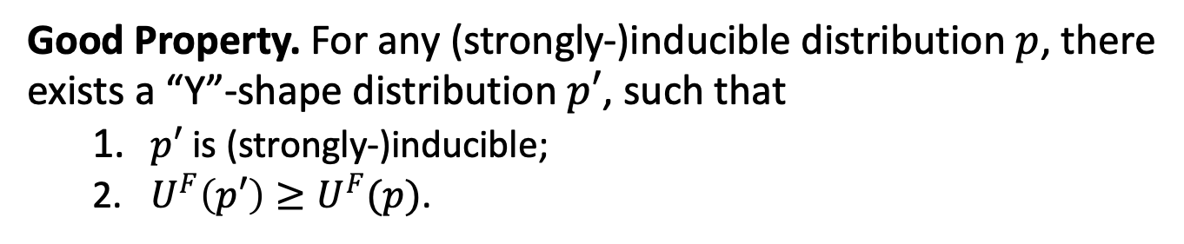
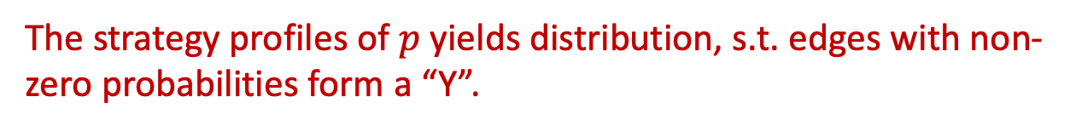
A Key Technique – “Y”-shape Distribution
Definition. Distribution $p$ is “Y”-shape if $\#\{leaf node z:p\left(z\right)≠0\}≤2$.
The strategy profiles of $p$ yields distribution, s.t. edges with non-zero probabilities form a “Y”.
Good Property. For any (strongly-)inducible distribution $p$, there exists a “Y”-shape distribution $p′$, such that
$p′$ is (strongly-)inducible;
$U^{F}\left(p′\right)≥U^{F}(p)$.
“Y”-shape distributions enable us to design algorithms for general settings and find the characterization for property USE
An example of Y-shape strategy pair
Notes:
<=2

Slide 13



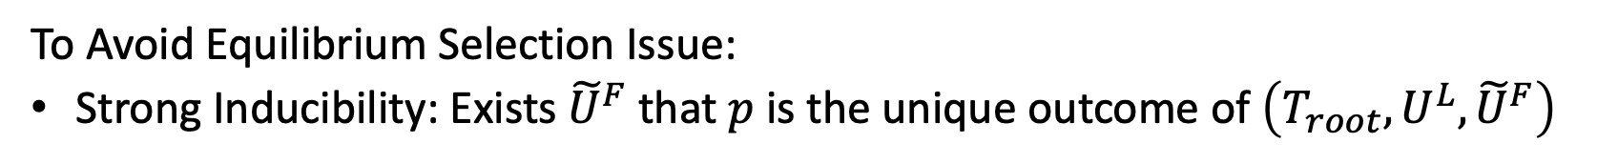














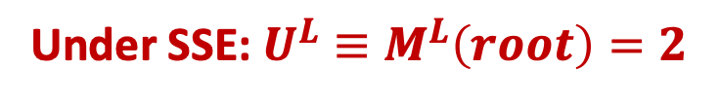




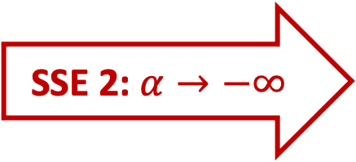









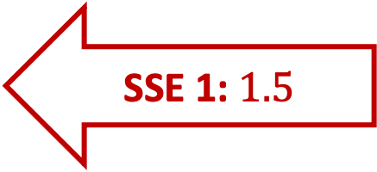

Extension – Strong Inducibility
Under SSE: $U^{L}≡M^{L}\left(root\right)=2$
Follower
Leader
$$U^{F}=…$$
Leaf nodes
SSE 1: $1.5$
$$\frac{1}{2}$$
$$\frac{1}{2}$$
SSE 2: $α→−∞$
$$U^{L}$$
$$0$$
$$4$$
$$2$$
$$1$$
$$U^{L}$$
$$0$$
$$4$$
$$2$$
$$1$$
$$U^{F}$$
$$2$$
$$1$$
$$α(<0)$$
$$0$$
$$U^{F}$$
$$2$$
$$1$$
$$α$$
$$0$$
$$p$$
$$1/2$$
$$1/2$$
$$0$$
$$0$$
$$p$$
$$0$$
0
$$1$$
$$0$$
To Avoid Equilibrium Selection Issue:
Strong Inducibility: Exists ${\tilde{U}}^{F}$ that $p$ is the unique outcome of $\left(T_{root},U^{L},{\tilde{U}}^{F}\right)$
Notes:
Another extension is from manipulation side.
Consider a new example, the game structure and designations remain the same, but players' utilities are changed. The optimal inducible distribution in this game is to put 1/2 probabilities on the first two leaf nodes.
For any induced game that one of whose SSEs yields this distribution , leader utilities are her maximin value 2.
While the follower's utility.
In the SSE shown on the left, this leads to our desired distribution and follower gets 1.5.
However, the leader can always commits to his maximin strategies, and get at least 2.
To make sure leader's equilibrium utility is 2, follower must best respond by going right, which yields another SSE. under this SSE, follower's utility is alpha. When alpha goes to negative infinity, the follower's utility can be arbitrarily bad.
Thus to avoid equilibrium selection issue, we call a distribution p is strongly inducible, if there exists a payoff function, that all SSEs of the induced game will lead to p.

Slide 14
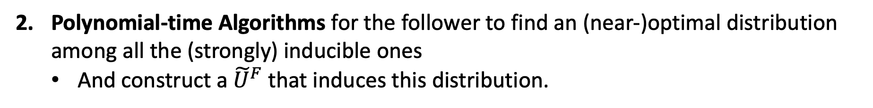
Summary: Our Contribution
For both pure and behavioral commitment settings:
Characterizations of all the (strongly) inducible distributions;
WE compare the optimal utilities in ONE game a follower can get in different settings:
Inducibility v.s. Strong Inducibility: characterization of games where the values are (nearly-)equal.
Utility Supremum Equivalence (USE) property
Polynomial-time Algorithms for the follower to find an (near-)optimal distribution among all the (strongly) inducible ones
And construct a ${\tilde{U}}^{F}$ that induces this distribution.
Pure v.s. Behavioral Commitment: The optimal value under behavioral commitment is always no less than that under pure commitment.
Pure & Inducibility
Characterization and Algorithm
USE
Behavioral & Inducibility
Characterization and Algorithm
No Less Utility
No Less Utility
Pure & Strong inducibility
Characterization and Algorithm
USE
Behavioral & Strong inducibility
Characterization and Algorithm
Notes:
We directly goes to the summary of our contribution:
For both pure and behavioral commitment settings: we fully characterize all the inducible and strongly inducible distributions
we provide polynomial-time algorithms for the follower to find an optimal distribution among all the inducible and strongly inducible ones, respectively. and construct a corresponding payoff function to induce it.
Second, we compare the optimal utilities a follower can get in ONE games in different settings:
As for inducibility v.s. strong inducibility setting: we characterize all the games where the optimal values are equal. We call such games satisfy Utility Supremum Equivalence property.
For pure v.s. behavioral commitment setting: We show that the optimal value a follower can get via optimal manipulation under behavioral commitment, is always no less than he get under pure commitment.

Slide 15
Literature Review: A reflection on the classic assumption
To do the equilibrium analysis, usually…
Players’ payoff functions are assumed to be common knowledge.
However, this is not the case in most real scenarios!
Private information manipulation:
Value distributions in auctions: Tang & Zeng’18; Deng et al.’20; Chen et al.’22.
Stackelberg Equilibrium: normal-form games (Birmpas et al. ’21), security games (Nguyen & Xu’19).
Nash Equilibrium under dynamic settings: Kolumbus & Nisan’21.
Notes:
Before summary, let's reflect on the classic assumption of game theory.
Usually, to do the equilibrium analysis,
players' payoff functions are assumed to be common knowledge.
However, this is not the case in most real scenarios. Players' payoff information are often private information.
Learning methods have been proposed to learn players' private information through interaction. Therefore, private information manipulation has been a research of interests in both learning and game theory community.
One line of research focuses on how bidders strategically modify their value distribution, to distort auctioneer's revenue-maximizing auction design.
Other work on follower payoff manipulation on Stackelberg equilibrium focuses on normal-form games and security games.
And there are some work discussing on how two players misreport their payoff functions simulanteously and distort the nash equilibrium, but in 2 by 2 games.

Slide 16
Take-Aways and Further Thoughts
Follower can gain more power under information asymmetry and sometimes completely defeat Leader’s first-mover advantage.
Follower’s capability of manipulation is closely related to Leader’s maximin value.
However, the tractability of this manipulation crucially relies on Follower’s information advantage:
Follower knows Leader’s payoff information while Leader does not know Follower’s.
Q1: Is the optimal manipulation still tractable when Follower knows nothing about Leader’s payoff information, but has to learn through interaction.
We gave the positive answer in an incoming paper.
Notes:
Finally, I will present the take-away messages and some further thoughts on this topic.
While leader has the first-mover advantage when leader knows follower's payoff information. However, our results show that follower can gain more power under information asymmetry and sometimes completely defeat leader's first-mover advantage, making her gain her maximin value.
And follower's capability of manipulation is closely related wo Leader's maximin value.
However, we note that our tractability results crucially relies on follower's information advantage.
That is, follower knows leader's payoff information while leader does know follower's.
We argue this might also be not that practical, and one first question might be:
Is this optimal manipulation still tractable, when Follower knows nothing about leader's payoff information, but has to learn through interaction.
We gave the positive answer in an incoming paper. Specifically, we show that poly number of queries and operations suffice for the follower to learn enough needed information and optimally manipulate.

Slide 17
But,
Q2: Where will the game end in, when payoff functions are no longer commonly known, and players act simultaneously, i.e., Nash Equilibria (NE)?
Is NE still meaningful without the common knowledge assumption?
May not be credible as a stable state.
Then, what should a proper solution concept be?
Players best-respond to their believes.
A dynamical prospective: The convergence of believes and strategies.
Notes:
Another question would be to study the manipulation problem on Nash equilibrium of general bimatrix games.
However,
We wanna ask such a question: Is NE still meaningful, when players payoff functions are no longer common knowledge?
As a stable state, NE may not be as credible as before, as a player could not verify a given strategy profile is NE easily any more.
Then, what should a proper solution concept be like?
Here are some thoughts of myself.
A steady state may be like players best-respond to their believes.
And we can see from a dynamical prospective, and study the convergence of believes and strategies updated by learning algorithms.

Slide 18
THE END
Q & A?
For more detail, please see our full paper on Arxiv.
Notes:
That's all for my presentation.
Thank you for listening.

