Slide 1
Segmentation I

Slide 2
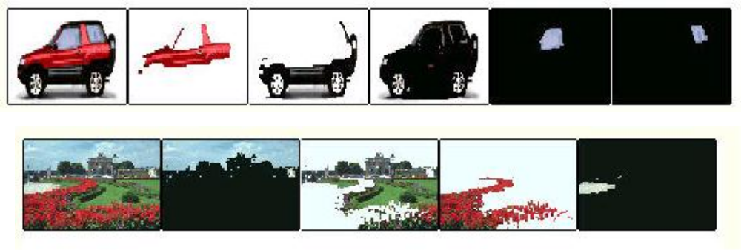
Segmentation/Clustering

Slide 3
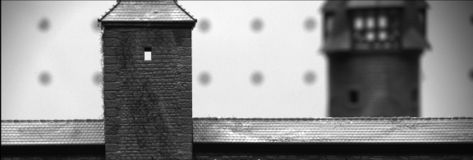
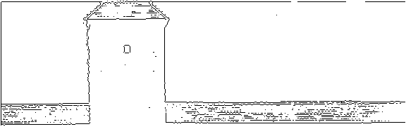


Slide 4
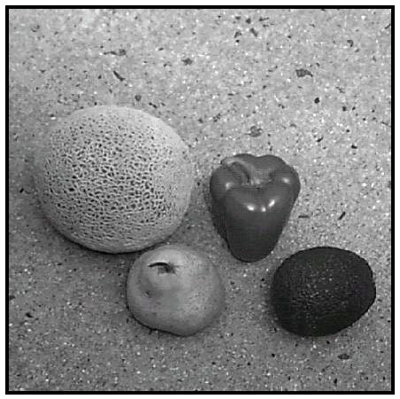
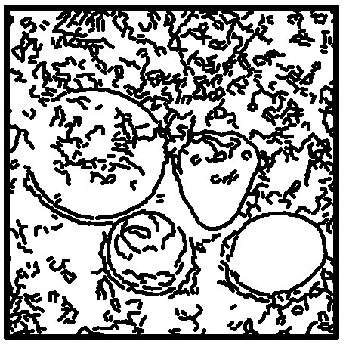
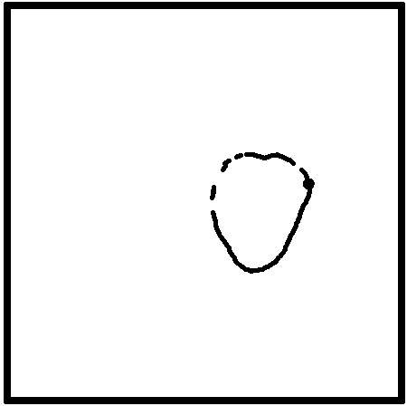
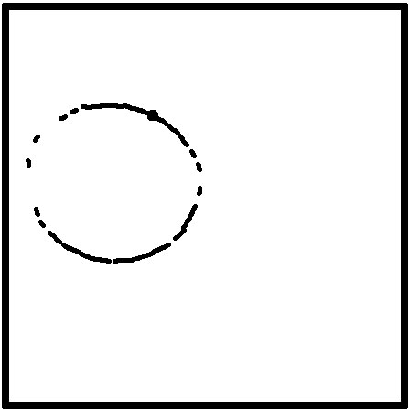
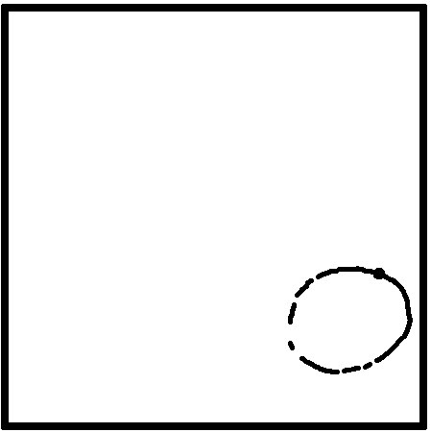

Slide 5
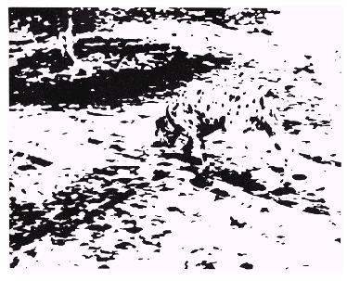

Slide 6
Segmentation (Informally):
Given a set of features {x_{i}}
Given a “distance” between features d(x,x’)
Find a partition {C_{j}} such that:
  d(x_{i},x_{j}) is “small” if x_{i} and x_{j} belong to the same group
  d(x_{i},x_{j}) is large if x_{i} and x_{j} belong to different groups
Examples:
  Color segmentation: x_{i} is color of pixel i. Subsets are connected
  regions of “similar” color.
  Texture segmentation: x_{i} is vector of responses to texture filters
  at pixel i. Subsets are regions of “similar” texture.
  x_{i} = [F₁*I,…, F_{n}*I]
  Contour grouping: x_{i} is edge element. Subsets are sets of edges that
  form a smooth connected contour.

Slide 7
Basic clustering, K-means (16.3)
Basic line fitting and Hough transform (17.1-17.2)
Robust techniques: M-estimators/RANSAC (18.2)
EM algorithms (18.1)
Model selection (18.3)
Graph-based techniques (16.4)

Slide 8
Clustering
dendogram
6
Divisive (split)
5
1
Agglomerative (merge)
4
2
3
1 2 3 4 5 6

Slide 9
Agglomerative (merging):
Make each point x_{i} a separate cluster C_{i}
  Find the two clusters C_{i} and C_{j} with the smallest inter-cluster
    distance
  Create a new cluster C = C_{i} U C_{j}
Divisive (splitting):
Create a single cluster C_{o} containing all the points
  Find the cluster C_{i} with two components with the
    largest inter-cluster distance
  Create two new clusters C_{j} and C_{k} such that C_{i} = C_{j} U C_{k}
Major issues:
Distance between clusters
Number of clusters (when to stop?)
Connectivity/proximity
Computational issues

Slide 10
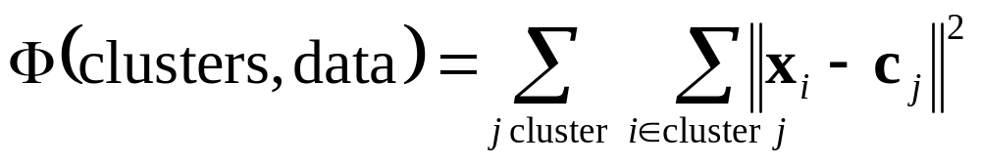
K-means algorithm
If the number of clusters is know a-priori:
Given {c_{j}}, assign each x_{i} to the closest j
Compute the centers c_{j} = 1/N Σ x_{i}
Converges to local minimum (although not guaranteed)
Still issue with definition of distances and connectivity

Slide 11
Line Fitting: Hough Transform
Image Space
Parameter Space
y
p
(x,y)
m
x
y
p
(x₃,y₃)
(x₂,y₂)
(m_{o}, p_{o})
(x₁,y₁)
x
m
Notes:
A line in the plane (x,y) is represented by an equation of the form y = mx + p
The parameter space is the space of all possible lines parameterized by (m,p)
The set of all lines passing through a point (x,y) is a line in parameter space of equation p = -mx + y
Consider a set of points (x_{i},y_{i}) on a line of equation y = m_{o}x + p_{o}. The corresponding lines in parameter space have equations p_{o} = -m_{o}x + y and all intersect at one point: (m_{o}, p_{o})
Suppose that we discretize the parameter space (m,p) into buckets. That is, there are only finite
values m_{i} and p_{i} of the parameters, distributed at intervals Δm and Δp.
Suppose that we have also a finite set of points (x_{j},y_{j}) is the plane. Those points are, for example,
the edge points detected by a Canny operator.
Each point (x_{j},y_{j}) corresponds to the set of lines p = -mx_{j} + y_{j} Let us increment by 1 each value
(m_{i}, p_{i}) the parameters such that p_{i} = -m_{i}x_{j} + y_{j}
The array of the parameter values (m_{i}, p_{i}) is called the accumulator.
The process of incrementing the accumulator for each possible parameter for
each line is called voting.
Two things can happen after voting for all the points:
The points (x_{j},y_{j}) are on a line (m_{o},p_{o}): All the lines in parameter space p = -mx_{j} + y_{j}intersect at
one point (m_{o},p_{o}). As a result, this point will be incremented by ALL the input points, while the
other parameters (m_{i}, p_{i}) will be incremented by fewer points. This suggests that searching
the parameter space for the maximum value after voting will tell us the parameters of the
line on which the points (x_{j},y_{j}) lie.
The points (x_{j},y_{j}) are not aligned: the lines in parameter space do not intersect at a single
point. Therefore there is no large value in the accumulator (although there is obviously always
a maximum, it does not have a very large value.
This suggest an algorithm:
For each input point, vote for the corresponding line parameters in the accumulator.
The parameter with the most votes corresponds to a line in the image, provided that
the number of votes is large enough.

Slide 12
Hough Transform for Lines:
Input: Set of coordinates (x_{j},y_{j}) (edge points)
Create an array A of regularly spaced parameter values (m_{i},p_{i})
Initialize A to 0
For each point edge (x_{j},y_{j}):
  For each parameter (m_{i},p_{i}) such that:
p_{i} = -m_{i}x_{j} + y_{j} ((x_{j},y_{j}) belongs to line (m_{i},p_{i}))
    A[m_{i},p_{i}] += 1
Find (m_{o},p_{o}) = arg max A[m_{i},p_{i}]
If A[m_{o},p_{o}] > T (threshold)
  Output the line described by (m_{o},p_{o})

Slide 13
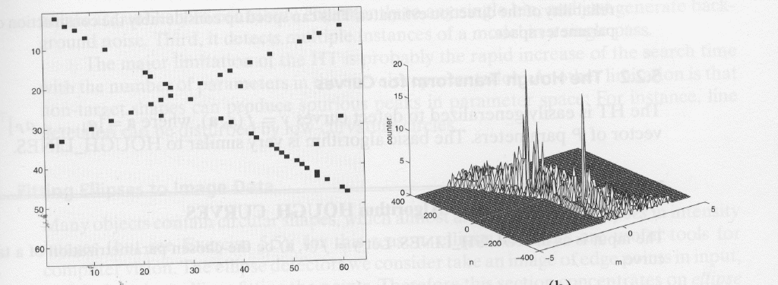
Notes:
Many issues with this first algorithm:
Parameterization: We chose (m,p) as the parametrization of the line. This is not a very good
parameterization because m and p are not bounded, and because the discretion of the accumulator
is not uniform. A different parameterization should be used.
Parameter sampling: The sampling step in parameter space Δm,Δp influences the performance
of HT. Some rules should be developed for defining those parameters.
Maximum detection: Because of noise and quantization, there can be a large number of peaks
in the accumulator. A better strategy than just taking the maxima.
Edge strength: All edge points contribute to the accumulator by the same amount, irrespective
of how confident we are that they are in fact edges. The voting should be related to the strength
of the edge.
Multiple lines: Very long lines are going to create large peaks in the accumulator that are going
to mask the other, smaller, lines.
Threshold: As usual, choice of the threshold is difficult.
Parameterization: Better parameterization of lines is:
Parameters are now bounded. θ is between 0 and 2π and ρ is between 0 and
sqrt(2) N where N is the size of the image. Sampling is uniform.
The voting is also easier:
For each θ_{i,} find the closest ρ_{k} such that
θ
ρ

Slide 14
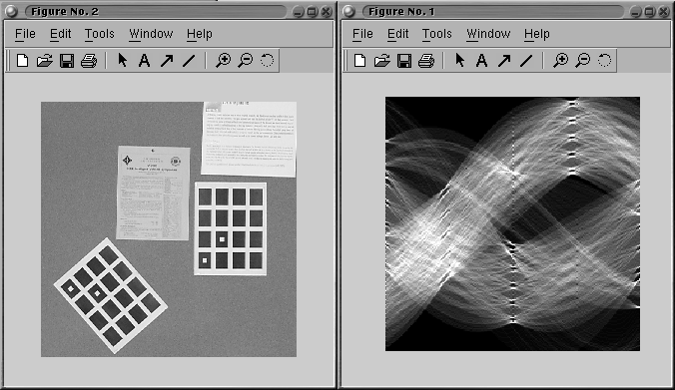
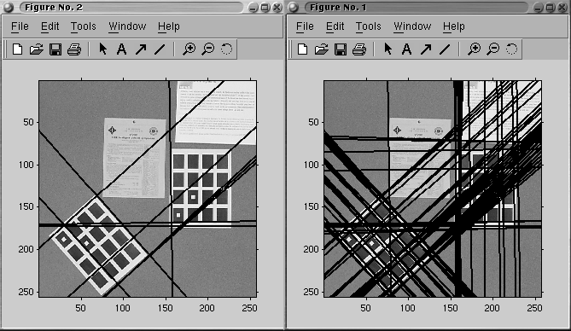
Notes:
Parameter sampling:
If sampling is too fine, points will be scattered in the accumulator.
If sampling is too coarse, several maxima could be merged and cannot
be distinguished.
Sampling in parameter space chosen to be equivalent to 1-pixel displacement
in the image.
Pyramid representation of accumulator also possible:
Find maxima at coarse resolution (small size accumulator)
Use a finer resolution accumulator (larger size)
Perform Transform only in the vicinity of the maximum found at coarse resolution.
Maximum detection:
Because of discretization and noise, not all the lines in parameter space intersect at
the same point. As a result the points contribute to many counters in a neighborhood of
the true maximum. Two effects result:
The maximum in the accumulator may be blurred
Spurious peaks appear in the accumulator due to noise.
This can be addressed by retaining only those peaks that are local maxima in a neighborhood.
That is (θ_{o},ρ_{o}) is retained only if:
A[θ_{o},ρ_{o}] > T_{g} and
A[θ_{o},ρ_{o}] > A[θ,ρ] for (θ,ρ) in a neighborhood of (θ_{o},ρ_{o})
Averaging can also be applied to the accumulator in order to eliminate the noisy peaks.

Slide 15
Input: Set of coordinates (x_{i},y_{i}) (edge points)
Create an array A of regularly spaced parameter values (θ_{j},ρ_{j})
of size N_{θ} by N_{ρ}
For each edge point (x_{i},y_{i}):
    For h = 1 to N_{θ}
      Compute ρ = x_{i} cos θ_{h} + y_{i} sin θ_{h}
      Find the entry ρ_{k} closest to ρ
      Increment A[θ_{h},ρ_{k}]:
        A[θ_{h},ρ_{k}] += 1 or
        A[θ_{h},ρ_{k}] += M[x_{i},y_{i}]
Optional: Smooth A
  For h = 1 to N_{θ}
    For k = 1 to N_{ρ}
      If A[θ_{h},ρ_{k}] > A[θ,ρ] for (θ,ρ) near (θ_{h},ρ_{k})
      AND A[θ_{h},ρ_{k}] > T
        Report (θ_{h},ρ_{k}) as a potential image line
Optional: Remove the strongest lines and repeat the entire algorithm
Notes:
Multiple lines:
Finding the maximum of A gives us the most prominent line in the image. However, there
might be other, much weaker, lines in the image. Those can be found using two strategies:
Find all the local maxima greater that some threshold and report those as lines. This does
not add any computation, but it may eliminate weaker lines.
Find the absolute maximum of A. Then, remove the corresponding points from the image and
run the HT again. This is better because short lines might be preserved. It is much more
expensive because HT is used multiple times.
Threshold: Unfortunately, as is often the case, there is no principled way of
choosing the threshold. One rule of thumb is to set the threshold relative to the
expected maximum length of the lines in the image.
Edge strength:
Edges contribute equally to the accumulator. However, it may be known that some edges
are more reliable than others based on the magnitude of the gradient. To capture this, we
can increment the accumulator by the magnitude of the gradient rather than by a constant
value:
A[θ,ρ] += M[x,y]

Slide 16

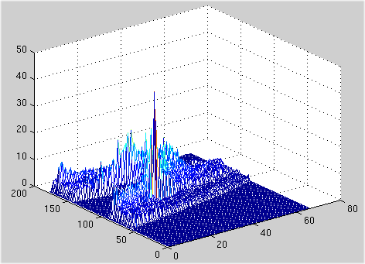
-180º
θ
+180º
ρ
Notes:
In principle, HT could be used for any shpae that can be represented by a function of the
form: f(x,y,a) = 0 where (x,y) are the image coordinates and a is a vector of parameters.
For example, if we want to find circles in images, the equation f is:
(x-x_{o})²+(y-y_{o})² = r²
and the parameter vector is: a = [x_{o}, y_{o}, r]
HT is generalized by discretizing the parameter space a (I.e., discretizing each component
a_{i} of a) and incrementing the appropriate entries of the accummulator A[a₁,..,a_{n}] for
each edge point (x,y).
Although it is possible in practice, the applicability is limited because of dimensionality
issues:
The size of the accumulator increases exponentially with the dimension of the parameter
space.
The extrema become more and more “spread-out” as the dimension increases

Slide 17
θ = 0º, ρ = 20, A = 43
θ = 45º, ρ = 33, A = 21
θ = 90º, ρ = 25, A = 39
Notes:
A general Hough Transform algorithm might look like:
Input: Set of coordinates (x_{i},y_{i}) (edge points)
Create an array A of regularly spaced parameter values a_{k}
For each edge point (x_{i},y_{i}):
For every a_{k} such that f(x,y,a_{k}) ~ 0
Increment A[a_{k}]:
A[a_{k}] += 1 or
A[a_{k}] += M[x_{i},y_{i}]
Optional: Smooth A
For every a_{k:}
If A[a_{k}] > A[a] for a near a_{k}
AND A[a_{k}] > T
Report a_{k} as a potential image curve

Slide 18
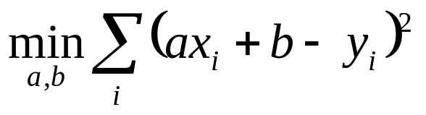
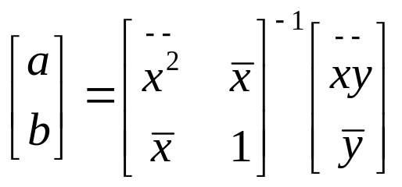
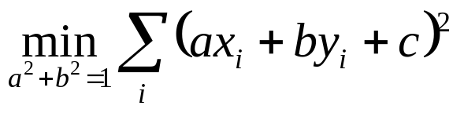
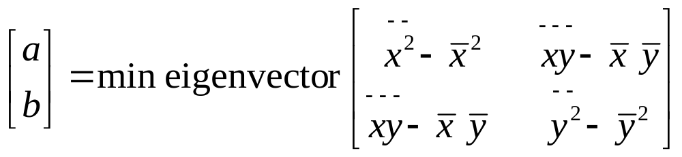
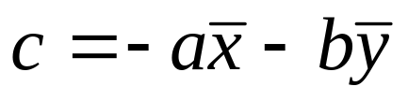
Least-squares fitting: Summary
Algebraic distance: y = ax+b
Geometric distance: ax+by+c = 0 and a²+b²=1
Notes:
Assuming first that we have a set of points (presumably edge pixels) that are known to belong to a line l, the standard way of recovering the parameters is to use least-squares fitting, that is, to find the parameters that minimize the sum of squared distances to the line.
The generic equation of a line can be written as: y = ax+b. The “distance” could be expressed as: d(l,p) = |ax+b-y|
This is the standard linear regression:
The solution is found using the pseudo-inverse:
In fact, this definition of the “distance” is not terribly good because, unlike statisticians, we want the result of the fitting to be independent of the orientation of the coordinate system, whereas |ax+b-y| is the distance along the y axis, not the distance to the line. To compute the true distance, the line is represented by three parameters as ax+by+c = 0 with the constraint a²+b²=1. With this representation, [a b] is the normal to the line, and the geometric distance to the line is simply |ax+by+c|. The estimation becomes:
Writing that the derivative in c of this expression is 0 shows that:
After substitution, the solution is the minimum:
It can be shown that the solution is the eigenvector of the scatter matrix corresponding to the smallest eigenvalue. The intuitive interpretation of the eigenvalues is that they characterize the elongations of the set of points along the principal directions.

Slide 19
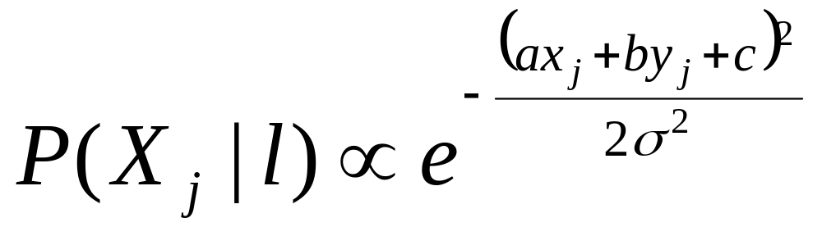
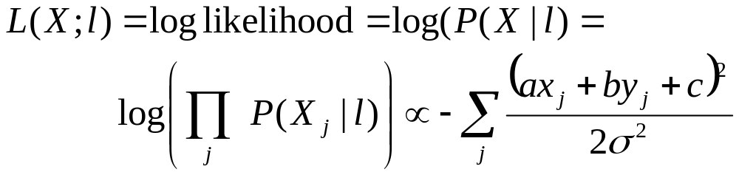
Probabilistic Interpretation
Sum of squared errors = - log likelihood
Least squares = maximum likelihood estimation

Slide 20
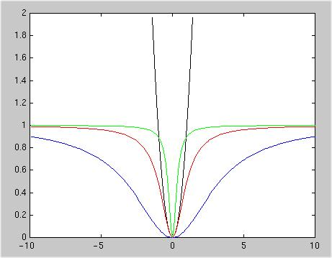
ρ
ρ = d²
σ = 1/3
σ = 1
σ = 3
d
Notes:
The least square estimation techniques all assume that the points all lie near the line. That is, the points deviate from the line by a small random error. In practice, it often happen that a few points are quite far from the line. The problem then is that their contribution d(l,p)² to the error function increases quadratically with the distance d. For example, if we have 100 points within 1 pixel of a line and a single additional point 10 pixels away, then the distance square for that single point is equal to the entire sum of square distances for all the points combined. This shows that, because of the quadratic nature of the error function, a single point can disturb the entire estimation.
The solution to this problem is found in the theory of robust statistics. The idea is to replace the squared distance d(l,p)² by a different function of the distance ρ(d(l,p)) where ρ is a function that is quadratic if d is close to 0 and becomes nearly constant as d increases. Such an estimator is called an M-estimator.
The commonly used M-estimator uses the function:
The parameter σ (the scale) controls how close ρ is to a quadratic function. If σ is large, then ρ behaves almost like a quadratic function. If σ is small, ρ is almost constant except very close to 0. We would like σ to be related to the current distribution of errors. Robust statistics tells us that s should be chosen as:
σ = 1.4826 Median(d(l,p₁),…,d(l,p_{n}))
The M-estimation algorithm is an iterative algorithm: at each step, σ is estimated from the current estimate of l,
a new estimate of l is computed by minimizing the sum of the ρ(d(l,p)). As the errors decrease, so does σ, and the estimator becomes less forgiving to outliers. The iterations stop when there is no significant variation of the objective function.

Slide 21
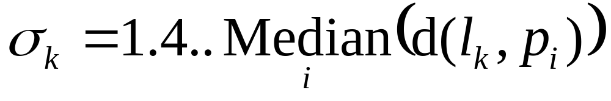
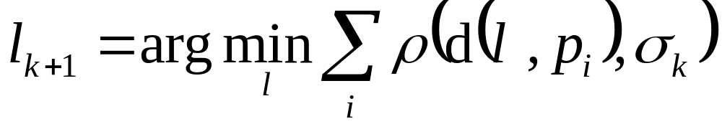
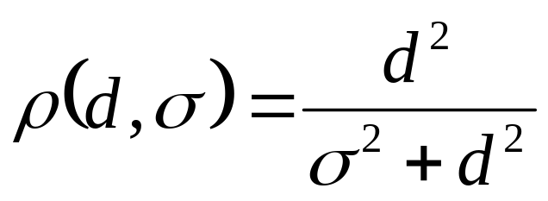
M-estimator
Given points (p₁,..,p_{n}) and initial estimate of the line l_{o}
Repeat until the line does not change:
Notation:
d(l,p_{i}) = distance to line l

Slide 22
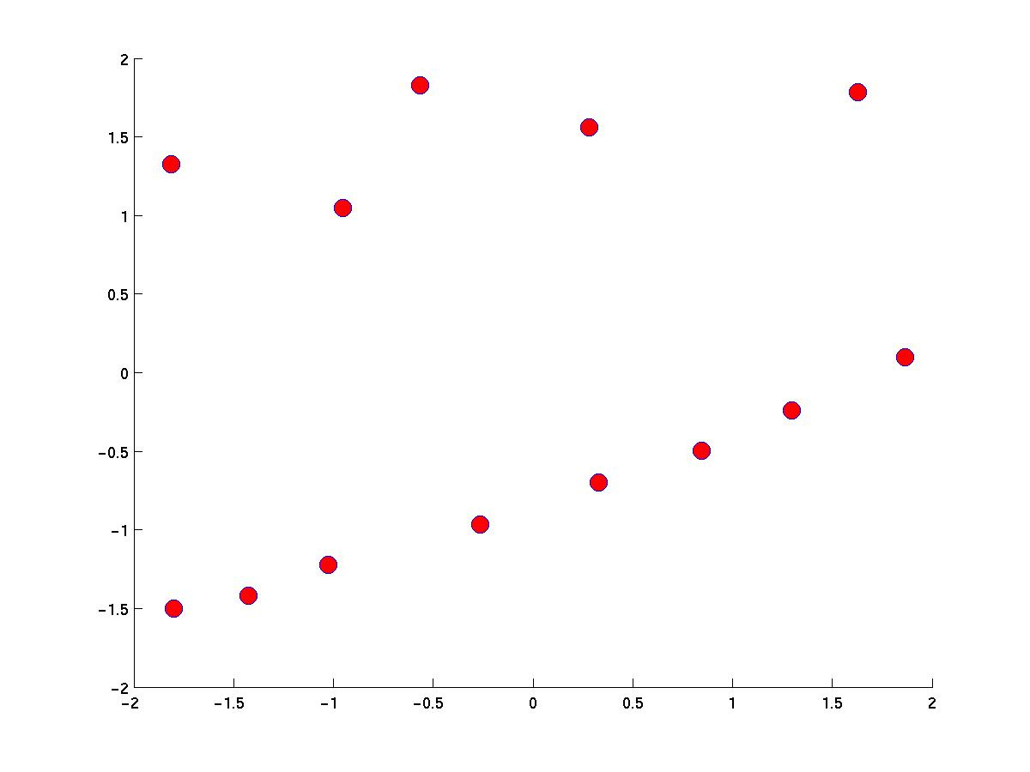
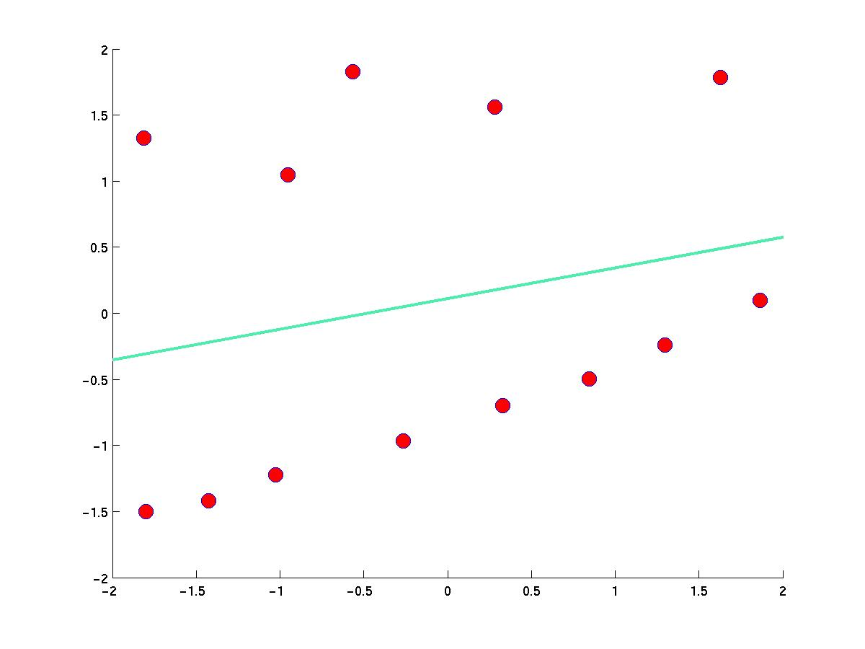
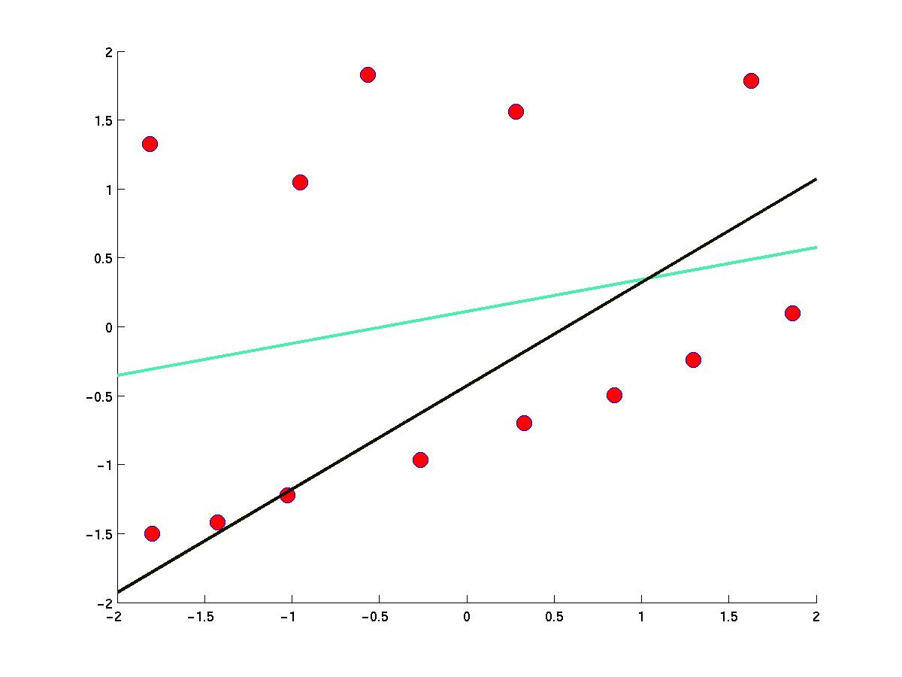
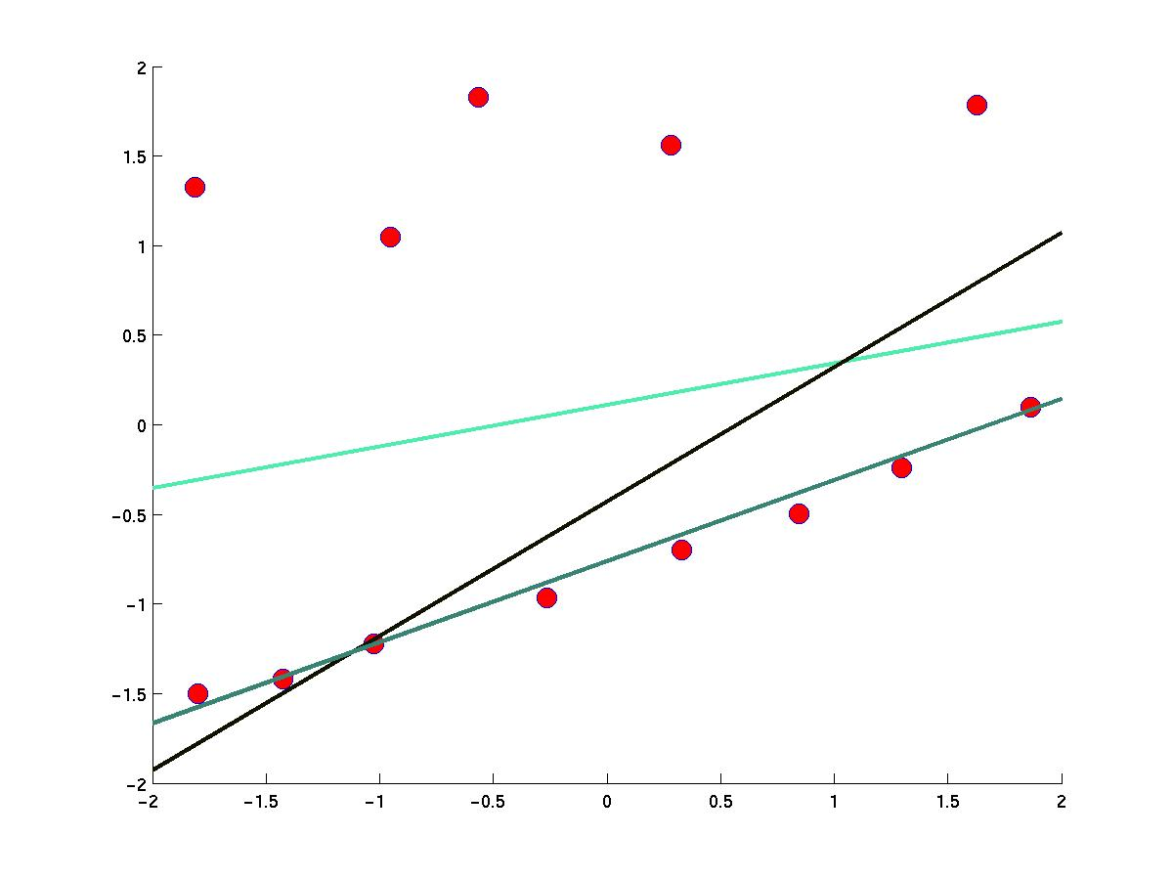
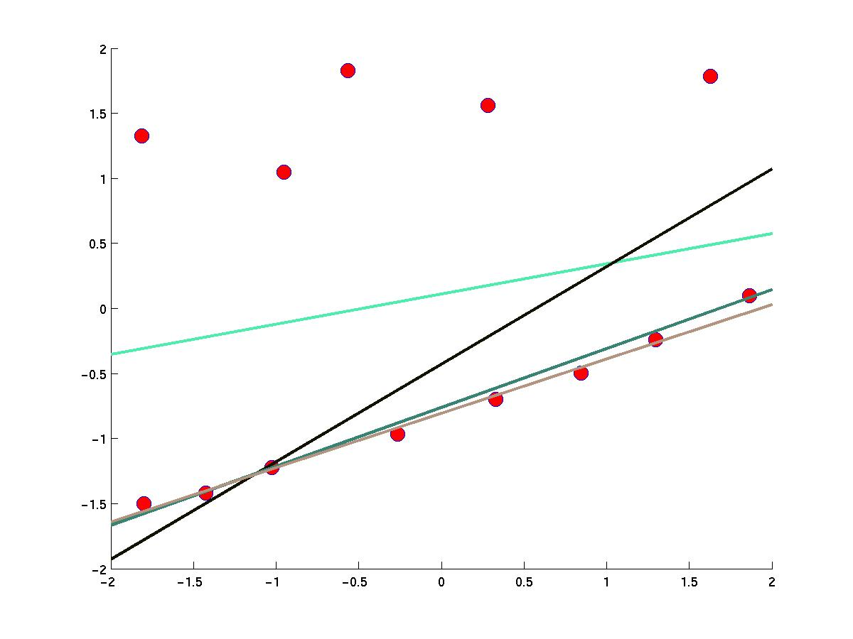
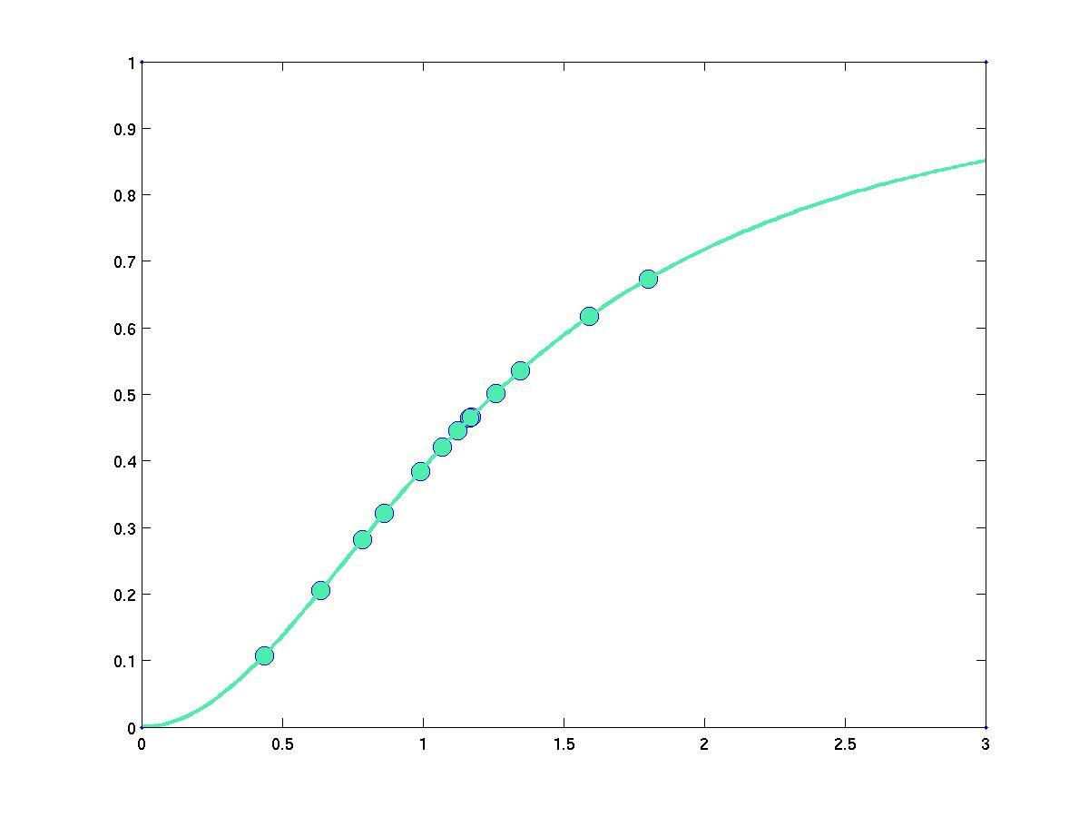
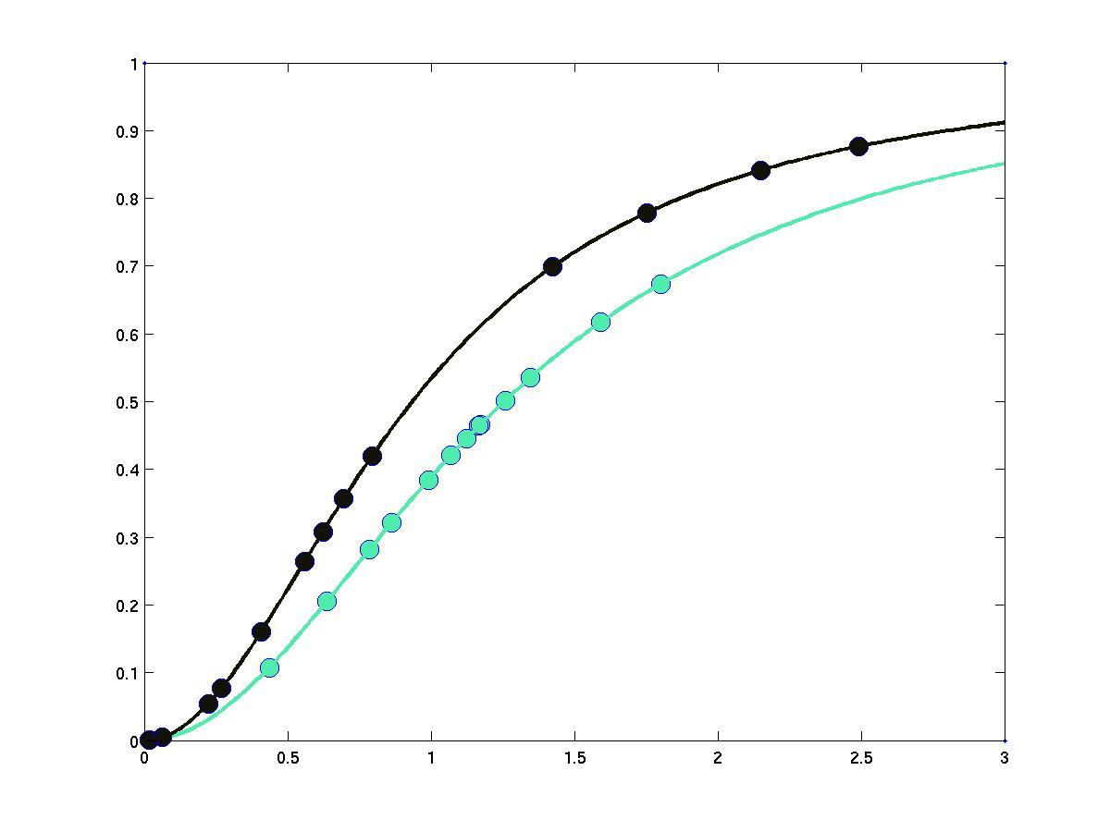
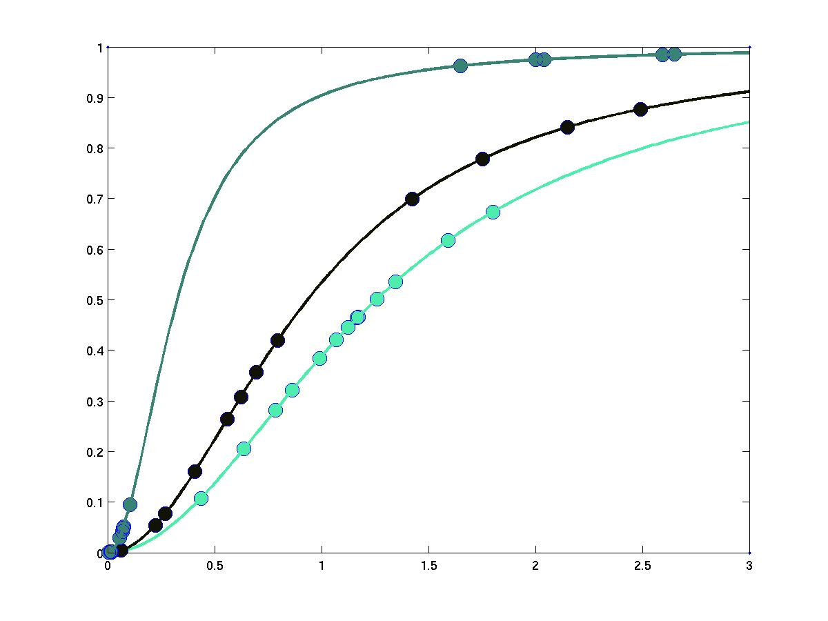
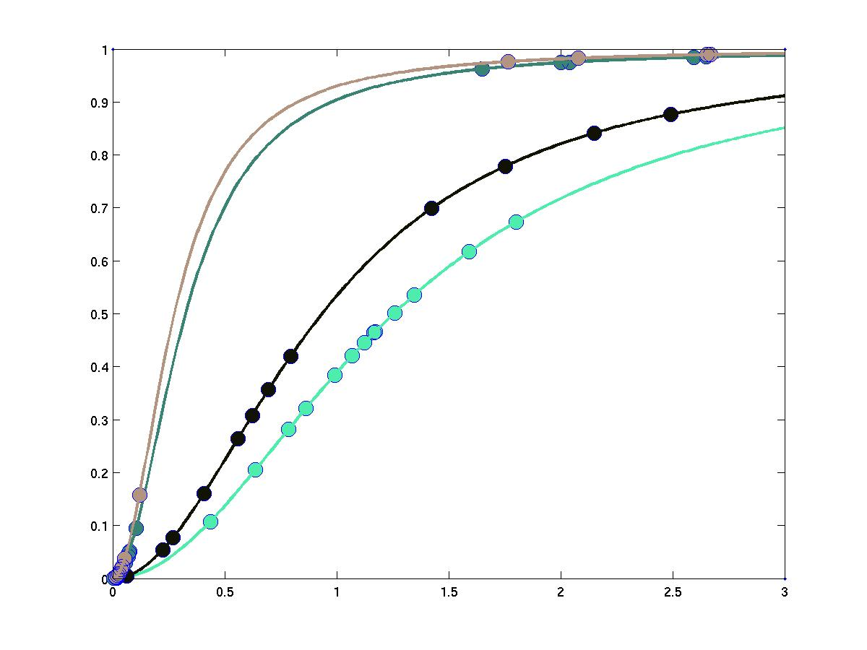
Notes:
Given points (p₁,..,p_{n}) and initial estimate of the line l_{o}
Repeat until the line does not change:
Notation:
d(l,p_{i}) = distance to line l

Slide 23
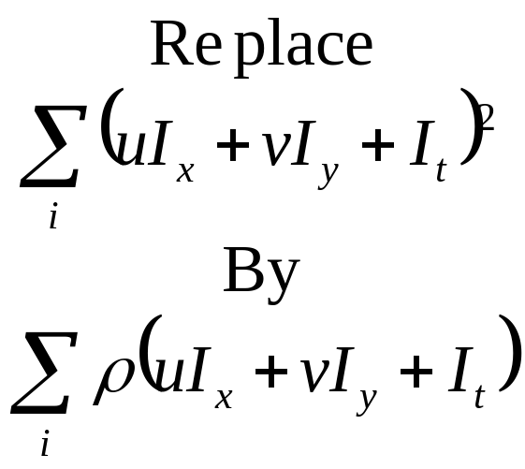
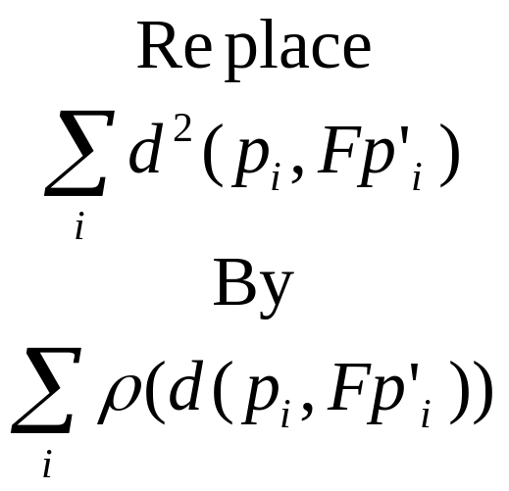
General approach to fitting applicable to any fitting problem.
Find occlusions in optical flow:
Eliminate mismatches for estimating the epipolar geometry:

Slide 24
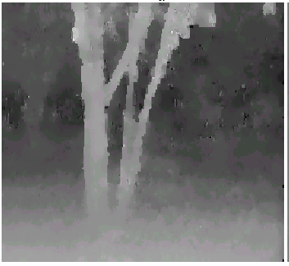
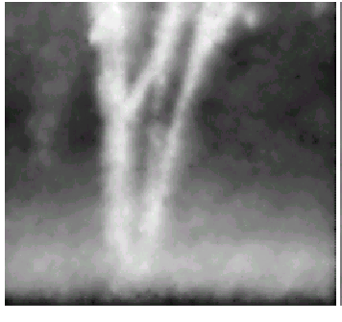
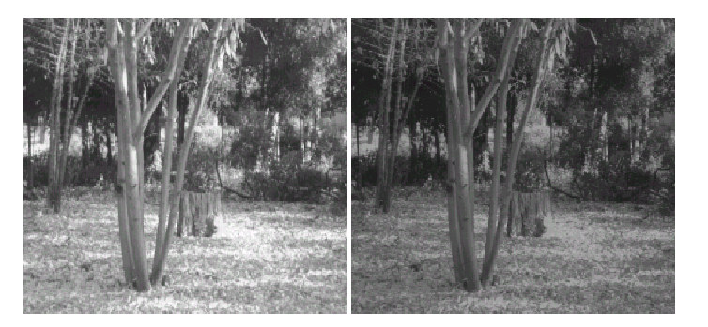
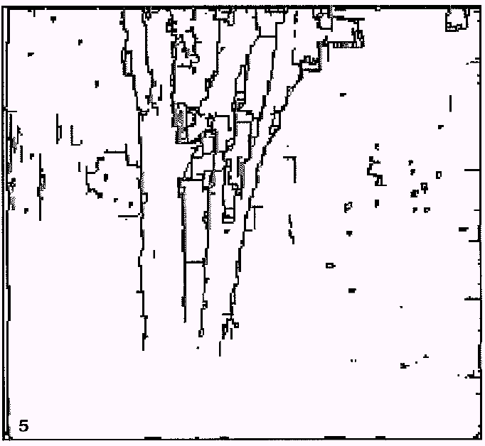
Optical Flow (http://www.cs.brown.edu/people/black/ignc.html)
Notes:
General approach to fitting applicable to any fitting problem.
Find occlusions in optical flow:
Eliminate mismatches for estimating the epipolar geometry:
Bundle adjustment: Replace the sum of squared distances between feature locations in images and projected 3-D points by robust estimator.

Slide 25
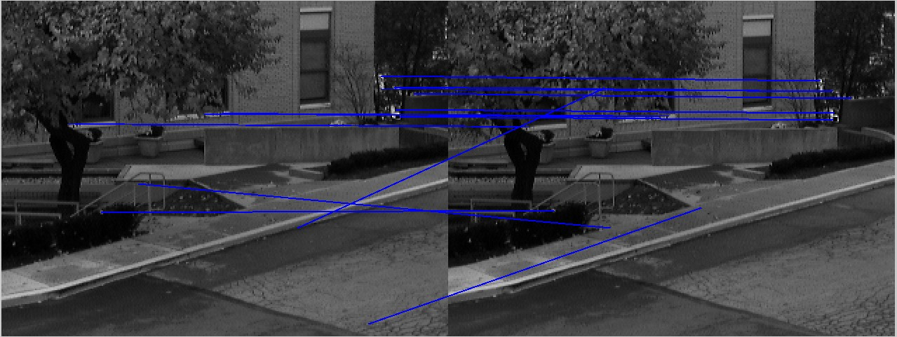
Epipolar Geometry: Initial Matches

Slide 26
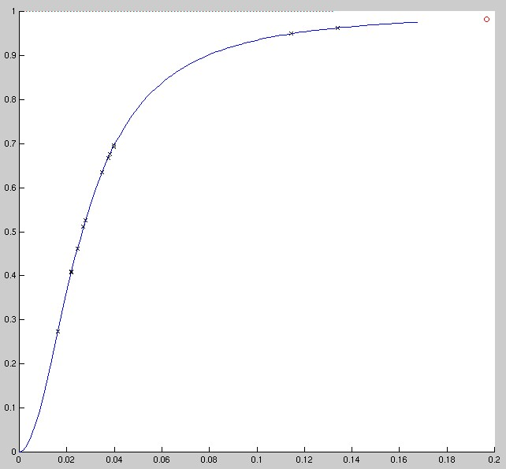
ρ
d

Slide 27
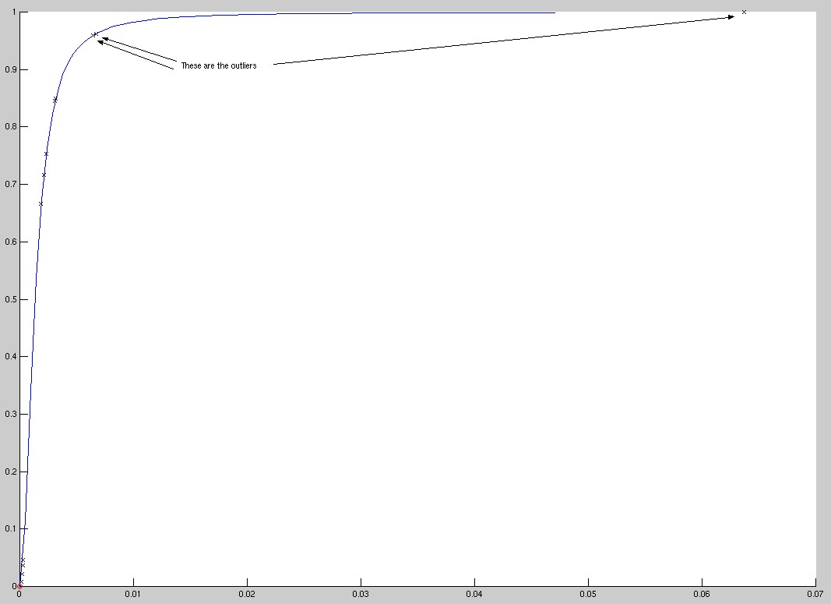
Outliers

Slide 28
Ransac
Do k times:
  Draw set of n points
  Fit to the set
  Count the number d of points that are closer than t to the fitted line
  If d > d_{min}, recompute fit error using all the points
Return best fit found

Slide 29
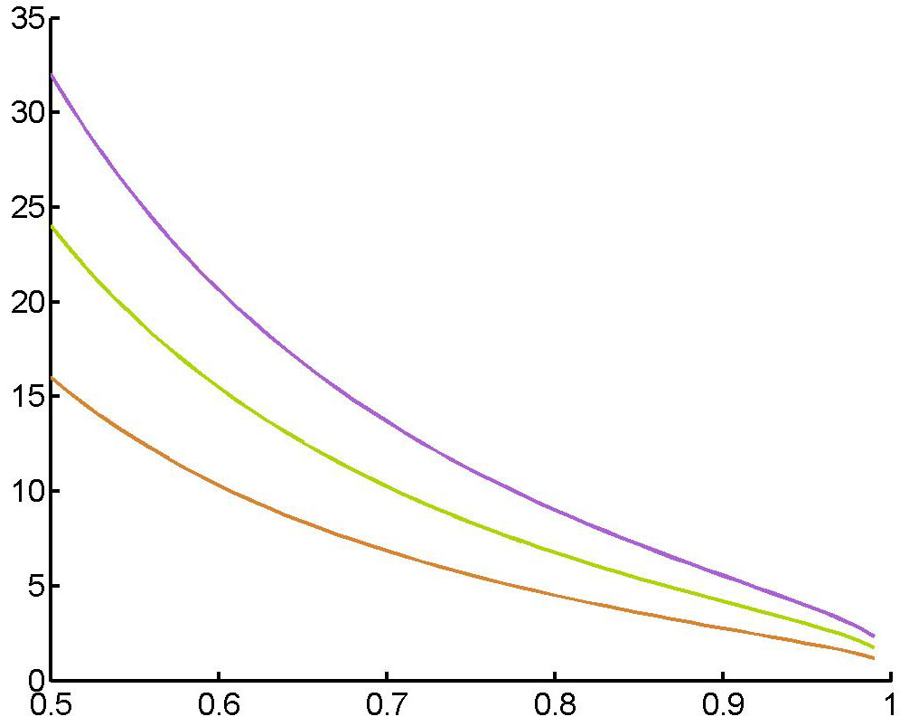
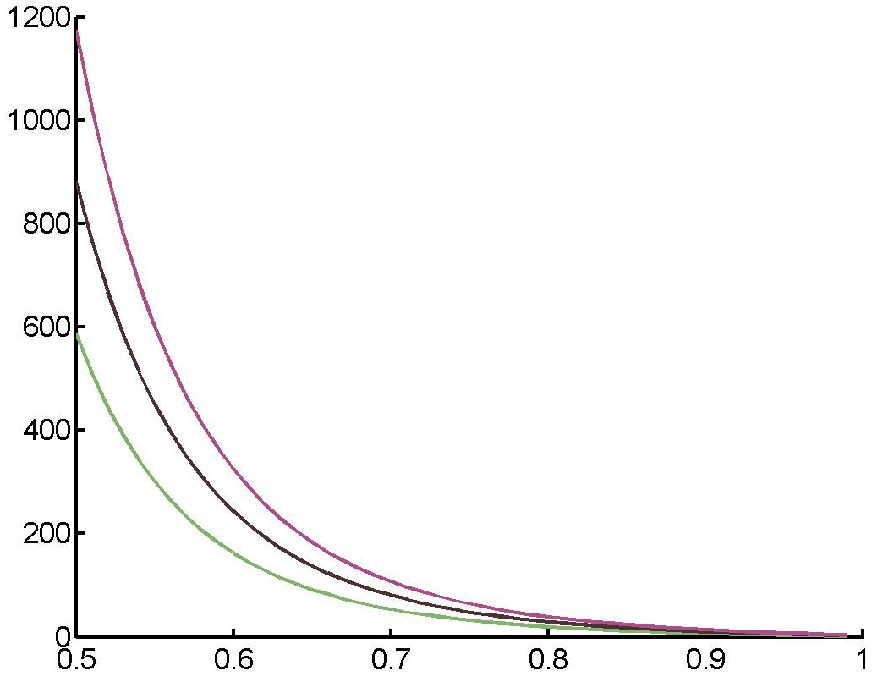
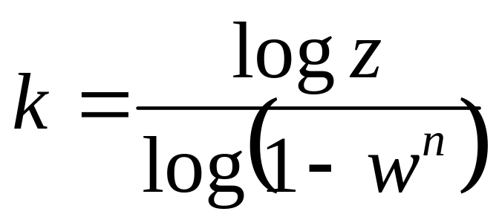
n = 2
n = 7
z = 10⁻⁴
z = 10⁻³
z = 10⁻²
Notes:
A remarkable property of RANSAC is that the number of trials necessary does not depend on the total size of the data set. If n is the minimum number of points necessary to fit, and w is the proportion of good data points (at least 50%) then the probability of drawing a set of k bad points is (1-w^{n})^{k}. Suppose that we want to guarantee that we find a good set with probability 1-z, then:
z = (1-w^{n})^{k}
Remarkably, this does not depend on the size of the data set but only on the expected proportion of good data points.

Slide 30
Incremental merging
ε
l₁
p_{n}
p₁
l₂
Notes:
Now that we know how to estimate parameters of lines (and curves) from image points, the next problem is to find out which point belongs to which line. Several techniques can be used:
Incremental fitting: merge points until the least-square error is large enough. Start a new line when that happens. This algorithm is quite effective in practice. It does not require any prior knowledge of the number of lines or the membership of points to lines. It does require the contours to be linked. The main drawback of this technique is that it tends to overfits the contour. That is, segments tend to be too long.
Given a sequence of contour points p₁,..,p_{n}
start = 1 end = 2 k = 1
repeat until end = n:
LS fit line l_{k} to list of points (p_{start},..,p_{end})
If error > ε
start = end end = start+1 k += 1

Slide 31
K-means Algorithms
l₂
l₁
Input
l₂
l₁
l₂
l₁
Assign points
Estimate lines
Notes:
K-means: If we know the number of lines, K, we can use the same kind of K-means approach as before for clustering by alternating between estimating lines and deciding which point belongs to which line.
Given a set of lines {l_{i}} and a set of points {p_{j}}
Repeat until no change in the line parameters:
For each point p_{j}:
Assign each point p_{j} to the closest line l_{i}
For each line l_{i}:
Estimate the new parameters of the line l_{i}
Suppose that there are k lines along a particular contour. The K-means algorithm permits the
simultaneous recovery of the parameters of the lines and of the assignments of points to lines
by alternatively adjusting the assignment of points to lines and estimating the line
parameters.
More effective than the incremental merging because it takes into account the entire data
set at every iteration. Drawbacks: needs to know the number of lines. Typically used as
adjustment after an initial segmentation. This is equivalent to minimizing the criterion above over the possible lines and point assignments

Slide 32
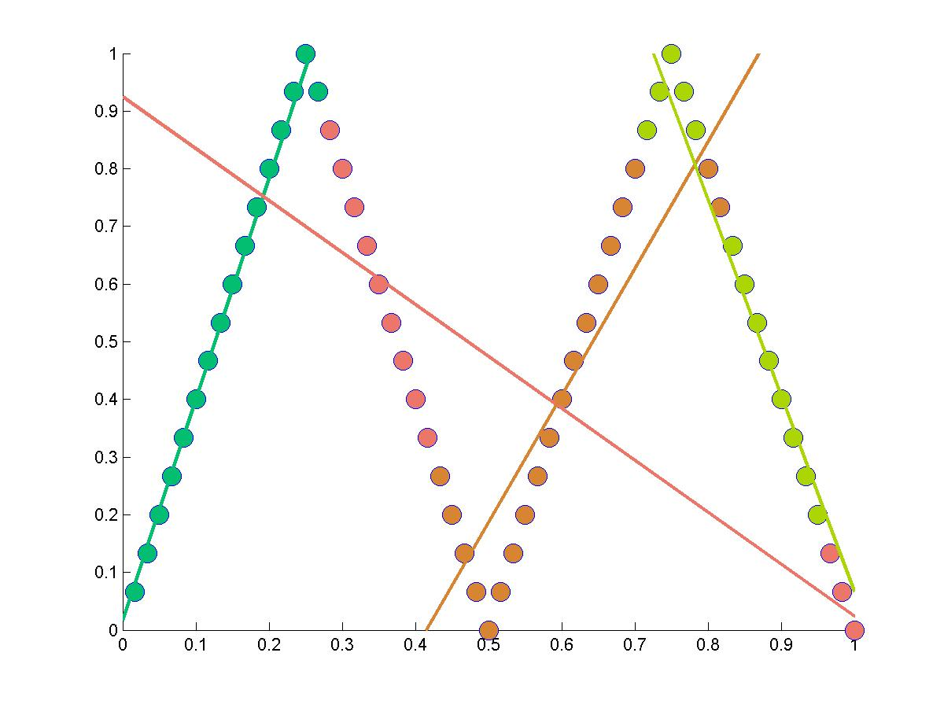
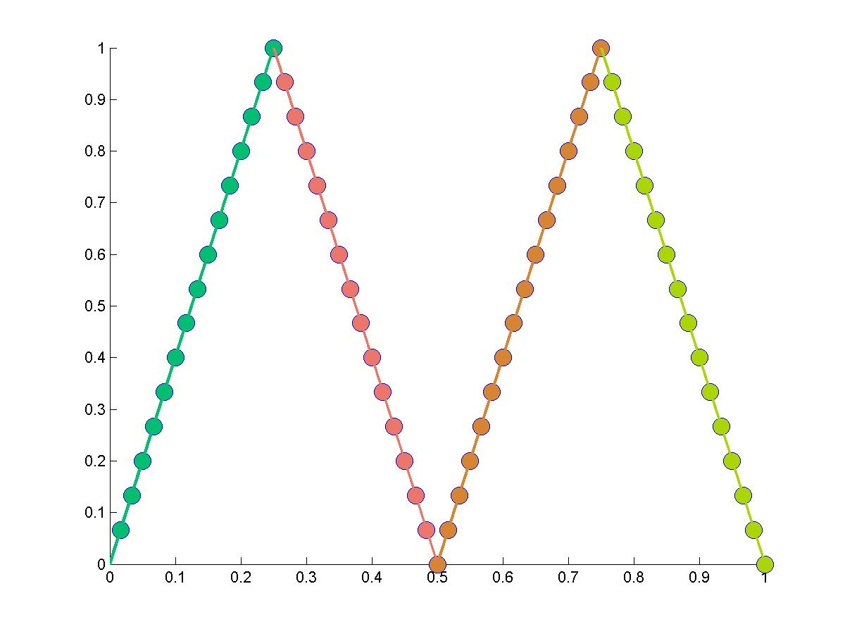
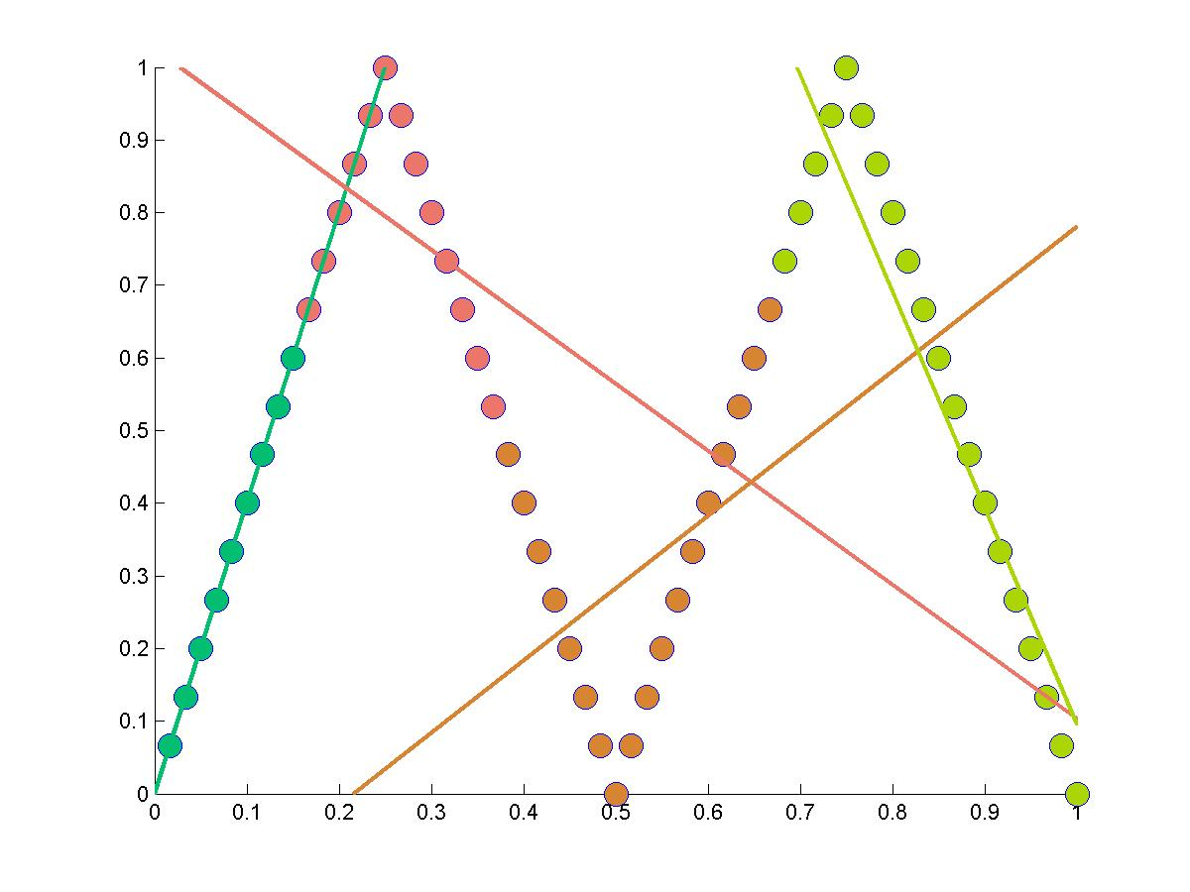
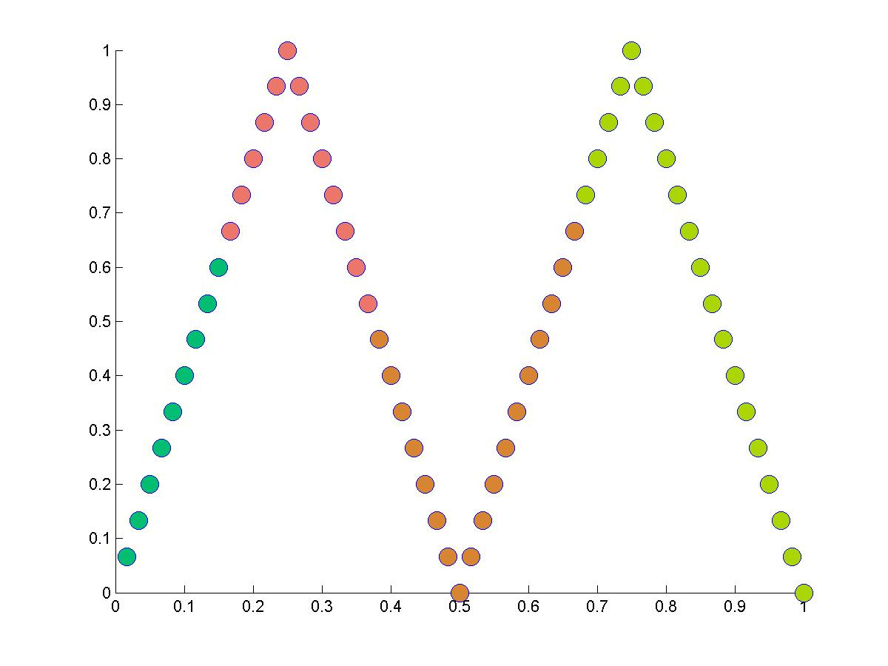






Slide 33

More general case: Curves
p
q
Notes:
More general curves can be represented as an implicit equation of the form f(p,a) = 0 where a is a
vector of parameters. For example, for an ellipse, a = [center, elongation]. As in the case of lines,
the algebraic distance to a curve is simply |f(p,a)|. The least-squares estimation is done by minimizing:
The difference is that a non-linear minimization algorithm needs to be used. The problem is that, like
for lines, this is not the right distance to minimize. Given a point p, the real distance that we want to
minimize is the distance between p and the closest point q on the curve. From differential geometry, it
turns out that pq is such that it is aligned with the gradient of f at q. Since we do not know the gradient
at q, it is approximated by the value at the known point p. The final estimation of the distance is:
Although the geometric distance is a more accurate estimation of distance, it is in general more difficult
to compute. The algebraic distance is often used for that reason. Note that in both cases we are dealing with
approximations which break down if the points a far from the optimal curve.

Slide 34


More general case: Curves
Implicit representation of l: f(p,a) = 0
Algebraic distance: d(l,p) = | f(p,a) |
Geometric distance: d(l,p) =
Estimation:

Slide 35
Summary
1. What are the parameters?
2. How many lines?
3. Which pixel below to which line?
K-means
1,3+
Incremental
fitting
1,2,3-
Hough Transform
1,2,(3)
Recursive splitting
1-,2,3-
(Robust) least-squares fitting
1
Algebraic
distance
Geometric
distance

