Slide 1

Creating Adaptive Web Servers Using Incremental Web Log Mining
Tapan Kamdar
kamdar@cs.umbc.edu

Slide 2

Overview
Proliferation of the web and the need to Personalize
  Improves e-commerce and e-services
  Saves network bandwidth and time
Create Adaptive Web Sites
  Web mining to generate traversal patterns
My Contribution
  Tool to create adaptive web pages
  Incremental Web Log Mining
Notes:
Personalization of content returned from a web site is an important problem in general, and affects e-commerce and e-services in particular. Targeting appropriate information or products to the end user can significantly change (for the better) the users experience on a web site.

Slide 3
Motivation and Problem Definition
“Web surfing”
Personalizing
Current Approaches
  Question and Answer Profiles
  Collaborative Filtering
Our Approach
  Passive Analysis of Logs ⇒ Profiles
  Update Profiles Incrementally

Slide 4
Proposed Approach
Fuzzy Clustering Algorithm to generate Profiles
Incremental approach to update profiles
Modified Apache Web Server to generate Personalized Pages

Slide 5
Organization
Background
Web Personalization
Incremental Web Log Mining
System Design
Experiments
Web Personalization using Incremental Web Log Mining
Summary and Future Work

Slide 6
Background
Web Personalization
  Information Brokers [Collaborative Filters and Recommender Systems]
    FireFly by Maes @ MIT
    PHOAKS by Tarveen et. al. @ ATT
    W³IQ by Joshi et. al. @ UMBC
  End-End Personalization
    WebMiner @ UMN
    Shahabi et. al. @ USC
    Chen et. al. @ NTU

Slide 7
Background
Clustering Algorithms
  PAM
    Finding k medoids :: Sum of intra-cluster dissimilarity is minimum
  CLARANS
    Finding k medoids efficiently :: Candidate sets of k elements in the neighborhood of current set
Incremental Clustering Algorithms
  Ester et. al. @ Univ. of Munich
  Motwani et. al. @ Stanford
    Metric Space

Slide 8
Organization
Background
Web Personalization
Incremental Web Log Mining
System Design
Experiments
Web Personalization using Incremental Web Log Mining
Summary and Future Work

Slide 9
Web Personalization
Apache Server at http://nataraj.cs.umbc.edu:8080/webmine/
  Places Cookie using mod_usertrack
  No identd used
Mod-perl script uses
  Web Logs ⇒ Clusters
  Java-JDBC Scripts ⇒ Profiles of Clusters

Slide 10
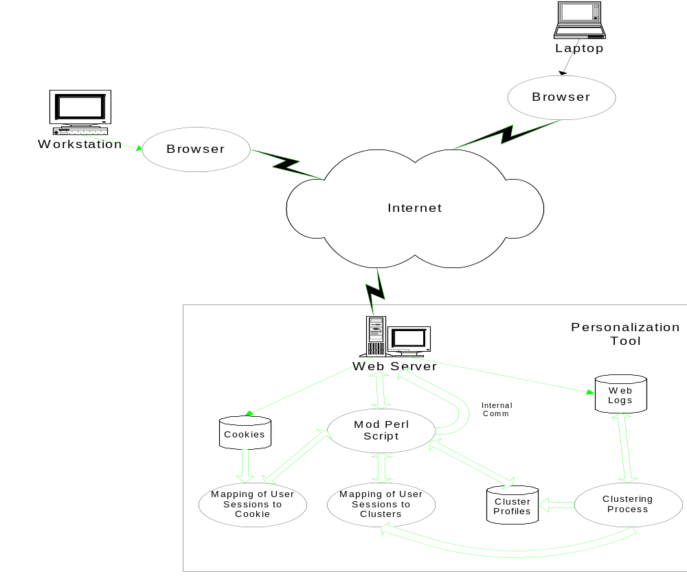
System Architecture

Slide 11
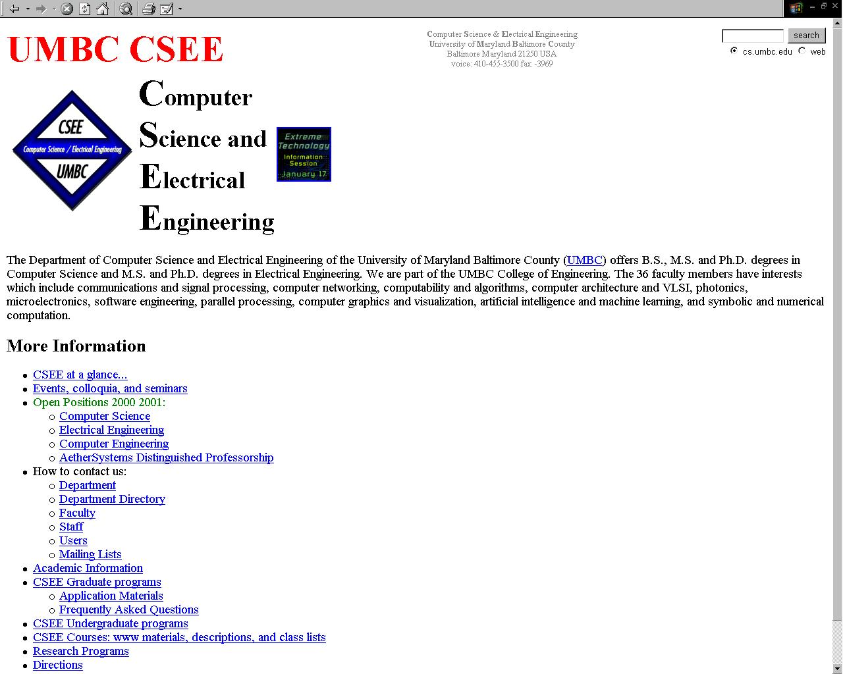
Default Page..

Slide 12
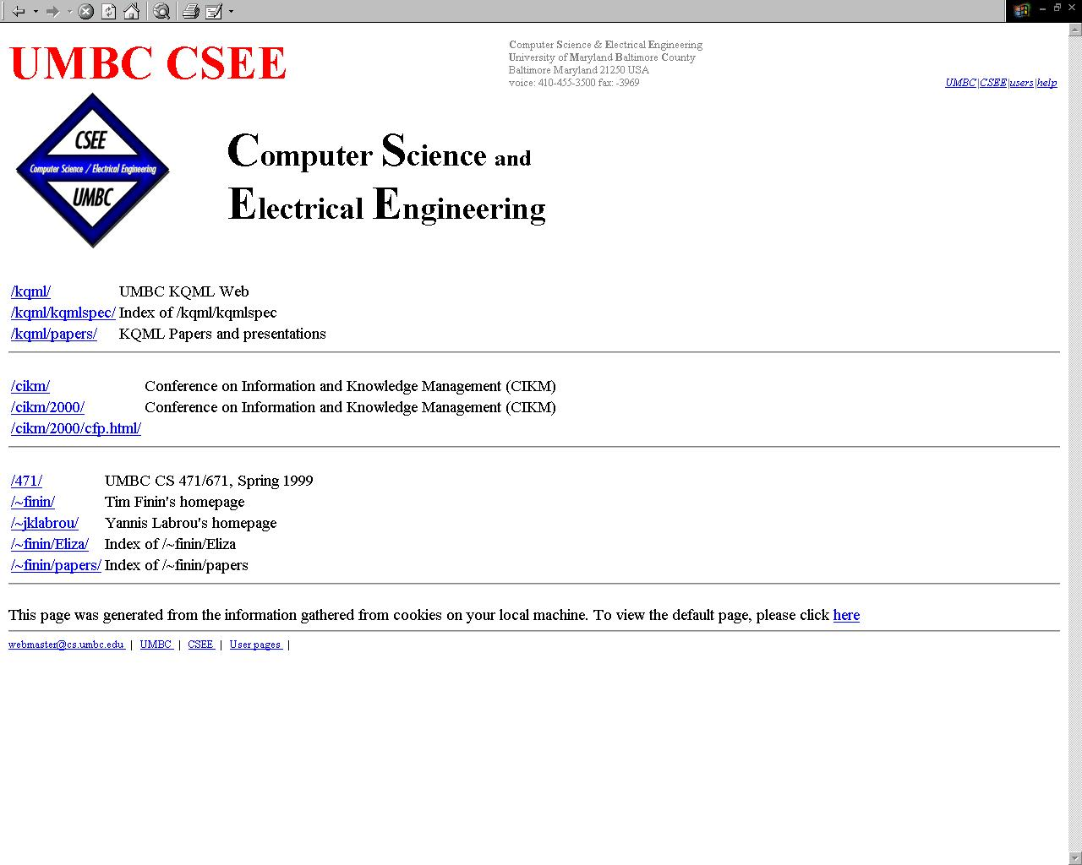
Personalized Page..

Slide 13
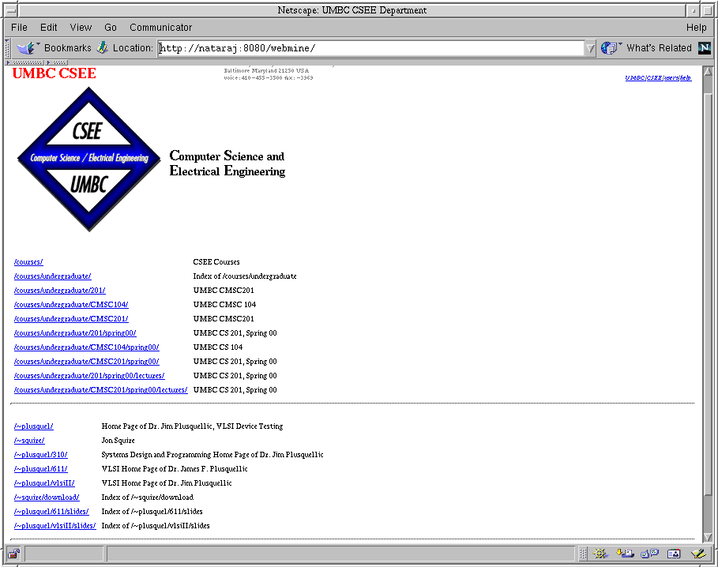
Personalized Page..

Slide 14
Organization
Background
Web Personalization
Incremental Web Log Mining
System Design
Experiments
Web Personalization using Incremental Web Log Mining
Summary and Future Work

Slide 15
Data set is large
SCALABILITY
Robust, Fuzzy, Relational

Slide 16
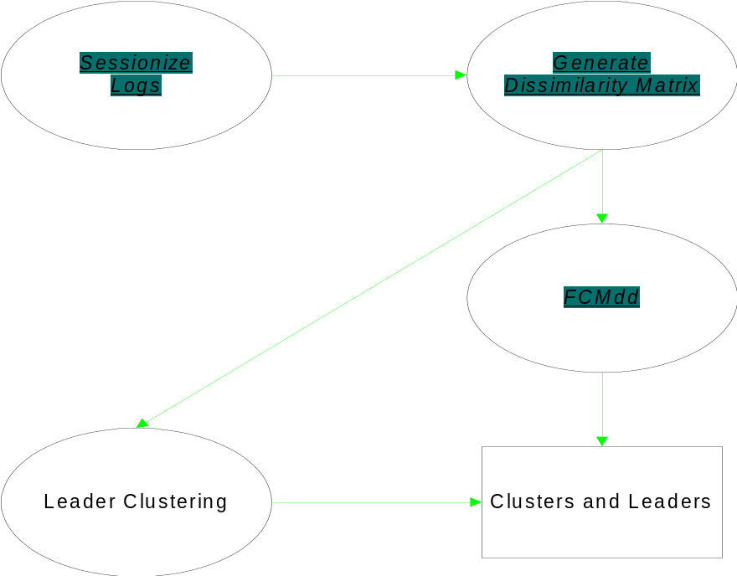
Base Clustering

Slide 17
Base Clustering
Sessionizing Logs : Modification of Follow [Joshi et. Al. Technical Report 1999]
Matrix File -- Dissimilarity between sessions [Krishnapuram et. al., IEEE Fuzzy Systems 2001]
Fuzzy C-Medoids Clustering Algorithm [Krishnapuram et. al.]
  Suitable for web mining application
    Handles relational data
    Creates fuzzy clusters
    Robust : handles noise

Slide 18

Similarity Between URLs
Structural similarity between URLs
  Prefix match
P_{i} = /www/cmsc621/hw/hw1.html
P_{j} = /www/cmsc621/hw/hw2.html
P_{k}= /www/policy.html
S_{u}(i,j) = 0.67 S_{u}(i,k) = 0.33

Slide 19
Leader Clustering
User Session
Leader Session

Slide 20
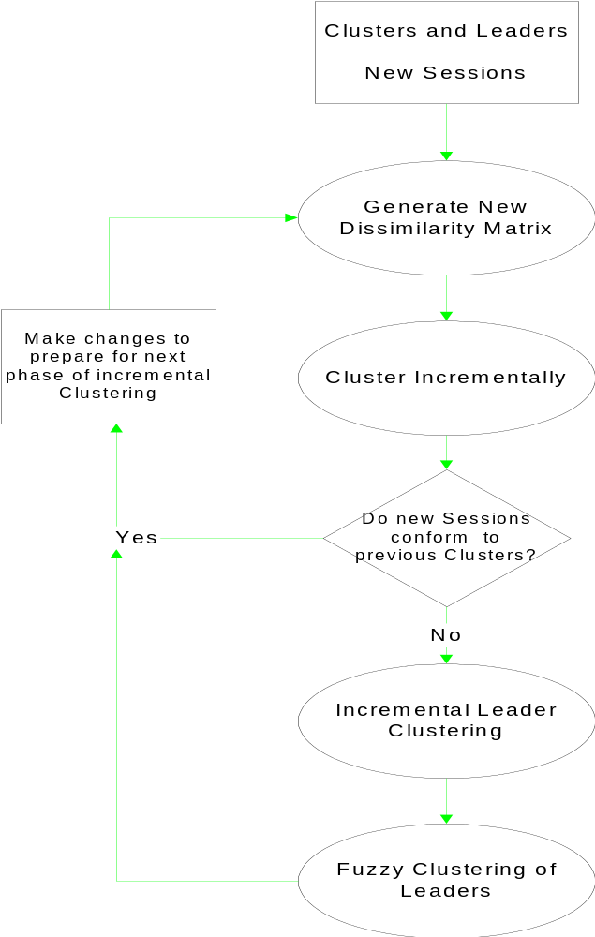
Incremental Web Log Mining

Slide 21
Multiple Medoids Per Cluster
Medoids : Representatives of Clusters
Requirement of Clustering Algorithms
  Specify the number of Clusters to generate
Over specify the number of clusters
  Use SAHN to merge clusters
    Multiple medoids per cluster

Slide 22
Generating New Distance Matrix
Obtain medoid session/s representing clusters
Computing membership of new sessions
  Two approaches
    Minimum Distance Approach
    Average Distance Approach

Slide 23
Minimum Distance Approach
Find medoid closest to new user session
Assign new session to cluster represented by medoid
Maintain count of unassigned sessions
If unassigned sessions / total sessions > T
  New sessions conform to clusters
else
  Perform Incremental Leader Clustering

Slide 24
Average Distance Approach
Multiple Medoids per Cluster due to SAHN
Find distance of new session from all medoids
Distance of new session from cluster
= Normalize ( Sum of distances of new session from all medoids belonging to that cluster )

Slide 25
Average Distance Approach
Assign new session to closest cluster
Maintain count of unassigned sessions
If unassigned sessions / total sessions > T
  New sessions conform to clusters
else
  Perform Incremental Leader Clustering

Slide 26
Incremental Leader Clustering
User Session
Leader Session

Slide 27
Fuzzy Clustering of Leaders
Compute dissimilarity between Leaders
  Use dissimilarity matrix between
    Old leaders
    Existing medoids and new sessions
    Old Leaders and new user sessions
  Compute unknown dissimilarities
  Weighted leaders
  FCMdd of Leaders ⇒New Clusters

Slide 28
Organization
Background
Web Personalization
Incremental Web Log Mining
System Design
Experiments
Web Personalization using Incremental Web Log Mining
Summary and Future Work

Slide 29
URL Maps
URLs identified by URL Ids
  Unique URL Ids maintained between different incremental stages
Pre-generated list of URL - URL Id mapping
Mapping look up by parser while assigning URLs to sessions
“Merged” map file consists of URLs used in base as well as incremental log : To reduce overlap file size

Slide 30
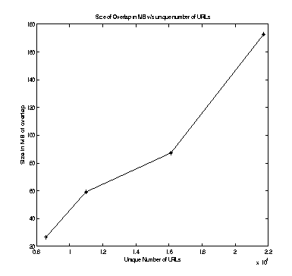
Overlaps Between URLs
Overlaps = Structural similarity between URLs
As #URLs ↑, Overlap matrix size ↑
Intelligent Approach
Still ???
Overlap Approach

Slide 31
Organization
Background and Rationale
Web Personalization
Incremental Web Log Mining
System Design
Experiments
Web Personalization using Incremental Web Log Mining
Summary and Future Work

Slide 32
Intra & Inter Cluster Distance
Metric used to compare clusters
  Intra Cluster Distance
    Distance between all sessions belonging to a cluster from each other
    Ideal Value : close to 0 :: Densely packed
  Inter Cluster Distance
    Distance between clusters = Distance of all sessions belonging to cluster from all sessions belonging to other clusters
    Ideal value : close to 1 :: As far as possible from other clusters

Slide 33
Experiments
Cookies v/s IP Addresses as sessionizing key
Minimum v/s Average Distance Approach
Savings due to Leader Clustering
Incremental Clustering
Base v/s Incremental Clustering Timings

Slide 34
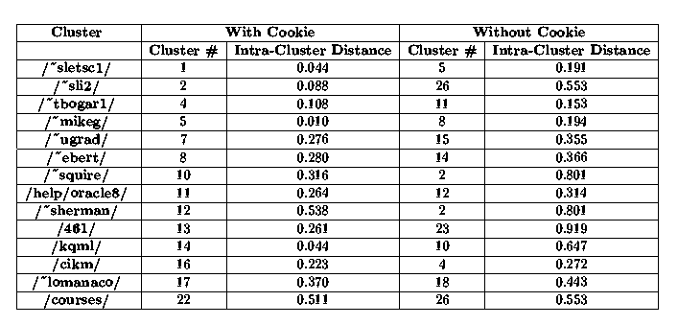
Cookie V/s IP Addresses

Slide 35
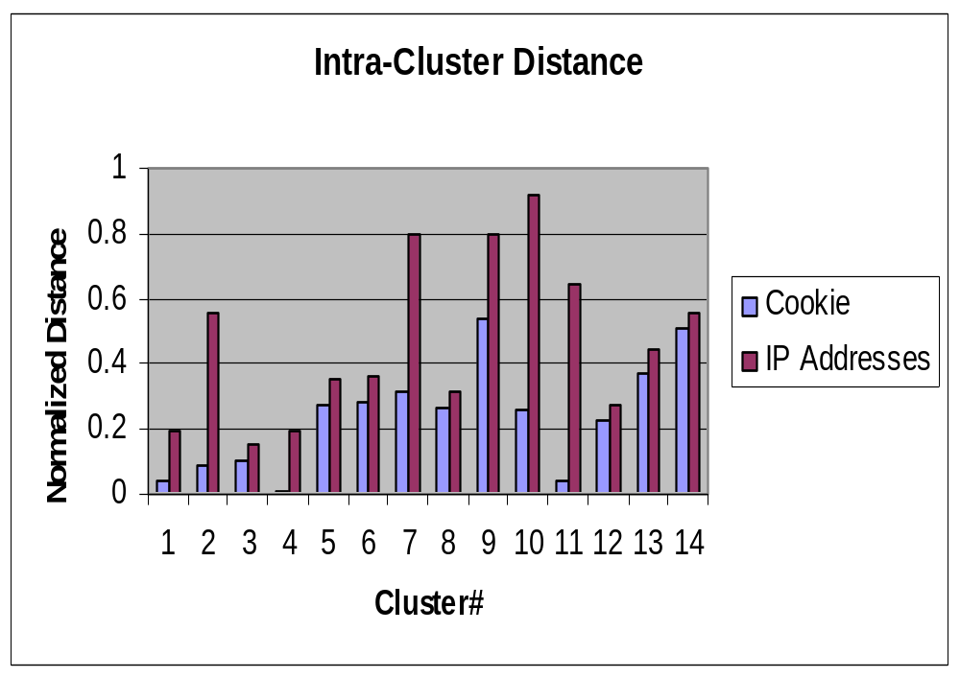
Cookie V/s IP Addresses
Average #Clusters
Without Cookie : 21 With Cookie : 19

Slide 36
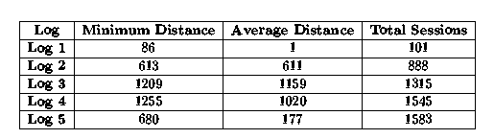
Minimum V/s Average Distance
Sessions assigned to existing clusters
using specific approach

Slide 37
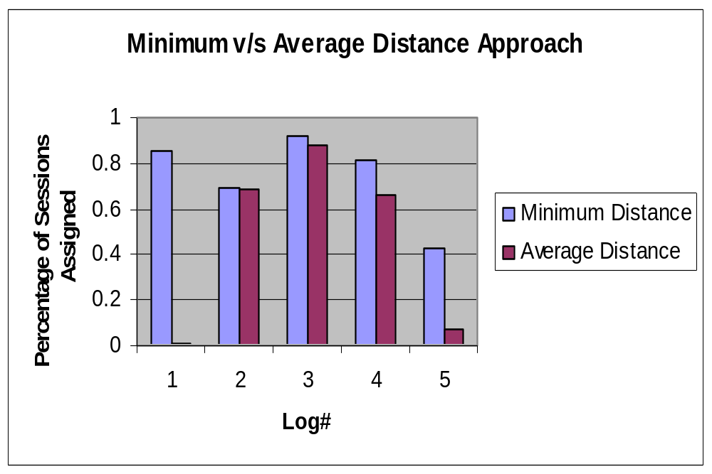
Minimum V/s Average Distance

Slide 38
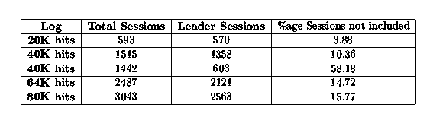
Savings Due to Leader Clustering

Slide 39
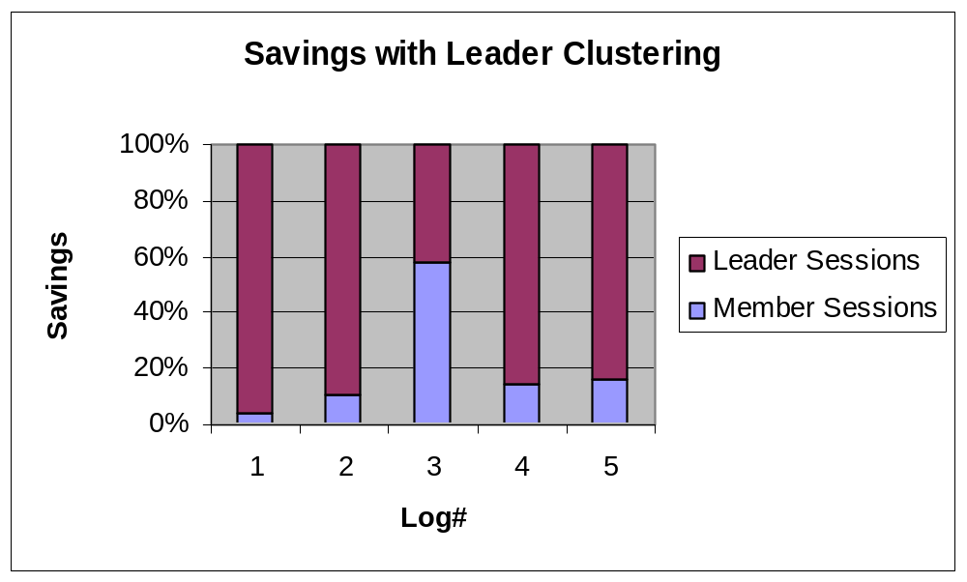
Savings Due to Leader Clustering

Slide 40
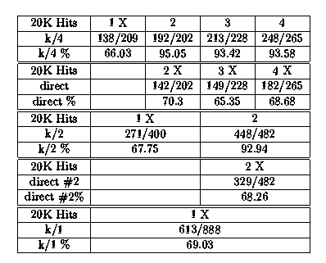
Incremental Clustering

Slide 41
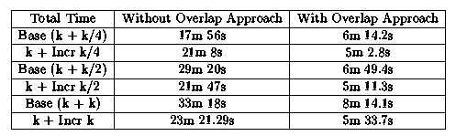
Base V/s Incremental Clustering Timings

Slide 42
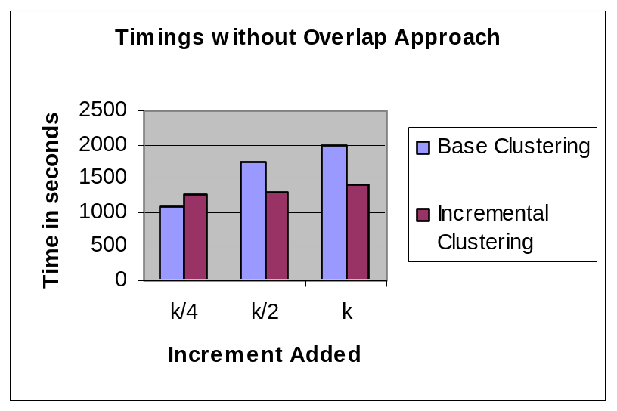
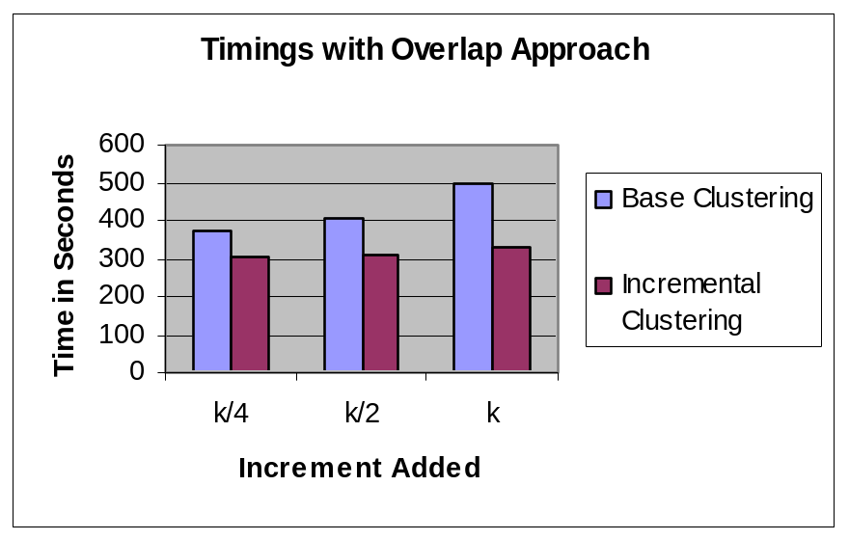
Base V/s Incremental Clustering Timings

Slide 43
Organization
Background
Web Personalization
Incremental Web Log Mining
System Design
Experiments
Web Personalization using Incremental Web Log Mining
Summary and Future Work

Slide 44
Ground Truth Verification
Users browse according to randomly selected pre-defined patterns and deviate occasionally
Two random patterns assigned to each user
  First day traversal according to first pattern
  Second day traversal according to second pattern
  Third day traversal using both patterns

Slide 45
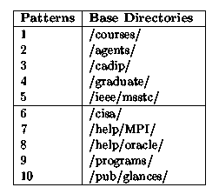
Ground Truth Verification
Patterns assigned to a user belonged to a single group

Slide 46
Incremental Clustering
Day
1
2
3
61%
94%
Incremental
Incremental
Clustering
Base
Re-clustering
None

Slide 47
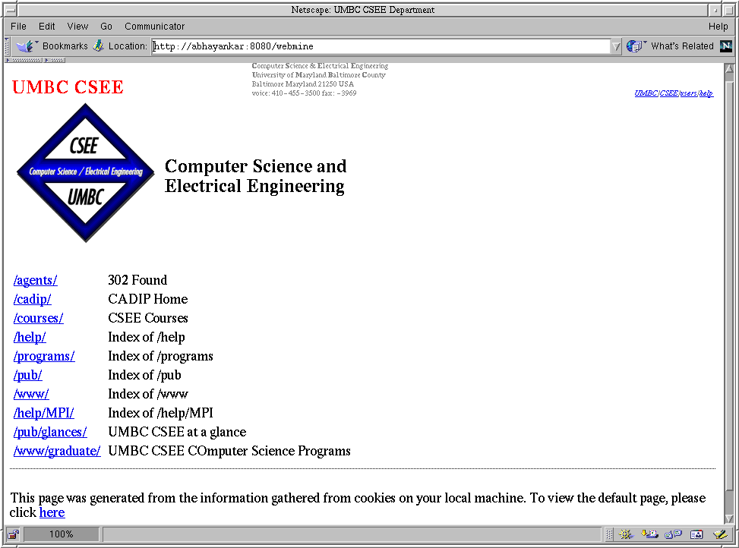
First Day Pattern

Slide 48
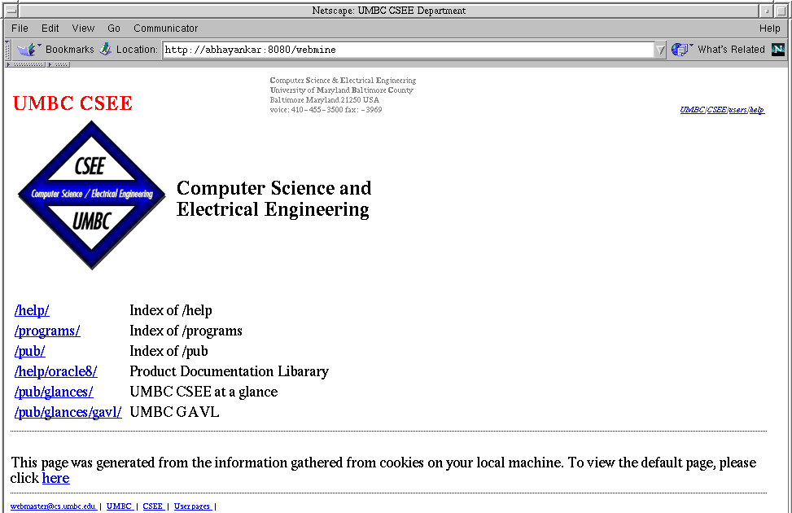
Second & Third Day Pattern

Slide 49
Organization
Background
Web Personalization
Incremental Web Log Mining
System Design
Experiments
Web Personalization using Incremental Web Log Mining
Summary and Future Work

Slide 50
Summary
Incremental Web Log Mining
  Leader Clustering
  Fuzzy Incremental Clustering
Web Personalization Tool
  Dynamic personalized web pages
    Reflect present traversal pattern of the user

Slide 51
Future Work...
Better Overlap Computation
Different Dissimilarity Measures
Personalization tool for Wireless Devices
???...

Slide 52
Acknowledgements
Thesis advisor
  Dr. Anupam Joshi
Committee members
  Dr. Charles Nicholas
  Dr. Konstantinos Kalpakis
  Dr. Hillol Kargupta
Dr. Raghu Krishnapuram, IBM Labs, India
Office of CSEE department
Family, Colleagues at CADIP and Friends
Financial support
  National Science Foundation

Slide 53

Questions??

Slide 54

Thank You

