Slide 1
CEN 522:Microprocessor Systems and Interfacing
Introduction
BY OMORUYI O. and Chukwu E.

Slide 2
Evolution of Computer systems
We can’t talk about microprocessors without talking about micro computers.
First Generation (1939-1954) - vacuum tube
Second Generation Computers (1954-1959) - transistor
Third Generation Computers (1959-1971) - IC
Fourth Generation (1971-Present) - microprocessor
Fifth Generation (Present and Beyond)

Slide 3
First Generation (1939-1954) - vacuum tube
1937 - John V. Atanasoff designed the first digital electronic computer
1939 - Atanasoff and Clifford Berry demonstrate in Nov. the ABC prototype
1941 - Konrad Zuse in Germany developed in secret the Z3
1943 - In Britain, the Colossus was designed in secret at Bletchley Park to decode German messages
1944 - Howard Aiken developed the Harvard Mark I mechanical computer for the Navy
1945 - John W. Mauchly and J. Presper Eckert built ENIAC at U of PA for the U.S. Army

Slide 4
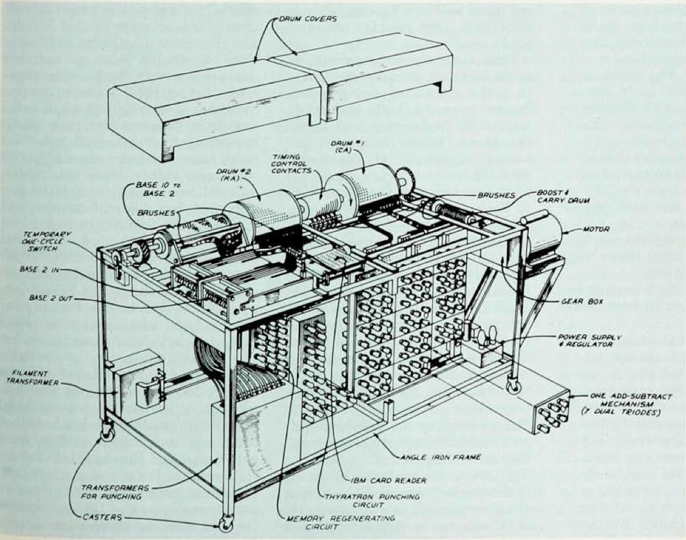
Atanasoff-Berry ABC Prototype

Slide 5
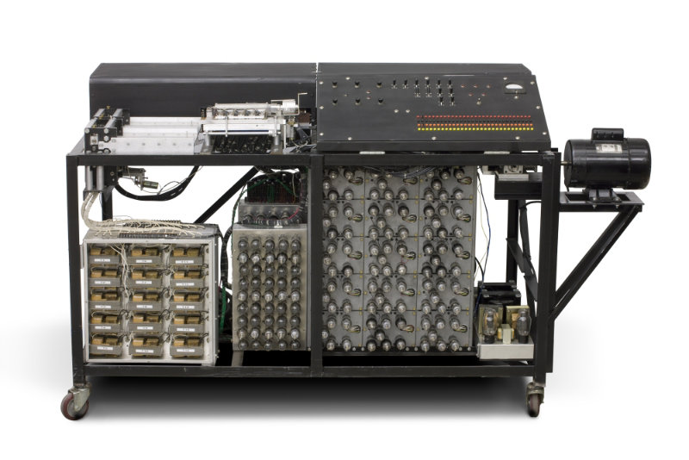
Continued….

Slide 6
The idea….
Electricity and electronics, not mechanical methods
Binary numbers internally
Separate memory made with capacitors, refreshed to maintain 0 or I state
Direct 0-1 logic operations, not enumeration
Since an expert computer¹ requires about eight hours to solve a full set of eight equations in eight unknowns, k is about 1/64. To solve twenty equations in twenty unknowns should thus require 125 hours. But this caculation does not take into effect the increased labor due to the greater chances of error in the larger systems ... The solution of general systems of linear equations with a number of unknowns greater than ten is not often attempted. But this is precisely what is needed to make approximate methods more effective in the solution of practical problems.
Atanasoff’s original thought was to improve upon existing calculating machines, notably the IBM tabulator.

Slide 7
Second Generation Computers (1954-1959) - transistor
1950 - National Bureau of Standards (NBS) introduced its Standards Eastern Automatic Computer (SEAC) with 10,000 newly developed germanium diodes in its logic circuits, and the first magnetic disk drive designed by Jacob Rabinow
1953 - Tom Watson, Jr., led IBM to introduce the model 604 computer, its first with transistors, that became the basis of the model 608 of 1957, the first solid-state computer for the commercial market. Transistors were expensive at first, cost $8 vs. $.75 for a vacuum tube. But Watson was impressed with the new transistor radios and gave them to his engineers to study. IBM also developed the 650 Magnetic Drum Calculator, the first by IBM to use magnetic drum memory rather than punched cards, and began shipment of the 701 scientific "Defense Calculator" that was the first of the Model 700 line that dominated main frame computers for the next decade

Slide 8
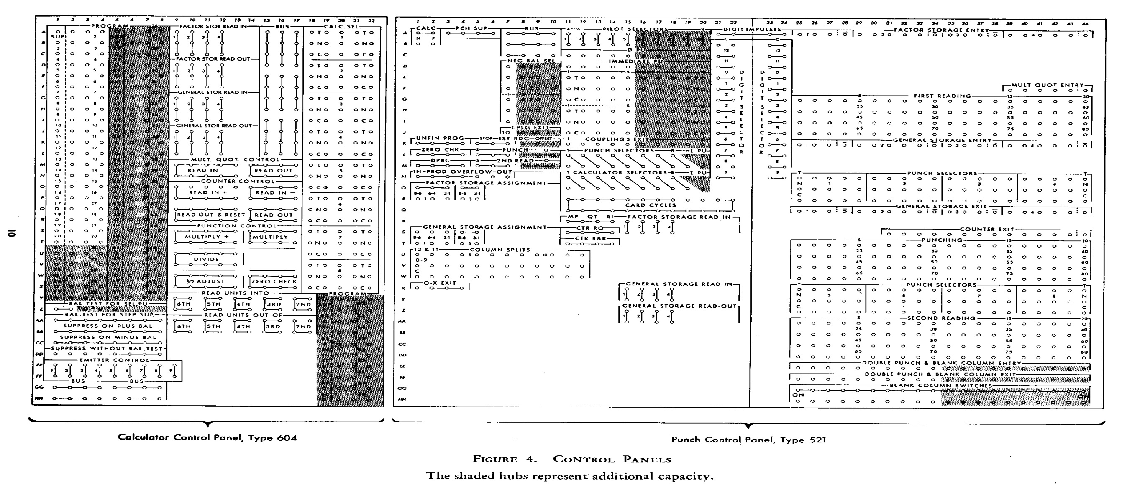
604 board

Slide 9
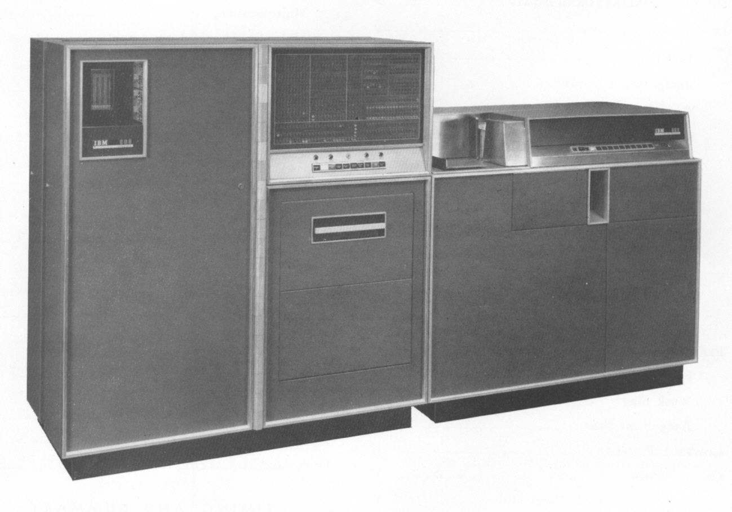
608 Calculator(1957)

Slide 10
Third Generation Computers (1959-1971) - IC
1959 - Jack Kilby of Texas Instruments patented the first integrated circuit in Feb. 1959; Kilby had made his first germanium IC in Oct. 1958; Robert Noyce at Fairchild used planar process to make connections of components within a silicon IC in early 1959; the first commercial product using IC was the hearing aid in Dec. 1963; General Instrument made LSI chip (100+ components) for Hammond organs 1968
1964 - IBM produced SABRE, the first airline reservation tracking system for American Airlines; IBM announced the System/360 all-purpose computer, using 8-bit character word length (a "byte") that was pioneered in the 7030 of April 1961 that grew out of the AF contract of Oct. 1958 following Sputnik to develop transistor computers for BMEWS
1968 - DEC introduced the first "mini-computer", the PDP-8, named after the mini-skirt; DEC was founded in 1957 by Kenneth H. Olsen who came for the SAGE project at MIT and began sales of the PDP-1 in 1960
1969 - Development began on ARPAnet, funded by the DOD
1971 - Intel produced large scale integrated (LSI) circuits that were used in the digital delay line, the first digital audio device

Slide 11
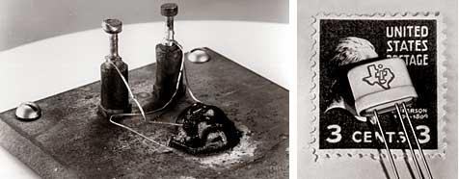
What’s an IC?
IC’S are combination of components on the same block of semiconductor material.
“Because he was newly employed, Kilby had no vacation like the rest of the staff. Working alone in the lab, he saw an opportunity to find a solution of his own to the miniaturization problem. Kilby's idea was to make all the components and the chip out of the same block (monolith) of semiconductor material. When the rest of the workers returned from vacation, Kilby presented his new idea to his superiors. He was allowed to build a test version of his circuit. In September 1958, he had his first integrated circuit ready. It was tested and it worked perfectly!”
http://www.nobelprize.org/educational/physics/integrated_circuit/history/
The Transistor

