Slide 1
CEN 522: Programming Model in Protected mode
By Omoruyi O.

Slide 2
Topic
Registers
Memory management
Address translation,
Descriptor and page tables.

Slide 3
Protected mode programming model
Protected mode memory addressing (80286 and above) allows access to data and programs located above the first 1M byte of memory, as well as within the first 1M byte of memory.
Protected Mode was designed by Intel to deal with the inadequacies of the 16-bit segmented architecture, mainly, the 1MB limit.

Slide 4
TEST
1. calculate the effective address of the instruction to be executed given the values above.
2. which two registers are used in this operation above? Specify their functions
3. give the results and the storage points of the following instructions
MOV AL, DL
MOV DL, AL
MOV BH, BL
MOV BL, DL
MOV BL, AL

Slide 5
Protected mode
Protected Mode is not faster than Real Mode.
Loading segment registers is painfully slow, and some of the instructions are slower in PM (due to the protection mechanism and privilege level verification).

Slide 6
Benefits of Using Protected Mode
Access to 4 gigabytes of memory
The Memory Management Unit (MMU) on older processors allows virtual memory to be implemented.
The MMU also allows addresses to be translated, or mapped, before use.
Memory protection - The 386 allows memory to be protected. For example, a user's program may not be able to overwrite operating system data. This, combined with the checks on segments, protects programs against bugs that would crash the computer.

Slide 7
Registers (80386 programming model)
EFLAGS
Memory-Management Registers
Control Registers
Debug Registers
Test Registers

Slide 8
EFLAGS
The systems flags of the EFLAGS register control I/O, maskable interrupts, debugging, task switching, and enabling of virtual 8086 execution in a protected, multitasking environment. These flags are highlighted in Figure 5-1 .
IF (Interrupt-Enable Flag, bit 9)
Setting IF allows the CPU to recognize external (maskable) interrupt requests. Clearing IF disables these interrupts. IF has no effect on either exceptions or non-maskable external interrupts .
NT (Nested Task, bit 14)
The processor uses the nested task flag to control chaining of interrupted and called tasks. NT influences the operation of the IRET instruction .

Slide 9
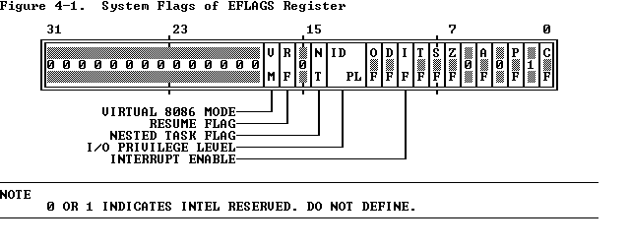
EFLAGS

Slide 10
EFLAGS
RF (Resume Flag, bit 16)
The RF flag temporarily disables debug exceptions so that an instruction can be restarted after a debug exception without immediately causing another debug exception .
TF (Trap Flag, bit 8)
Setting TF puts the processor into single-step mode for debugging. In this mode, the CPU automatically generates an exception after each instruction, allowing a program to be inspected as it executes each instruction. Single-stepping is just one of several debugging features of the 80386 .
VM (Virtual 8086 Mode, bit 17)
When set, the VM flag indicates that the task is executing an 8086 program . Refer to Chapter 14 for a detailed discussion of how the 80386 executes 8086 tasks in a protected, multitasking environment.

Slide 11
Memory-Management Registers
Four registers of the 80386 locate the data structures that control segmented memory management:
Global Descriptor Table Register (GDTR) and Local Descriptor Table Register (LDTR)
These registers point to the segment descriptor tables GDT and LDT.
Interrupt Descriptor Table Register (IDTR)
This register points to a table of entry points for interrupt handlers (the IDT ).
Task Register (TR)
This register points to the information needed by the processor to define the current task .

Slide 12
Control Registers
Figure 4-2 shows the format of the 80386 control registers CR0, CR2, and CR3. These registers are accessible to systems programmers only via variants of the MOV instruction, which allow them to be loaded from or stored in general registers; for example:
MOV EAX, CR0
MOV CR3, EBX

Slide 13
Control Registers
CR0
It contains system control flags, which control or indicate conditions that apply to the system as a whole, not to an individual task.
CR2
It is used for handling page faults when PG is set. The processor stores in CR2 the linear address that triggers the fault .
CR3
It is used when PG is set. CR3 enables the processor to locate the page table directory for the current task .

Slide 14
Control Register (CR0)
CR0 is divided into the following:
EM (Emulation, bit 2), EM indicates whether coprocessor functions are to be emulated.
ET (Extension Type, bit 4), ET indicates the type of coprocessor present in the system (80287 or 80387 ) .
MP (Math Present, bit 1) controls the function of the WAIT instruction, which is used to coordinate a coprocessor .
PE (Protection Enable, bit 0), Setting PE causes the processor to begin executing in protected mode. Resetting PE returns to real-address mode .
PG (Paging, bit 31), PG indicates whether the processor uses page tables to translate linear addresses into physical addresses .
TS (Task Switched, bit 3), the processor sets TS with every task switch and tests TS when interpreting coprocessor instructions .

Slide 15
Debug and Test Registers
The debug registers bring advanced debugging abilities to the 80386, including data breakpoints and the ability to set instruction breakpoints without modifying code segments .
The test registers are not a standard part of the 80386 architecture. They are provided solely to enable confidence testing of the translation look aside buffer (TLB), the cache used for storing information from page tables .

Slide 16
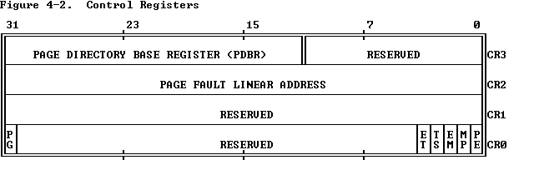
Control Register

Slide 17
Memory Management
The 80386 transforms logical addresses (i.e., addresses as viewed by programmers) into physical address (i.e., actual addresses in physical memory) in two steps:
Segment translation, in which a logical address (consisting of a segment selector and segment offset) are converted to a linear address.
Page translation, in which a linear address is converted to a physical address. This step is optional, at the discretion of systems-software designers.
These translations are performed in a way that is not visible to applications programmers. Figure 4-3 illustrates the two translations at a high level of abstraction.

Slide 18
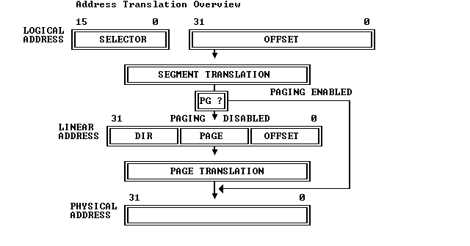
Memory Management (figure 4-3)

Slide 19
Descriptors
The segment descriptor provides the processor with the data it needs to map a logical address into a linear address. Descriptors are created by compilers, linkers, loaders, or the operating system. Figure 4-5 illustrates the two general descriptor formats. The Segment-descriptor fields are:
1. BASE: Defines the location of the segment within the 4 gigabyte linear address space. The processor concatenates the three fragments of the base address to form a single 32-bit value.
2. LIMIT: Defines the size of the segment. When the processor concatenates the two parts of the limit field, a 20-bit value results. The processor interprets the limit field in one of two ways, depending on the setting of the granularity bit: In units of one byte, to define a limit of up to 1 megabyte. In units of 4 Kilobytes, to define a limit of up to 4 gigabytes. The limit is shifted left by 12 bits when loaded, and low-order one-bits are inserted.
3. Granularity bit: Specifies the units with which the LIMIT field is interpreted. When the bit is clear, the limit is interpreted in units of one byte; when set, the limit is interpreted in units of 4 Kilobytes.
4. TYPE: Distinguishes between various kinds of descriptors.
5. DPL (Descriptor Privilege Level): Used by the protection mechanism.

Slide 20
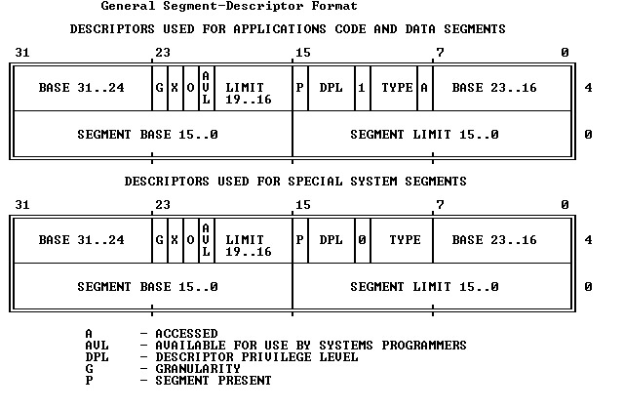
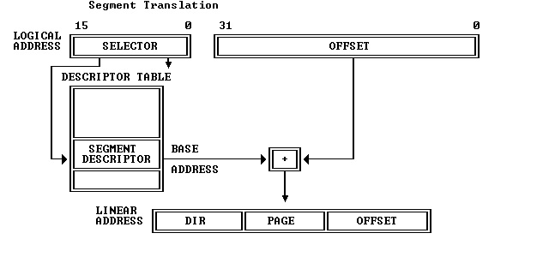
Figures 4-4 and 4-5

Slide 21
Descriptors
Segment-Present bit: If this bit is zero, the descriptor is not valid for use in address transformation; the processor will signal an exception when a selector for the descriptor is loaded into a segment register. Figure 4-6 shows the format of a descriptor when the present-bit is zero. The operating system is free to use the locations marked AVAILABLE. Operating systems that implement segment-based virtual memory clear the present bit in either of these cases:
When the linear space spanned by the segment is not mapped by the paging mechanism.
When the segment is not present in memory.
Accessed bit: The processor sets this bit when the segment is accessed; i.e., a selector for the descriptor is loaded into a segment register or used by a selector test instruction. Operating systems that implement virtual memory at the segment level may, by periodically testing and clearing this bit, monitor frequency of segment usage.

Slide 22
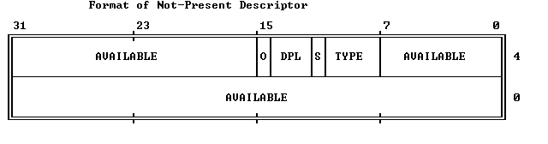
figure 4.6

Slide 23
Descriptor Tables
Segment descriptors are stored in either of two kinds of descriptor table:
The global descriptor table (GDT)
A local descriptor table (LDT)
A descriptor table is simply a memory array of 8-byte entries that contain descriptors, as Figure 4-7 shows. A descriptor table is variable in length and may contain up to 8192 (2^(13)) descriptors.
The first entry of the GDT (INDEX=0) is not used by the processor, however. The processor locates the GDT and the current LDT in memory by means of the GDTR and LDTR registers.
These registers store the base addresses of the tables in the linear address space and store the segment limits. The instructions LGDT and SGDT give access to the GDTR; the instructions LLDT and SLDT give access to the LDTR.

Slide 24
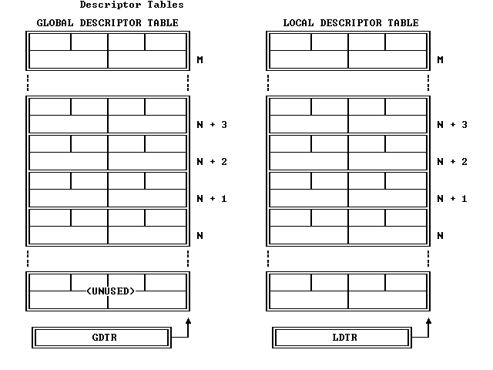
Descriptor tables

Slide 25
Selectors
The selector portion of a logical address identifies a descriptor by specifying a descriptor table and indexing a descriptor within that table. Selectors may be visible to applications programs as a field within a pointer variable, but the values of selectors are usually assigned (fixed up) by linkers or linking loaders. Figure 4-8 shows the format of a selector.
Index: Selects one of 8192 descriptors in a descriptor table. The processor simply multiplies this index value by 8 (the length of a descriptor), and adds the result to the base address of the descriptor table in order to access the appropriate segment descriptor in the table.
Table Indicator: Specifies to which descriptor table the selector refers. A zero indicates the GDT; a one indicates the current LDT.
Requested Privilege Level: Used by the protection mechanism.
Because the first entry of the GDT is not used by the processor, a selector that has an index of zero and a table indicator of zero (i.e., a selector that points to the first entry of the GDT), can be used as a null selector. The processor does not cause an exception when a segment register (other than CS or SS) is loaded with a null selector. It will, however, cause an exception when the segment register is used to access memory. This feature is useful for initializing unused segment registers so as to trap accidental references.

Slide 26
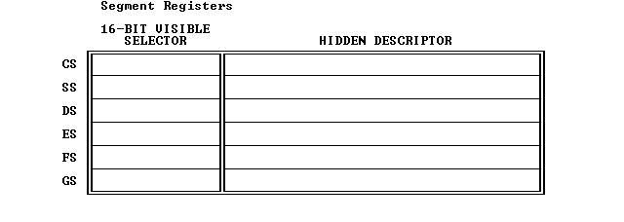

Figures 4-8 and 4-9

Slide 27
Segment Registers
The 80386 stores information from descriptors in segment registers, thereby avoiding the need to consult a descriptor table every time it accesses memory.
Every segment register has a "visible" portion and an "invisible" portion, as Figure 4-9 illustrates. The visible portions of these segment address registers are manipulated by programs as if they were simply 16-bit registers. The invisible portions are manipulated by the processor.
The operations that load these registers are normal program instructions. These instructions are of two classes:
Direct load instructions; for example, MOV, POP, LDS, LSS, LGS, LFS. These instructions explicitly reference the segment registers.
Implied load instructions; for example, far CALL and JMP. These instructions implicitly reference the CS register, and load it with a new value.
Using these instructions, a program loads the visible part of the segment register with a 16-bit selector. The processor automatically fetches the base address, limit, type, and other information from a descriptor table and loads them into the invisible part of the segment register. Because most instructions refer to data in segments whose selectors have already been loaded into segment registers, the processor can add the segment-relative offset supplied by the instruction to the segment base address with no additional overhead.

Slide 28
Page Translation
In the second phase of address transformation, the 80386 transforms a linear address into a physical address. This phase of address transformation implements the basic features needed for page-oriented virtual-memory systems and page-level protection.
The page-translation step is optional. Page translation is in effect only when the PG bit of CR0 is set. This bit is typically set by the operating system during software initialization. The PG bit must be set if the operating system is to implement multiple virtual 8086 tasks, page-oriented protection, or page-oriented virtual memory.

Slide 29
Page Frame and Linear Address
A page frame is a 4K-byte unit of contiguous addresses of physical memory. Pages begin on-byte boundaries and are fixed in size.
A linear address refers indirectly to a physical address by specifying a page table, a page within that table, and an offset within that page. Figure 4-10 shows the format of a linear address.
Figure 4-11 shows how the processor converts the DIR, PAGE, and OFFSET fields of a linear address into the physical address by consulting two levels of page tables. The addressing mechanism uses the DIR field as an index into a page directory, uses the PAGE field as an index into the page table determined by the page directory, and uses the OFFSET field to address a byte within the page determined by the page table.

Slide 30
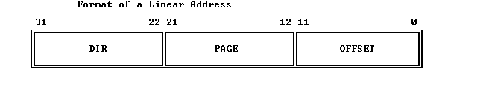
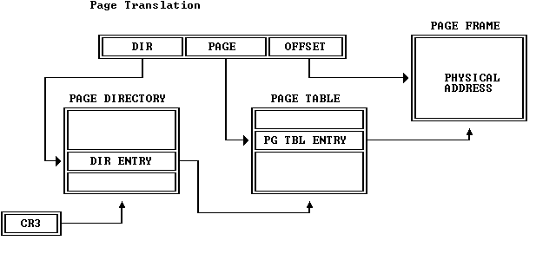
figures 4-10 and 4-11

Slide 31
Page Tables
A page table is simply an array of 32-bit page specifiers. A page table is itself a page, and therefore contains 4 Kilobytes of memory or at most 1K 32-bit entries.
Two levels of tables are used to address a page of memory. At the higher level is a page directory. The page directory addresses up to 1K page tables of the second level. A page table of the second level addresses up to 1K pages.
All the tables addressed by one page directory, therefore, can address 1M pages (2^(20)). Because each page contains 4K bytes 2^(12) bytes), the tables of one page directory can span the entire physical address space of the 80386 (2^(20) times 2^(12) = 2^(32)).
The physical address of the current page directory is stored in the CPU register CR3, also called the page directory base register (PDBR). Memory management software has the option of using one page directory for all tasks, one page directory for each task, or some combination of the two.

Slide 32
Page-Table Entries and Page Frame Address
Entries in either level of page tables have the same format. Figure 4-12 illustrates this format.
The page frame address specifies the physical starting address of a page. Because pages are located on 4K boundaries, the low-order 12 bits are always zero. In a page directory, the page frame address is the address of a page table. In a second-level page table, the page frame address is the address of the page frame that contains the desired memory operand.

Slide 33
Present Bit
The Present bit indicates whether a page table entry can be used in address translation. P=1 indicates that the entry can be used.
When P=0 in either level of page tables, the entry is not valid for address translation, and the rest of the entry is available for software use; none of the other bits in the entry is tested by the hardware. Figure 4-13 illustrates the format of a page-table entry when P=0.
If P=0 in either level of page tables when an attempt is made to use a page-table entry for address translation, the processor signals a page exception. In software systems that support paged virtual memory, the page-not-present exception handler can bring the required page into physical memory. The instruction that caused the exception can then be re-executed.

Slide 34
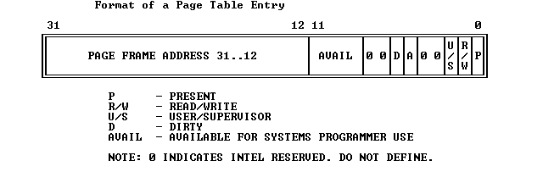
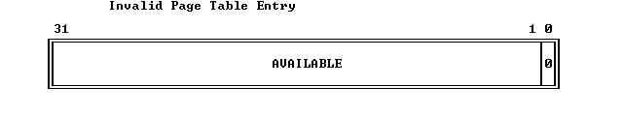
figures 4-12 and 4-13

Slide 35
Accessed and Dirty Bits
These bits provide data about page usage in both levels of the page tables. With the exception of the dirty bit in a page directory entry, these bits are set by the hardware; however, the processor does not clear any of these bits.
The processor sets the corresponding accessed bits in both levels of page tables to one before a read or write operation to a page.
The processor sets the dirty bit in the second-level page table to one before a write to an address covered by that page table entry. The dirty bit in directory entries is undefined.
An operating system that supports paged virtual memory can use these bits to determine what pages to eliminate from physical memory when the demand for memory exceeds the physical memory available. The operating system is responsible for testing and clearing these bits.

Slide 36
Read/Write and User/Supervisor Bits
These bits are not used for address translation, but are used for page-level protection, which the processor performs at the same time as address translation.
Page Translation Cache
For greatest efficiency in address translation, the processor stores the most recently used page-table data in an on-chip cache. Only if the necessary paging information is not in the cache must both levels of page tables be referenced.
The existence of the page-translation cache is invisible to applications programmers but not to systems programmers; operating-system programmers must flush the cache whenever the page tables are changed. The page-translation cache can be flushed by either of two methods:
By reloading CR3 with a MOV instruction; for example: MOV CR3, EAX

Slide 37
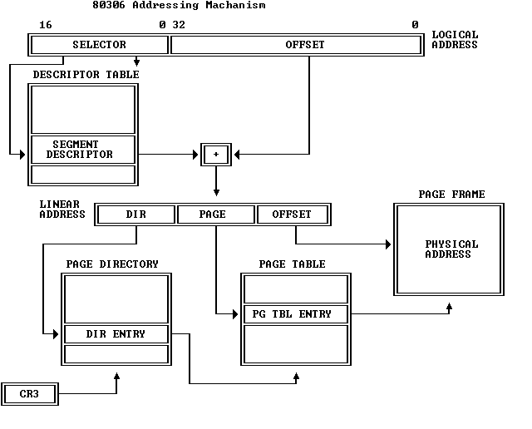
Combining Segment and Page Translation

Slide 38
"Flat" Architecture
When the 80386 is used to execute software designed for architectures that don't have segments, it may be expedient to effectively "turn off" the segmentation features of the 80386. The 80386 does not have a mode that disables segmentation, but the same effect can be achieved by initially loading the segment registers with selectors for descriptors that encompass the entire 32-bit linear address space. Once loaded, the segment registers don't need to be changed. The 32-bit offsets used by 80386 instructions are adequate to address the entire linear-address space.

Slide 39
Segments Spanning Several Pages
The architecture of the 80386 permits segments to be larger or smaller than the size of a page (4 Kilobytes). For example, suppose a segment is used to address and protect a large data structure that spans 132 Kilobytes. In a software system that supports paged virtual memory, it is not necessary for the entire structure to be in physical memory at once. The structure is divided into 33 pages, any number of which may not be present. The applications programmer does not need to be aware that the virtual memory subsystem is paging the structure in this manner.

Slide 40
Non-Aligned Page and Segment Boundaries
The architecture of the 80386 does not enforce any correspondence between the boundaries of pages and segments. It is perfectly permissible for a page to contain the end of one segment and the beginning of another. Likewise, a segment may contain the end of one page and the beginning of another.

Slide 41
Aligned Page and Segment Boundaries
Memory-management software may be simpler, however, if it enforces some correspondence between page and segment boundaries. For example, if segments are allocated only in units of one page, the logic for segment and page allocation can be combined. There is no need for logic to account for partially used pages.

Slide 42
Page-Table per Segment
An approach to space management that provides even further simplification of space-management software is to maintain a one-to-one correspondence between segment descriptors and page-directory entries, as Figure 4-15 illustrates. Each descriptor has a base address in which the low-order 22 bits are zero; in other words, the base address is mapped by the first entry of a page table. A segment may have any limit from 1 to 4 megabytes. Depending on the limit, the segment is contained in from 1 to 1K page frames. A task is thus limited to 1K segments (a sufficient number for many applications), each containing up to 4 Mbytes. The descriptor, the corresponding page-directory entry, and the corresponding page table can be allocated and de-allocated simultaneously.

Slide 43
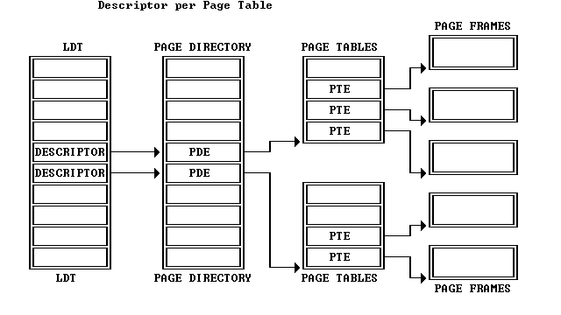
figure 4-15

Slide 44
References
http://www.monstersoft.com/tutorial1/PM_adv.html
https://pdos.csail.mit.edu/6.828/2008/readings/i386/
The Intel Microprocessor, Architecture, Programming and Interfacing, 6th Ed., by Barr B Brey.

