Slide 1
CEN 511: Embedded System Design and Programming
PIC Microcontroller
BY Omoruyi O. and Simonyan E.

Slide 2
PIC Microcontroller Introduction
Introduction
Elements of a Microcontroller
PIC 16F Family Features
Typical Configuration Bits

Slide 3
Introduction
The first to be widely used microcontroller was the Intel 8051. It was developed alongside the early Intel PC processors, such as the 8086.
However in keeping with the times and to stay dynamic in an ever changing world this semester we will cover the PIC family of microcontrollers.
Notes are available for the Intel 8051 on moodle.

Slide 4
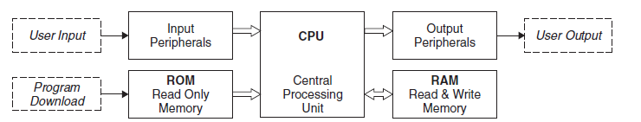
Elements of a Typical Microcontroller
Figure 1: Elements of a Microcontroller

Slide 5
Typical microcontroller cont’d
The computer or microcontroller has three main elements: input and output devices, which communicate with the outside world; a processor, to make calculations and handle data operations; and memory, to store programs and data.

Slide 6
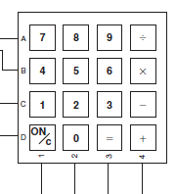
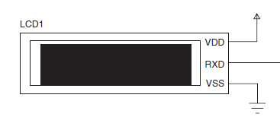
Typical microcontroller cont’d
The MCU is essentially a computer on a chip; however, it still needs input and output devices, such as a keypad and display, to form a working system.
Figure 2: Typical Peripherals for Input and Output

Slide 7
Typical microcontroller cont’d
The microcontroller stores its program in ROM (read only memory). In the past, UV (ultraviolet) erasable programmable ROM (EPROM) was used for prototyping or small batch production, and one-time programmable ROM for longer product runs.
Programmable ROM chips are programmed in the final stages of manufacture, while EPROM could be programmed by the user.
Flash ROM is now normally used for prototyping and low-volume production. This can be programmed in circuit by the user after the circuit has been built.

Slide 8
Features of a Microcontroller
Number of inputs and outputs(Ports)
Program memory size
Data RAM size
Nonvolatile data memory(ROM)
Maximum clock speed
Range of interfaces
The PIC16F877A is useful as a reference device because it has a minimal instruction set but a full range of peripheral features.

Slide 9
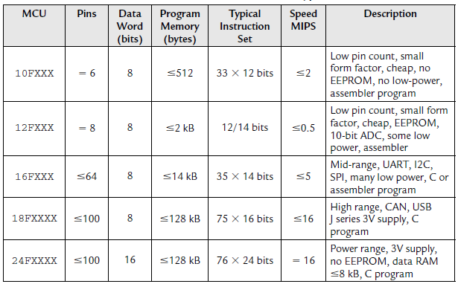
PIC Family of Microcontrollers

Slide 10
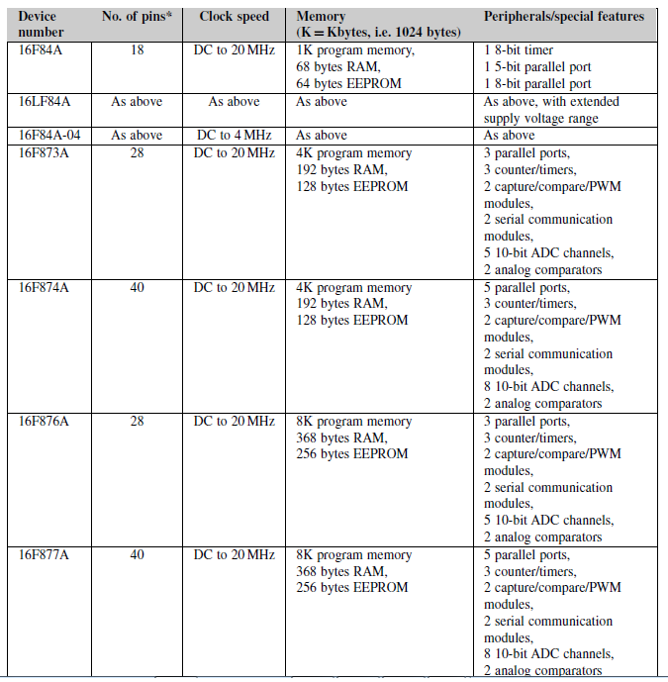
PIC 16FXXX Family Features

Slide 11
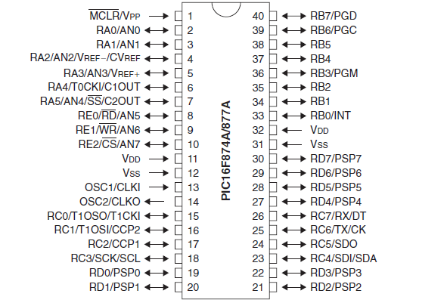
PIC16F877 Device Specification
Figure 3: PIC16F877 Pinout

Slide 12
PIC16F877 cont’d
The most significant variation among PIC chips is the instruction size, which can be 12, 14, or 16 bits.
When PICs are affixed with A, it implies a maximum clock speed of 20MHz.
The PIC16F877 chip has 8k (8096 X 14 bits) of flash ROM program memory.

Slide 13
PIC16F877 Instruction and instruction Set
The PIC16F877 has a limited number of instructions (35) and is therefore classified as a RISC (reduced instruction set computer) processor.

Slide 14
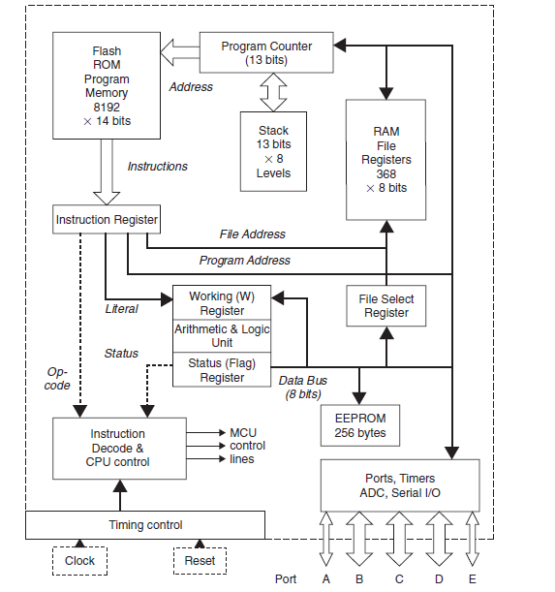
PIC16F877 Block Diagram

Slide 15
PIC Configuration Options
Watchdog Timer
When enabled, the watchdog timer (WDT) automatically resets the processor after a given period (default 18 ms). This allows, for example, an application to escape from an endless loop caused by a program bug or run-time condition not anticipated by the software designer.
To maintain normal operation, the WDT must be disabled or reset within the program loop before the set time-out period has expired. It is therefore important to set the MCU configuration bits to disable the WDT if it is not intended to use this feature. Otherwise, the program is liable to misbehave, due to random resetting of the MCU.

Slide 16
PIC Configuration Options
Power-up Timer
The power-up timer (PuT) provides a nominal 72 ms delay between the power supply voltage reaching the operating value and the start of program execution. This ensures that the supply voltage is stable before the clock starts up. It is recommended that it be enabled as a precaution, as there is no adverse effect on normal program execution.
Oscillator Start-up Timer
After the power-up timer has expired, a further delay allows the clock to stabilize before program execution begins. When one of the crystal clock modes is selected, the CPU waits 1024 cycles before the CPU is enabled.

Slide 17
PIC Configuration Options
Brown-out Reset (BoR)
It is possible for a transitory supply voltage drop, or brown-out, to disrupt the MCU program execution. When enabled, the brown-out detection circuit holds the MCU in reset while the supply voltage is below a given threshold and releases it when the supply has recovered.
Code Protection (CP)
The chip can be configured during programming to prevent the machine code being read back from the chip to protect commercially valuable or secure code. Optionally, only selected portions of the program code may be write protected (see WRT_X% later).

Slide 18
PIC Configuration Options
In-Circuit Programming and Debugging
Most PIC chips now support in-circuit programming and debugging (ICPD), which allows the program code to be downloaded and tested in the target hardware, under the control of the host system. This provides a final test stage after software simulation has been used to eliminate most of the program bugs. MPLAB allows the same interface to beused for debugging in both the simulation and in-circuit modes.

Slide 19
PIC Configuration Options
Low-Voltage Programming Mode
The low-voltage programming mode can be selected during programming so that the customary high (12V) programming voltage is not needed, and the chip can beprogrammed at Vdd (+5 V). The downside is that the programming pin cannot then be used for digital I/O. In any case, it is recommended here that the programming pins not be used for I/O as hardware contention could occur.
Electrically Erasable Programmable Read Only Memory
Many PIC MCUs have a block of nonvolatile user memory where data can be stored
during power-down. These data could, for example, be the secure code for an electronic
lock or smart card reader. The electrically erasable programmable read only memory
(EEPROM) can be rewritten by individual location, unlike flash program ROM. The ‘ 877
has a block of 256 bytes, which is a fairly typical value. There is a special read/write
sequence to prevent accidental overwriting of the data.

Slide 20
PIC Peripherals
Digital I/O
Timers
A/D converter
Comparator
Parallel slave port
Interrupts

Slide 21
Conclusion
This Lecture introduces the students to PIC Microntrollers. In the coming weeks we will explore Oscillator configuration and other Peripherals of the PIC microcontroller.

