Slide 1
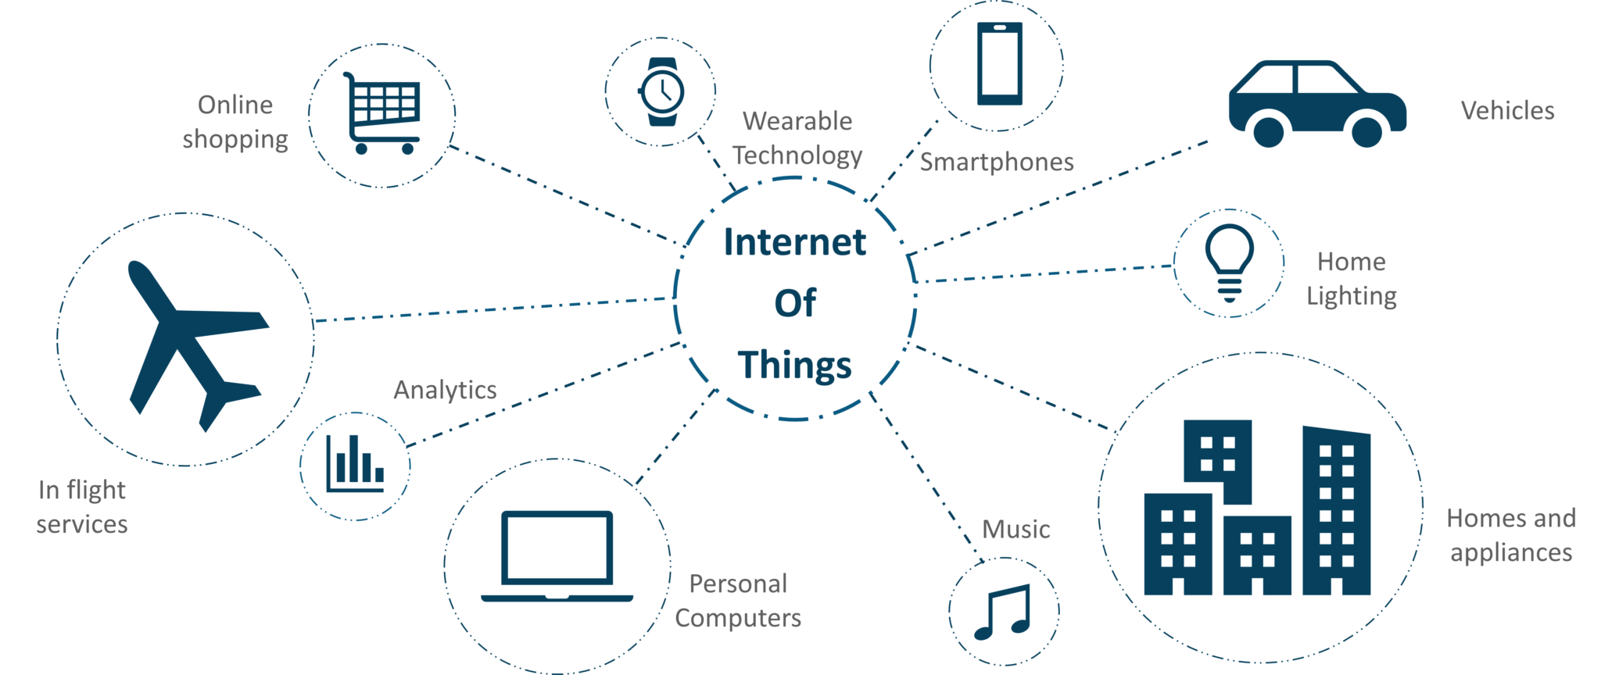
IoT
(Internet of Things)

Slide 2
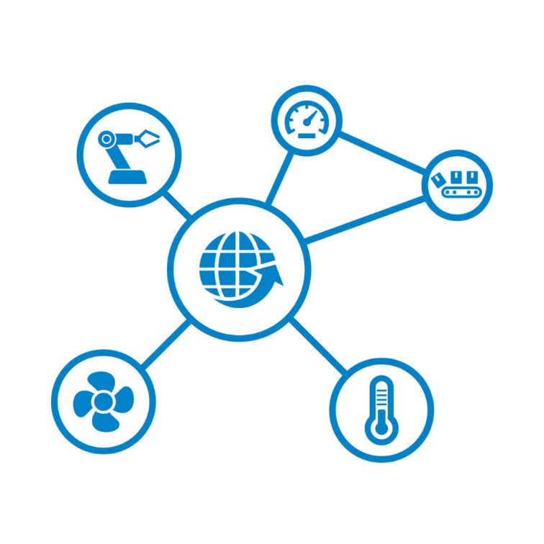
What is the Internet of Things?
The Internet of Things, or IoT, refers to the billions of physical devices around the world that are now connected to the internet, all collecting and sharing data.
Connecting up all these different objects and adding sensors to them adds a level of digital intelligence to devices that would be otherwise dumb, enabling them to communicate real-time data without involving a human being.

Slide 3
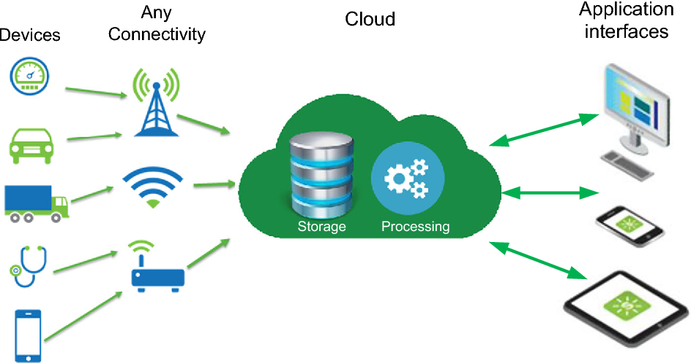
Why Physical Devices are Connected To Internet ?

Slide 4
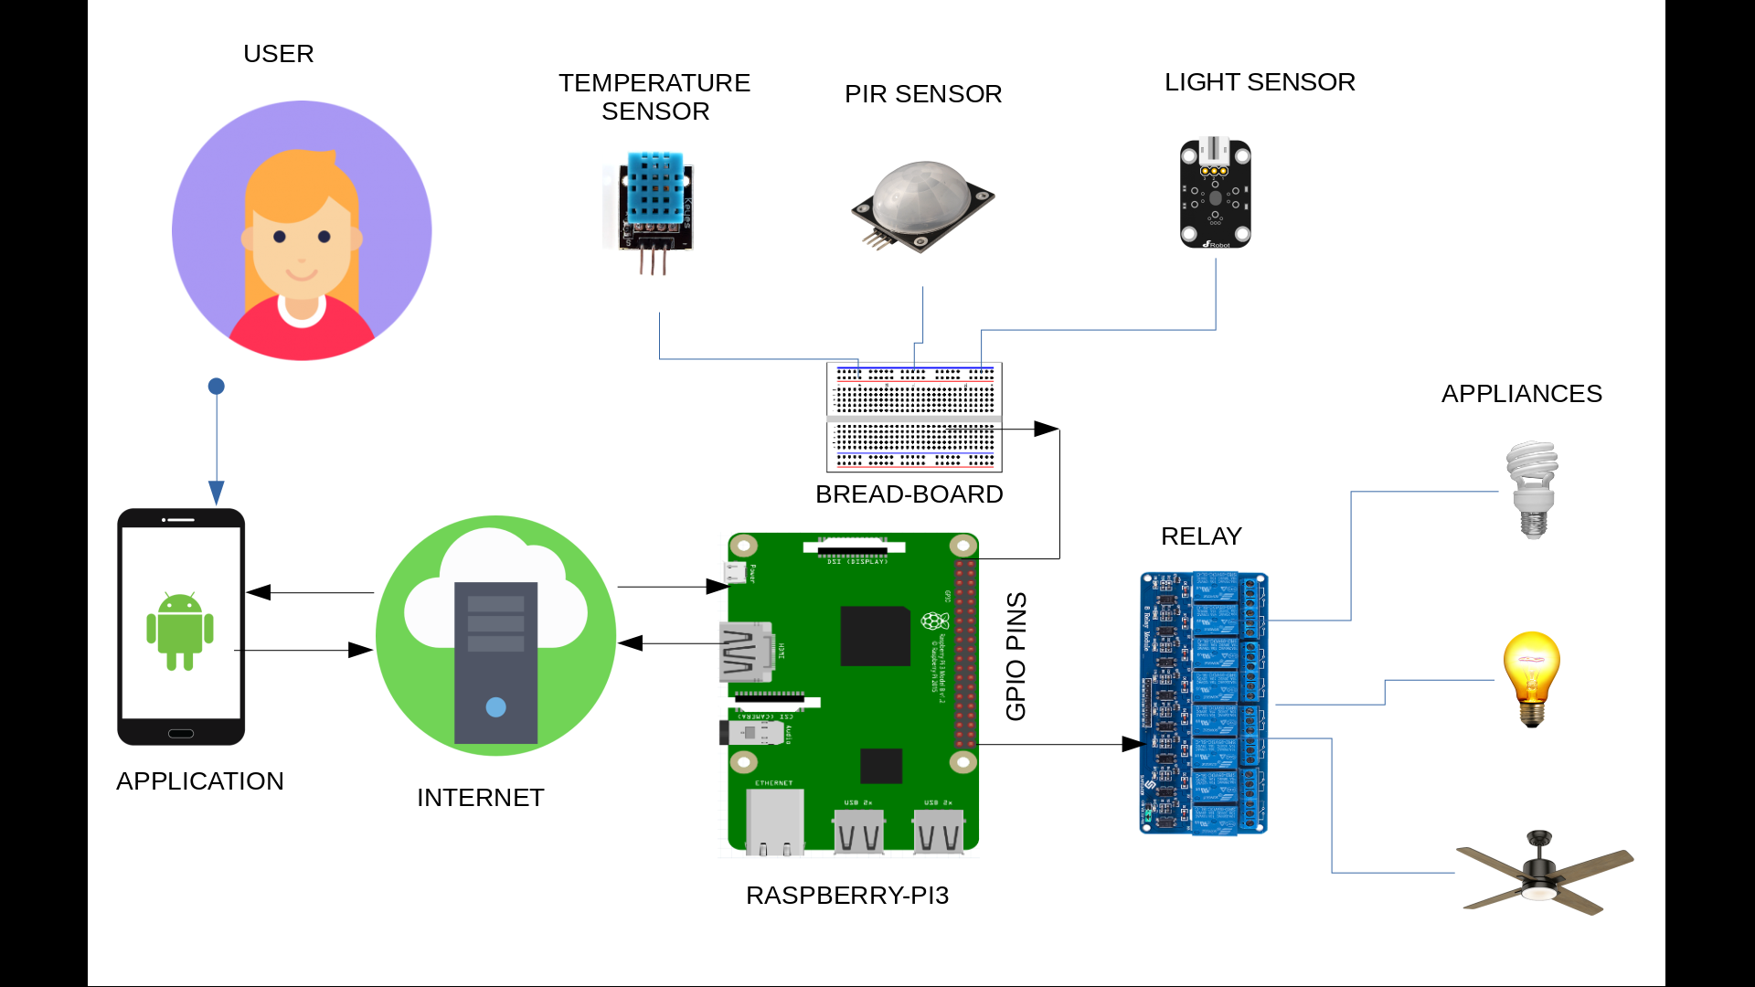

Slide 5
How industries use IoT technology ?
Production flow monitoring
IoT in manufacturing can enable the monitoring of production lines starting from the refining process down to the packaging of final products. This complete monitoring of the process in (near) real-time provides scope to recommend adjustments in operations for better management of operational cost. Moreover, the close monitoring highlights lags in production thus eliminating wastes and unnecessary work in progress inventory.
2. Quality control
IoT sensors collect aggregate product data and other third-party syndicated data from various stages of a product cycle. This data relates to the composition of raw materials used, temperature and working environment, wastes, the impact of transportation etc. on the final products. Moreover, if used in the final product, the IoT device can provide data about the customer sentiments on using the product. All of these inputs can later be analyzed to identify and correct quality issues.

Slide 6
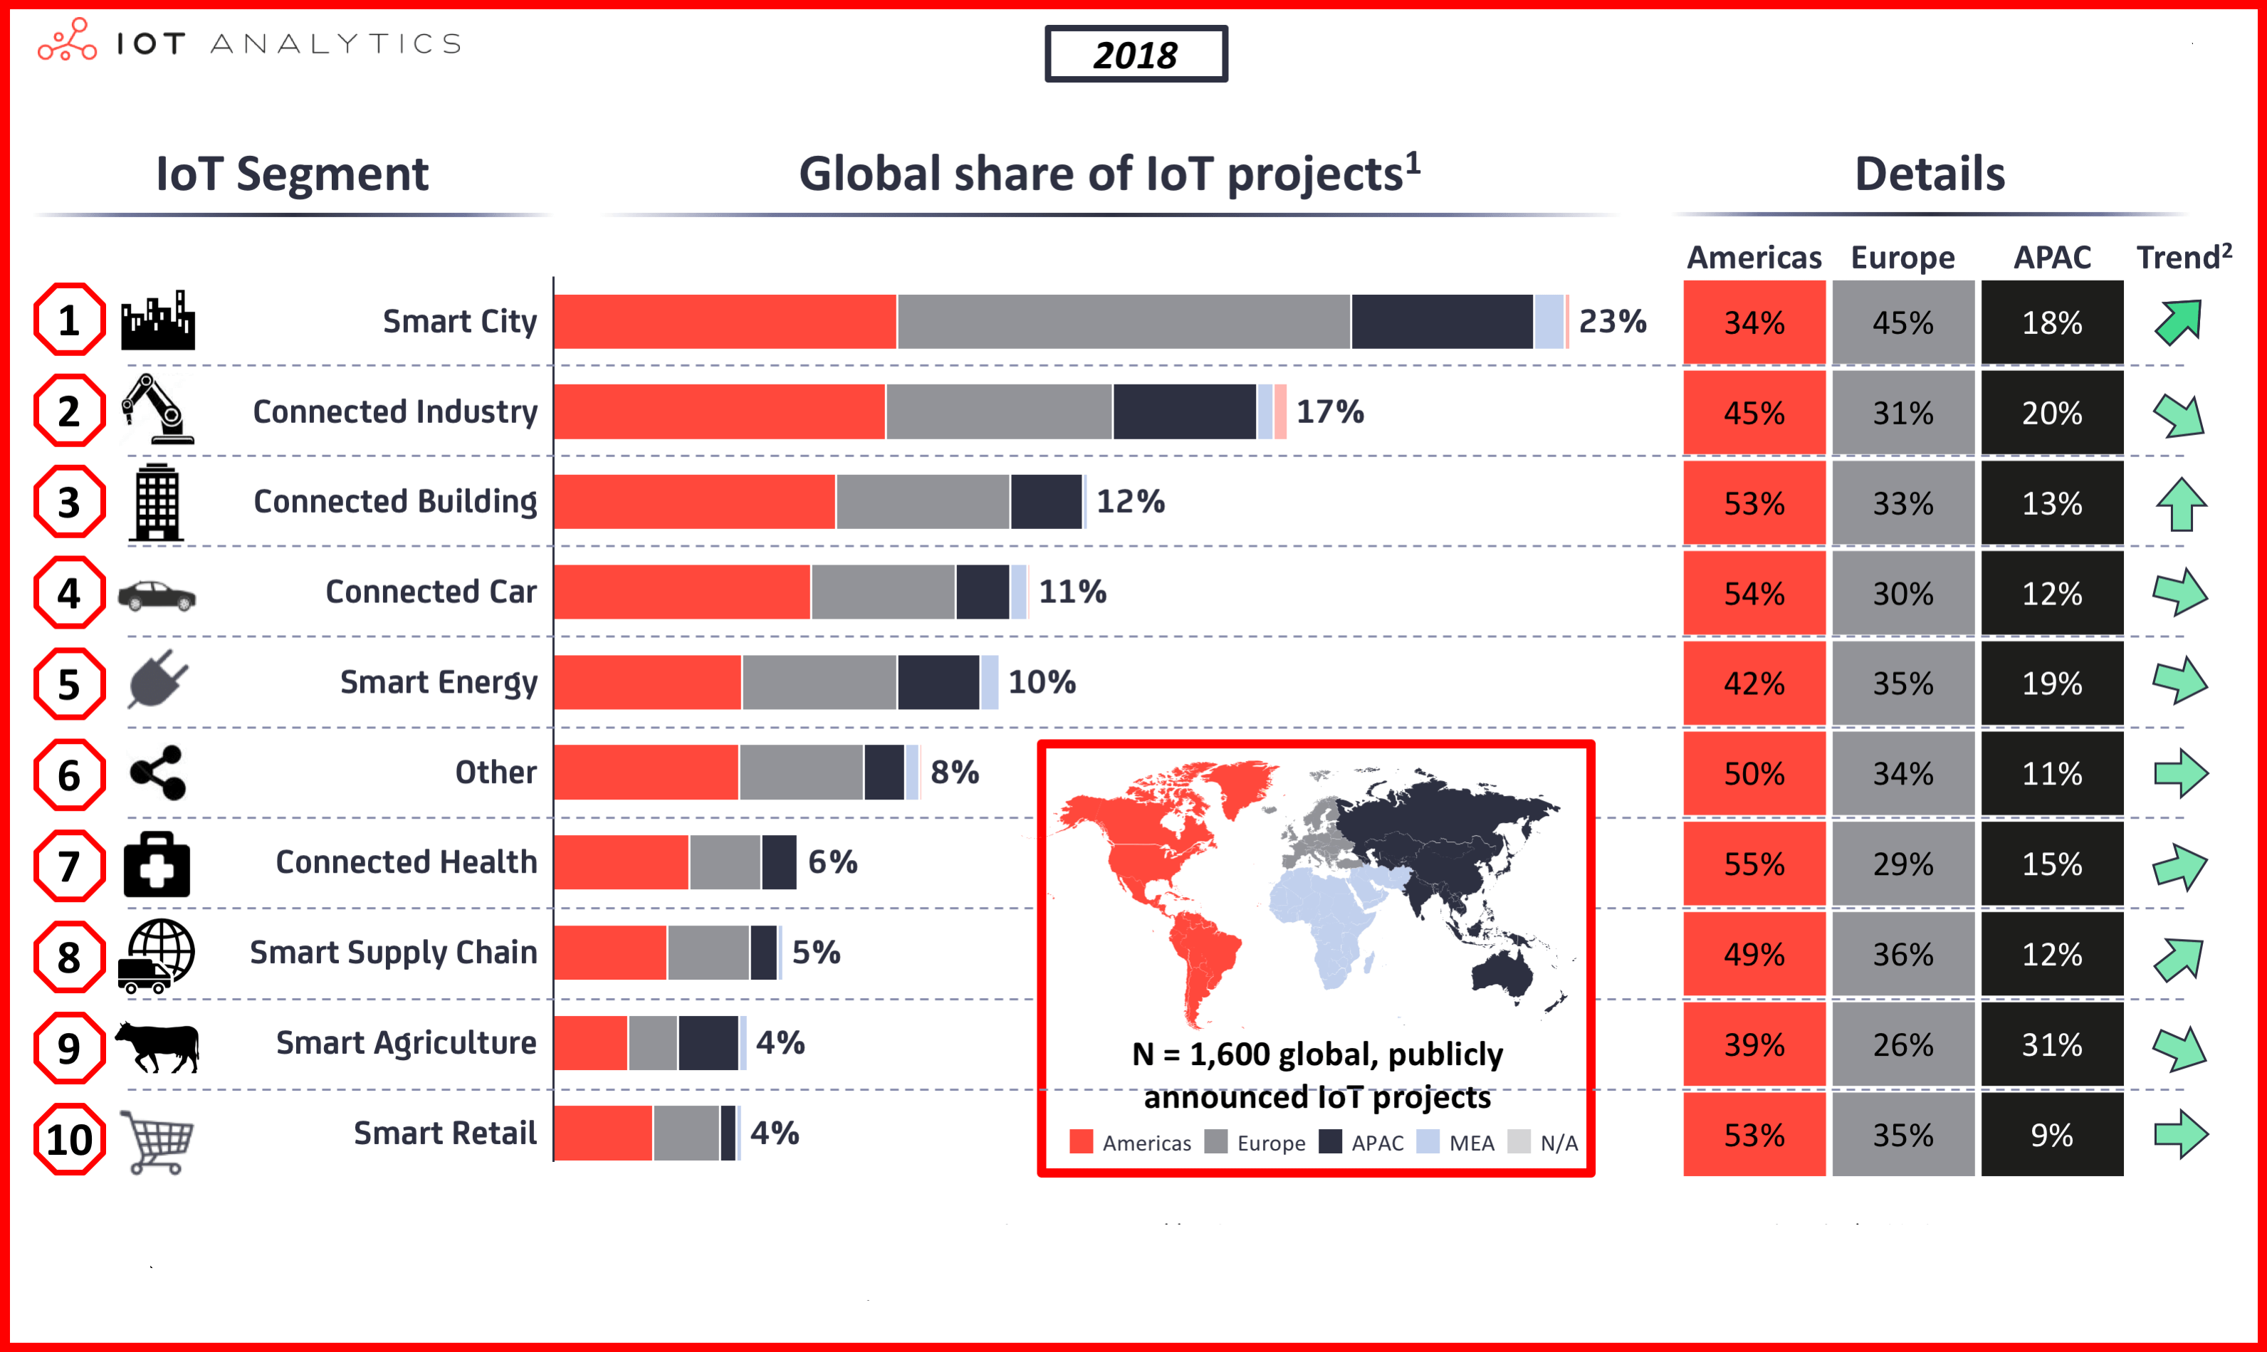

Slide 7
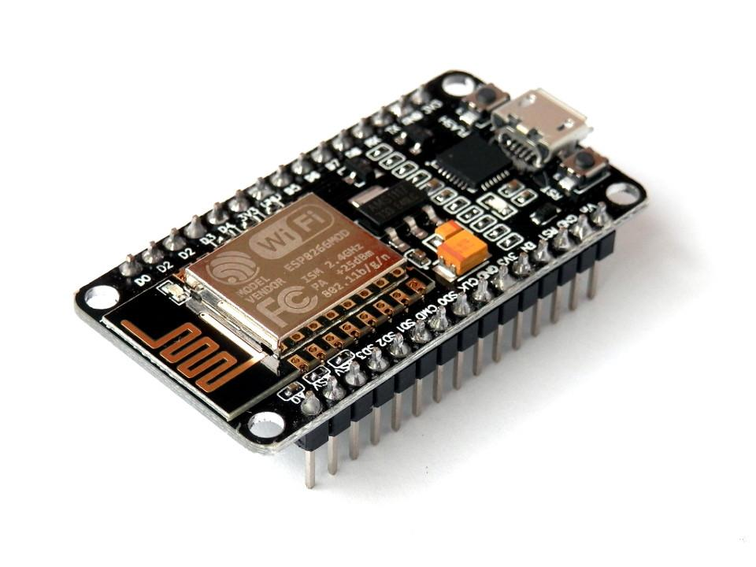
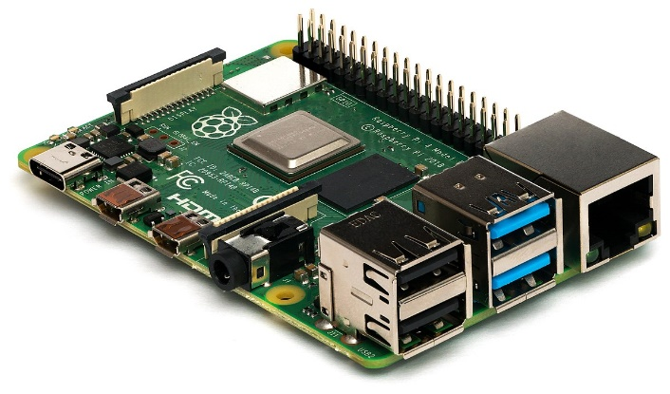


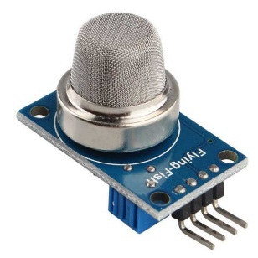
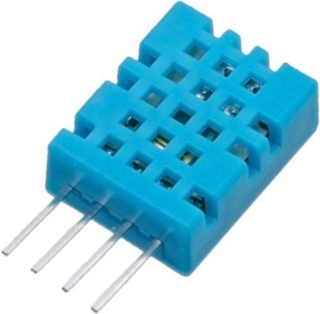
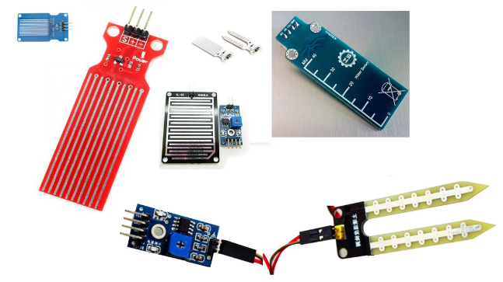

How to make simple own IoT device ?
Router
Raspberry Pie
ESP8266 Nodemcu
Cloud
Sensors (Gas , Temperature , Soil Moisture)
Mobile or Web App

Slide 8
Thank You !

