Slide 1

Online Courier Service System
Ruzaik Mohomad

Slide 2




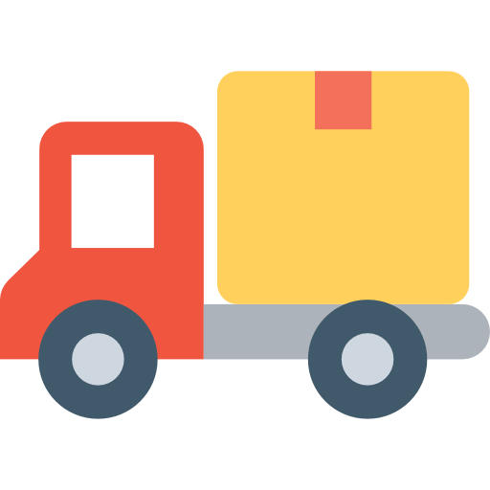
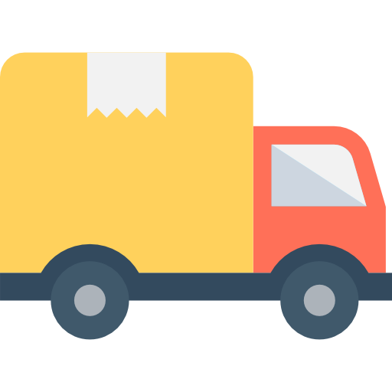

How Online Courier System Works ?
1 .Add Courier Request
(Web Application)
2. Collect Delivery Items
3. Delivered to Destination
(Address)

Slide 3
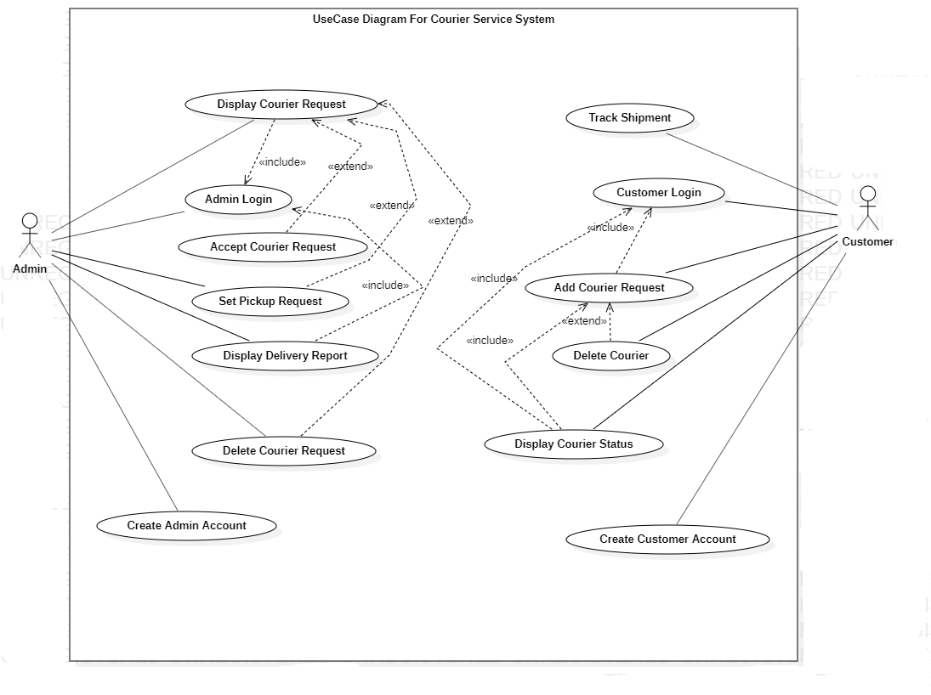

Slide 4
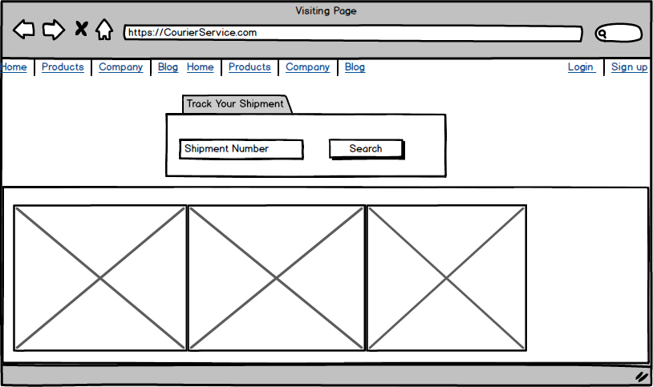
Visiting Page

Slide 5
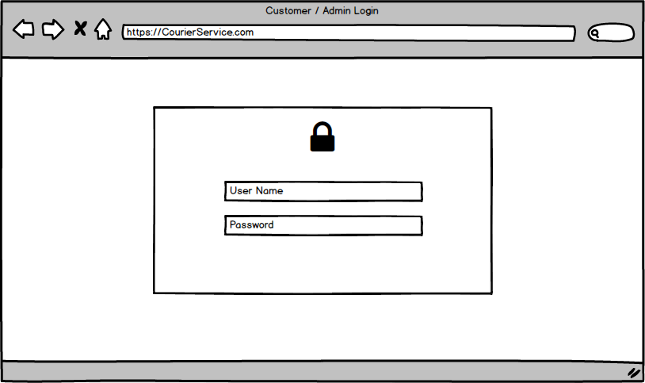
User Interfaces (UI)
Admin / Customer Login

Slide 6
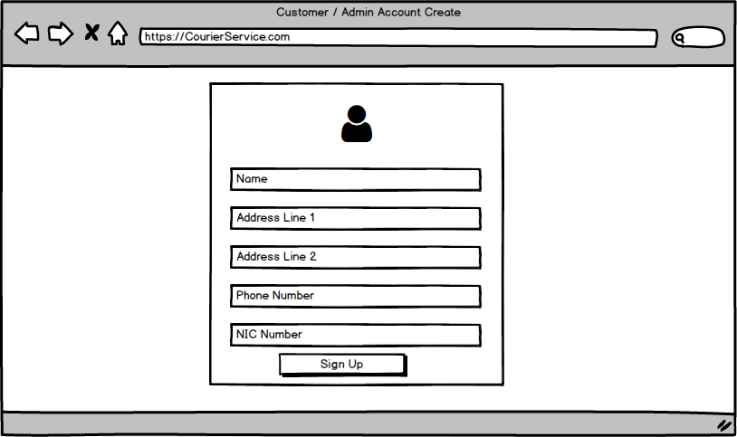
Admin / Customer Account Create (Sign up)

Slide 7
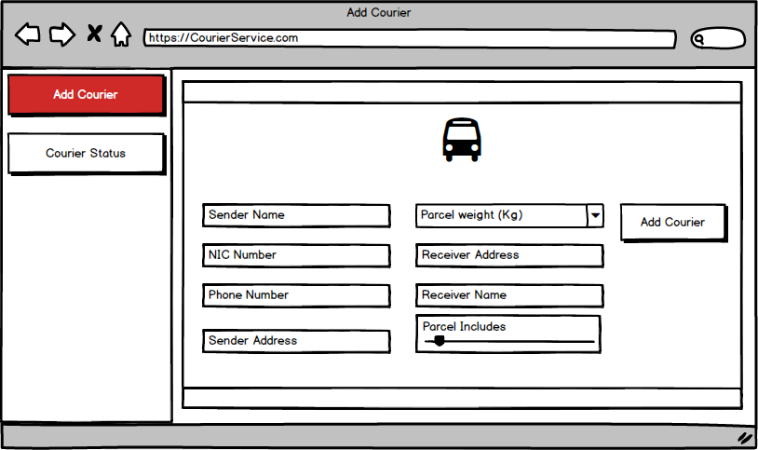
Add Courier (Customer)

Slide 8
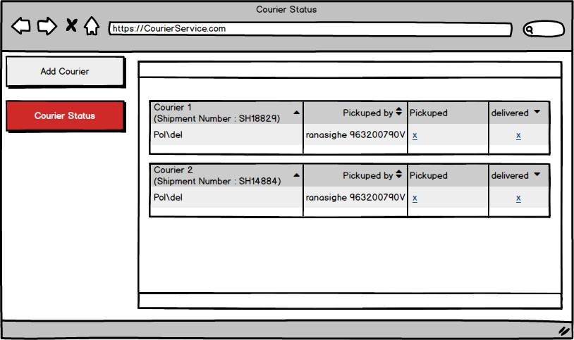
Courier Status (Customer)

Slide 9
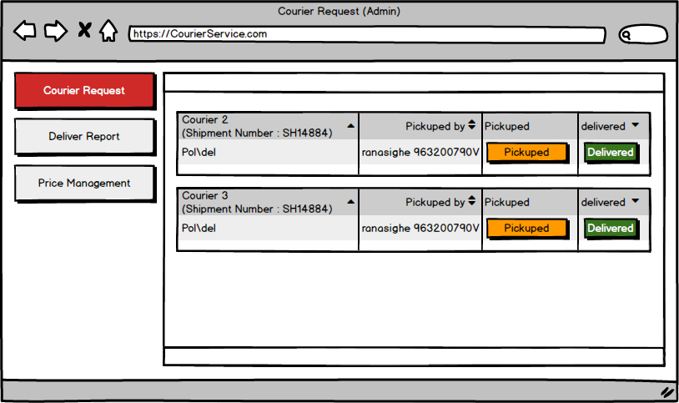
Courier Requests (Admin)

Slide 10
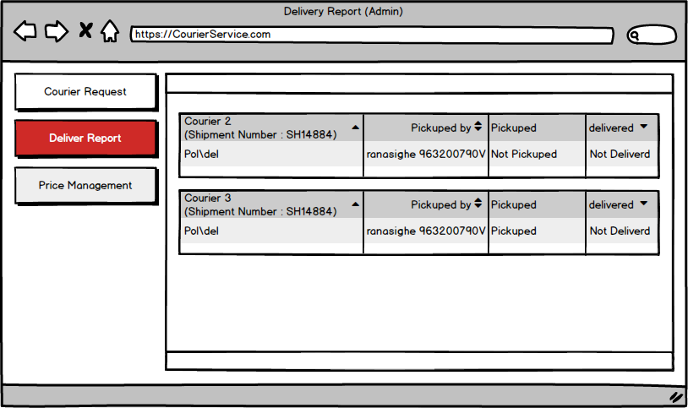
Delivery Report (Admin)

Slide 11
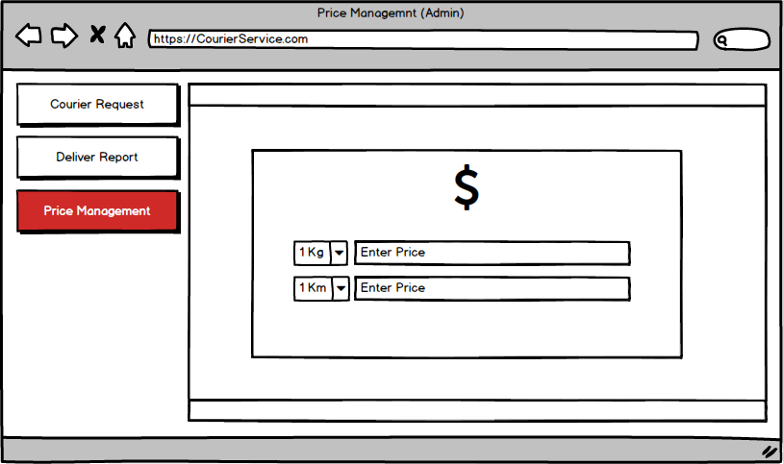
Price Management (Admin)

Slide 12
Development Technologies
Front End
Angular 7
Back End
Spring Boot

Slide 13

Backend Services
2. Courier Service
1. Customer Account Service
Customer Login
Customer Account Creation
Track Shipment
Add Courier Request
Courier Status
Courier Request
Deliver Report
Discovery Service
3. Price Control Service
4. Admin Account Service
Price Management
Admin Login
Admin Account Creation

Slide 14




Web Application (Angular 7)
HTTP
Customer Account
Courier Service
Price Management
Admin Account
Discover Service
HTTP

