Slide 1
Multi-dimensional Analysis of Complex Networks for Covid-19
22S151142-李泽林
22S151072-石潇丽
22S151058-宁振华
22S151085-唐振宇
22/10/20

Slide 2
Current Situation in China
1、The Trends of Covid-19 after 22/10/01
2、Calculate & Formula Derivation
3、Result of 7 days Iteration

Slide 3
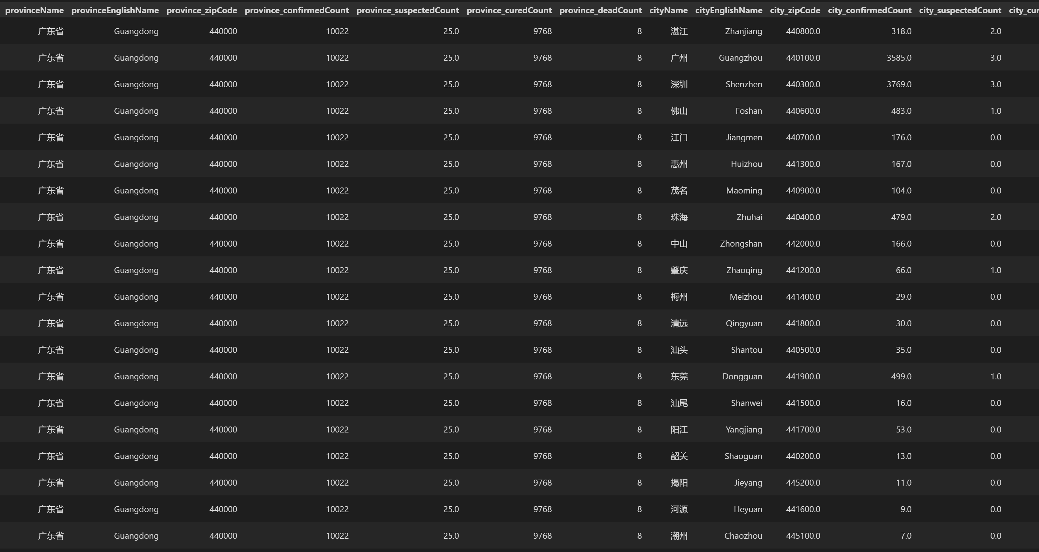
Detailed Data from Github
Data from https://github.com/BlankerL/DXY-COVID-19-Data
Province, City, Confirmed, Suspected, Cured …

Slide 4
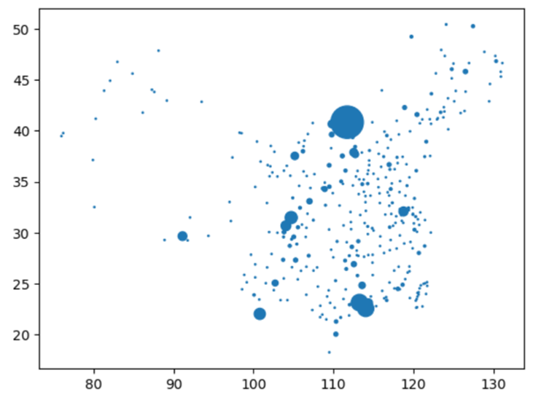
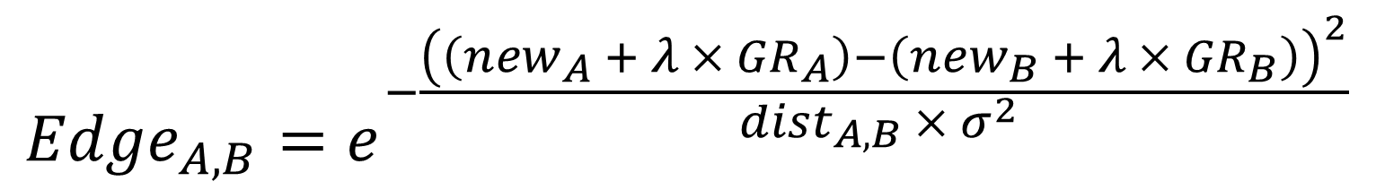
The Trends of Covid-19 after 22/10/01
Node: Every city in China
Size: New confirmed cases
Edge: The similarity of cities
GR = Growth Rate
Edges?
$${{Edge}_{A,B}=e}^{−\frac{{\left(\left({new}_{A} + {λ × GR}_{A}\right)−\left({new}_{B} + λ × {GR}_{B}\right)\right)}^{2}}{{dist}_{A,B} × σ^{2} }}$$

Slide 5
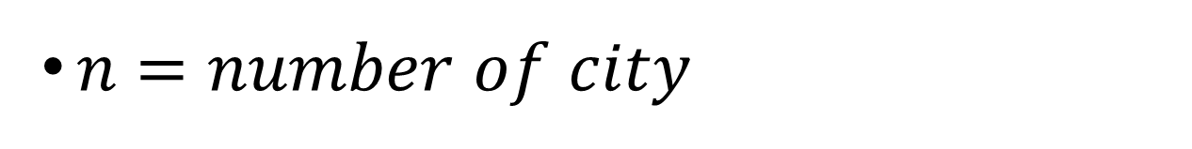
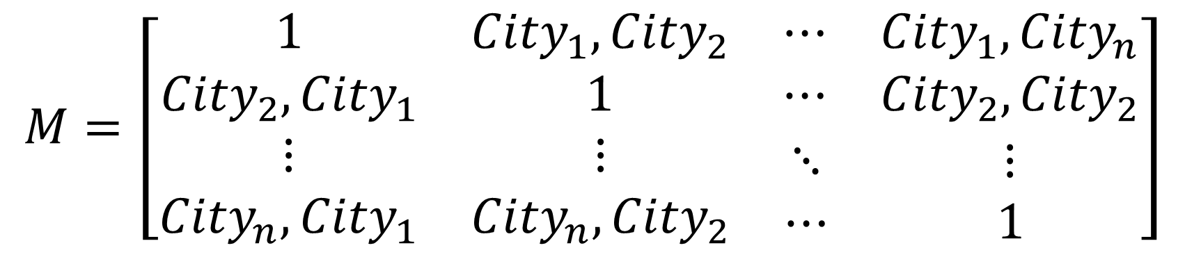
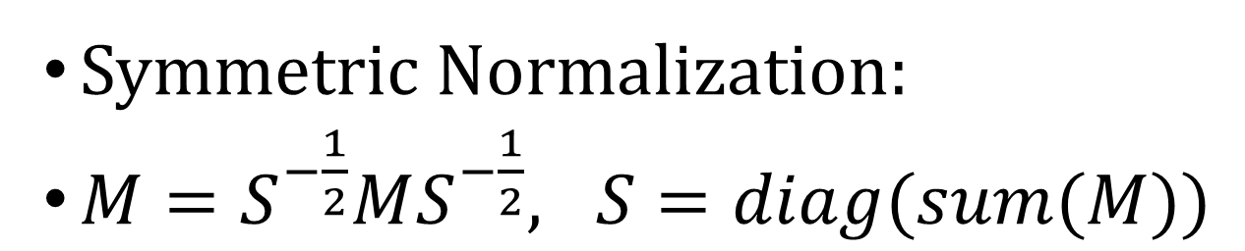
Calculate & Formula Derivation
$similarity matrix M∈ R^{n × n},$
$$M=\left[\begin{matrix}\begin{matrix}1 & {City}_{1},{City}_{2} \\ {City}_{2},{City}_{1} & 1\end{matrix} & \begin{matrix}⋯ & {City}_{1},{City}_{n} \\ ⋯ & {City}_{2},{City}_{2}\end{matrix} \\ \begin{matrix}⋮ & ⋮ \\ {City}_{n},{City}_{1} & {City}_{n},{City}_{2}\end{matrix} & \begin{matrix}⋱ & ⋮ \\ ⋯ & 1 \end{matrix}\end{matrix}\right]$$
𝑛 $=$ 𝑛𝑢𝑚𝑏𝑒𝑟 𝑜𝑓 𝑐𝑖𝑡𝑦
Symmetric Normalization:
$M=S^{−\frac{1}{2}}MS^{−\frac{1}{2}}, S=diag(sum(M))$

Slide 6
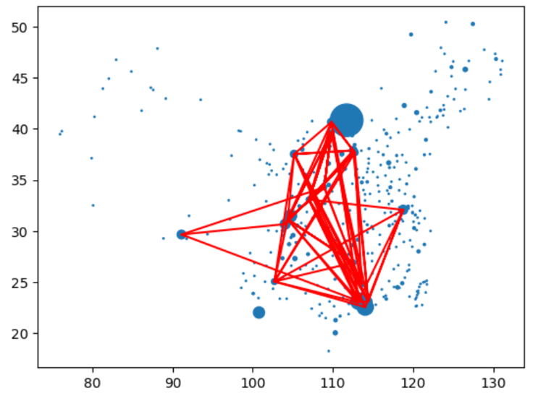
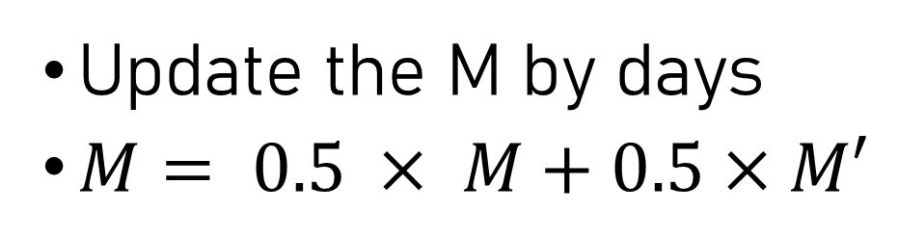
First similarity calculation & shows high relative edges
Update the M by days
$M= 0.5 × M+0.5×M′$
Shenzhen and Guangzhou (big population cities) seem to be more similar
Edges of Complex Network are heterogeneous

Slide 7
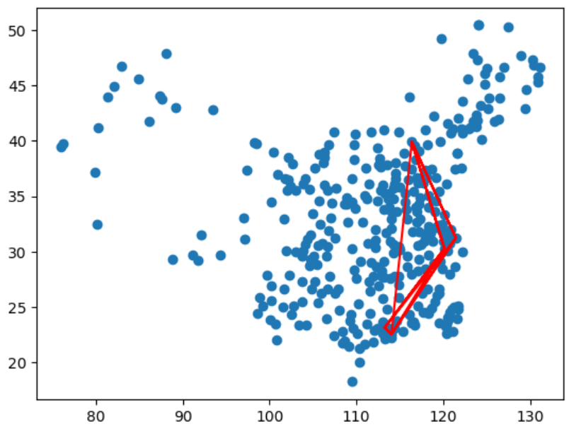
Result of 7 days Iteration
Edges show the highly similar cities during these days.
Top cities like BJ, SH, SZ, HZ owns high population movement.

Slide 8
Future works
Using classical algorithms such as Conditional Random Field (CRF) to predict the risk of outbreaks in cities
Choose a more proper way to visualize the Nodes & Edges
Broaden the analysis to the specific country or other continents
Edges?

Slide 9
Current Situation in World
1、Correlations between Confirmed and Deaths
2、22 Representative Countries & K-means Clustering
3、Mapping to The World Map

Slide 10
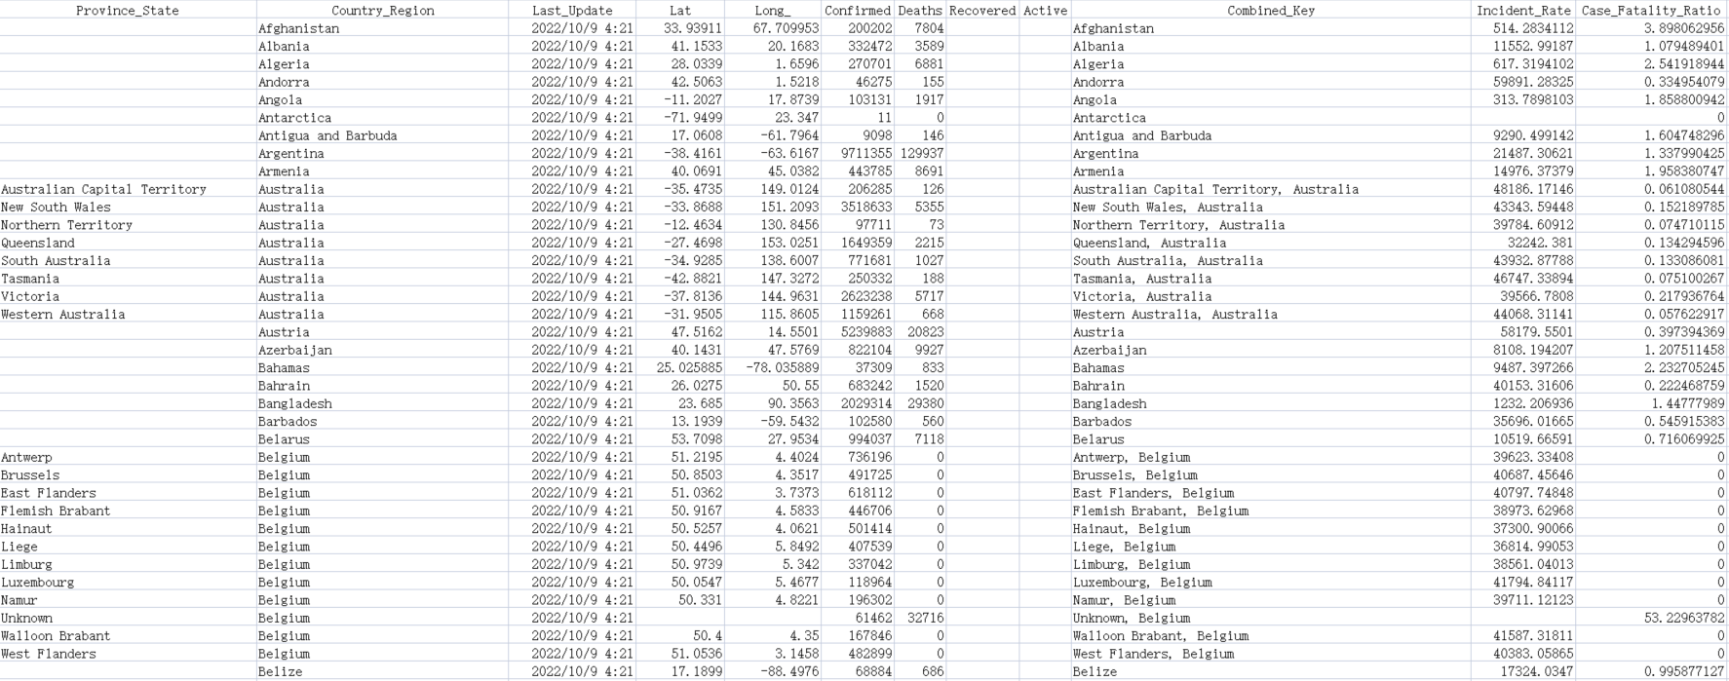

Data from Professional Institutions
https://github.com/CSSEGISandData/COVID-19
https://zh.wikipedia.org/wiki/各国家和地区人口列表

Slide 11
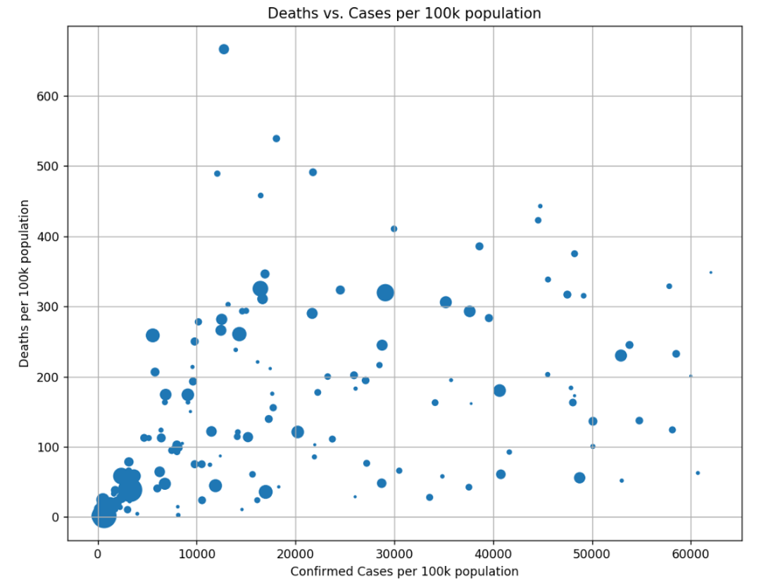
Correlations between Confirmed and Deaths
Use Confirmed cases rate and Deaths rate as indicators to analyze the correlation of outbreaks across countries (before 2022/10/09)
Countries with large population and with smaller population have smaller Confirmed and Deaths, which means better control of the epidemic.
Most of the other countries are evenly distributed, with only a few countries having disproportionately high Confirmed and Deaths.

Slide 12
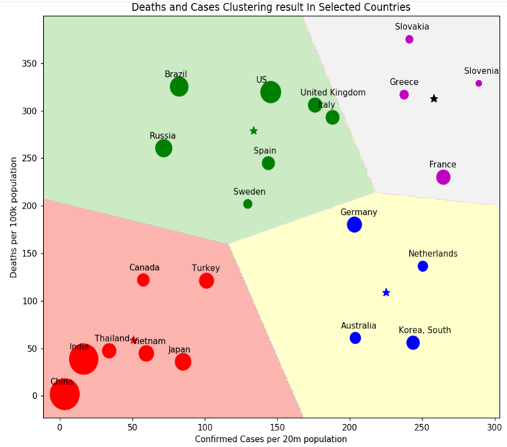
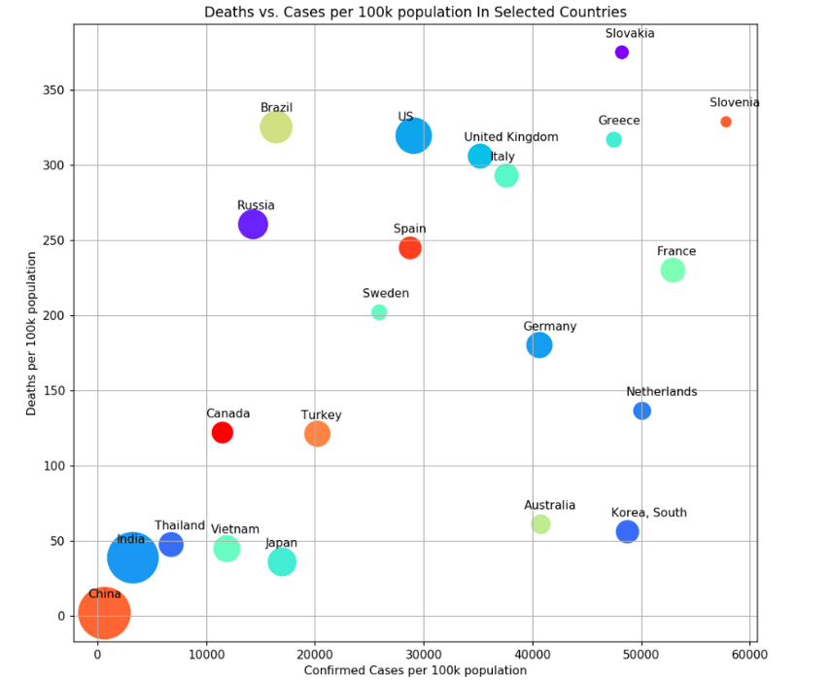
22 Representative Countries & K-means Clustering
All countries will contain more noise and redundancy, especially for small country.
We manually select 22 Representative countries.
Using K-means Clustering to find the relationship.
These countries can be divided to exactly four types

Slide 13
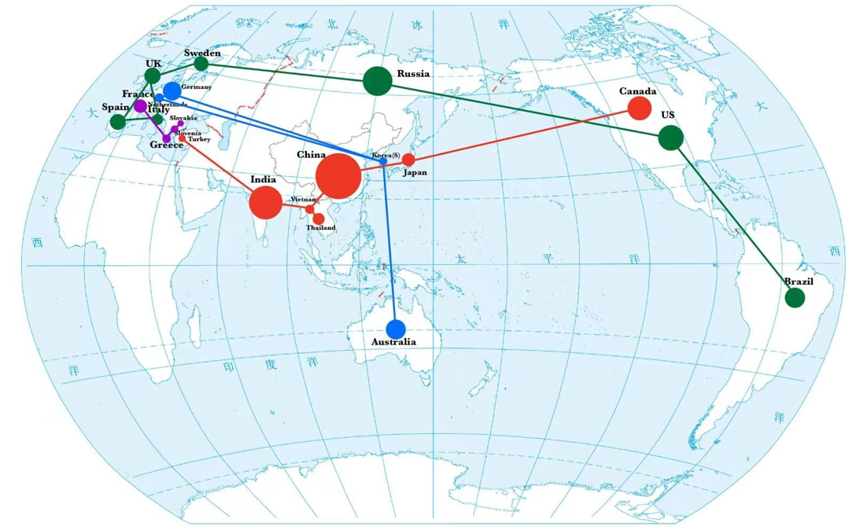
Mapping to The World Map
low-low are mainly located in Southeast Asia.
low-high are mainly located in Western Europe.
high-high are mainly located near the Middle East.
high-low are widely distributed and not concentrated.
Each type has the far away countries, the result may be relevant with politics, policies and medical & financial strength.

Slide 14
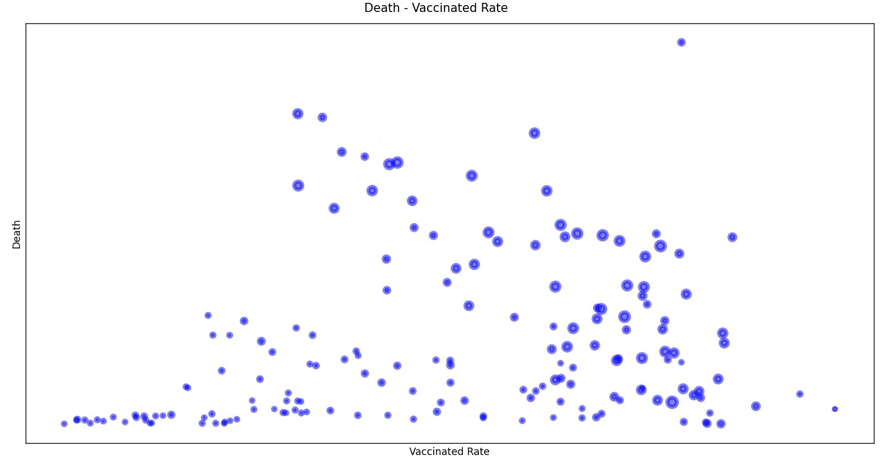
Death number & Vaccinated Rate
Node: Every Country
Size: People Over 70
Except from the small countries, higher Vaccinated Rate brings lower Death
Comparison between more old people with less, Death rises up more quickly with less Vaccinated Rate

Slide 15
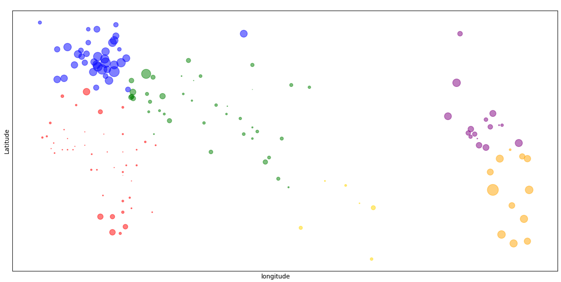
Death of people from different continents
In Europe more people die much and concentrated, while South America and North America die much but not concentrated
Asia, Africa, Australia died not so many people

Slide 16
How to Handle with Epidemics
1、Add some functions to satisfy the demands
2、Update some functions to satisfy the demands
3、Modify some functions to quicken the process speed

Slide 17
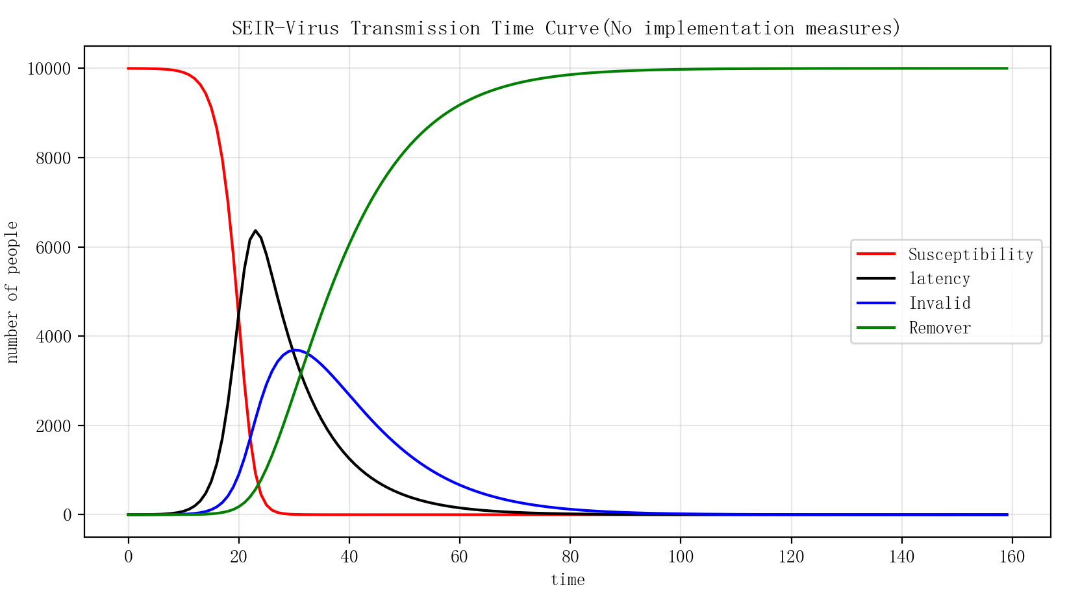
SEIR Models

Slide 18
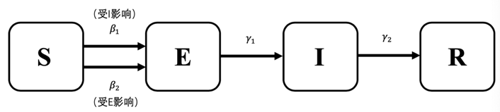
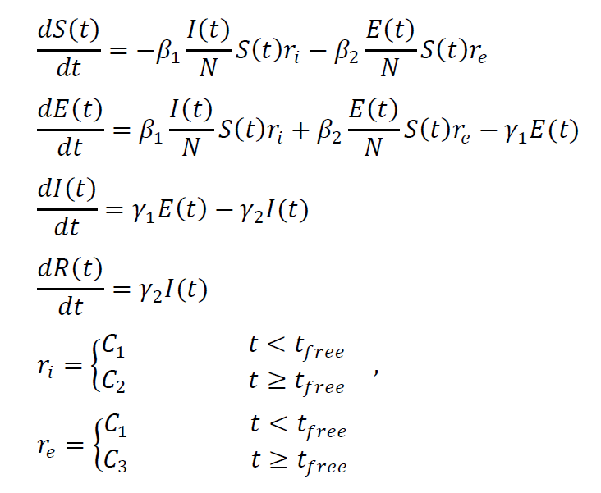
Partial Differential Equations

Slide 19
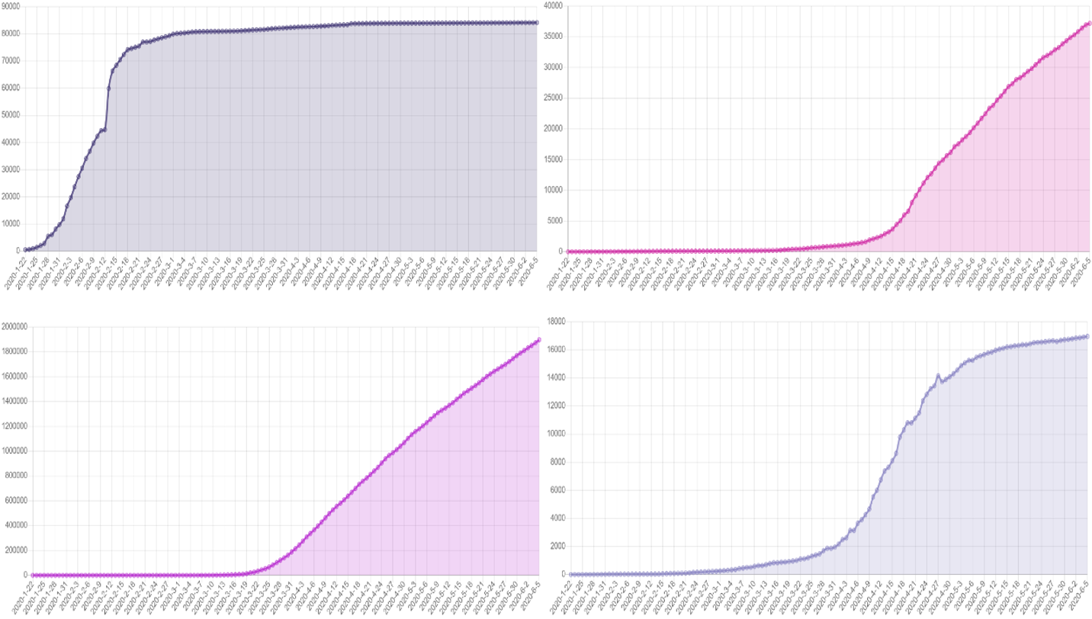
Total Cases in China, Singapore, US, Japan
Choose 4 representative countries, China, Singapore, US, Japan, as the initial outbreak indicators as of 5 June 2020.
With widely varying epidemic control strategies, their analysis can more visually highlight the impact of epidemic control strategies

Slide 20
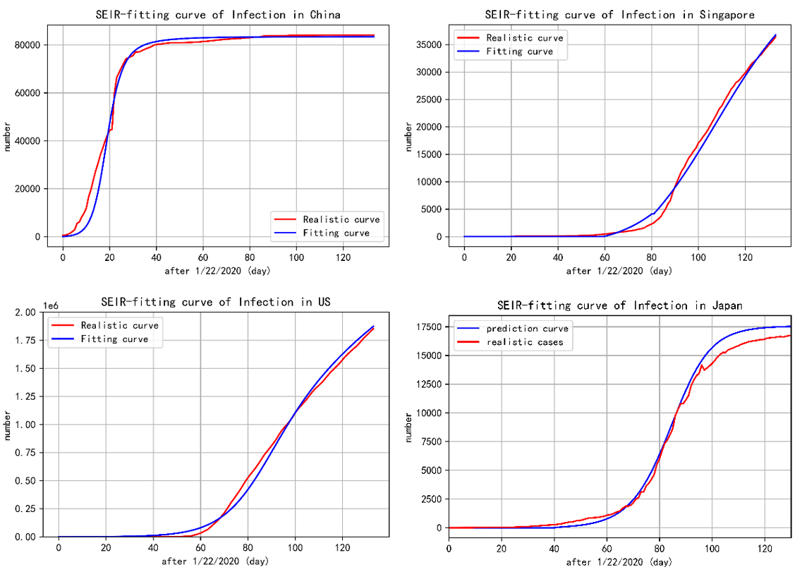
Fitting Curve for each country
By fitting the realistic curve, we got the parameters of each country which represents their performance of epidemic control strategy for analysis.

Slide 21
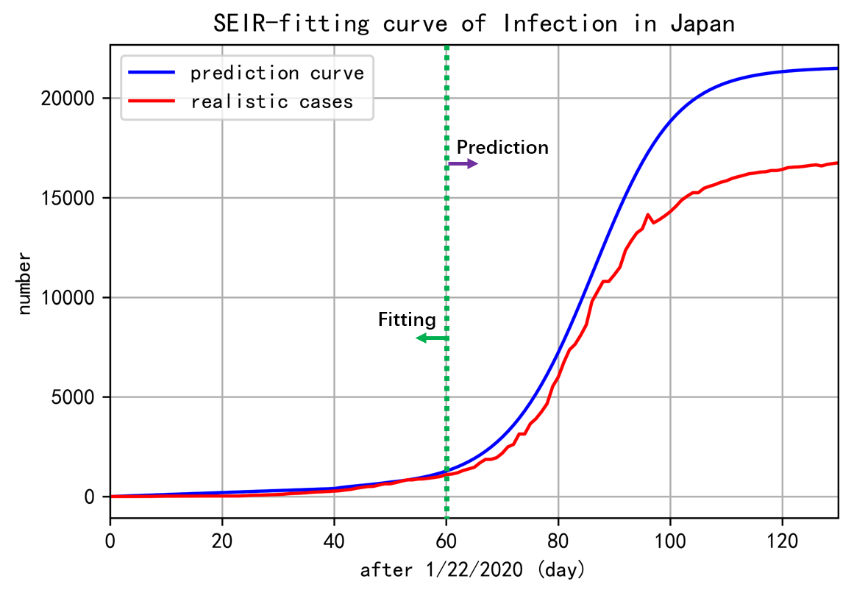
Early 60 days for Prediction # Reality
60 days after: with the help of other counties
International delivery of medical supplies and countries working together to fight against Covid-19

Slide 22
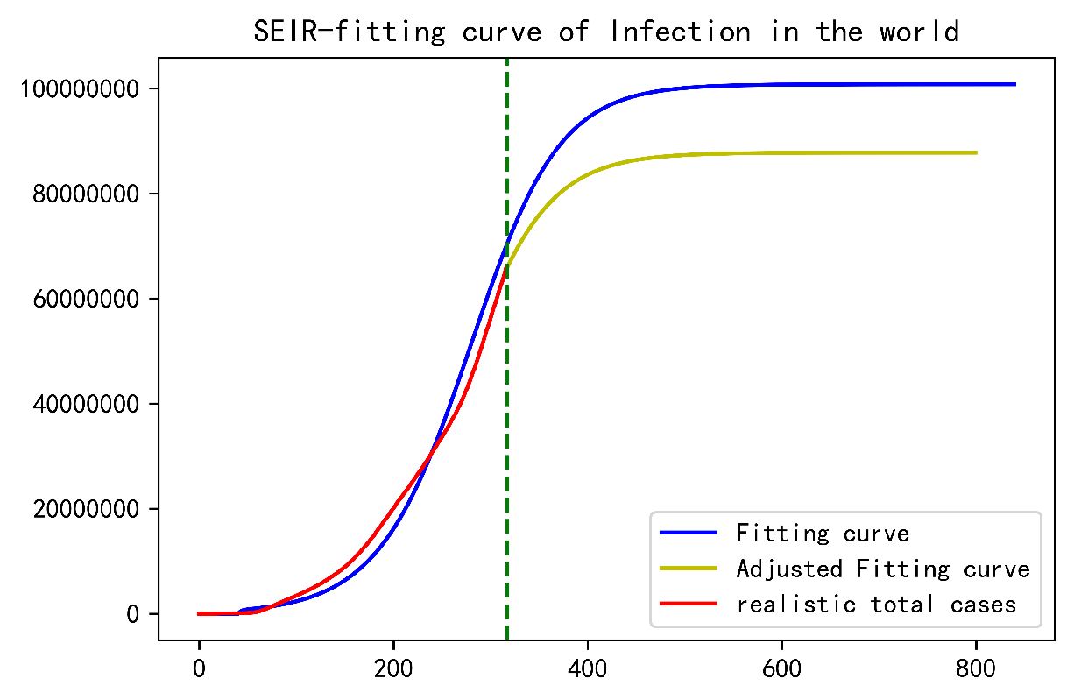
What if every country be like China?
Reduce the stable time from 500 days to 400 days.
It’s just a simple Qualitative Analysis for what if, showing the conclusion that epidemic control strategy should follow CHINA

Slide 23
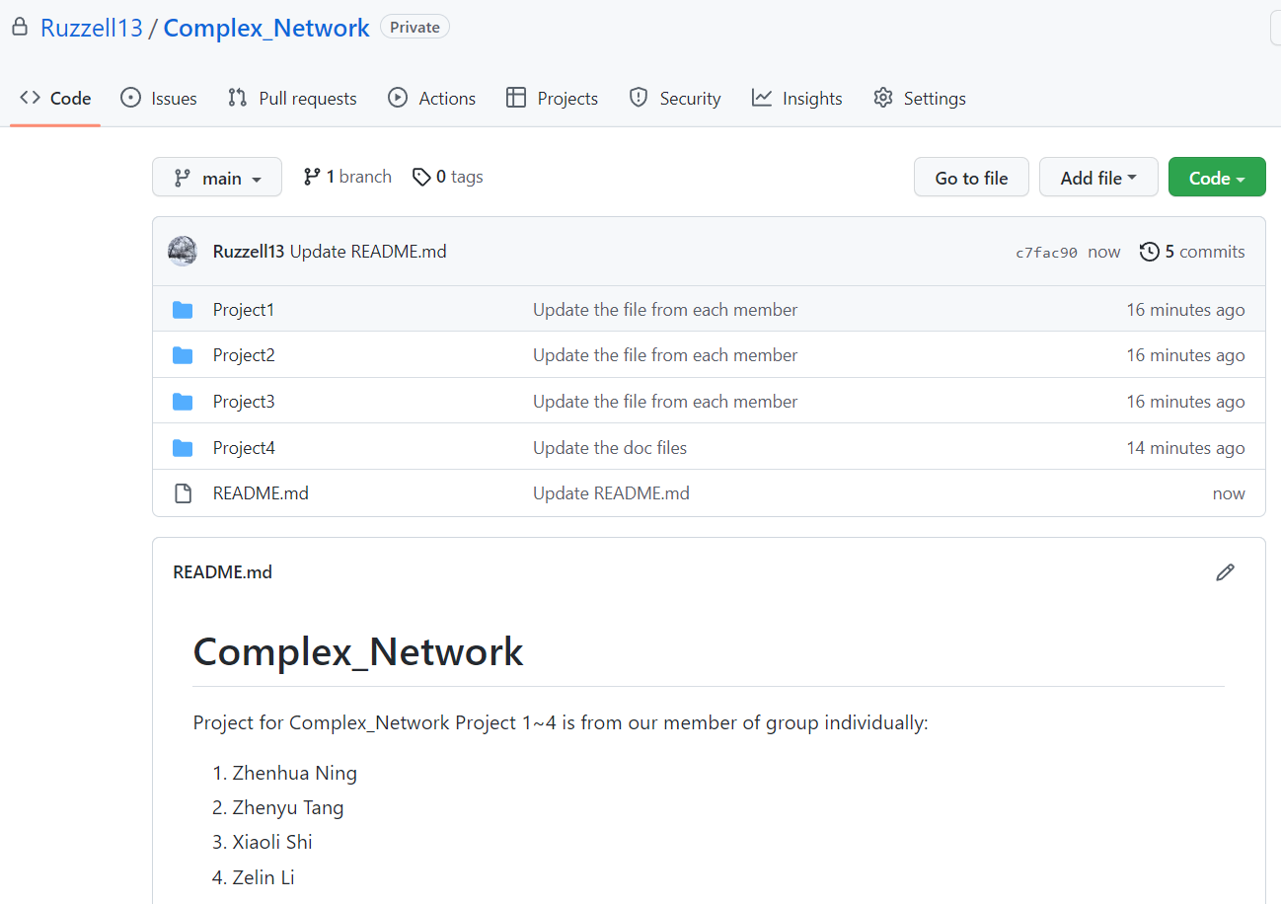
Shared on the Github & Welcome Communications~
Ruzzell13/Complex_Network: Project for Complex_Network (github.com)

Slide 24
Thanks
22S151142-李泽林
22S151072-石潇丽
22S151058-宁振华
22S151085-唐振宇
22/10/20

