Slide 1

Linked list
Presented by: ROthmel Fortune II

Slide 2

What is a linked list?
It is a linked list is a linear data structure consisting of multiple elements (nodes) that each contain a data field and a pointer (reference) to the next element.

Slide 3
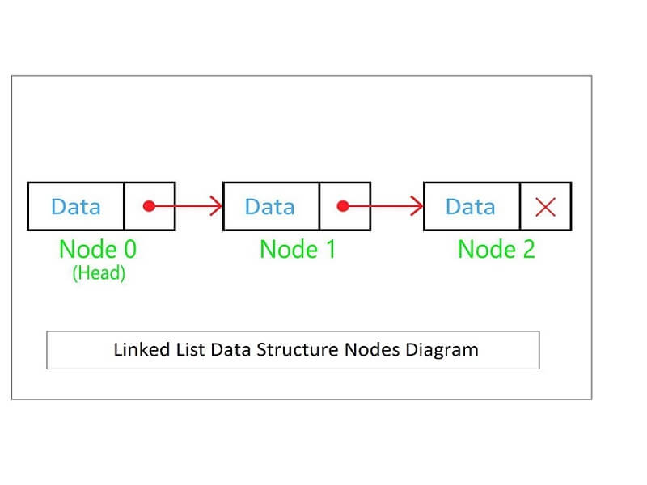
Node Structure

Slide 4
'Insert'

Slide 5
Insert at tail
Insert at index

Slide 6
Delete
Update

Slide 7
Get

Slide 8
The results

