Slide 1
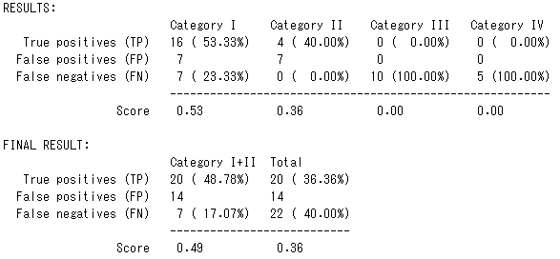

Licence Plate Recognition
Title
Tomas Heinsohn Huala 4xxxxxx
Remi van der Laan 4326156
Next iteration
Text
Text output
We improved the accuracy of the license plates shown in the table by counting which license plates are recognized more frequently. If the difference between a new recognized license plate has 3 or more characters different, then we assume it’s a new license plate.
Here is how the table looks like at the moment, it’s a lot cleaner:
<table>
Now we were also able to compare our solution with the answers:
<grade>
We almost have a sufficient grade for the first two categories. We lost a lot of points because the dashes are often are misplaced, but we have a good idea of how to fix this.
Title
Text

