Slide 1
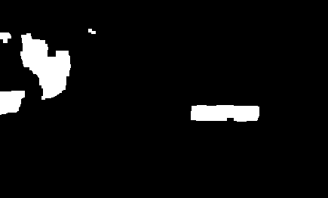
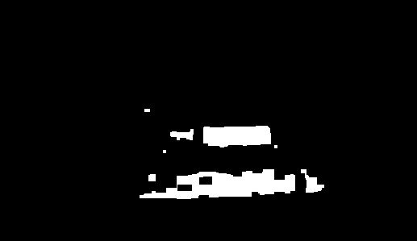
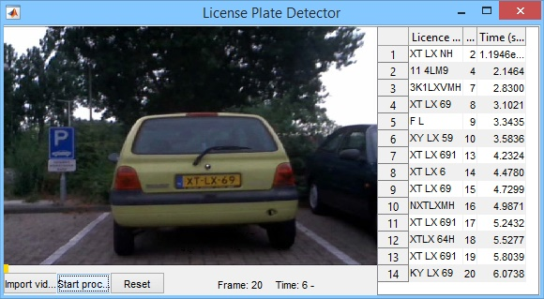
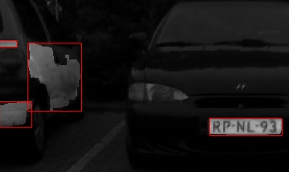
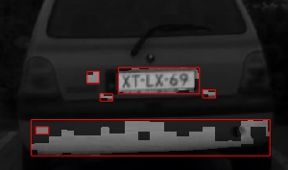
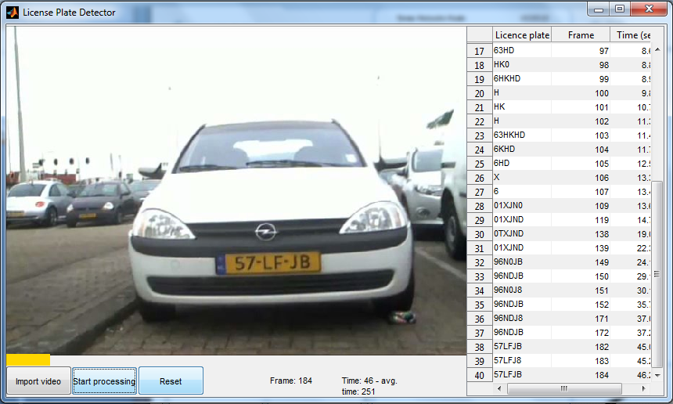


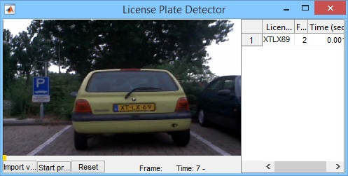

License Plate Recognition
This iteration
Group: 9
Tomas Heinsohn Huala 4326318
Remi van der Laan 4326156
Segmentation
With the short break we managed to do some extra things. We changed the GUI and we began with the recognition system. For this we used OCR (Optical character recognition) and we began to segment the license plate from the picture to read every character. As a result of that we are now able to detect the license plates and write down the licenses. There are only some problems with this, for example it write down a lot licenses and these we all different. An other problem was that in one case it is able to read something at all and then the system crashes. This error is made by our implementation of our OCR-function.
OCR
We improved our segmentation algorithm in a few different ways. Here are the steps in which we currently segment every frame:
We segment the image by only selecting the yellow colors and then open and close the image to remove small objects and to fill gaps:
Then we label the image and calculate the area and bounding box for each object.
We then loop through every object , starting with the largest area, and check if its bounding box has an aspect ratio similar to a license plate.
Once we find an object which meets that condition, we stop the loop, crop the area of the original frame in the bounding box , threshold it with its mean value and pass it on to our OCR function.
After the license plate segmentation was complete, we tried to use OCR (Optical Character Recognition) to recognize the characters on the license plate. At first, we used the built-in OCR function of MatLab which we managed to get working, but it was very slow. Here are some results (if the result is the same as the previous one, it’s not added):
In many cases the result was incorrect, so we started thinking about other OCR methods. We now use a library of every possible character on Dutch license plates and find the highest correlation between every object found in the license plate and every character from our library. These are the characters we use:
After we managed to get it working, the results were surprisingly good but it wasn’t a whole lot faster:
For this car, it found the same result for every frame. In some cases however, this method does not work very well because the segmentation is not good, which we will explain further in the next section.
This process is quite costly, mostly because we have to resize every character to the size of every object for every frame to calculate the correlation. This could be precomputed but we would have to have a library of every character in every size.
GUI
This is how our GUI look likes at the moment :
Now we have a import video button, a start processing button which changes in a pause button if pressed. And there is a reset button now. The GUI also contains a progress bar. This says something about how long the video remains. The list with the actual license plate is still the same. As you can see we are already reading and write down some license plates. Furthermore, the window of the GUI is now adjustable. Also if a license plate emerges a second in a row then the list wont show it. This is still something we have to work on cause if the detector sees 1 character different it prints it and then the actual license plate will be printed right after it.
This is an example of a correct result with its frame number and timestamp.
This is an example of and wrongly read license plate.
Title
Next iteration
We’re satisfied with the progress we made this iteration, and hope we will finish
product for the next iteration which will pass the first two categories.
Here are the tasks which we will focus on for the next iteration:
- Speed up the processing to play and process the video at the specified frame rate.
- Improve the segmentation algorithm to completely separate the characters from each other and the background.
- Find and correct the rotation of the video to improve the OCR algorithm.

