Slide 1

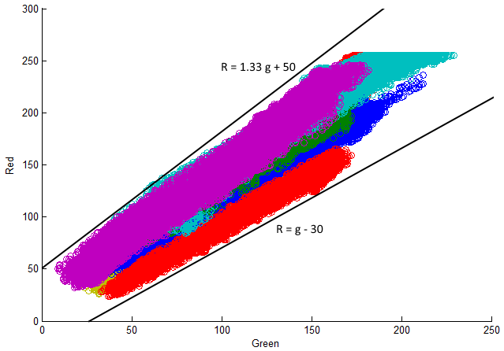
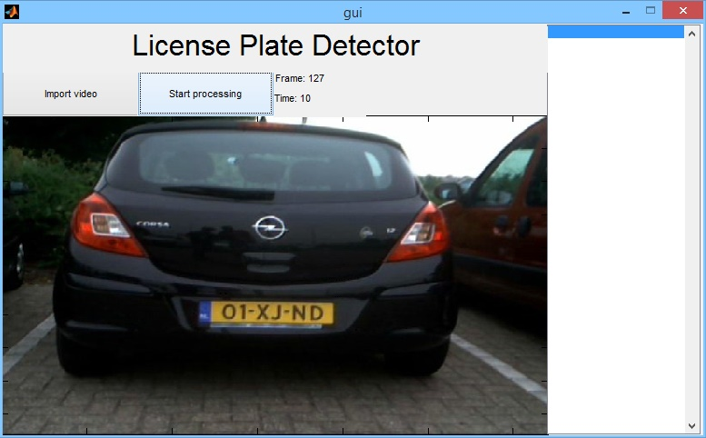

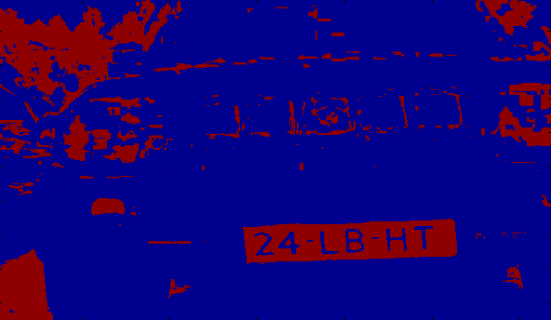

License Plate Recognition
Week 1
Introduction
Group 9:
Tomas Heinsohn Huala 4326318
Remi van der Laan 4326156
GUI
All those car drivers with their unregistered cars and all those uninsured cars, it should be stopped! We have the possibility to stop it and help the government. The solution is license plate recognition. Based on images we have the possibility to recognize license plates and to write those numbers down.
This is how a typically Dutch license plate looks like. Most of the time it is a yellow plate, but this is not always the case. There are also different kind of plates and there are also foreign license plates. Another problem is that those license plates will not always be that visible. This is an example of an different license plate.
Segmentation
The Graphical User Interface is important to let the user navigate efficiently through all the options our software has to offer. Up until this point we have implemented buttons to let the user import a video file and to start the video processing.
We also let the user know which frame is currently being processed and how long the processing took so far in total. The list on the right of the video does not currently have any function, but we will use it to display the recognized license plates in future versions.
We created the GUI with MatLab’s GUIDE tool which allows us to easily modify the GUI with very little effort. Here is a screenshot of our program for the first iteration:
The first step of recognizing the license plates is to remove the background of the image. We do this by creating graphs of the colors of license plates and looking where they are present in the red, green and blue channels. For every pair of two colors we created these graphs, here is the one for Green versus Red:
Here you can see that the red and green colors are between two lines. By looking at each of the graphs and checking where the colors were present, we were able to remove the background almost completely, like in this image:
As you can see, the result is not perfect, but we hope improve this by tweaking the values of our thresholds and using other ways to segment the image.
Project requirements
There are several requirements for this projects:
We need to be able to read a large amount of license plates from a video with our application.
This application must be written in MatLab with the use of the GUI–tool named GUIDE and DIPimage.
The GUI for our application should consist of the video to detect from, the current time and frame, the possibility to load a video and a table with output of the detector
This output table should contain the license plate number, frame number and the timestamp when it is detected.
The detection of those license plates should be on the right frames and the right time.
Next Iteration
For the next iteration we hope to complete the following tasks:
Finish segmenting the frames
Finding and tracking the license plates
Basic character recognition
This Iteration
This week we focused on creating a basic structure from where we can advance in the next iterations. We created a basic Graphical User Interface (GUI) and started with segmenting the license plates from the background from frames of a video, which are all described in more detail in the next parts of the poster.

