Slide 1
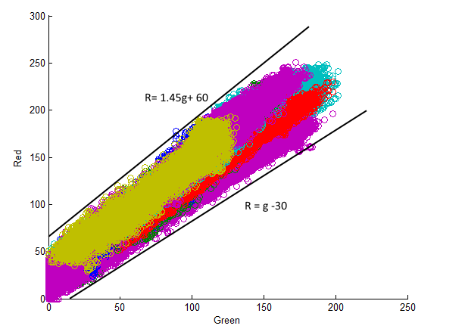
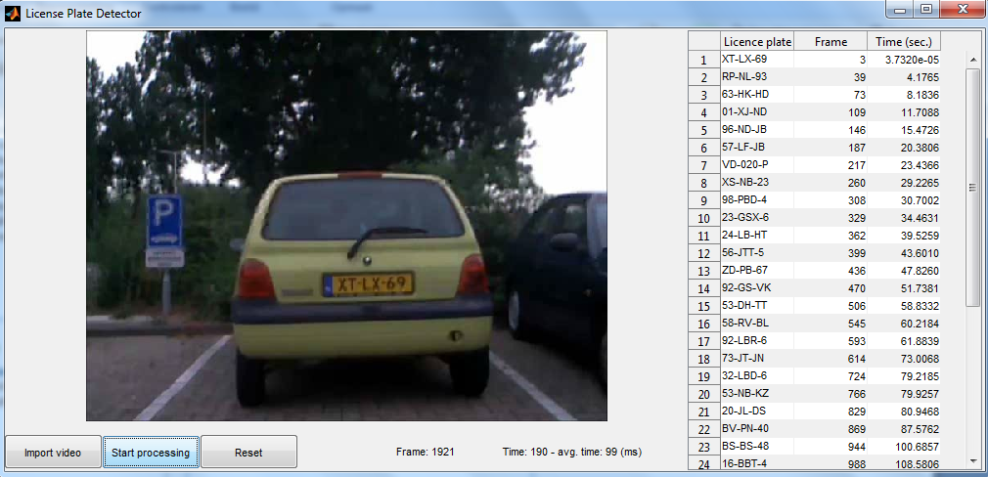

License Plate Recognition
Introduction
Tomas Heinsohn Huala 4326318
Remi van der Laan 4326156
Segmentation
These days is impossible to fill in all the cars you see by hand to find them in a car database. Therefore we thought it should be possible to make this easier with the technology and knowledge of these days. Therefore we made an application in MATLAB that is able to recognize license plates of cars and to write them down. For this application we used several image processing techniques to recognize the license plates.
Character Recognition
A important part of the application is the segmentation which is the first part of the process. This part has the task of locating the license plate. The segmentation is done in the RGB domain. Therefore we looked at different kind of license plates and we made graphs of the data we acquired. With these graphs we made restrictions for our segmentation function. This is an example of one of those graphs:
After checking the frame with the restrictions we segment the license plate from the hole frame and process this plate further with the character recognition
Text
GUI
For our application we needed a GUI, that’s why we used the MATLAB toolbox guide. As a result of this we made this GUI:
The GUI consist of three important parts:
The area where it displays the video to be processed
The three buttons
The list with results
These three buttons are: An import video button, a start/pause button and a reset button. The GUI also consists of the part which says what frame your are looking at and it has some time indicators like the time the video has played and the average time spend on each frame in milliseconds. The results are displayed in this way:
Evaluation
After we several weeks of processing this project has come to an end. Obviously we made a very good license plate recognition application, but there are always points to improve. This a list of some thing we could have done better:
In this application were are only able to recognize Dutch yellow license plates, all the others are not seen by the system because of the implementation of the segmentation
When there are two license plate on 1 frame we are not able to detect this either
In some cases, when the yellow license plates are heavily obscured or overexposed by its environment or the sun, we weren't able to detect the plates.

