Slide 1
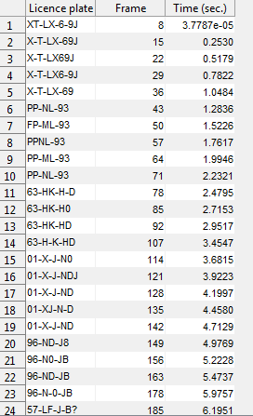
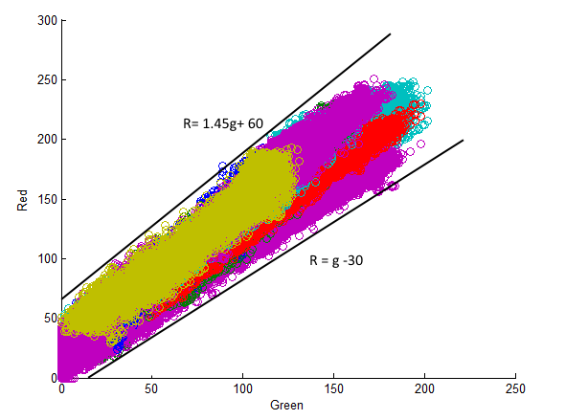

Licence Plate Recognition
This iteration
Tomas Heinsohn Huala 4326318
Remi van der Laan 4326156
Closer to the final deadline we tried to improve our program resulting in a better license plate detector with better results. This week we managed to improve several things. These are the little improvements:
We improved the detection of the license plates
We changed the output of the program so we get fewer results
We changed the processing of the frames so we get the wanted detection speed.
Text Output
Plate Detection
We wanted to detect as many plate as possible, but this wasn’t the case before this week. So we had to change the code which was seeking for the yellow license plates. Just like the last time we used graphs to determine what to select . To make the graph we now used the license plates which were brighter or darker than the normal license plates. This is how our new graph looks like with the red channel on the Y-axis and the green channel on the X -axis
We also said that the green and the red channel must be bigger than twice the blue channel. This is because of the yellow color which especially consist of green and red with a low value of blue. After all this the detector is able to detect the license plates of almost all of the license plates
Next Iteration
This will be the last iteration till the final deadline. Now we want to fine tune our program so we are able to get enough good results from the license plate detector. We can achieve this by adjust our results. Now we have the problem that the stripes in the license plate are not always on the right spot. For example:
An other problem is the fact that our system still has problems with detecting some of the license plates.
For next week we want to change these things. We also want to change the fact that in the results it should not be possible to place a digit next to a letter and vice versa. We could also implement some standard license plate formats so we can fit our results in those standards. The last thing we should create next week is the final poster which gives a view of our final product.

